Slide 1
WELCOME
TO
WORSHIP
We pray God bless your time in His Word!

Slide 2
Leader: We begin today remembering our Baptism – in the name Father, Son, and of the Holy Spirit. Amen.

Slide 3
People: Confession:
We came here because we need God,
but sometimes we forget
we are weak.
We are stubborn;
we lie to ourselves.
We do not love God as we should,
and we do not love other people as we should.
We hurt each other.
We feel sorry for doing that,
and we know our souls are sick from sin.
We want new life

Slide 4
Leader: God, YOU give us life.
Please heal us and free us from sin.
People: Almighty God, Show mercy to us,
and forgive our sins.
Lead us to life forever. Amen.

Slide 5
Leader:
I serve God’s Holy Word with you.
Our Lord, Jesus Christ command me,
Jesus gives me authority
In name of Father, Son, and Holy Spirit
God forgives ALL your sins.
Your sins finish forgive! Amen
People: Holy Spirit speak to us.
Help us live as YOUR people.
Come, our hearts in

Slide 6
PRAYER FOR THE DAY Leader: We pray
Thank You Jesus!
You open our hearts and minds.
Send Your Holy Spirit guide us.
Make New our faith and love.
In Your Holy Name.
People: Amen.

Slide 7
People: THE APOSTLES' CREED
I believe in God the Father Almighty;
God made heaven and earth.
And I believe in Jesus Christ,
His only Son, our Lord.
Jesus received a body through the Holy Spirit
born from the Virgin Mary;
suffered under Pontius Pilate,
got crucified, died and buried.
Jesus descended into hell;
the third day Jesus rose from the dead.

Slide 8
Jesus ascended into heaven
and rules with God the Father Almighty.
From heaven Christ will come
to judge the living and dead people.
I believe in the Holy Spirit,
the Holy Christian Church,
my fellowship with holy people,
the forgiveness of sins,
the resurrection of the body
and life eternal.
Amen.

Slide 9
BIBLE READINGS – act story SERMON
Pentecost
Acts 2

Slide 10
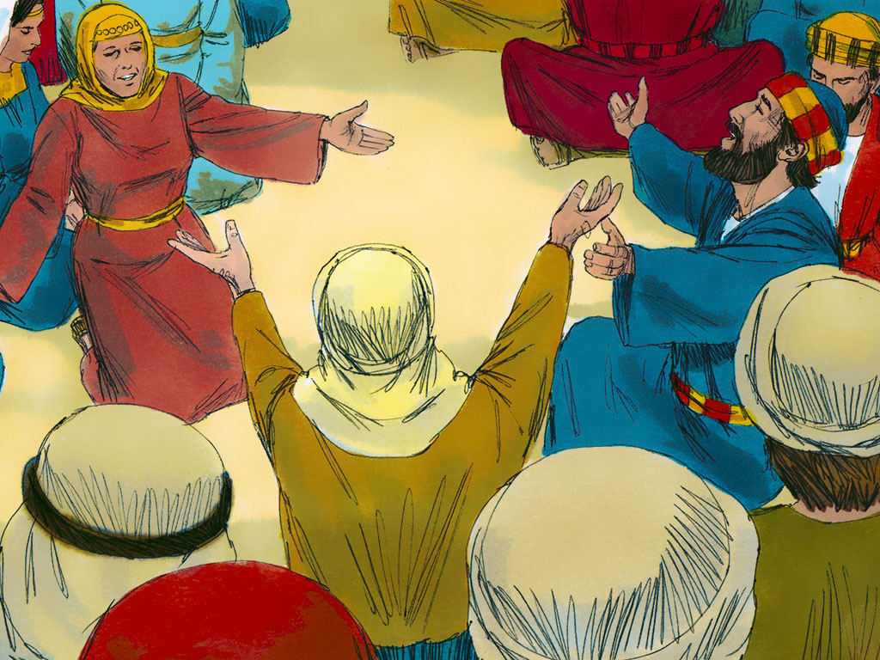
The Disciples together waiting for Holy Spirit – more than 120 people
Easter to Ascension is 40 days
Ascension to Pentecost is 10 days

Slide 11
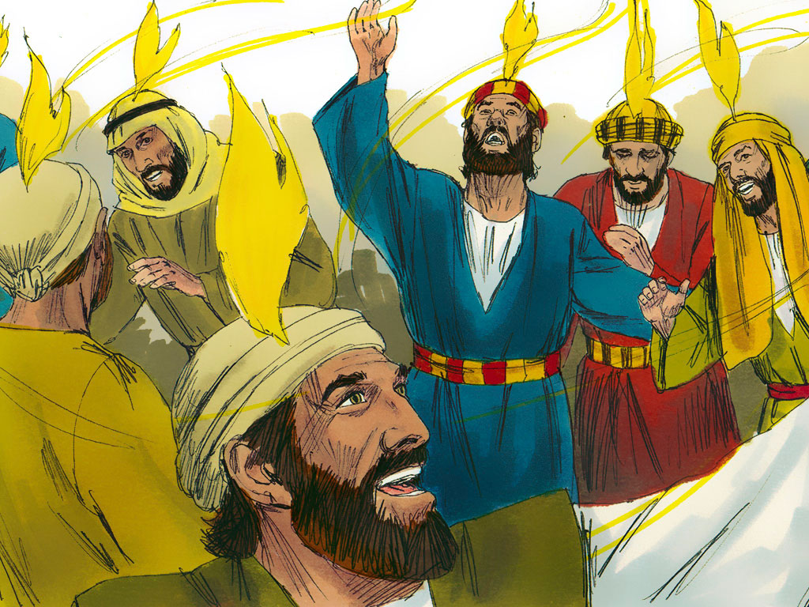
Holy Spirit comes on all Disciples

Slide 12
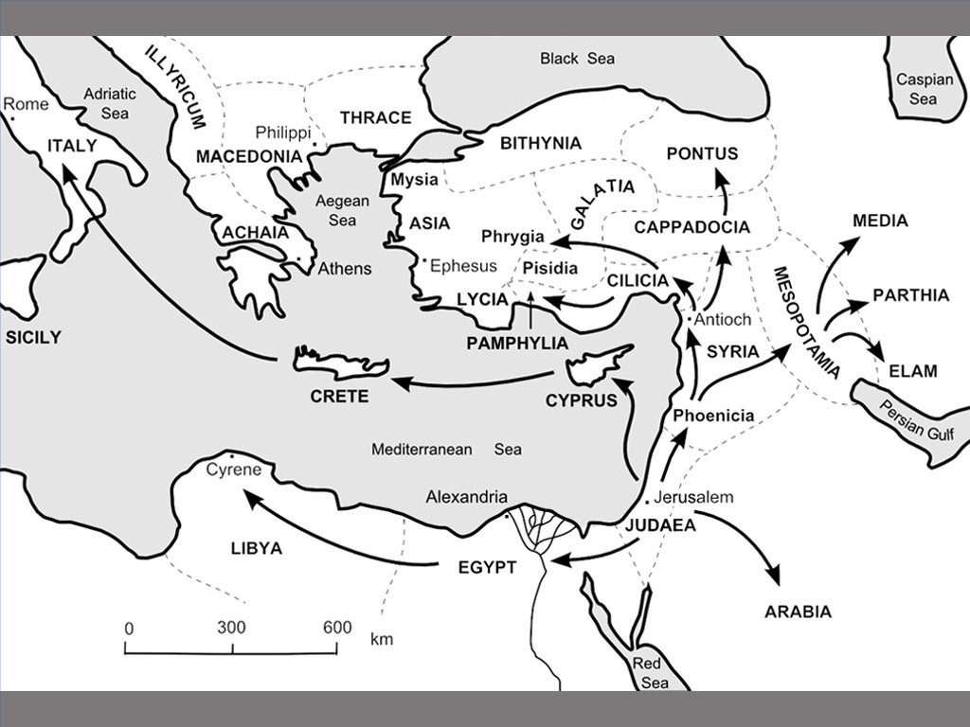
Jewish People from over 15 countries in Jerusalem for celebration

Slide 13
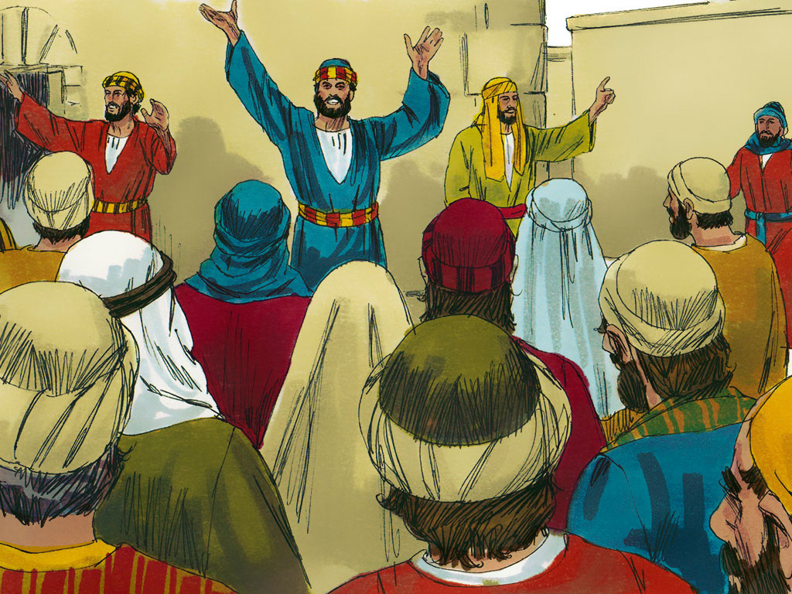
People hear the noise from the wind and come see what happen
Disciples speak in different languages

Slide 14
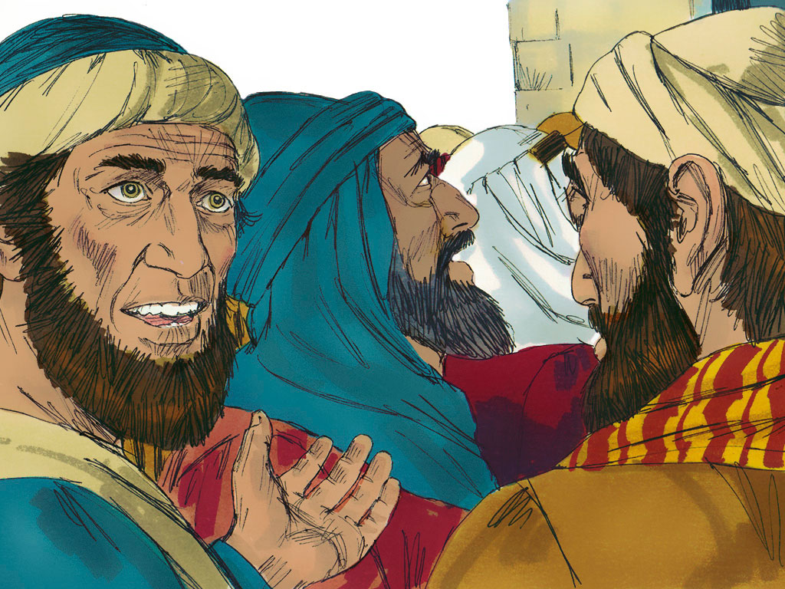
People think Disciples are drunk

Slide 15
Tower of Babal

Slide 16
Genesis 11- Tower of Babal
4 Then they said, “Come on! Let’s build a city for ourselves.
Let’s build a tower that reaches to the sky.
We’ll make a name for ourselves.
(WHY) - Then we won’t be scattered over the whole earth.”
God command Noah and his children to scatter over the whole earth –
People are saying “NO” to God

Slide 17
You see Towers like this all over the world
From people spread after the flood

Slide 18
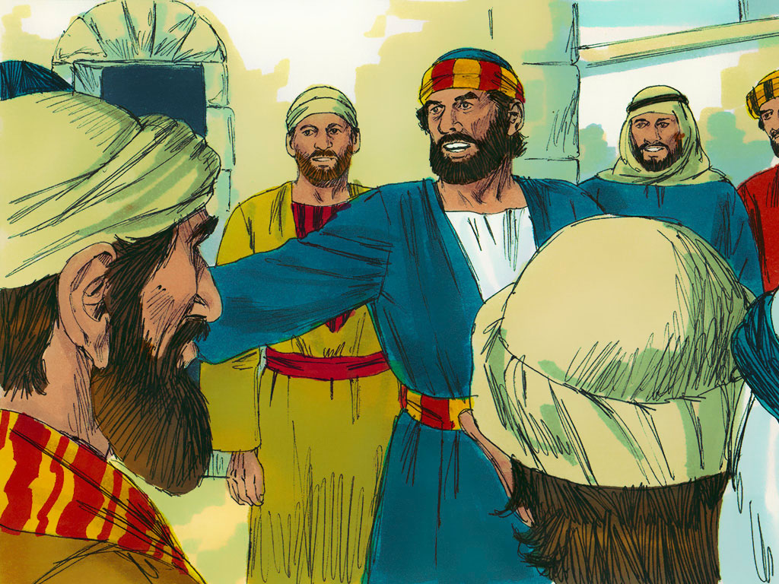
Peter explains – we are not drunk - only 9 am - Peter explains who is Jesus
Jesus died to forgive their sins

Slide 19
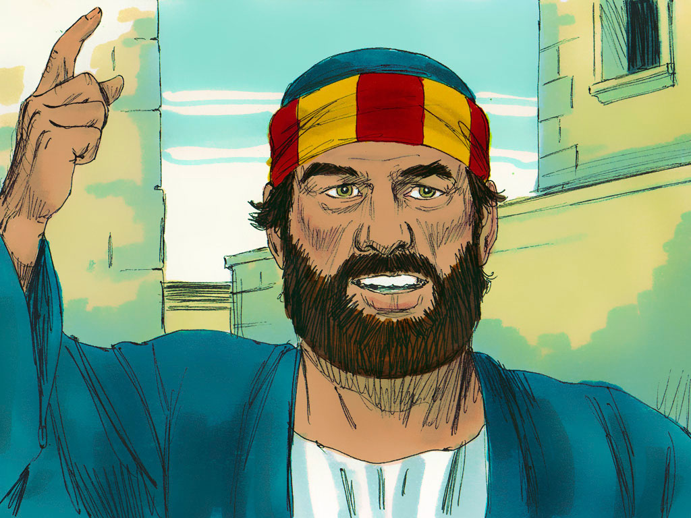
Peter explain Jesus died forgive your sins

Slide 20
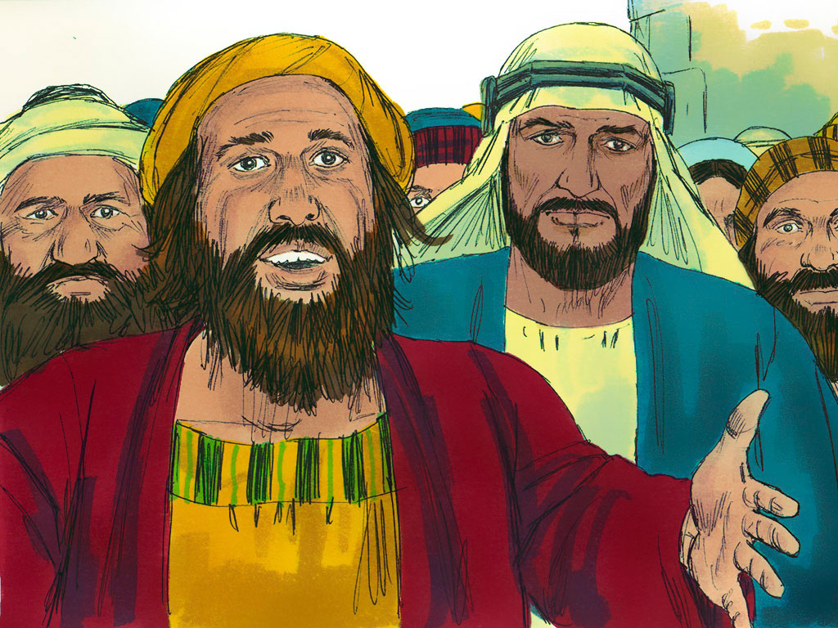
People ask what they can do –
How become saved?

Slide 21
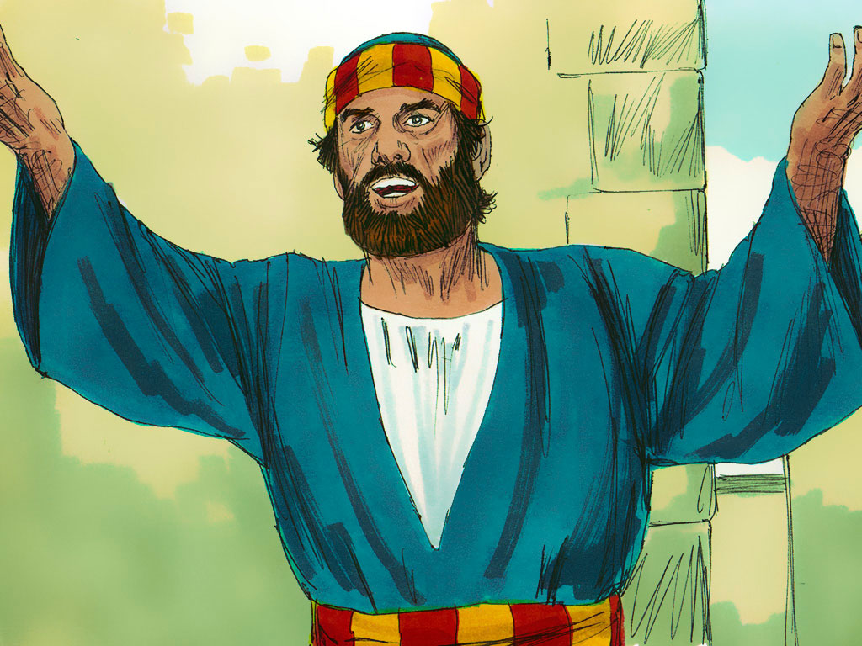
Peter explain - Look to God
You and your children Become Baptized
God will give you His Holy Spirit

Slide 22
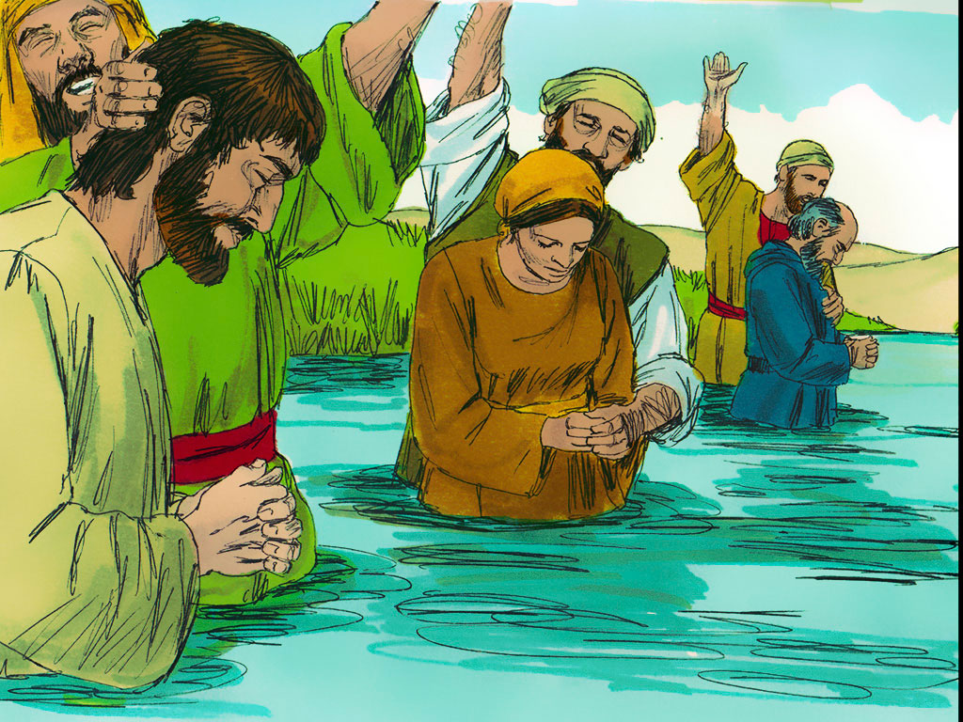
More than ____________ people became baptized in one day
Not dunk under water – no important how much water Important – in Name Father, Son, Holy Spirit

Slide 23
Matthew 28:19 So you must go and make disciples of all nations. Baptize them in the name of the Father and of the Son and of the Holy Spirit. 20 Teach them to obey everything I have commanded you. And you can be sure that I am always with you, to the very end.”

Slide 24
Matthew 28:19 So you must go and make disciples of all nations. Baptize them in the name of the Father and of the Son and of the Holy Spirit.
Babies become American Citizen – how old?
We become citizen of Heaven when?
First Baptize - Then Teach

Slide 25
PRAYERS:
LORD’S PRAYER

Slide 26
LORD’S PRAYER
Our Father in heaven.
Holy is Your name.
Your kingdom come.
Your want happen on earth same-as in heaven.
Give us today our daily bread
forgive our sins,
Same-as we forgive people sinning against us.
lead us not into temptation,
but deliver us from evil.
Because Yours is the kingdom
and the power and the glory forever. Amen.

Slide 27
OFFERING PRAYER Father,
accept these gifts from our labors.
We give them to You
Same -we give ourselves to You.
Please accept our gifts
through Jesus Christ our Lord.
Amen.

Slide 28
Leader:
Father - Thanks and praise to You
You sent Your only Son into the world Jesu became man, born from a woman,
Why? - die for us on the cross,
crucified because our sins.
People: Jesus came for us.
Help us understand with faith

Slide 29
Pastor said -
On the night Judas betrayed Jesus,
Jesus took bread, after He gave thanks,
He broke it, gave it to the disciples, said:
“Take eat; this is My body, given for you.
This do often remember Me.”
After they ate, Jesus took the cup, gave thank, gave it to them, saying, “Drink of it, all of you;
this new testament (promise) in My blood,
shed for you for the forgiveness of sins.
Do this often to remember Me.”

Slide 30
Jesus body and blood forgives your sins

Slide 31
Leader: Our hearts rejoice! People: We rejoice in Jesus, our Lord. Leader: We give thanks for HIS glory. People: We give thanks:
We rejoice because Jesus is with us!

Slide 32
BENEDICTION - Numbers 6:24-26
"The LORD bless you and keep you; the LORD make His face shine upon you and be gracious to you; the LORD Look upon you and give you His peace." Amen.
HYMN

Slide 33
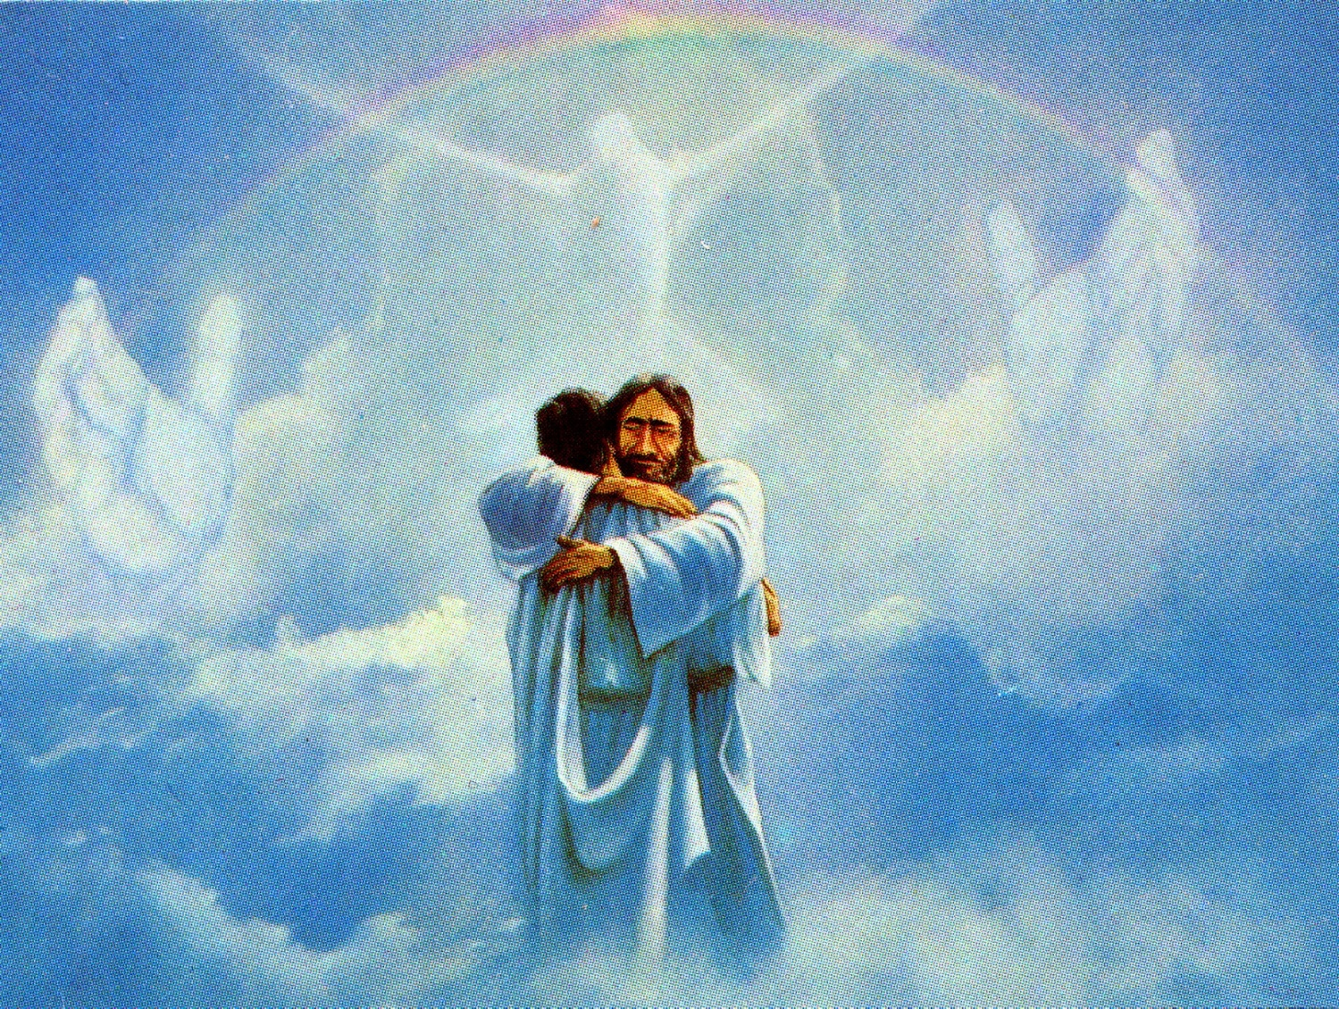
Jesus is the LIGHT for the world!!

Slide 34
Our goal is not only for you to be able to study God’s Word, but also give you a way to teach and share with other people.
We pray God will bless your time in His Word!
WWW.Mark732.org
For more information and for further training: Contact
Rev. Dr. John Reinke
At RevReinke@gmail.com
or 608-436-9600 (voice/text)
Material Copyright ©Mark732
Bible Verses are from the New International Readers Version - NIrV
Pictures: Copyright © Language Recordings Inc (Australia). Used by permission
Material Copyright ©Mark732

