Slide 1
Our goal is not only for you to be able to study God’s Word, but also give you a way to teach and share with other people.
We pray God will bless your time in His Word!
WWW.Mark732.org
For more information and for further training: Contact
Rev. Dr. John Reinke
At RevReinke@gmail.com
or 608-436-9600 (voice/text)
Material Copyright ©Mark732
Bible Verses are from the New International Readers Version - NIrV
Pictures: Copyright © Language Recordings Inc (Australia). Used by permission
Material Copyright ©Mark732

Slide 3
NEXT

Slide 4
NEXT

Slide 5
Matthew 28:1
The Sabbath day was now over. It was dawn on the first day of the week. Mary Magdalene and the other Mary went to look at the tomb.

Slide 6
NEXT

Slide 7
NEXT

Slide 8
Matthew 28:5
The angel said to the women, “Don’t be afraid. I know that you are looking for Jesus, who was crucified. 6 He is not here! He has risen, just as he said he would! Come and see the place where he was lying. 7 Go quickly! Tell his disciples, ‘He has risen from the dead. He is going ahead of you into Galilee. There you will see him.’ Now I have told you.”

Slide 9
NEXT

Slide 10
NEXT

Slide 11
Mark 16:9
Jesus rose from the dead early on the first day of the week. He appeared first to Mary Magdalene. He had driven seven demons out of her.

Slide 12
NEXT

Slide 13
NEXT

Slide 14
Mark 16:9
Jesus rose from the dead early on the first day of the week. He appeared first to Mary Magdalene. He had driven seven demons out of her.

Slide 15
NEXT

Slide 16
NEXT

Slide 17
John 20:2
So she ran to Simon Peter and another disciple, the one Jesus loved. She said, “They have taken the Lord out of the tomb! We don’t know where they have put him!” 3 So Peter and the other disciple started out for the tomb. 4 Both of them were running. The other disciple ran faster than Peter. He reached the tomb first.

Slide 18
NEXT

Slide 19
NEXT

Slide 20
Matthew 28:11
While the women were on their way, some of the guards went into the city. They reported to the chief priests all that had happened. 12 When the chief priests met with the elders, they came up with a plan. They gave the soldiers a large amount of money. 13 They told the soldiers, “We want you to say, ‘His disciples came during the night. They stole his body while we were sleeping.’ 14 If the governor hears this report, we will pay him off. That will keep you out of trouble.” 15 So the soldiers took the money and did as they were told. This story has spread all around among the Jews to this day.

Slide 21
NEXT

Slide 22
NEXT

Slide 23
Luke 24:13
That same day two of Jesus’ followers were going to a village called Emmaus. It was about seven miles from Jerusalem.

Slide 24
NEXT

Slide 25
NEXT

Slide 26
Luke 24:35
Then the two of them told what had happened to them on the way. They told how they had recognized Jesus when he broke the bread.

Slide 27
NEXT

Slide 28
NEXT

Slide 29
Luke 24:33
They got up and returned at once to Jerusalem. There they found the 11 disciples and those with them. They were all gathered together.

Slide 30
NEXT

Slide 31
NEXT

Slide 32
John 20:24
Thomas was one of the 12 disciples. He was also called Didymus. He was not with the other disciples when Jesus came. 25 So they told him, “We have seen the Lord!”

Slide 33
NEXT

Slide 34
NEXT

Slide 35
John 21:15
When Jesus and the disciples had finished eating, Jesus spoke to Simon Peter. He asked, “Simon, son of John, do you love me more than these others do?”
“Yes, Lord,” he answered. “You know that I love you.”
Jesus said, “Feed my lambs.”

Slide 36
NEXT

Slide 37
NEXT

Slide 38
Acts 1:1
Theophilus, I wrote about Jesus in my earlier book. I wrote about all he did and taught 2 until the day he was taken up to heaven. Before Jesus left, he gave orders to the apostles he had chosen. He did this through the Holy Spirit.

Slide 39
NEXT

Slide 40
NEXT

Slide 41
Acts 1:3
After his suffering and death, he appeared to them. In many ways he proved that he was alive. He appeared to them over a period of 40 days. During that time he spoke about God’s kingdom.

Slide 42
NEXT

Slide 43
NEXT

Slide 44
Acts: 1:4
One day Jesus was eating with them. He gave them a command. “Do not leave Jerusalem,” he said. “Wait for the gift my Father promised. You have heard me talk about it. 5 John baptized with water. But in a few days you will be baptized with the Holy Spirit.”

Slide 45
NEXT

Slide 46
NEXT

Slide 47
Acts 1:9
After Jesus said this, he was taken up to heaven. The apostles watched until a cloud hid him from their sight. 10 While he was going up, they kept on looking at the sky. Suddenly two men dressed in white clothing stood beside them. 11 “Men of Galilee,” they said, “why do you stand here looking at the sky? Jesus has been taken away from you into heaven. But he will come back in the same way you saw him go.” 12 The apostles returned to Jerusalem from the hill called the Mount of Olives. It is just over half a mile from the city.

Slide 48
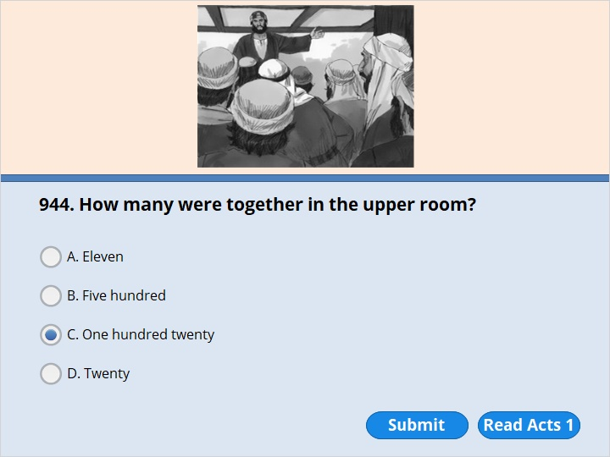
NEXT

Slide 49
NEXT

Slide 50
Acts 1:13
When they arrived, they went upstairs to the room where they were staying. Here is a list of those who were there. Peter, John, James and Andrew, Philip and Thomas, Bartholomew and Matthew,
James son of Alphaeus, Simon the Zealot and Judas son of James 14 They all came together regularly to pray. The women joined them too. So did Jesus’ mother Mary and his brothers. 15 In those days Peter stood up among the believers. About 120 of them were there.

Slide 51
NEXT

Slide 52
NEXT

Slide 53
Acts 1:25
Show us who should take the place of Judas as an apostle. He gave up being an apostle to go where he belongs.” 26 Then they cast lots. Matthias was chosen. So he was added to the 11 apostles.

Slide 54
NEXT

Slide 55
NEXT

Slide 56
Acts 2:1
When the day of Pentecost came, all the believers gathered in one place. 2 Suddenly a sound came from heaven. It was like a strong wind blowing. It filled the whole house where they were sitting. 3 They saw something that looked like fire in the shape of tongues. The flames separated and came to rest on each of them. 4 All of them were filled with the Holy Spirit. They began to speak in languages they had not known before. The Spirit gave them the ability to do this.

Slide 57
NEXT

Slide 58
NEXT

Slide 59
Acts 2:6
A crowd came together when they heard the sound. They were bewildered because each of them heard their own language being spoken. 7 The crowd was really amazed. They asked, “Aren’t all these people who are speaking Galileans? 8 Then why do we each hear them speaking in our own native language?

Slide 60
NEXT

Slide 61
NEXT

Slide 62
Acts 2:13
But some people in the crowd made fun of the believers. “They’ve had too much wine!” they said.

Slide 63
NEXT

Slide 64
NEXT

Slide 65
Acts 2:14
Then Peter stood up with the 11 apostles. In a loud voice he spoke to the crowd. “My fellow Jews,” he said, “let me explain this to you. All of you who live in Jerusalem, listen carefully to what I say.

Slide 66
NEXT

Slide 67
NEXT

Slide 68
Acts 2:16
No, here is what the prophet Joel meant.

Slide 69
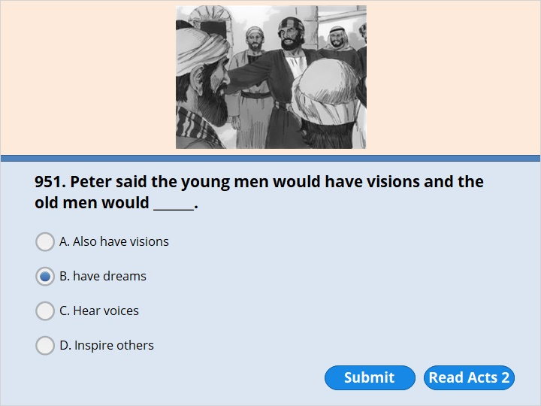
NEXT

Slide 70
NEXT

Slide 71
Acts 2:17
He said,“ ‘In the last days, God says, I will pour out my Holy Spirit on all people. Your sons and daughters will prophesy. Your young men will see visions. Your old men will have dreams.

Slide 72
NEXT

Slide 73
NEXT

Slide 74
Acts 2:41
Those who accepted his message were baptized. About 3,000 people joined the believers that day.

Slide 75
NEXT

Slide 76
NEXT

Slide 77
Acts 3:1
One day Peter and John were going up to the temple. It was three o’clock in the afternoon. It was the time for prayer.

Slide 78
NEXT

Slide 79
NEXT

Slide 80
Acts 3:2
A man unable to walk was being carried to the temple gate called Beautiful. He had been that way since he was born. Every day someone put him near the gate. There he would beg from people going into the temple courtyards.

Slide 81
NEXT

Slide 82
NEXT

Slide 83
Acts 4:22
The man who had been healed by the miracle was over 40 years old.

Slide 84
NEXT

Slide 85
NEXT

Slide 86
Acts 4:8
Peter was filled with the Holy Spirit. He said to them, “Rulers and elders of the people! 9 Are you asking us to explain our actions today? Do you want to know why we were kind to a man who couldn’t walk? Are you asking how he was healed? 10 Then listen to this, you and all the people of Israel! You nailed Jesus Christ of Nazareth to the cross. But God raised him from the dead. It is through Jesus’ name that this man stands healed in front of you. 11 Scripture says that Jesus is
“ ‘the stone you builders did not accept. But it has become the most important stone of all.’ (Psalm 118:22)

Slide 87
NEXT

Slide 88
NEXT

Slide 89
Acts 4:36
Joseph was a Levite from Cyprus. The apostles called him Barnabas. The name Barnabas means Son of Help. 37 Barnabas sold a field he owned. He brought the money from the sale. He put it down at the apostles’ feet.

Slide 90
NEXT

Slide 91
NEXT

Slide 92
Acts 5:1
A man named Ananias and his wife, Sapphira, also sold some land. 2 He kept part of the money for himself. Sapphira knew he had kept it. He brought the rest of it and put it down at the apostles’ feet. 3 Then Peter said, “Ananias, why did you let Satan fill your heart? He made you lie to the Holy Spirit. You have kept some of the money you received for the land. 4 Didn’t the land belong to you before it was sold? After it was sold, you could have used the money as you wished. What made you think of doing such a thing? You haven’t lied just to people. You’ve also lied to God.” 5 When Ananias heard this, he fell down and died. All who heard what had happened were filled with fear.

Slide 93
6 Some young men came and wrapped up his body. They carried him out and buried him. 7 About three hours later, the wife of Ananias came in. She didn’t know what had happened. 8 Peter asked her, “Tell me. Is this the price you and Ananias sold the land for?” “Yes,” she said. “That’s the price.” 9 Peter asked her, “How could you agree to test the Spirit of the Lord? Listen! You can hear the steps of the men who buried your husband. They are at the door. They will carry you out also.” 10 At that moment she fell down at Peter’s feet and died. Then the young men came in. They saw that Sapphira was dead. So they carried her out and buried her beside her husband.

Slide 94
NEXT

Slide 95
NEXT

Slide 96
Acts 5:34
But a Pharisee named Gamaliel stood up in the Sanhedrin. He was a teacher of the law. He was honored by all the people. He ordered the apostles to be taken outside for a little while. 35 Then Gamaliel spoke to the Sanhedrin. “Men of Israel,” he said, “think carefully about what you plan to do to these men.

Slide 97
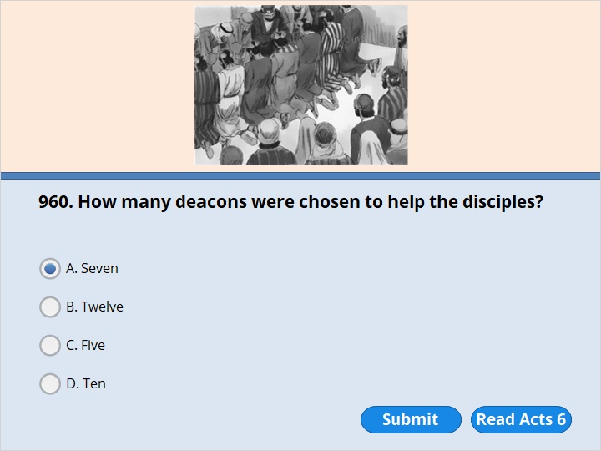
NEXT

Slide 98
NEXT

Slide 99
Acts 6:3
Brothers and sisters, choose seven of your men. They must be known as men who are wise and full of the Holy Spirit. We will turn this important work over to them.

Slide 100
NEXT

Slide 101
NEXT

Slide 102
Acts 7:59
While the members of the Sanhedrin were throwing stones at Stephen, he prayed. “Lord Jesus, receive my spirit,” he said. 60 Then he fell on his knees. He cried out, “Lord! Don’t hold this sin against them!” When he had said this, he died.

Slide 103
NEXT

Slide 104
NEXT

Slide 105
Acts 9:1
Meanwhile, Saul continued to oppose the Lord’s followers. He said they would be put to death. He went to the high priest.

Slide 106
NEXT

Slide 107
NEXT

Slide 108
Acts 8:5
Philip went down to a city in Samaria. There he preached about the Messiah.

Slide 109
NEXT

Slide 110
NEXT

Slide 111
Acts 8:14
The apostles in Jerusalem heard that people in Samaria had accepted God’s word. So they sent Peter and John to Samaria.

Slide 112
NEXT

Slide 113
NEXT

Slide 114
Acts 8:26
An angel of the Lord spoke to Philip. “Go south to the desert road,” he said. “It’s the road that goes down from Jerusalem to Gaza.”

Slide 115
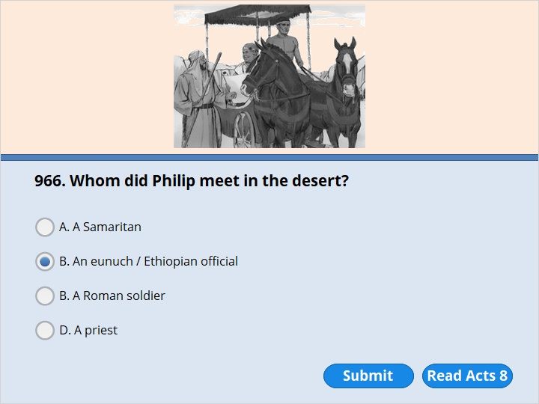
C. A Roman soldier
NEXT

Slide 116
C. A Roman soldier
NEXT

Slide 117
Acts 8:27
So Philip started out. On his way he met an Ethiopian official. The man had an important position in charge of all the wealth of the Kandake. Kandake means queen of Ethiopia. This official had gone to Jerusalem to worship.

Slide 118
NEXT

Slide 119
NEXT

Slide 120
Acts 8:27
So Philip started out. On his way he met an Ethiopian official. The man had an important position in charge of all the wealth of the Kandake. Kandake means queen of Ethiopia. This official had gone to Jerusalem to worship.

Slide 121
NEXT

Slide 122
NEXT

Slide 123
Acts 8:28
On his way home he was sitting in his chariot. He was reading the Book of Isaiah the prophet.

Slide 124
NEXT

Slide 125
NEXT

Slide 126
Acts 9:1
Meanwhile, Saul continued to oppose the Lord’s followers. He said they would be put to death. He went to the high priest. 2 He asked the priest for letters to the synagogues in Damascus. He wanted to find men and women who belonged to the Way of Jesus. The letters would allow him to take them as prisoners to Jerusalem. 3 On his journey, Saul approached Damascus. Suddenly a light from heaven flashed around him. 4 He fell to the ground. He heard a voice speak to him, “Saul! Saul! Why are you opposing me?”

Slide 127
NEXT

Slide 128
NEXT

Slide 129
Acts 9:8
Saul got up from the ground. He opened his eyes, but he couldn’t see. So they led him by the hand into Damascus. 9 For three days he was blind. He didn’t eat or drink anything.

Slide 130
NEXT

Slide 131
NEXT

Slide 132
Acts 9:11
The Lord told him, “Go to the house of Judas on Straight Street. Ask for a man from Tarsus named Saul. He is praying.

Slide 133
NEXT

Slide 134
NEXT

Slide 135
Acts 9:11
The Lord told him, “Go to the house of Judas on Straight Street. Ask for a man from Tarsus named Saul. He is praying.

Slide 136
NEXT

Slide 137
NEXT

Slide 138
Acts 9:17
Then Ananias went to the house and entered it. He placed his hands on Saul. “Brother Saul,” he said, “you saw the Lord Jesus. He appeared to you on the road as you were coming here. He has sent me so that you will be able to see again. You will be filled with the Holy Spirit.” 18 Right away something like scales fell from Saul’s eyes. And he could see again. He got up and was baptized. 19 After eating some food, he got his strength back.

Slide 139
NEXT

Slide 140
NEXT

Slide 141
Acts 9:25
But his followers helped him escape by night. They lowered him in a basket through an opening in the wall.

Slide 142
NEXT

Slide 143
NEXT

Slide 144
Acts 9:27
But Barnabas took him to the apostles. He told them about Saul’s journey. He said that Saul had seen the Lord. He told how the Lord had spoken to Saul. Barnabas also said that Saul had preached without fear in Jesus’ name in Damascus.

Slide 145
NEXT

Slide 146
NEXT

Slide 147
Acts 9:33
There he found a disabled man named Aeneas. For eight years the man had spent most of his time in bed.

Slide 148
NEXT

Slide 149
NEXT

Slide 150
Acts 9:33
There he found a disabled man named Aeneas. For eight years the man had spent most of his time in bed.

Slide 151
NEXT

Slide 152
NEXT

Slide 153
Acts 9:36
In Joppa there was a believer named Tabitha. Her name in the Greek language is Dorcas. She was always doing good and helping poor people. 37 About that time she became sick and died. Her body was washed and placed in a room upstairs.

Slide 154
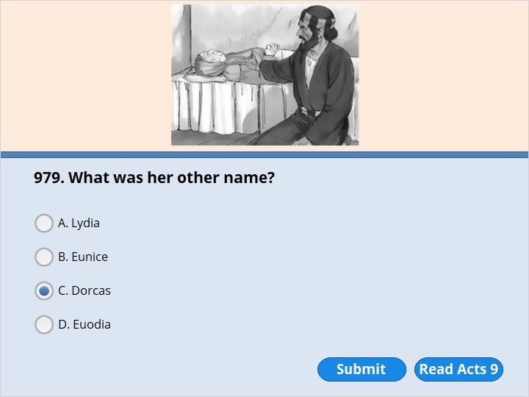
NEXT

Slide 155
NEXT

Slide 156
Acts 9:36
In Joppa there was a believer named Tabitha. Her name in the Greek language is Dorcas. She was always doing good and helping poor people. 37 About that time she became sick and died. Her body was washed and placed in a room upstairs.

Slide 157
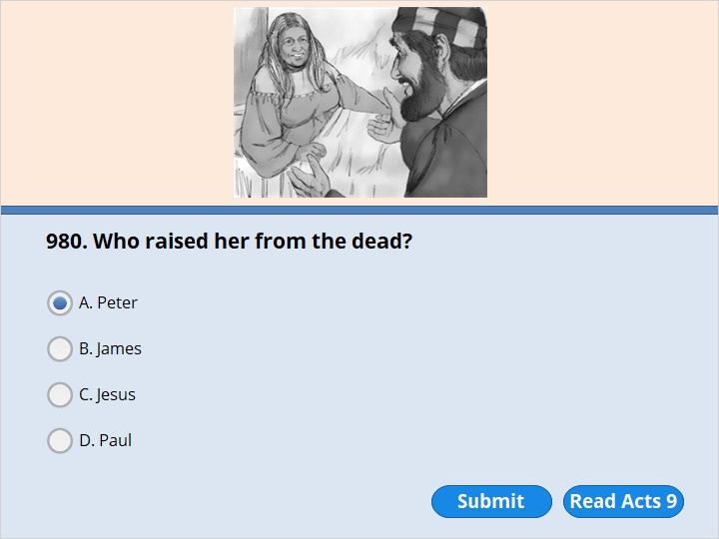
NEXT

Slide 158
NEXT

Slide 159
Acts 9:40
Peter sent them all out of the room. Then he got down on his knees and prayed. He turned toward the dead woman. He said, “Tabitha, get up.” She opened her eyes. When she saw Peter, she sat up.

Slide 160
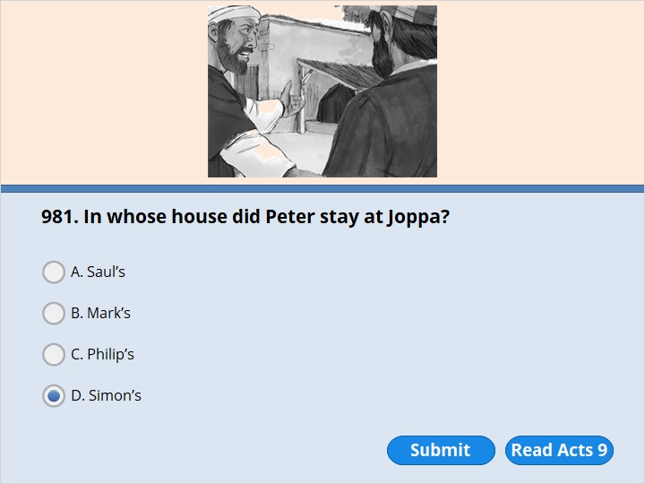
NEXT

Slide 161
NEXT

Slide 162
Acts 9:43
Peter stayed in Joppa for some time. He stayed with Simon, a man who worked with leather.

Slide 163
NEXT

Slide 164
NEXT

Slide 165
Acts 10:1
A man named Cornelius lived in Caesarea. He was a Roman commander in the Italian Regiment.

Slide 166
NEXT

Slide 167
NEXT

Slide 168
Acts 10:9
It was about noon the next day. The men were on their journey and were approaching the city. Peter went up on the roof to pray. 10 He became hungry. He wanted something to eat. While the meal was being prepared, Peter had a vision. 11 He saw heaven open up. There he saw something that looked like a large sheet. It was being let down to earth by its four corners. 12 It had all kinds of four-footed animals in it. It also had reptiles and birds in it. 13 Then a voice told him, “Get up, Peter. Kill and eat.”

Slide 169
NEXT

Slide 170
NEXT

Slide 171
Acts 11:25
Then Barnabas went to Tarsus to look for Saul. 26 He found him there. Then he brought him to Antioch. For a whole year Barnabas and Saul met with the church. They taught large numbers of people. At Antioch the believers were called Christians for the first time.

Slide 172
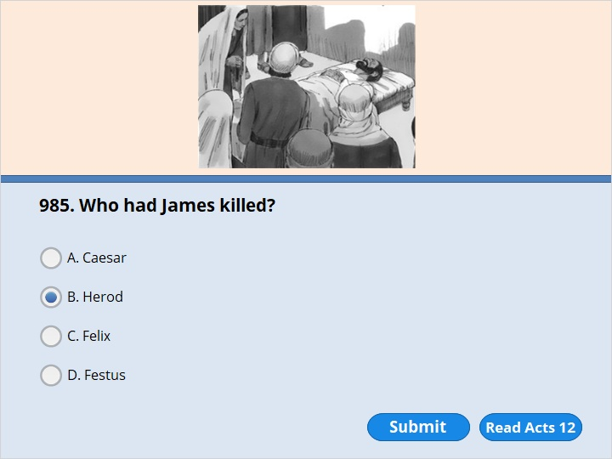
NEXT

Slide 173
NEXT

Slide 174
Acts 12:1
About this time, King Herod arrested some people who belonged to the church. He planned to make them suffer greatly. 2 He had James killed with a sword. James was John’s brother.

Slide 175
NEXT

Slide 176
NEXT

Slide 177
Acts 12:3
Herod saw that the death of James pleased some Jews. So he arrested Peter also. This happened during the Feast of Unleavened Bread.

Slide 178
NEXT

Slide 179
NEXT

Slide 180
Acts 12:7
Suddenly an angel of the Lord appeared. A light shone in the prison cell. The angel struck Peter on his side. Peter woke up. “Quick!” the angel said. “Get up!” The chains fell off Peter’s wrists. 8 Then the angel said to him, “Put on your clothes and sandals.” Peter did so. “Put on your coat,” the angel told him. “Follow me.” 9 Peter followed him out of the prison. But he had no idea that what the angel was doing was really happening. He thought he was seeing a vision.

Slide 181
NEXT

Slide 182
NEXT

Slide 183
Acts 12:12
When Peter understood what had happened, he went to Mary’s house. Mary was the mother of John Mark. Many people had gathered in her home. They were praying there.

Slide 184
NEXT

Slide 185
NEXT

Slide 186
Acts 12:12
When Peter understood what had happened, he went to Mary’s house. Mary was the mother of John Mark. Many people had gathered in her home. They were praying there.

Slide 187
NEXT

Slide 188
NEXT

Slide 189
Acts 12:13
Peter knocked at the outer entrance. A servant named Rhoda came to answer the door. 14 She recognized Peter’s voice. She was so excited that she ran back without opening the door. “Peter is at the door!” she exclaimed.

Slide 190
NEXT

Slide 191
NEXT

Slide 192
Acts 12:21
The appointed day came. Herod was seated on his throne. He was wearing his royal robes. He made a speech to the people. 22 Then they shouted, “This is the voice of a god. It’s not the voice of a man.” 23 Right away an angel of the Lord struck Herod down. Herod had not given praise to God. So he was eaten by worms and died.

Slide 193
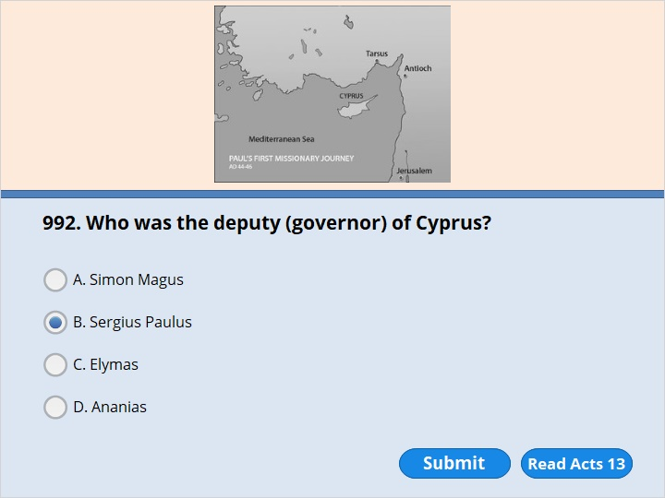
NEXT

Slide 194
NEXT

Slide 195
Acts 13:7
He was an attendant of Sergius Paulus, the governor. Paulus was a man of understanding. He sent for Barnabas and Saul. He wanted to hear God’s word.

Slide 196
NEXT

Slide 197
NEXT

Slide 198
Acts 13:9
Saul was also known as Paul. He was filled with the Holy Spirit. He looked straight at Elymas. He said to him, 10 “You are a child of the devil! You are an enemy of everything that is right! You cheat people. You use all kinds of tricks. Won’t you ever stop twisting the right ways of the Lord? 11 Now the Lord’s hand is against you. You are going to go blind. For a while you won’t even be able to see the light of the sun.”

Slide 199
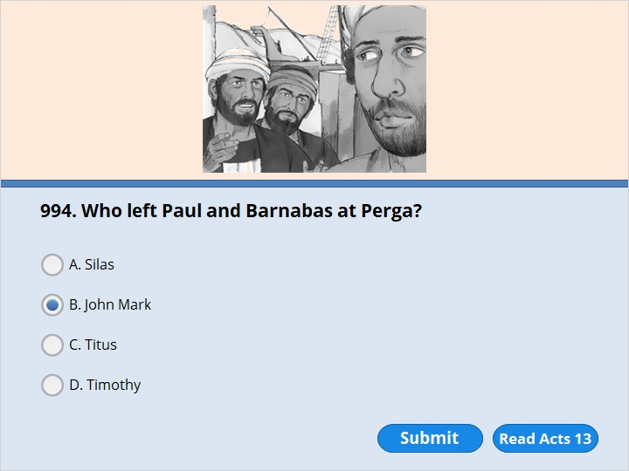
NEXT

Slide 200
NEXT

Slide 201
Acts 13:13
From Paphos, Paul and his companions sailed to Perga in Pamphylia. There John Mark left them and returned to Jerusalem.

Slide 202
NEXT

Slide 203
NEXT

Slide 204
Acts 14:12
They called Barnabas Zeus. Paul was the main speaker. So they called him Hermes.

Slide 205
NEXT

Slide 206
NEXT

Slide 207
Acts 14:12
They called Barnabas Zeus. Paul was the main speaker. So they called him Hermes.

Slide 208
NEXT

Slide 209
NEXT

Slide 210
Acts 14:19
Then some Jews came from Antioch and Iconium. They won the crowd over to their side. They threw stones at Paul. They thought he was dead, so they dragged him out of the city.

Slide 211
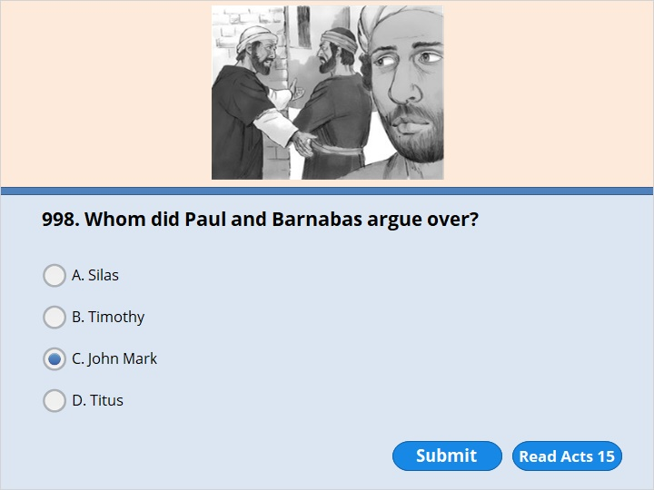
NEXT

Slide 212
NEXT

Slide 213
Acts 15:37
Barnabas wanted to take John Mark with them. 38 But Paul didn’t think it was wise to take him. Mark had deserted them in Pamphylia. He hadn’t continued with them in their work. 39 Barnabas and Paul strongly disagreed with each other. So they went their separate ways. Barnabas took Mark and sailed for Cyprus.

Slide 214
NEXT

Slide 215
NEXT

Slide 216
Acts 15:37
Barnabas wanted to take John Mark with them. 38 But Paul didn’t think it was wise to take him. Mark had deserted them in Pamphylia. He hadn’t continued with them in their work. 39 Barnabas and Paul strongly disagreed with each other. So they went their separate ways. Barnabas took Mark and sailed for Cyprus.

Slide 217
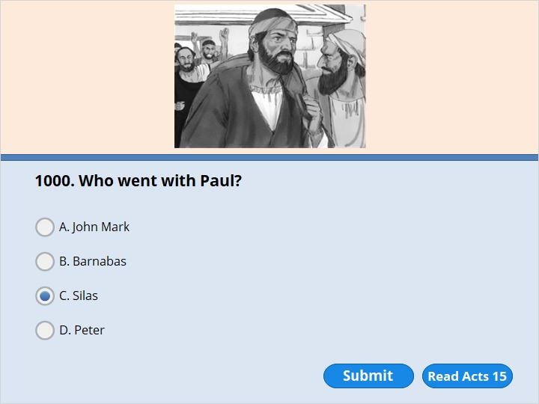
NEXT

Slide 218
NEXT

Slide 219
Acts 15:40
But Paul chose Silas. The believers asked the Lord to give his grace to Paul and Silas as they went. 41 Paul traveled through Syria and Cilicia. He gave strength to the churches there.

Slide 220
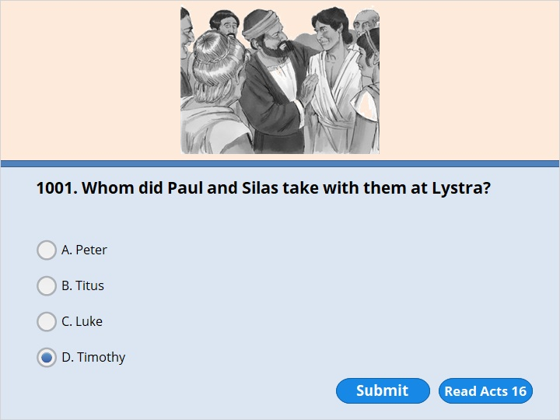
NEXT

Slide 221
NEXT

Slide 222
Acts 16:1
Paul came to Derbe. Then he went on to Lystra. A believer named Timothy lived there. His mother was Jewish and a believer. His father was a Greek. 2 The believers at Lystra and Iconium said good things about Timothy. 3 Paul wanted to take him along on the journey. So he circumcised Timothy because of the Jews who lived in that area. They all knew that Timothy’s father was a Greek.

Slide 223
NEXT

Slide 224
NEXT

Slide 225
Acts 16:6
Paul and his companions traveled all through the area of Phrygia and Galatia. The Holy Spirit had kept them from preaching the word in Asia Minor. 7 They came to the border of Mysia. From there they tried to enter Bithynia. But the Spirit of Jesus would not let them.

Slide 226
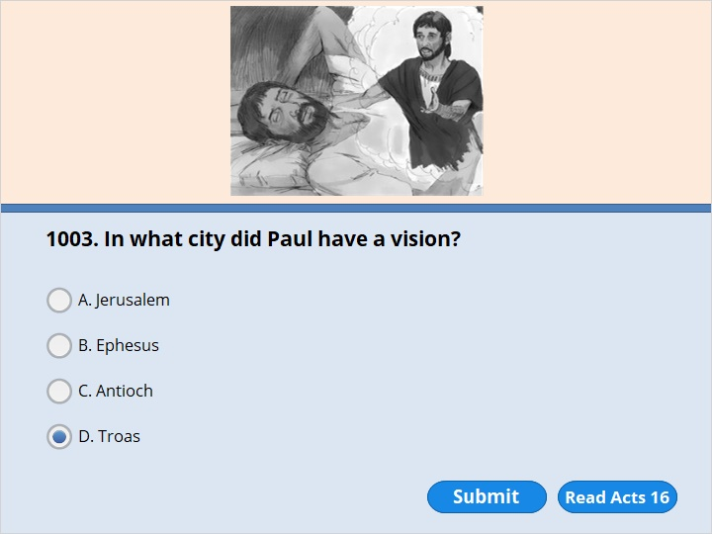
NEXT

Slide 227
NEXT

Slide 228
Acts 16:8
So they passed by Mysia. Then they went down to Troas. 9 During the night Paul had a vision. He saw a man from Macedonia standing and begging him. “Come over to Macedonia!” the man said. “Help us!”

Slide 229
NEXT

Slide 230
NEXT

Slide 231
Acts 16:8
So they passed by Mysia. Then they went down to Troas. 9 During the night Paul had a vision. He saw a man from Macedonia standing and begging him. “Come over to Macedonia!” the man said. “Help us!”

Slide 232
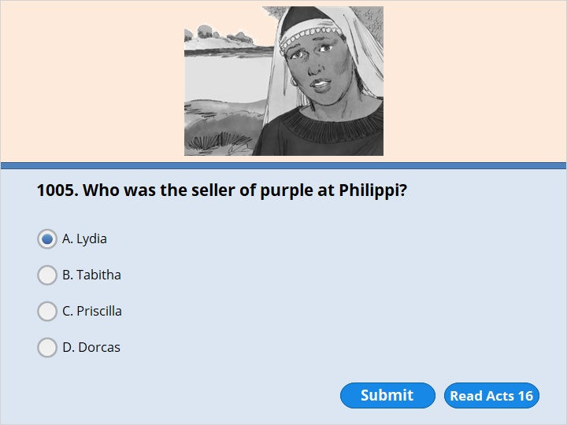
NEXT

Slide 233
NEXT

Slide 234
Acts 16:14
One of the women listening was from the city of Thyatira. Her name was Lydia, and her business was selling purple cloth. She was a worshiper of God. The Lord opened her heart to accept Paul’s message.

Slide 235
NEXT

Slide 236
NEXT

Slide 237
Acts 16:24
When he received these orders, he put Paul and Silas deep inside the prison. He fastened their feet so they couldn’t get away. 25 About midnight Paul and Silas were praying. They were also singing hymns to God. The other prisoners were listening to them.

Slide 238
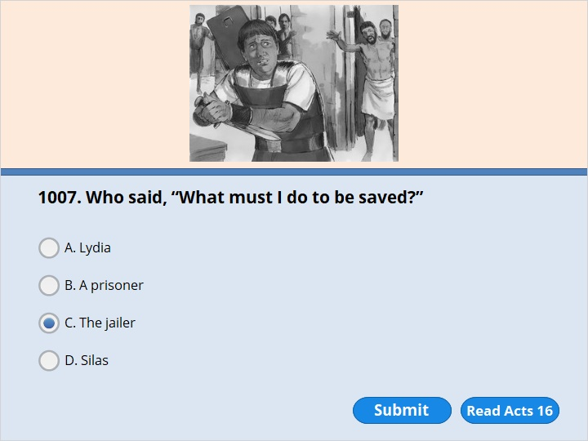
NEXT

Slide 239
NEXT

Slide 240
Acts 16:27
The jailer woke up. He saw that the prison doors were open. He pulled out his sword and was going to kill himself. He thought the prisoners had escaped. 28 “Don’t harm yourself!” Paul shouted. “We are all here!” 29 The jailer called out for some lights. He rushed in, shaking with fear. He fell down in front of Paul and Silas. 30 Then he brought them out. He asked, “Sirs, what must I do to be saved?”

Slide 241
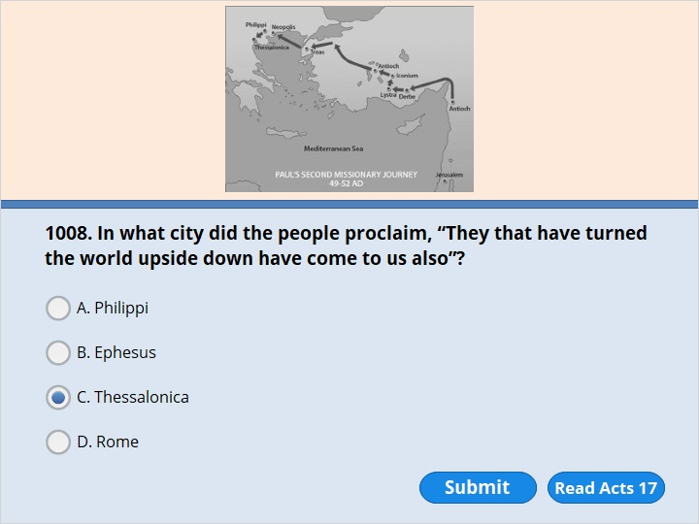
NEXT

Slide 242
NEXT

Slide 243
Acts 17:1
Paul and those traveling with him passed through Amphipolis and Apollonia. They came to Thessalonica. A Jewish synagogue was there.
….
6 But they couldn’t find them. So they dragged Jason and some other believers to the city officials. “These men have caused trouble all over the world,” they shouted. “Now they have come here. 7 Jason has welcomed them into his house. They are all disobeying Caesar’s commands. They say there is another king. He is called Jesus.”

Slide 244
NEXT

Slide 245
NEXT

Slide 246
Acts 17:10
As soon as it was night, the believers sent Paul and Silas away to Berea. When they arrived, they went to the Jewish synagogue. 11 The Berean Jews were very glad to receive Paul’s message. They studied the Scriptures carefully every day. They wanted to see if what Paul said was true. So they were more noble than the Thessalonian Jews.

Slide 247
NEXT

Slide 248
NEXT

Slide 249
Acts 17:15
The believers who went with Paul took him to Athens. Then they returned with orders that Silas and Timothy were supposed to join him as soon as they could.

Slide 250
NEXT

Slide 251
NEXT

Slide 252
Acts 17:22
Then Paul stood up in the meeting of the Areopagus. He said, “People of Athens! I see that you are very religious in every way. 23 As I walked around, I looked carefully at the things you worship. I even found an altar with to an unknown god written on it. So you don’t know what you are worshiping. Now I am going to tell you about this ‘unknown god.’

Slide 253
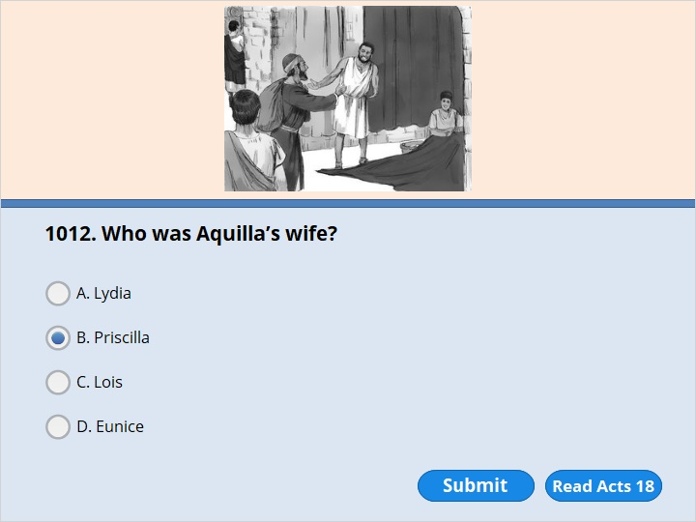
NEXT

Slide 254
NEXT

Slide 255
Acts 18:1
After this, Paul left Athens and went to Corinth. 2 There he met a Jew named Aquila, who was a native of Pontus. Aquila had recently come from Italy with his wife Priscilla. The emperor Claudius had ordered all Jews to leave Rome. Paul went to see Aquila and Priscilla.

Slide 256
NEXT

Slide 257
NEXT

Slide 258
Acts 18:3
They were tentmakers, just as he was. So he stayed and worked with them.

Slide 259
NEXT

Slide 260
NEXT

Slide 261
Acts 19:19
A number of those who had practiced evil magic brought their scrolls together. They set them on fire out in the open. They added up the value of the scrolls. The scrolls were worth more than someone could earn in two lifetimes.

Slide 262
NEXT

Slide 263
NEXT

Slide 264
Acts 19:24
There was a man named Demetrius who made things out of silver. He made silver models of the temple of the goddess Artemis. He brought in a lot of business for the other skilled workers there.

Slide 265
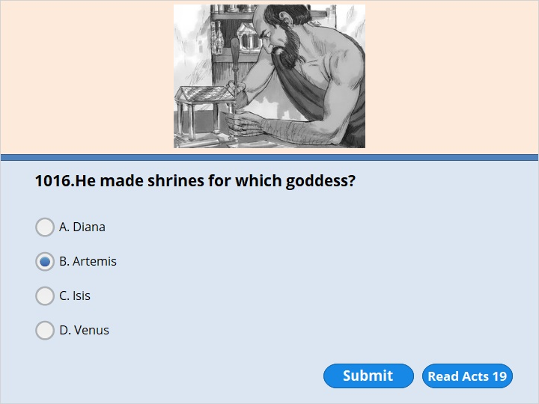
NEXT

Slide 266
NEXT

Slide 267
Acts 19:24
There was a man named Demetrius who made things out of silver. He made silver models of the temple of the goddess Artemis. He brought in a lot of business for the other skilled workers there

Slide 268
NEXT

Slide 269
NEXT

Slide 270
Acts 20:9
A young man named Eutychus was sitting in a window. He sank into a deep sleep as Paul talked on and on. Sound asleep, Eutychus fell from the third floor. When they picked him up from the ground, he was dead.

Slide 271
NEXT

Slide 272
NEXT

Slide 273
Acts 20:17
From Miletus, Paul sent for the elders of the church at Ephesus.

Slide 274
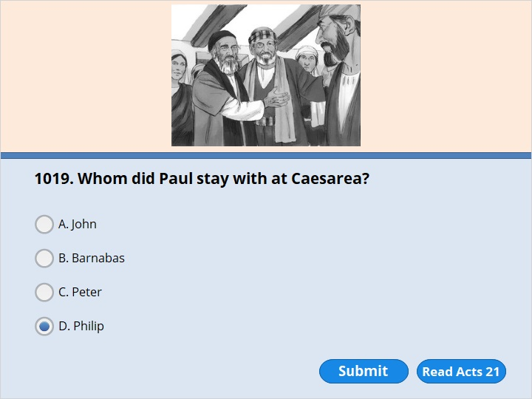
NEXT

Slide 275
NEXT

Slide 276
Acts 21:8
The next day we left and arrived at Caesarea. We stayed at the house of Philip the evangelist. He was one of the seven deacons. 9 He had four unmarried daughters who prophesied.

Slide 277
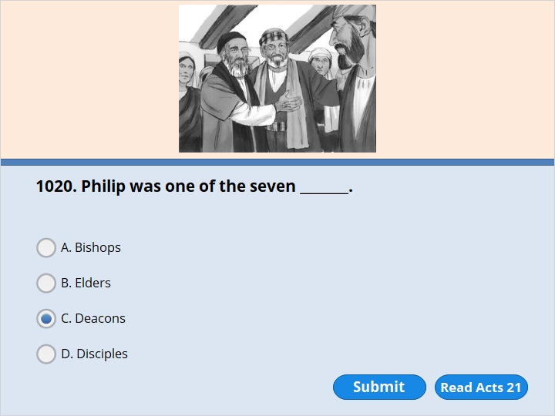
NEXT

Slide 278
NEXT

Slide 279
Acts 21:8
The next day we left and arrived at Caesarea. We stayed at the house of Philip the evangelist. He was one of the seven deacons. 9 He had four unmarried daughters who prophesied.

Slide 280
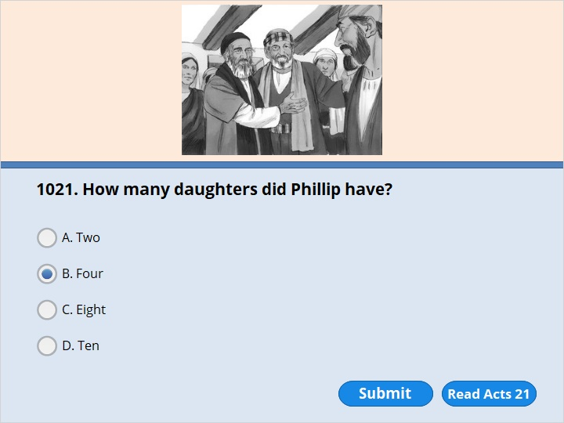
NEXT

Slide 281
NEXT

Slide 282
Acts 21:8
The next day we left and arrived at Caesarea. We stayed at the house of Philip the evangelist. He was one of the seven deacons. 9 He had four unmarried daughters who prophesied

Slide 283
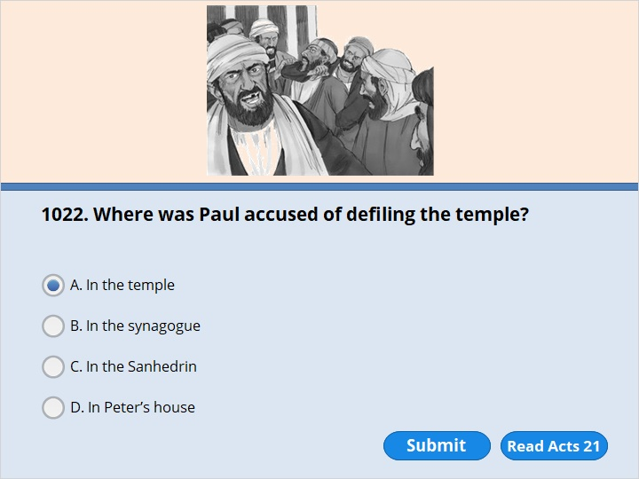
NEXT

Slide 284
NEXT

Slide 285
Acts 21:27
The seven days of cleansing were almost over. Some Jews from Asia Minor saw Paul at the temple. They stirred up the whole crowd and grabbed Paul. 28 “Fellow Israelites, help us!” they shouted. “This is the man who teaches everyone in all places against our people. He speaks against our law and against this holy place. Besides, he has brought Greeks into the temple. He has made this holy place ‘unclean.’ ”

Slide 286
NEXT

Slide 287
NEXT

Slide 288
Acts 21:37
The soldiers were about to take Paul into the fort. Then he asked the commander, “May I say something to you?” “Do you speak Greek?” he replied. 38 “Aren’t you the Egyptian who turned some of our people against their leaders? Didn’t you lead 4,000 terrorists out into the desert some time ago?”

Slide 289
NEXT

Slide 290
NEXT

Slide 291
Acts 22:3
“I am a Jew. I was born in Tarsus in Cilicia, but I grew up here in Jerusalem. I studied with Gamaliel. I was well trained by him in the law given to our people long ago. I wanted to serve God as much as any of you do today.

Slide 292
NEXT

Slide 293
NEXT

Slide 294
Phil 3:5
I was circumcised on the eighth day. I am part of the people of Israel. I am from the tribe of Benjamin. I am a pure Hebrew. As far as the law is concerned, I am a Pharisee.

Slide 295
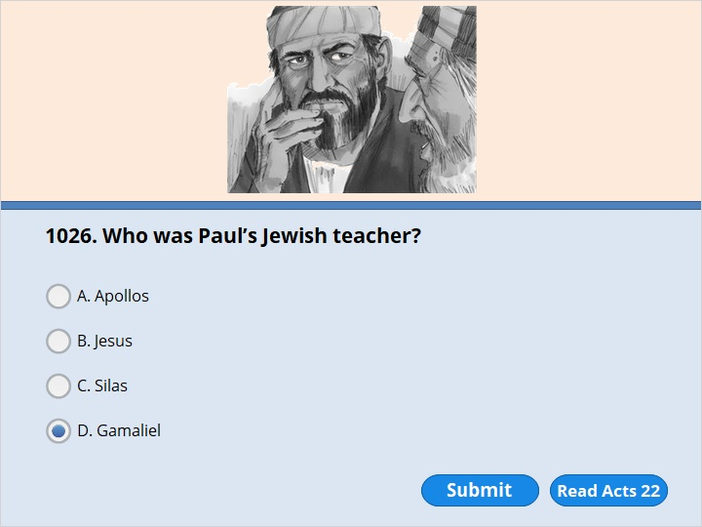
NEXT

Slide 296
NEXT

Slide 297
Acts 22:3
“I am a Jew. I was born in Tarsus in Cilicia, but I grew up here in Jerusalem. I studied with Gamaliel. I was well trained by him in the law given to our people long ago. I wanted to serve God as much as any of you do today. 4 I hurt the followers of the Way of Jesus. I sent many of them to their death. I arrested men and women. I threw them into prison. 5 The high priest and the whole Council can be witnesses of this themselves. I even had some official letters they had written to their friends in Damascus. So I went there to bring these people as prisoners to Jerusalem to be punished.

Slide 298
NEXT

Slide 299
NEXT

Slide 300
Acts 22:21
“Then the Lord said to me, ‘Go. I will send you far away to people who are not Jews.’ ”
Paul the Roman Citizen
22 The crowd listened to Paul until he said this. Then they shouted, “Kill him! He isn’t fit to live!”

Slide 301
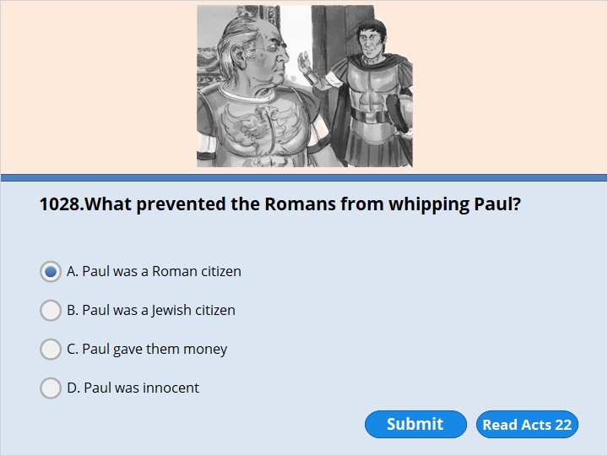
NEXT

Slide 302
NEXT

Slide 303
Acts 22:25
A commander was standing there as they stretched Paul out to be whipped. Paul said to him, “Does the law allow you to whip a Roman citizen who hasn’t even been found guilty?”
26 When the commander heard this, he went to the commanding officer and reported it. “What are you going to do?” the commander asked. “This man is a Roman citizen.”
27 So the commanding officer went to Paul. “Tell me,” he asked. “Are you a Roman citizen?”
“Yes, I am,” Paul answered.

Slide 304
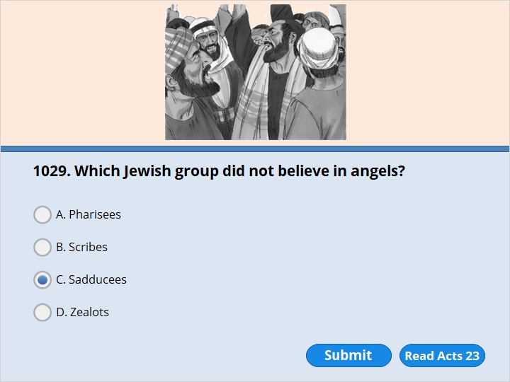
NEXT

Slide 305
NEXT

Slide 306
Acts 23:8
The Sadducees say that people will not rise from the dead. They don’t believe there are angels or spirits either. But the Pharisees believe all these things.

Slide 307
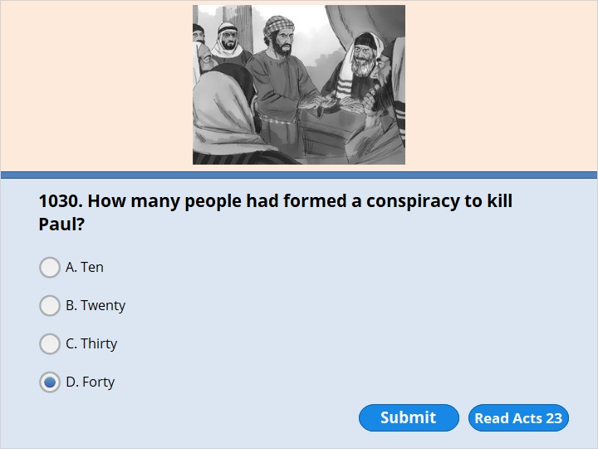
NEXT

Slide 308
NEXT

Slide 309
Acts 23:12
The next morning some Jews gathered secretly to make plans against Paul. They made a promise to themselves. They promised that they would not eat or drink anything until they killed him. 13 More than 40 men took part in this plan.

Slide 310
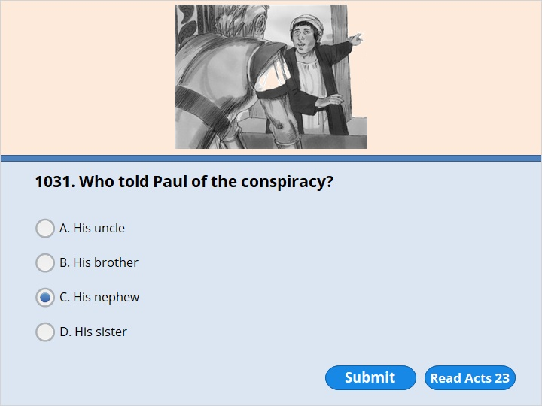
NEXT

Slide 311
NEXT

Slide 312
Acts 23:16
But Paul’s nephew heard about this plan. So he went into the fort and told Paul.

Slide 313
NEXT

Slide 314
NEXT

Slide 315
Acts 23:33
The horsemen arrived in Caesarea. They gave the letter to the governor. Then they handed Paul over to him. 34 The governor read the letter. He asked Paul where he was from. He learned that Paul was from Cilicia.

Slide 316
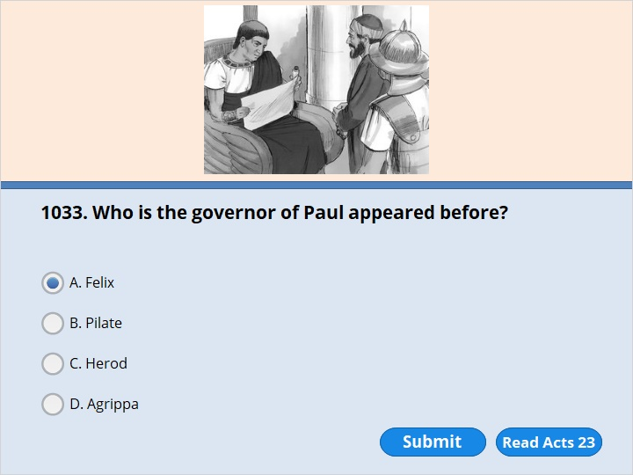
NEXT

Slide 317
NEXT

Slide 318
Acts 23:24
Provide horses for Paul so that he may be taken safely to Governor Felix.”

Slide 319
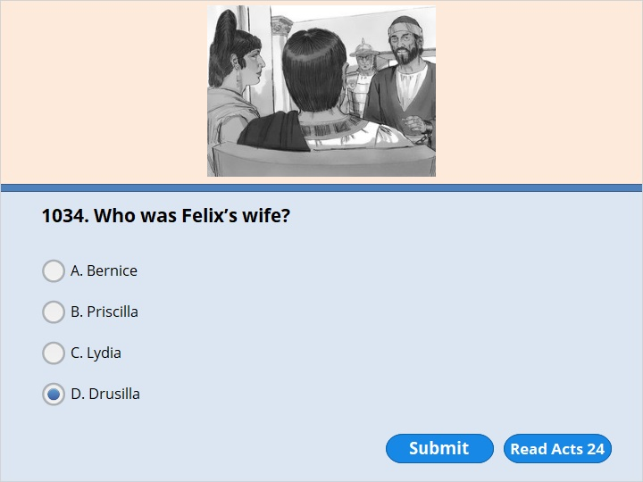
NEXT

Slide 320
NEXT

Slide 321
Acts 24:24
Several days later Felix came with his wife Drusilla. She was a Jew. Felix sent for Paul and listened to him speak about faith in Christ Jesus.

Slide 322
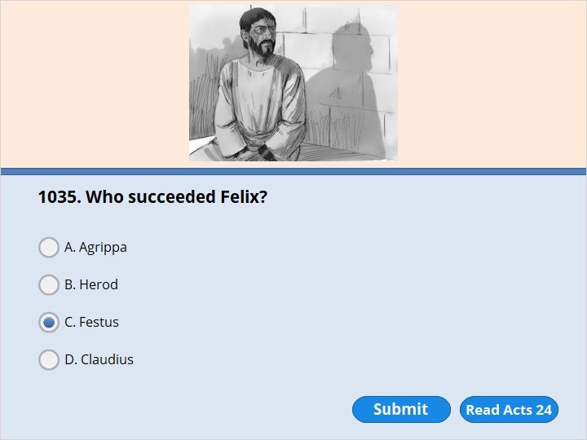
NEXT

Slide 323
NEXT

Slide 324
Acts 24:27
Two years passed. Porcius Festus took the place of Felix. But Felix wanted to do the Jews a favor. So he left Paul in prison.

Slide 325
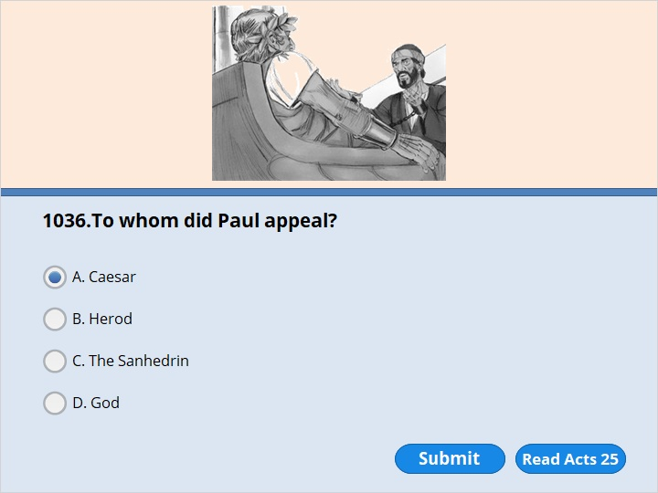
NEXT

Slide 326
NEXT

Slide 327
Acts 25:11
If I am guilty of anything worthy of death, I’m willing to die. But the charges brought against me by these Jews are not true. No one has the right to hand me over to them. I make my appeal to Caesar!”

Slide 328
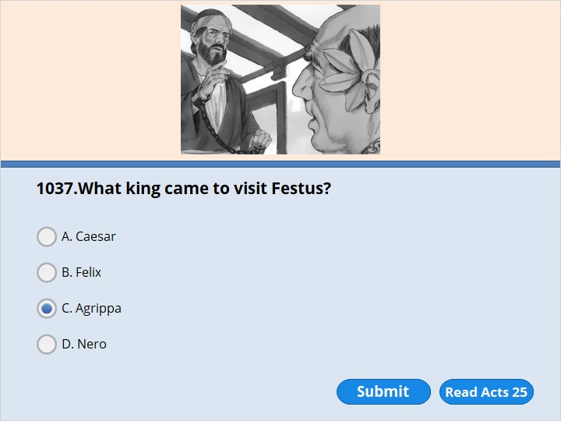
NEXT

Slide 329
NEXT

Slide 330
Acts 25:13
A few days later King Agrippa and Bernice arrived in Caesarea. They came to pay a visit to Festus.

Slide 331
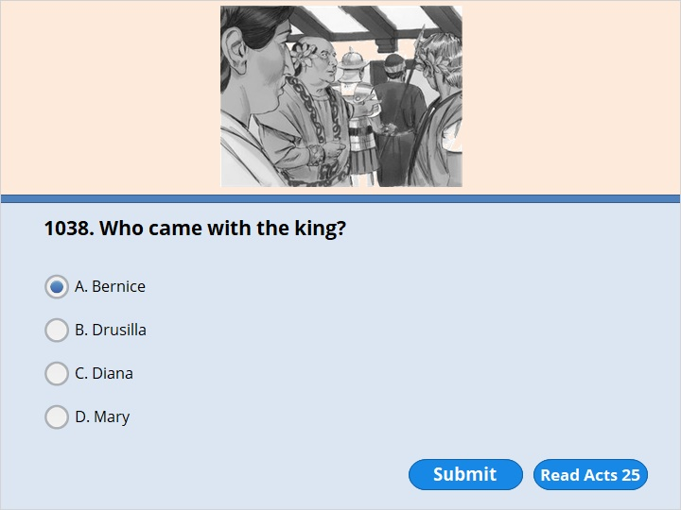
NEXT

Slide 332
NEXT

Slide 333
Acts 25:13
A few days later King Agrippa and Bernice arrived in Caesarea. They came to pay a visit to Festus.

Slide 334
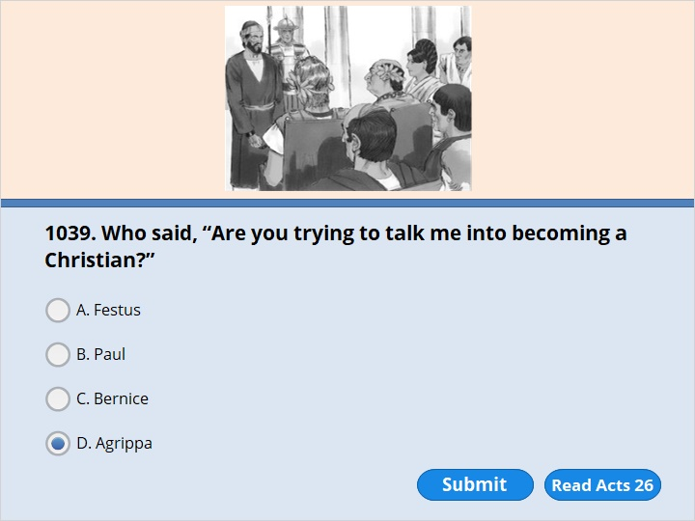
NEXT

Slide 335
NEXT

Slide 336
Acts 26:28
Then Agrippa spoke to Paul. “Are you trying to talk me into becoming a Christian?” he said. “Do you think you can do that in such a short time?”

Slide 337
NEXT

Slide 338
NEXT

Slide 339
Acts 27:14
Before very long, a wind blew down from the island. It had the force of a hurricane. It was called the Northeaster. 15 The ship was caught by the storm. We could not keep it sailing into the wind. So we gave up and were driven along by the wind.

Slide 340
NEXT

Slide 341
NEXT

Slide 342
Acts 28:1
When we were safe on shore, we found out that the island was called Malta. 2 The people of the island were unusually kind. It was raining and cold. So they built a fire and welcomed all of us. 3 Paul gathered some sticks and put them on the fire. A poisonous snake was driven out by the heat. It fastened itself on Paul’s hand.

Slide 343
NEXT

Slide 344
NEXT

Slide 345
Acts 28:3
Paul gathered some sticks and put them on the fire. A poisonous snake was driven out by the heat. It fastened itself on Paul’s hand. 4 The people of the island saw the snake hanging from his hand. They said to one another, “This man must be a murderer. He escaped from the sea. But the female god Justice won’t let him live.” 5 Paul shook the snake off into the fire. He was not harmed. 6 The people expected him to swell up. They thought he would suddenly fall dead. They waited for a long time. But they didn’t see anything unusual happen to him. So they changed their minds. They said he was a god.

Slide 346
NEXT

Slide 347
NEXT

Slide 348
Acts 28:16
When we got to Rome, Paul was allowed to live by himself. But a soldier guarded him.

Slide 349
NEXT

Slide 350
NEXT

Slide 351
2 Timothy 1:5
I remember your honest and true faith. It was alive first in your grandmother Lois and in your mother Eunice. And I am certain that it is now alive in you also.

Slide 352
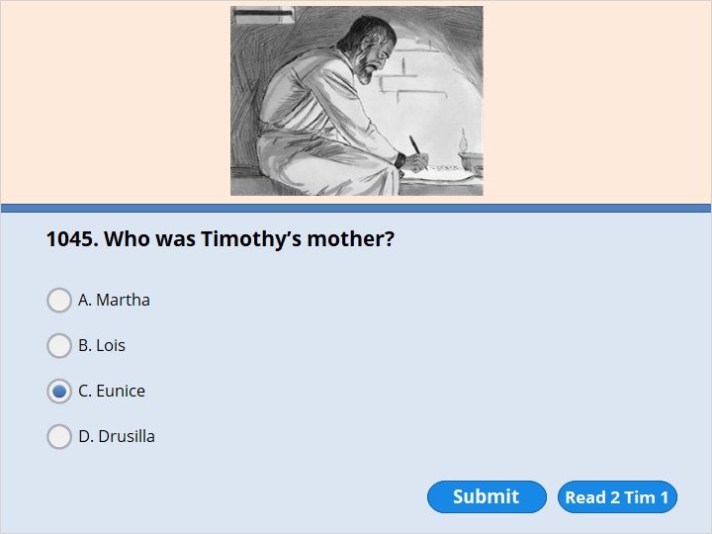
NEXT

Slide 353
NEXT

Slide 354
2 Timothy 1:5
I remember your honest and true faith. It was alive first in your grandmother Lois and in your mother Eunice. And I am certain that it is now alive in you also.

Slide 355
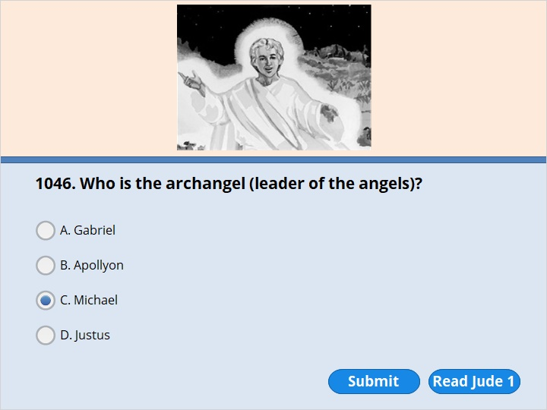
NEXT

Slide 356
NEXT

Slide 357
Jude 1:9
But even Michael, the leader of the angels, didn’t dare to say these things. He didn’t even say these things when he argued with the devil about the body of Moses. Michael didn’t dare to judge the devil. He didn’t say the devil was guilty of saying evil things. Instead, Michael said, “May the Lord judge you!”

Slide 359
Our goal is not only for you to be able to study God’s Word, but also give you a way to teach and share with other people.
We pray God will bless your time in His Word!
WWW.Mark732.org
For more information and for further training: Contact
Rev. Dr. John Reinke
At RevReinke@gmail.com
or 608-436-9600 (voice/text)
Material Copyright ©Mark732
Bible Verses are from the New International Readers Version - NIrV
Pictures: Copyright © Language Recordings Inc (Australia). Used by permission
Material Copyright ©Mark732

