Slide 1
Our goal is not only for you to be able to study God’s Word, but also give you a way to teach and share with other people.
We pray God will bless your time in His Word!
WWW.Mark732.org
For more information and for further training: Contact
Rev. Dr. John Reinke
At RevReinke@gmail.com
or 608-436-9600 (voice/text)
Material Copyright ©Mark732
Bible Verses are from the New International Readers Version - NIrV
Pictures: Copyright © Language Recordings Inc (Australia). Used by permission
Material Copyright ©Mark732

Slide 3
NEXT

Slide 4
NEXT

Slide 5
Mark 14:27
“You will all turn away,” Jesus told the disciples. “It is written, “ ‘I will strike the shepherd down. Then the sheep will be scattered.’ (Zechariah 13:7)

Slide 6
NEXT

Slide 7
NEXT

Slide 8
Mark 14:28
But after I rise from the dead, I will go ahead of you into Galilee.”

Slide 9
NEXT

Slide 10
NEXT

Slide 11
Mark 14:29
Peter said, “All the others may turn away. But I will not.”

Slide 12
NEXT

Slide 13
NEXT

Slide 14
Mark 14:30
“What I’m about to tell you is true,” Jesus answered. “It will happen today, in fact tonight. Before the rooster crows twice, you yourself will say three times that you don’t know me.”

Slide 15
NEXT

Slide 16
NEXT

Slide 17
Mark 15:42
It was the day before the Sabbath. That day was called Preparation Day. As evening approached, 43 Joseph went boldly to Pilate and asked for Jesus’ body. Joseph was from the town of Arimathea. He was a leading member of the Jewish Council. He was waiting for God’s kingdom.

Slide 18
NEXT

Slide 19
NEXT

Slide 20
Mark 14:32
Jesus and his disciples went to a place called Gethsemane. Jesus said to them, “Sit here while I pray.” 33 He took Peter, James and John along with him. He began to be very upset and troubled. 34 “My soul is very sad. I feel close to death,” he said to them. “Stay here. Keep watch.”
35 He went a little farther. Then he fell to the ground. He prayed that, if possible, the hour might pass by him.

Slide 21
NEXT

Slide 22
NEXT

Slide 23
Mark 14:32
Jesus and his disciples went to a place called Gethsemane. Jesus said to them, “Sit here while I pray.” 33 He took Peter, James and John along with him. He began to be very upset and troubled. 34 “My soul is very sad. I feel close to death,” he said to them. “Stay here. Keep watch.”
35 He went a little farther. Then he fell to the ground. He prayed that, if possible, the hour might pass by him.

Slide 24
NEXT

Slide 25
NEXT

Slide 26
Mark 14:36
“Abba, Father,” he said, “everything is possible for you. Take this cup of suffering away from me. But let what you want be done, not what I want.”

Slide 27
NEXT

Slide 28
NEXT

Slide 29
Mark 14:37
Then he returned to his disciples and found them sleeping. “Simon,” he said to Peter, “are you asleep? Couldn’t you keep watch for one hour? 38 Watch and pray. Then you won’t fall into sin when you are tempted. The spirit is willing, but the body is weak.”

Slide 30
NEXT

Slide 31
NEXT

Slide 32
Mark 14:39
Once more Jesus went away and prayed the same thing. 40 Then he came back. Again he found them sleeping. They couldn’t keep their eyes open. They did not know what to say to him.
41 Jesus returned the third time. He said to them, “Are you still sleeping and resting? Enough! The hour has come. Look! The Son of Man is about to be handed over to sinners. 42 Get up! Let us go! Here comes the one who is handing me over to them!”

Slide 33
NEXT

Slide 34
NEXT

Slide 35
Mark 14:44
Judas, who was going to hand Jesus over, had arranged a signal with them. “The one I kiss is the man,” he said. “Arrest him and have the guards lead him away.” 45 So Judas went to Jesus at once. Judas said, “Rabbi!” And he kissed Jesus. 46 The men grabbed Jesus and arrested him. 47 Then one of those standing nearby pulled his sword out. He struck the servant of the high priest and cut off his ear.

Slide 36
NEXT

Slide 37
NEXT

Slide 38
John 18:1
When Jesus had finished praying, he left with his disciples. They crossed the Kidron Valley. On the other side there was a garden. Jesus and his disciples went into it.

Slide 39
NEXT

Slide 40
NEXT

Slide 41
John 18:4
Jesus knew everything that was going to happen to him. So he went out and asked them, “Who do you want?”

Slide 42
NEXT

Slide 43
NEXT

Slide 44
John 18:5
“Jesus of Nazareth,” they replied. “I am he,” Jesus said. Judas, who was going to hand Jesus over, was standing there with them. 6 When Jesus said, “I am he,” they moved back. Then they fell to the ground.

Slide 45
NEXT

Slide 46
NEXT

Slide 47
John 18:8
Jesus answered, “I told you I am he. If you are looking for me, then let these men go.” 9 This happened so that the words Jesus had spoken would come true. He had said, “I have not lost anyone God has given me.” (John 6:39)

Slide 48
NEXT

Slide 49
NEXT

Slide 50
John 18:10
Simon Peter had a sword and pulled it out. He struck the high priest’s slave and cut off his right ear. The slave’s name was Malchus.

Slide 51
NEXT

Slide 52
NEXT

Slide 53
John 18:10
Simon Peter had a sword and pulled it out. He struck the high priest’s slave and cut off his right ear. The slave’s name was Malchus.

Slide 54
NEXT

Slide 55
NEXT

Slide 56
Matthew 26:52
“Put your sword back in its place,” Jesus said to him. “All who use the sword will die by the sword. 53 Do you think I can’t ask my Father for help? He would send an army of more than 70,000 angels right away. 54 But then how would the Scriptures come true? They say it must happen in this way.”

Slide 57
NEXT

Slide 58
NEXT

Slide 59
Luke 22:51
But Jesus answered, “Stop this!” And he touched the man’s ear and healed him.
John 18:10
Simon Peter had a sword and pulled it out. He struck the high priest’s slave and cut off his right ear. The slave’s name was Malchus.

Slide 60
NEXT

Slide 61
NEXT

Slide 62
Mark 14:50
Then everyone left him and ran away.

Slide 63
NEXT

Slide 64
NEXT

Slide 65
Mark 14:51
A young man was following Jesus. The man was wearing nothing but a piece of linen cloth. When the crowd grabbed him, 52 he ran away naked. He left his clothing behind.

Slide 66
NEXT

Slide 67
NEXT

Slide 68
John 18:12
Then the group of soldiers, their commander and the Jewish officials arrested Jesus. They tied him up 13 and brought him first to Annas. He was the father-in-law of Caiaphas, the high priest at that time. 14 Caiaphas had advised the Jewish leaders that it would be good if one man died for the people.

Slide 69
NEXT

Slide 70
NEXT

Slide 71
John 18:15
Simon Peter and another disciple were following Jesus. The high priest knew the other disciple. So that disciple went with Jesus into the high priest’s courtyard. 16 But Peter had to wait outside by the door. The other disciple came back. He was the one the high priest knew. He spoke to the servant woman who was on duty there. Then he brought Peter in.

Slide 72
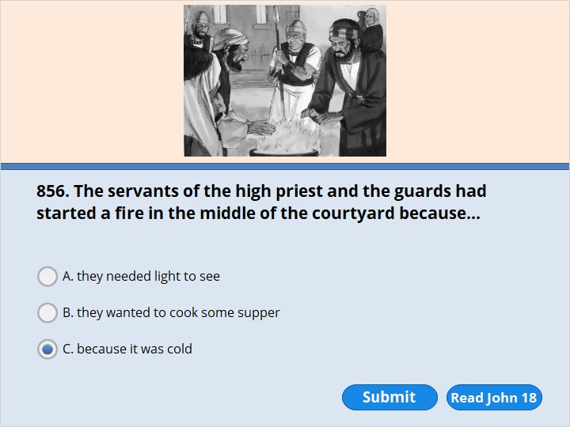
NEXT

Slide 73
NEXT

Slide 74
John 18:18
It was cold. The slaves and officials stood around a fire. They had made it to keep warm. Peter was also standing with them. He was warming himself.

Slide 75
NEXT

Slide 76
NEXT

Slide 77
John 18:19
Meanwhile, the high priest questioned Jesus. He asked him about his disciples and his teaching.

Slide 78
NEXT

Slide 79
NEXT

Slide 80
John 18:21
Why question me? Ask the people who heard me. They certainly know what I said.”

Slide 81
NEXT

Slide 82
NEXT

Slide 83
John 18:22
When Jesus said that, one of the officials nearby slapped him in the face. “Is this any way to answer the high priest?” he asked.

Slide 84
NEXT

Slide 85
NEXT

Slide 86
John 18:23
“Have I said something wrong?” Jesus replied. “If I have, then tell everyone what it was. But if I spoke the truth, why did you hit me?” 24 Annas sent him, tied up, to Caiaphas, the high priest.

Slide 87
NEXT

Slide 88
NEXT

Slide 89
Matthew 26:57
Those who had arrested Jesus took him to Caiaphas, the high priest. The teachers of the law and the elders had come together there.

Slide 90
NEXT

Slide 91
NEXT

Slide 92
Mark 14:58
“We heard him say, ‘I will destroy this temple made by human hands. In three days I will build another temple, not made by human hands.’ ” 59 But what they said did not agree.

Slide 93
NEXT

Slide 94
NEXT

Slide 95
Mark 14:60
Then the high priest stood up in front of them. He asked Jesus, “Aren’t you going to answer? What are these charges these men are bringing against you?” 61 But Jesus remained silent. He gave no answer. Again the high priest asked him, “Are you the Messiah? Are you the Son of the Blessed One?”

Slide 96
NEXT

Slide 97
NEXT

Slide 98
Matthew 26:63
But Jesus remained silent. The high priest said to him, “I am commanding you in the name of the living God. May he judge you if you don’t tell the truth. Tell us if you are the Messiah, the Son of God.”

Slide 99
NEXT

Slide 100
NEXT

Slide 101
Mark 14:64
“You have heard him say a very evil thing against God. What do you think?” They all found him guilty and said he must die.

Slide 102
NEXT

Slide 103
NEXT

Slide 104
Mark 14:63
The high priest tore his clothes. “Why do we need any more witnesses?” he asked.

Slide 105
NEXT

Slide 106
NEXT

Slide 107
Mark 14:61
But Jesus remained silent. He gave no answer. Again the high priest asked him, “Are you the Messiah? Are you the Son of the Blessed One?” 62 “I am,” said Jesus. “And you will see the Son of Man sitting at the right hand of the Mighty One. You will see the Son of Man coming on the clouds of heaven.” 63 The high priest tore his clothes. “Why do we need any more witnesses?” he asked. 64 “You have heard him say a very evil thing against God. What do you think?” They all found him guilty and said he must die.

Slide 108
NEXT

Slide 109
NEXT

Slide 110
Mark 14:57
Then some of them stood up. Here is what those false witnesses said about him.
…..
64 “You have heard him say a very evil thing against God. What do you think?”
They all found him guilty and said he must die. 65 Then some began to spit at him. They blindfolded him. They hit him with their fists. They said, “Prophesy!” And the guards took him and beat him.
…..
Note: They did not understand Jesus was talking about Himself dying and rising in 3 days.

Slide 111
NEXT

Slide 112
NEXT

Slide 113
Luke 23:8
When Herod saw Jesus, he was very pleased. He had been wanting to see Jesus for a long time. He had heard much about him. He hoped to see Jesus perform a sign of some kind.

Slide 114
NEXT

Slide 115
NEXT

Slide 116
Luke 23:11
Herod and his soldiers laughed at him and made fun of him. They dressed him in a beautiful robe. Then they sent him back to Pilate. 12 That day Herod and Pilate became friends. Before this time they had been enemies.

Slide 117
NEXT

Slide 118
NEXT

Slide 119
Luke 23:13
Pilate called together the chief priests, the rulers and the people. 14 He said to them, “You brought me this man. You said he was turning the people against the authorities. I have questioned him in front of you. I have found no basis for your charges against him. 15 Herod hasn’t either. So he sent Jesus back to us. As you can see, Jesus has done nothing that is worthy of death. 16-17 So I will just have him whipped and let him go.”

Slide 120
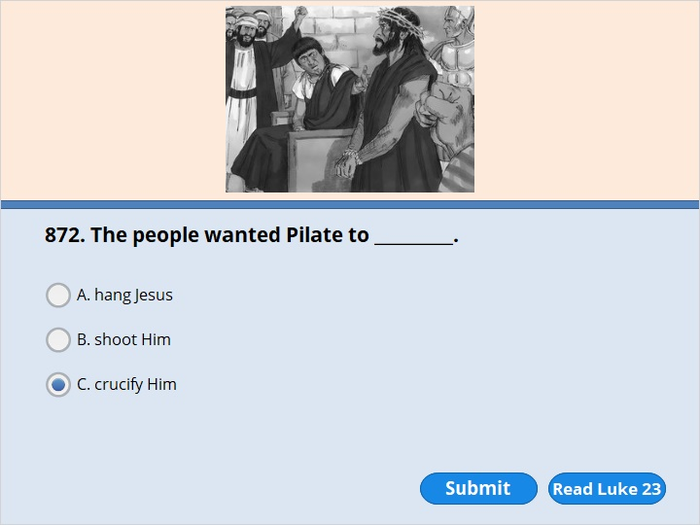
NEXT

Slide 121
NEXT

Slide 122
Luke 23:20
Pilate wanted to let Jesus go. So he made an appeal to the crowd again. 21 But they kept shouting, “Crucify him! Crucify him!”

Slide 123
NEXT

Slide 124
NEXT

Slide 125
Matthew 27:19
While Pilate was sitting on the judge’s seat, his wife sent him a message. It said, “Don’t have anything to do with that man. He is not guilty. I have suffered a great deal in a dream today because of him.”

Slide 126
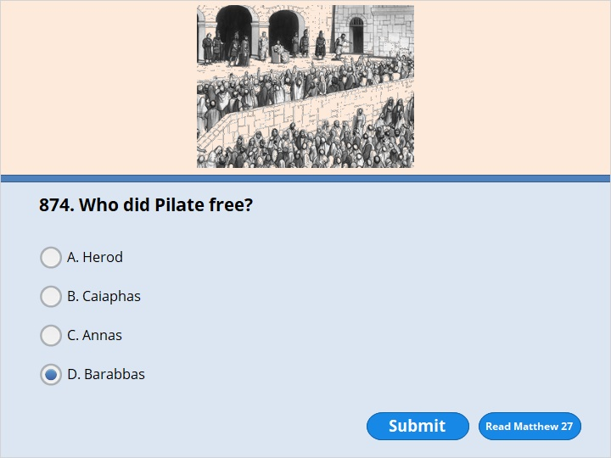
NEXT

Slide 127
NEXT

Slide 128
Matthew 27:26
Pilate let Barabbas go free. But he had Jesus whipped. Then he handed him over to be nailed to a cross.

Slide 129
NEXT

Slide 130
NEXT

Slide 131
Matthew 27:26
Pilate let Barabbas go free. But he had Jesus whipped. Then he handed him over to be nailed to a cross.

Slide 132
NEXT

Slide 133
NEXT

Slide 134
Matthew 27:28
hey took off his clothes and put a purple robe on him.

Slide 135
NEXT

Slide 136
NEXT

Slide 137
Matthew 27:29
Then they twisted thorns together to make a crown. They placed it on his head. They put a stick in his right hand. Then they fell on their knees in front of him and made fun of him. “We honor you, king of the Jews!” they said.

Slide 138
NEXT

Slide 139
NEXT

Slide 140
Matthew 27:29
Then they twisted thorns together to make a crown. They placed it on his head. They put a stick in his right hand. Then they fell on their knees in front of him and made fun of him. “We honor you, king of the Jews!” they said.

Slide 141
NEXT

Slide 142
NEXT

Slide 143
Matthew 27:29
Then they twisted thorns together to make a crown. They placed it on his head. They put a stick in his right hand. Then they fell on their knees in front of him and made fun of him. “We honor you, king of the Jews!” they said.

Slide 144
NEXT

Slide 145
NEXT

Slide 146
Matthew 27:30
They spit on him. They hit him on the head with the stick again and again. 31 After they had made fun of him, they took off the robe. They put his own clothes back on him. Then they led him away to nail him to a cross.

Slide 147
NEXT

Slide 148
NEXT

Slide 149
John 19:4
Once more Pilate came out. He said to the Jews gathered there, “Look, I am bringing Jesus out to you. I want to let you know that I find no basis for a charge against him.”

Slide 150
NEXT

Slide 151
NEXT

Slide 152
John 19:7
The Jewish leaders replied, “We have a law. That law says he must die. He claimed to be the Son of God.”

Slide 153
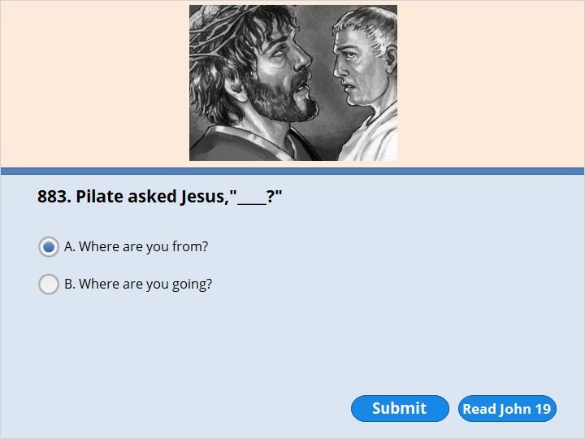
NEXT

Slide 154
NEXT

Slide 155
John 19:8
When Pilate heard that, he was even more afraid. 9 He went back inside the palace. “Where do you come from?” he asked Jesus. But Jesus did not answer him.

Slide 156
NEXT

Slide 157
NEXT

Slide 158
John 19:10
“Do you refuse to speak to me?” Pilate said. “Don’t you understand? I have the power to set you free or to nail you to a cross.”

Slide 159
NEXT

Slide 160
NEXT

Slide 161
John 19:12
From then on, Pilate tried to set Jesus free. But the Jewish leaders kept shouting, “If you let this man go, you are not Caesar’s friend! Anyone who claims to be a king is against Caesar!”

Slide 162
NEXT

Slide 163
NEXT

Slide 164
John 19:13
When Pilate heard that, he brought Jesus out. Pilate sat down on the judge’s seat. It was at a place called the Stone Walkway. In the Aramaic language it was called Gabbatha. 14 It was about noon on Preparation Day in Passover Week. “Here is your king,” Pilate said to the Jews.

Slide 165
NEXT

Slide 166
NEXT

Slide 167
John 19:15
But they shouted, “Take him away! Take him away! Crucify him!”
“Should I crucify your king?” Pilate asked.
“We have no king but Caesar,” the chief priests answered.

Slide 168
NEXT

Slide 169
NEXT

Slide 170
John 19:15
But they shouted, “Take him away! Take him away! Crucify him!”
“Should I crucify your king?” Pilate asked.
“We have no king but Caesar,” the chief priests answered.

Slide 171
NEXT

Slide 172
NEXT

Slide 173
John 19:16
Finally, Pilate handed Jesus over to them to be nailed to a cross.

Slide 174
NEXT

Slide 175
NEXT

Slide 176
Mark 15:20
After they had made fun of him, they took off the purple robe. They put his own clothes back on him. Then they led him out to nail him to a cross.

Slide 177
NEXT

Slide 178
NEXT

Slide 179
Mark 15:20
After they had made fun of him, they took off the purple robe. They put his own clothes back on him. Then they led him out to nail him to a cross.

Slide 180
NEXT

Slide 181
NEXT

Slide 182
Mark 15:21
A man named Simon was passing by. He was from Cyrene. He was the father of Alexander and Rufus. Simon was on his way in from the country. The soldiers forced him to carry the cross.

Slide 183
NEXT

Slide 184
NEXT

Slide 185
Mark 15:21
A man named Simon was passing by. He was from Cyrene. He was the father of Alexander and Rufus. Simon was on his way in from the country. The soldiers forced him to carry the cross.

Slide 186
NEXT

Slide 187
NEXT

Slide 188
Luke 23:27
A large number of people followed Jesus. Some were women whose hearts were filled with sorrow. They cried loudly because of him. 28 Jesus turned and said to them, “Daughters of Jerusalem, do not weep for me. Weep for yourselves and for your children.

Slide 189
NEXT

Slide 190
NEXT

Slide 191
Matthew 27:33
They came to a place called Golgotha. The word Golgotha means the Place of the Skull.

Slide 192
NEXT

Slide 193
NEXT

Slide 194
John 19:17
He had to carry his own cross. He went out to a place called the Skull. In the Aramaic language it was called Golgotha.

Slide 195
NEXT

Slide 196
NEXT

Slide 197
Luke 23:33
The soldiers brought them to the place called the Skull. There they nailed Jesus to the cross. He hung between the two criminals. One was on his right and one was on his left.

Slide 198
NEXT

Slide 199
NEXT

Slide 200
Mark 15:27-28
They crucified with him two rebels against Rome. One was on his right and one was on his left.

Slide 201
NEXT

Slide 202
NEXT

Slide 203
Mark 15:25
It was nine o’clock in the morning when they crucified him.

Slide 204
NEXT

Slide 205
NEXT

Slide 206
John 19:23
When the soldiers crucified Jesus, they took his clothes. They divided them into four parts. Each soldier got one part. All that was left was Jesus’ long, inner robe. It did not have any seams. It was made out of one piece of cloth from top to bottom.

Slide 207
NEXT

Slide 208
NEXT

Slide 209
John 19:23
When the soldiers crucified Jesus, they took his clothes. They divided them into four parts. Each soldier got one part. All that was left was Jesus’ long, inner robe. It did not have any seams. It was made out of one piece of cloth from top to bottom.

Slide 210
NEXT

Slide 211
NEXT

Slide 212
John 19:19
Pilate had a notice prepared. It was fastened to the cross. It read, jesus of nazareth, the king of the jews.

Slide 213
NEXT

Slide 214
NEXT

Slide 215
John 19:20
Many of the Jews read the sign. That’s because the place where Jesus was crucified was near the city. And the sign was written in the Aramaic, Latin and Greek languages.

Slide 216
NEXT

Slide 217
NEXT

Slide 218
John 19:20
Many of the Jews read the sign. That’s because the place where Jesus was crucified was near the city. And the sign was written in the Aramaic, Latin and Greek languages.

Slide 219
NEXT

Slide 220
NEXT

Slide 221
John 19:21
The chief priests of the Jews argued with Pilate. They said, “Do not write ‘The King of the Jews.’ Write that this man claimed to be king of the Jews.” 22 Pilate answered, “I have written what I have written.”

Slide 222
NEXT

Slide 223
NEXT

Slide 224
Matthew 27:39
Those who passed by shouted at Jesus and made fun of him. They shook their heads 40 and said, “So you are going to destroy the temple and build it again in three days? Then save yourself! Come down from the cross, if you are the Son of God!” 41 In the same way the chief priests, the teachers of the law and the elders made fun of him.

Slide 225
NEXT

Slide 226
NEXT

Slide 227
Matthew 27:34
There they mixed wine with bitter spices and gave it to Jesus to drink. After tasting it, he refused to drink it.

Slide 228
NEXT

Slide 229
NEXT

Slide 230
Luke 23:39
One of the criminals hanging there made fun of Jesus. He said, “Aren’t you the Messiah? Save yourself! Save us!”

Slide 231
NEXT

Slide 232
NEXT

Slide 233
Luke 23:40
But the other criminal scolded him. “Don’t you have any respect for God?” he said. “Remember, you are under the same sentence of death. 41 We are being punished fairly. We are getting just what our actions call for. But this man hasn’t done anything wrong.” 42 Then he said, “Jesus, remember me when you come into your kingdom.”

Slide 234
NEXT

Slide 235
NEXT

Slide 236
Luke 23:40
But the other criminal scolded him. “Don’t you have any respect for God?” he said. “Remember, you are under the same sentence of death. 41 We are being punished fairly. We are getting just what our actions call for. But this man hasn’t done anything wrong.”
42 Then he said, “Jesus, remember me when you come into your kingdom.”
43 Jesus answered him, “What I’m about to tell you is true. Today you will be with me in paradise.”

Slide 237
NEXT

Slide 238
NEXT

Slide 239
John 19:26
Jesus saw his mother there. He also saw the disciple he loved standing nearby. Jesus said to his mother, “Dear woman, here is your son.” 27 He said to the disciple, “Here is your mother.” From that time on, the disciple took her into his home.

Slide 240
NEXT

Slide 241
NEXT

Slide 242
John 19:26
Jesus saw his mother there. He also saw the disciple he loved standing nearby. Jesus said to his mother, “Dear woman, here is your son.” 27 He said to the disciple, “Here is your mother.” From that time on, the disciple took her into his home.

Slide 243
NEXT

Slide 244
NEXT

Slide 245
Mark 15:33
At noon, darkness covered the whole land. It lasted three hours. 34 At three o’clock in the afternoon Jesus cried out in a loud voice, “Eloi, Eloi, lema sabachthani?” This means “My God, my God, why have you deserted me?” (Psalm 22:1)

Slide 246
NEXT

Slide 247
NEXT

Slide 248
Mark 15:33
At noon, darkness covered the whole land. It lasted three hours. 34 At three o’clock in the afternoon Jesus cried out in a loud voice, “Eloi, Eloi, lema sabachthani?” This means “My God, my God, why have you deserted me?” (Psalm 22:1)

Slide 249
NEXT

Slide 250
NEXT

Slide 251
Mark 15:36
Someone ran and filled a sponge with wine vinegar. He put it on a stick. He offered it to Jesus to drink. “Leave him alone,” he said. “Let’s see if Elijah comes to take him down.”

Slide 252
NEXT

Slide 253
NEXT

Slide 254
John 19:29
A jar of wine vinegar was there. So they soaked a sponge in it. They put the sponge on the stem of a hyssop plant. Then they lifted it up to Jesus’ lips. 30 After Jesus drank he said, “It is finished.” Then he bowed his head and died.

Slide 255
NEXT

Slide 256
NEXT

Slide 257
John 19:29
A jar of wine vinegar was there. So they soaked a sponge in it. They put the sponge on the stem of a hyssop plant. Then they lifted it up to Jesus’ lips. 30 After Jesus drank he said, “It is finished.” Then he bowed his head and died.

Slide 258
NEXT

Slide 259
NEXT

Slide 260
Luke 23:34
Jesus said, “Father, forgive them. They don’t know what they are doing.” The soldiers divided up his clothes by casting lots.
Luke 23:43
Jesus answered him, “What I’m about to tell you is true. Today you will be with me in paradise.”
John 19:26
Jesus saw his mother there. He also saw the disciple he loved standing nearby. Jesus said to his mother, “Dear woman, here is your son.” 27 He said to the disciple, “Here is your mother.” From that time on, the disciple took her into his home. ( )

Slide 261
Matthew 27:46
About three o’clock, Jesus cried out in a loud voice. He said, “Eli, Eli, lema sabachthani?” This means “My God, my God, why have you deserted me?” (Psalm 22:1)
John 19:28
Later, Jesus knew that everything had now been finished. He also knew that what Scripture said must come true. So he said, “I am thirsty.” ( )

Slide 262
John 19:28
Later, Jesus knew that everything had now been finished. He also knew that what Scripture said must come true. So he said, “I am thirsty.”
John 19:30
After Jesus drank he said, “It is finished.” Then he bowed his head and died.
Luke 23:46
Jesus called out in a loud voice, “Father, into your hands I commit my life.” After he said this, he took his last breath.

Slide 263
NEXT

Slide 264
NEXT

Slide 265
Matthew 27:51
At that moment the temple curtain was torn in two from top to bottom. The earth shook. The rocks split.

Slide 266
NEXT

Slide 267
NEXT

Slide 268
Mark 15:39
A Roman commander was standing there in front of Jesus. He saw how Jesus died. Then he said, “This man was surely the Son of God!”

Slide 269
NEXT

Slide 270
NEXT

Slide 271
John 19:32
The soldiers came and broke the legs of the first man who had been crucified with Jesus. Then they broke the legs of the other man.

Slide 272
NEXT

Slide 273
NEXT

Slide 274
John 19:33
But when they came to Jesus, they saw that he was already dead. So they did not break his legs.

Slide 275
NEXT

Slide 276
NEXT

Slide 277
John 19:34
Instead, one of the soldiers stuck his spear into Jesus’ side. Right away, blood and water flowed out.

Slide 278
NEXT

Slide 279
NEXT

Slide 280
John 19:36
These things happened in order that Scripture would come true. It says, “Not one of his bones will be broken.” (Exodus 12:46; Numbers 9:12; Psalm 34:20) 37 Scripture also says, “They will look to the one they have pierced.” (Zechariah 12:10)

Slide 281
NEXT

Slide 282
NEXT

Slide 283
John 19:31
It was Preparation Day. The next day would be a special Sabbath day. The Jewish leaders did not want the bodies left on the crosses during the Sabbath day. So they asked Pilate to have the legs broken and the bodies taken down.

Slide 284
NEXT

Slide 285
John 19:38
Later Joseph asked Pilate for Jesus’ body. Joseph was from the town of Arimathea. He was a follower of Jesus. But he followed Jesus secretly because he was afraid of the Jewish leaders. After Pilate gave him permission, Joseph came and took the body away.

Slide 286
NEXT

Slide 287
NEXT

Slide 288
Mark 15:44
Pilate was surprised to hear that Jesus was already dead. So he called for the Roman commander. He asked him if Jesus had already died. 45 The commander said it was true. So Pilate gave the body to Joseph.

Slide 289
NEXT

Slide 290
NEXT

Slide 291
John 19:39
Nicodemus went with Joseph. He was the man who had earlier visited Jesus at night. Nicodemus brought some mixed spices that weighed about 75 pounds.

Slide 293
Our goal is not only for you to be able to study God’s Word, but also give you a way to teach and share with other people.
We pray God will bless your time in His Word!
WWW.Mark732.org
For more information and for further training: Contact
Rev. Dr. John Reinke
At RevReinke@gmail.com
or 608-436-9600 (voice/text)
Material Copyright ©Mark732
Bible Verses are from the New International Readers Version - NIrV
Pictures: Copyright © Language Recordings Inc (Australia). Used by permission
Material Copyright ©Mark732

