Slide 1
Our goal is not only for you to be able to study God’s Word, but also give you a way to teach and share with other people.
We pray God will bless your time in His Word!
WWW.Mark732.org
For more information and for further training: Contact
Rev. Dr. John Reinke
At RevReinke@gmail.com
or 608-436-9600 (voice/text)
Material Copyright ©Mark732
Bible Verses are from the New International Readers Version - NIrV
Pictures: Copyright © Language Recordings Inc (Australia). Used by permission
Material Copyright ©Mark732

Slide 2
NEXT

Slide 3
NEXT

Slide 4
NEXT

Slide 5
Luke 7:11
Some time later, Jesus went to a town called Nain. His disciples and a large crowd went along with him. 12 He approached the town gate. Just then, a dead person was being carried out. He was the only son of his mother. She was a widow. A large crowd from the town was with her. 13 When the Lord saw her, he felt sorry for her. So he said, “Don’t cry.” 14 Then he went up and touched the coffin. Those carrying it stood still. Jesus said, “Young man, I say to you, get up!” 15 The dead man sat up and began to talk. Then Jesus gave him back to his mother.

Slide 6
NEXT

Slide 7
NEXT

Slide 8
Luke 8:41
Then a man named Jairus came. He was a synagogue leader. He fell at Jesus’ feet and begged Jesus to come to his house. 42 His only daughter was dying. She was about 12 years old. As Jesus was on his way, the crowds almost crushed him.

Slide 9
NEXT

Slide 10
NEXT

Slide 11
Luke 8:51
When he arrived at the house of Jairus, he did not let everyone go in with him. He took only Peter, John and James, and the child’s father and mother.

Slide 12
NEXT

Slide 13
NEXT

Slide 14
Matthew 11:2
John the Baptist was in prison. When he heard about the actions of the Messiah, he sent his disciples to him. 3 They asked Jesus, “Are you the one who is supposed to come? Or should we look for someone else?”

Slide 15
NEXT

Slide 16
NEXT

Slide 17
Matthew 12:24
The Pharisees heard this. So they said, “This fellow drives out demons by the power of Beelzebul, the prince of demons.”

Slide 18
NEXT

Slide 19
NEXT

Slide 20
Matthew
12:39 He answered, “Evil and unfaithful people ask for a sign! But none will be given except the sign of the prophet Jonah.

Slide 21
NEXT

Slide 22
NEXT

Slide 23
Matthew 12:43
“What happens when an evil spirit comes out of a person? It goes through dry areas looking for a place to rest. But it doesn’t find it. 44 Then it says, ‘I will return to the house I left.’ When it arrives there, it finds the house empty. The house has been swept clean and put in order. 45 Then the evil spirit goes and takes with it seven other spirits more evil than itself. They go in and live there. That person is worse off than before. That is how it will be with the evil people of today.”

Slide 24
NEXT

Slide 25
NEXT

Slide 26
Matthew 13:53
Jesus finished telling these stories. Then he moved on from there. 54 He came to his hometown of Nazareth. There he began teaching the people in their synagogue. They were amazed. “Where did this man get this wisdom? Where did he get this power to do miracles?” they asked. 55 “Isn’t this the carpenter’s son? Isn’t his mother’s name Mary? Aren’t his brothers James, Joseph, Simon and Judas? 56 Aren’t all his sisters with us? Then where did this man get all these things?”

Slide 27
NEXT

Slide 28
NEXT

Slide 29
John 6:1
Some time after this, Jesus crossed over to the other side of the Sea of Galilee. It is also called the Sea of Tiberias.

Slide 30
NEXT

Slide 31
NEXT

Slide 32
John 6:5
Jesus looked up and saw a large crowd coming toward him. So he said to Philip, “Where can we buy bread for these people to eat?” 6 He asked this only to test Philip. He already knew what he was going to do.

Slide 33
NEXT

Slide 34
NEXT

Slide 35
John 6:8
Another of his disciples spoke up. It was Andrew, Simon Peter’s brother. He said, 9 “Here is a boy with five small loaves of barley bread. He also has two small fish. But how far will that go in such a large crowd?”

Slide 36
NEXT

Slide 37
NEXT

Slide 38
John 6:8
Another of his disciples spoke up. It was Andrew, Simon Peter’s brother. He said, 9 “Here is a boy with five small loaves of barley bread. He also has two small fish. But how far will that go in such a large crowd?”

Slide 39
NEXT

Slide 40
NEXT

Slide 41
John 6:10
Jesus said, “Have the people sit down.” There was plenty of grass in that place, and they sat down. About 5,000 men were there. 11 Then Jesus took the loaves and gave thanks. He handed out the bread to those who were seated. He gave them as much as they wanted. And he did the same with the fish.

Slide 42
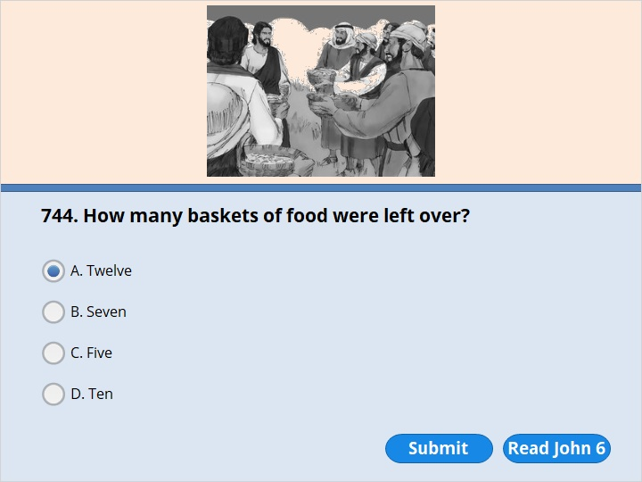
NEXT

Slide 43
NEXT

Slide 44
John 6:12
When all of them had enough to eat, Jesus spoke to his disciples. “Gather the leftover pieces,” he said. “Don’t waste anything.” 13 So they gathered what was left over from the five barley loaves. They filled 12 baskets with the pieces left by those who had eaten.

Slide 45
NEXT

Slide 46
NEXT

Slide 47
John 6:19
They rowed about three or four miles. Then they saw Jesus coming toward the boat. He was walking on the water. They were frightened

Slide 48
NEXT

Slide 49
NEXT

Slide 50
Matthew 14:29
“Come,” Jesus said. So Peter got out of the boat. He walked on the water toward Jesus. 30 But when Peter saw the wind, he was afraid. He began to sink. He cried out, “Lord! Save me!”

Slide 51
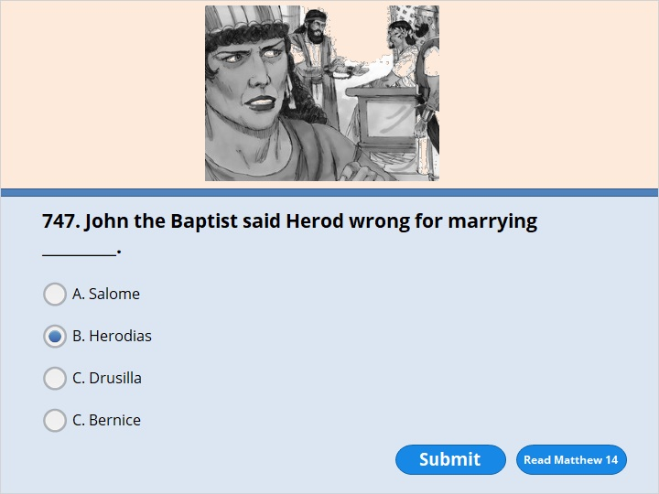
NEXT

Slide 52
NEXT

Slide 53
Matthew 14:3
Herod had arrested John. He had tied him up and put him in prison because of Herodias. She was the wife of Herod’s brother Philip. 4 John had been saying to Herod, “It is against the Law for you to have her as your wife.” 5 Herod wanted to kill John. But he was afraid of the people, because they thought John was a prophet.

Slide 54
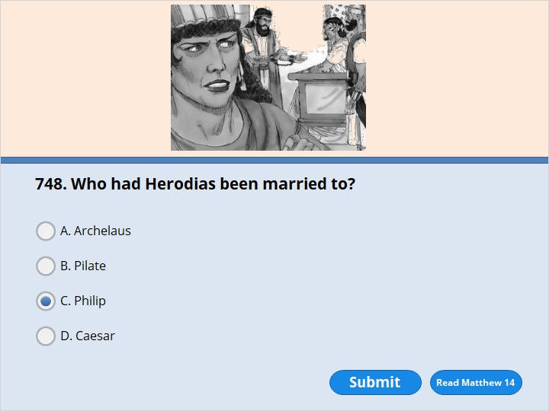
NEXT

Slide 55
NEXT

Slide 56
Matthew 14:3
Herod had arrested John. He had tied him up and put him in prison because of Herodias. She was the wife of Herod’s brother Philip. 4 John had been saying to Herod, “It is against the Law for you to have her as your wife.” 5 Herod wanted to kill John. But he was afraid of the people, because they thought John was a prophet.

Slide 57
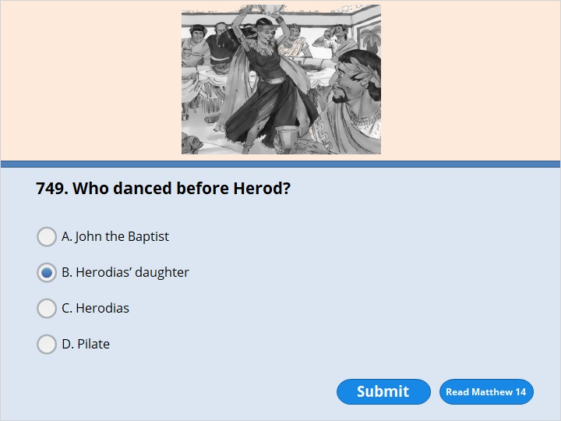
NEXT

Slide 58
NEXT

Slide 59
Matthew 14:6
On Herod’s birthday the daughter of Herodias danced for Herod and his guests. She pleased Herod very much.

Slide 60
NEXT

Slide 61
NEXT

Slide 62
Matthew 14:6
On Herod’s birthday the daughter of Herodias danced for Herod and his guests. She pleased Herod very much. 7 So he promised to give her anything she asked for. 8 Her mother told her what to say. So the girl said to Herod, “Give me the head of John the Baptist on a big plate.” 9 The king was very upset. But he thought of his promise and his dinner guests. So he told one of his men to give her what she asked for. 10 Herod had John’s head cut off in the prison.

Slide 63
NEXT

Slide 64
NEXT

Slide 65
Mark 5:9
Then Jesus asked the demon, “What is your name?” “My name is Legion,” he replied. “There are many of us.” 10 And he begged Jesus again and again not to send them out of the area.
11 A large herd of pigs was feeding on the nearby hillside. 12 The demons begged Jesus, “Send us among the pigs. Let us go into them.”

Slide 66
NEXT

Slide 67
NEXT

Slide 68
Mark 5:9
Then Jesus asked the demon, “What is your name?” “My name is Legion,” he replied. “There are many of us.” 10 And he begged Jesus again and again not to send them out of the area. 11 A large herd of pigs was feeding on the nearby hillside. 12 The demons begged Jesus, “Send us among the pigs. Let us go into them.”

Slide 69
NEXT

Slide 70
NEXT

Slide 71
Mark 5:11
A large herd of pigs was feeding on the nearby hillside. 12 The demons begged Jesus, “Send us among the pigs. Let us go into them.” 13 Jesus allowed it. The evil spirits came out of the man and went into the pigs. There were about 2,000 pigs in the herd. The whole herd rushed down the steep bank. They ran into the lake and drowned.

Slide 72
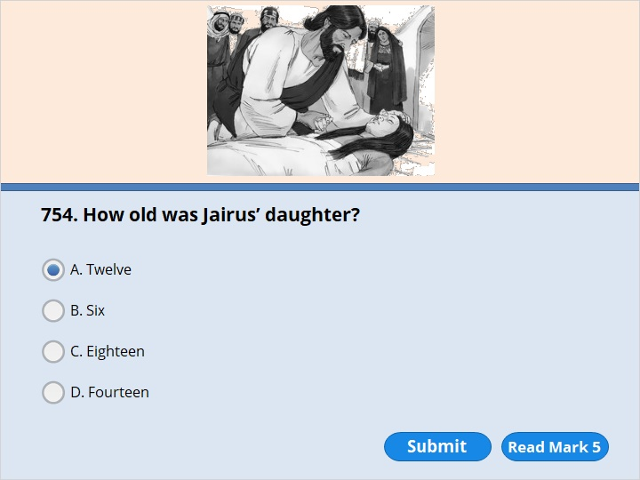
NEXT

Slide 73
NEXT

Slide 74
Mark 5:41
He took her by the hand. Then he said to her, “Talitha koum!” This means, “Little girl, I say to you, get up!” 42 The girl was 12 years old. Right away she stood up and began to walk around. They were totally amazed at this.

Slide 75
NEXT

Slide 76
NEXT

Slide 77
Mark 5:25
A woman was there who had a sickness that made her bleed. It had lasted for 12 years.

Slide 78
NEXT

Slide 79
NEXT

Slide 80
Matthew 15:36
He took the seven loaves and the fish and gave thanks. Then he broke them and gave them to the disciples. And the disciples passed them out to the people. 37 All of them ate and were satisfied. After that, the disciples picked up seven baskets of leftover pieces. 38 The number of men who ate was 4,000. Women and children also ate.

Slide 81
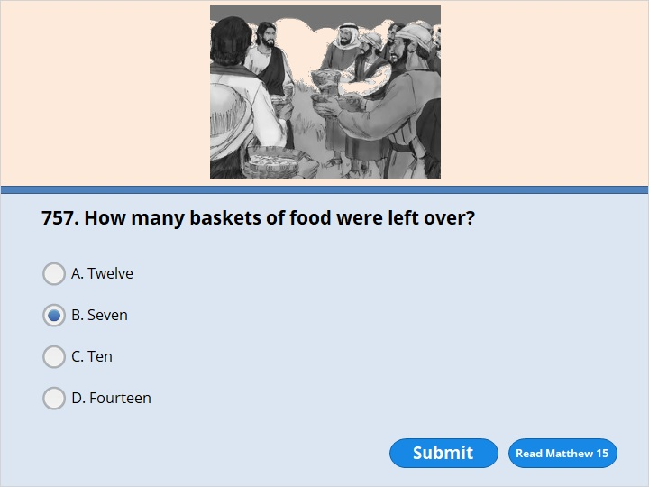
NEXT

Slide 82
NEXT

Slide 83
Matthew 15:36
He took the seven loaves and the fish and gave thanks. Then he broke them and gave them to the disciples. And the disciples passed them out to the people. 37 All of them ate and were satisfied. After that, the disciples picked up seven baskets of leftover pieces.

Slide 84
NEXT

Slide 85
NEXT

Slide 86
John 9:1
As Jesus went along, he saw a man who was blind. He had been blind since he was born. 2 Jesus’ disciples asked him, “Rabbi, who sinned? Was this man born blind because he sinned? Or did his parents sin?” 3 “It isn’t because this man sinned,” said Jesus. “It isn’t because his parents sinned. He was born blind so that God’s power could be shown by what’s going to happen. 4 While it is still day, we must do the works of the one who sent me. Night is coming. Then no one can work. 5 While I am in the world, I am the light of the world.”

Slide 87
NEXT

Slide 88
NEXT

Slide 89
John 9:6
After he said this, he spit on the ground. He made some mud with the spit. Then he put the mud on the man’s eyes. 7 “Go,” he told him. “Wash in the Pool of Siloam.” Siloam means Sent. So the man went and washed. And he came home able to see.

Slide 90
NEXT

Slide 91
NEXT

Slide 92
Matthew 16:13
Jesus went to the area of Caesarea Philippi. There he asked his disciples, “Who do people say the Son of Man is?”

Slide 93
NEXT

Slide 94
NEXT

Slide 95
Matthew 16:15
“But what about you?” he asked. “Who do you say I am?”
16 Simon Peter answered, “You are the Messiah. You are the Son of the living God.”

Slide 96
NEXT

Slide 97
NEXT

Slide 98
Matthew 17:1
After six days Jesus took Peter, James, and John the brother of James with him. He led them up a high mountain. They were all alone. 2 There in front of them his appearance was changed. His face shone like the sun. His clothes became as white as the light. 3 Just then Moses and Elijah appeared in front of them. Moses and Elijah were talking with Jesus.

Slide 99
NEXT

Slide 100
NEXT

Slide 101
Matthew 17:1
After six days Jesus took Peter, James, and John the brother of James with him. He led them up a high mountain. They were all alone. 2 There in front of them his appearance was changed. His face shone like the sun. His clothes became as white as the light. 3 Just then Moses and Elijah appeared in front of them. Moses and Elijah were talking with Jesus.

Slide 102
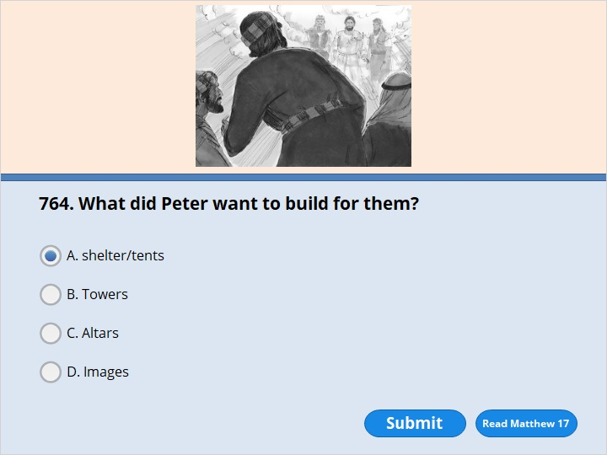
NEXT

Slide 103
NEXT

Slide 104
Matthew 17:4
Peter said to Jesus, “Lord, it is good for us to be here. If you wish, I will put up three shelters. One will be for you, one for Moses, and one for Elijah.”

Slide 105
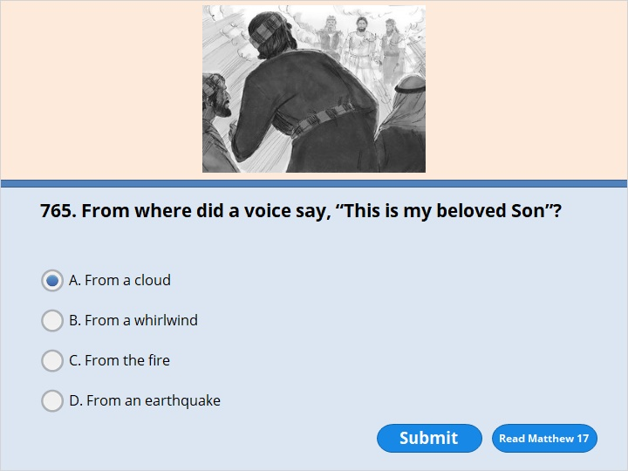
NEXT

Slide 106
NEXT

Slide 107
Matthew 17:5
While Peter was still speaking, a bright cloud covered them. A voice from the cloud said, “This is my Son, and I love him. I am very pleased with him. Listen to him!”

Slide 108
NEXT

Slide 109
NEXT

Slide 110
Matthew 17:27
“But we don’t want to make them angry. So go to the lake and throw out your fishing line. Take the first fish you catch. Open its mouth. There you will find the exact coin you need. Take it and give it to them for my tax and yours.”

Slide 111
NEXT

Slide 112
NEXT

Slide 113
Matthew 18:3
Jesus said, “What I’m about to tell you is true. You need to change and become like little children. If you don’t, you will never enter the kingdom of heaven. 4 Anyone who takes the humble position of this child is the most important in the kingdom of heaven. 5 Anyone who welcomes a little child like this one in my name welcomes me.

Slide 114
NEXT

Slide 115
NEXT

Slide 116
Matthew 18:21
Peter came to Jesus. He asked, “Lord, how many times should I forgive my brother or sister who sins against me? Up to seven times?” 22 Jesus answered, “I tell you, not seven times, but 77 times.

Slide 117
NEXT

Slide 118
NEXT

Slide 119
Luke 9:54
The disciples James and John saw this. They asked, “Lord, do you want us to call down fire from heaven to destroy them?” 55 But Jesus turned and commanded them not to do it. 56 Then Jesus and his disciples went on to another village.

Slide 120
NEXT

Slide 121
NEXT

Slide 122
Luke 10:1
After this the Lord appointed 72 others. He sent them out two by two ahead of him. They went to every town and place where he was about to go.

Slide 123
NEXT

Slide 124
NEXT

Slide 125
Luke 10:25-37
The Parable of the Good Samaritan
25 On one occasion an expert in the law stood up to test Jesus. “Teacher,” he asked, “what must I do to inherit eternal life?”
26 “What is written in the Law?” he replied. “How do you read it?”
27 He answered, “‘Love the Lord your God with all your heart and with all your soul and with all your strength and with all your mind’[c]; and, ‘Love your neighbor as yourself.’”
28 “You have answered correctly,” Jesus replied. “Do this and you will live.”
29 But he wanted to justify himself, so he asked Jesus, “And who is my neighbor?”
Continue to next page…

Slide 126
30 In reply Jesus said: “A man was going down from Jerusalem to Jericho, when he was attacked by robbers. They stripped him of his clothes, beat him and went away, leaving him half dead. 31 A priest happened to be going down the same road, and when he saw the man, he passed by on the other side. 32 So too, a Levite, when he came to the place and saw him, passed by on the other side. 33 But a Samaritan, as he traveled, came where the man was; and when he saw him, he took pity on him. 34 He went to him and bandaged his wounds, pouring on oil and wine. Then he put the man on his own donkey, brought him to an inn and took care of him. 35 The next day he took out two denarii[e] and gave them to the innkeeper. ‘Look after him,’ he said, ‘and when I return, I will reimburse you for any extra expense you may have.’
Continue to next page…

Slide 127
36 “Which of these three do you think was a neighbor to the man who fell into the hands of robbers?”
37 The expert in the law replied, “The one who had mercy on him.”
Jesus told him, “Go and do likewise.”

Slide 128
NEXT

Slide 129
NEXT

Slide 130
Luke 10:30
Jesus replied, “A man was going down from Jerusalem to Jericho. Robbers attacked him. They stripped off his clothes and beat him. Then they went away, leaving him almost dead.

Slide 131
NEXT

Slide 132
NEXT

Slide 133
Luke 10:31
A priest happened to be going down that same road. When he saw the man, he passed by on the other side.

Slide 134
NEXT

Slide 135
NEXT

Slide 136
Luke 10:32
A Levite also came by. When he saw the man, he passed by on the other side too.

Slide 137
NEXT

Slide 138
NEXT

Slide 139
Luke 10:33
But a Samaritan came to the place where the man was. When he saw the man, he felt sorry for him.

Slide 140
NEXT

Slide 141
NEXT

Slide 142
Luke 10:38
Jesus and his disciples went on their way. Jesus came to a village where a woman named Martha lived. She welcomed him into her home. 39 She had a sister named Mary. Mary sat at the Lord’s feet listening to what he said.

Slide 143
NEXT

Slide 144
NEXT

Slide 145
Luke 10:40
But Martha was busy with all the things that had to be done. She came to Jesus and said, “Lord, my sister has left me to do the work by myself. Don’t you care? Tell her to help me!”

Slide 146
NEXT

Slide 147
NEXT

Slide 148
Luke 11:1
One day Jesus was praying in a certain place. When he finished, one of his disciples spoke to him. “Lord,” he said, “teach us to pray, just as John taught his disciples.”

Slide 149
NEXT

Slide 150
NEXT

Slide 151
Luke 11:11
“Fathers, suppose your son asks for a fish. Which of you will give him a snake instead? 12 Or suppose he asks for an egg. Which of you will give him a scorpion? 13 Even though you are evil, you know how to give good gifts to your children. How much more will your Father who is in heaven give the Holy Spirit to those who ask him!”

Slide 152
NEXT

Slide 153
NEXT

Slide 154
Luke 11:30
He was a sign from God to the people of Nineveh. In the same way, the Son of Man will be a sign from God to the people of today.

Slide 155
NEXT

Slide 156
NEXT

Slide 157
Luke 11:33
“No one lights a lamp and hides it. No one puts it under a bowl. Instead, they put a lamp on its stand. Then those who come in can see the light.

Slide 158
NEXT

Slide 159
NEXT

Slide 160
Luke 12:6
Aren’t five sparrows sold for two pennies? But God does not forget even one of them.

Slide 161
NEXT

Slide 162
NEXT

Slide 163
Luke 12:16
Then Jesus told them a story. He said, “A certain rich man’s land produced a very large crop. 17 He thought to himself, ‘What should I do? I don’t have any place to store my crops.’
18 “Then he said, ‘This is what I’ll do. I will tear down my barns and build bigger ones. I will store my extra grain in them. 19 I’ll say to myself, “You have plenty of grain stored away for many years. Take life easy. Eat, drink and have a good time.” ’

Slide 164
NEXT

Slide 165
NEXT

Slide 166
Luke 13:31
At that time some Pharisees came to Jesus. They said to him, “Leave this place. Go somewhere else. Herod wants to kill you.” 32 He replied, “Go and tell that fox, ‘I will keep on driving out demons. I will keep on healing people today and tomorrow. And on the third day I will reach my goal.’ 33 In any case, I must keep going today and tomorrow and the next day. Certainly no prophet can die outside Jerusalem!

Slide 167
NEXT

Slide 168
NEXT

Slide 169
Luke 13:33
In any case, I must keep going today and tomorrow and the next day. Certainly no prophet can die outside Jerusalem! 34 “Jerusalem! Jerusalem! You kill the prophets and throw stones in order to kill those who are sent to you. Many times I have wanted to gather your people together. I have wanted to be like a hen who gathers her chicks under her wings. And you would not let me. 35 Look, your house is left empty. I tell you, you will not see me again until you say, ‘Blessed is the one who comes in the name of the Lord.’ ” (Psalm 118:26)

Slide 170
NEXT

Slide 171
NEXT

Slide 172
Luke 15:4
He said, “Suppose one of you has 100 sheep and loses one of them. Won’t he leave the 99 in the open country? Won’t he go and look for the one lost sheep until he finds it?

Slide 173
NEXT

Slide 174
NEXT

Slide 175
Luke 15:8
“Or suppose a woman has ten silver coins and loses one. Won’t she light a lamp and sweep the house? Won’t she search carefully until she finds the coin?

Slide 176
NEXT

Slide 177
NEXT

Slide 178
Luke 15:12
The younger son spoke to his father. He said, ‘Father, give me my share of the family property.’ So the father divided his property between his two sons.

Slide 179
NEXT

Slide 180
NEXT

Slide 181
Luke 15:15
He went to work for someone who lived in that country. That person sent the son to the fields to feed the pigs.

Slide 182
NEXT

Slide 183
NEXT

Slide 184
Luke 15:23
Bring the fattest calf and kill it. Let’s have a feast and celebrate.

Slide 185
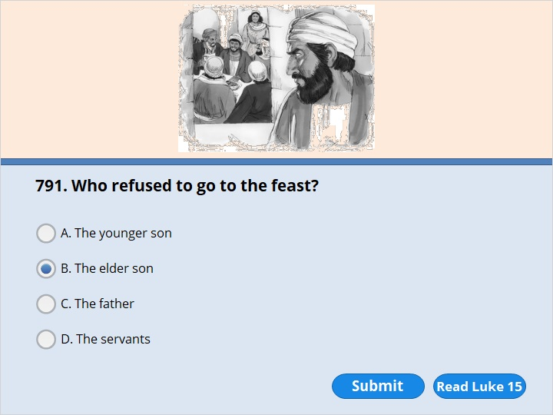
NEXT

Slide 186
NEXT

Slide 187
Luke 15:25
“The older son was in the field. When he came near the house, he heard music and dancing. 26 So he called one of the servants. He asked him what was going on. 27 ‘Your brother has come home,’ the servant replied. ‘Your father has killed the fattest calf. He has done this because your brother is back safe and sound.’ 28 “The older brother became angry. He refused to go in. So his father went out and begged him. 29 But he answered his father, ‘Look! All these years I’ve worked like a slave for you. I have always obeyed your orders. You never gave me even a young goat so I could celebrate with my friends. 30 But this son of yours wasted your money with some prostitutes. Now he comes home. And for him you kill the fattest calf!’

Slide 188
NEXT

Slide 189
NEXT

Slide 190
Luke 16:19
“Once there was a rich man. He was dressed in purple cloth and fine linen. He lived an easy life every day. 20 A man named Lazarus was placed at his gate. Lazarus was a beggar. His body was covered with sores. 21 Even dogs came and licked his sores. All he wanted was to eat what fell from the rich man’s table.

Slide 191
NEXT

Slide 192
NEXT

Slide 193
Luke 16:22
“The time came when the beggar died. The angels carried him to Abraham’s side. The rich man also died and was buried. 23 In the place of the dead, the rich man was suffering terribly. He looked up and saw Abraham far away. Lazarus was by his side. 24 So the rich man called out, ‘Father Abraham! Have pity on me! Send Lazarus to dip the tip of his finger in water. Then he can cool my tongue with it. I am in terrible pain in this fire.’

Slide 194
NEXT

Slide 195
NEXT

Slide 196
Luke 16:22
“The time came when the beggar died. The angels carried him to Abraham’s side. The rich man also died and was buried. 23 In the place of the dead, the rich man was suffering terribly. He looked up and saw Abraham far away. Lazarus was by his side. 24 So the rich man called out, ‘Father Abraham! Have pity on me! Send Lazarus to dip the tip of his finger in water. Then he can cool my tongue with it. I am in terrible pain in this fire.’

Slide 197
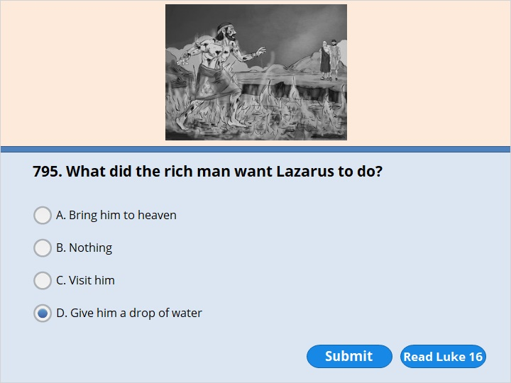
NEXT

Slide 198
NEXT

Slide 199
Luke 16:24
So the rich man called out, ‘Father Abraham! Have pity on me! Send Lazarus to dip the tip of his finger in water. Then he can cool my tongue with it. I am in terrible pain in this fire.’

Slide 200
NEXT

Slide 201
NEXT

Slide 202
Luke 16:27
“The rich man answered, ‘Then I beg you, father Abraham. Send Lazarus to my family. 28 I have five brothers. Let Lazarus warn them. Then they will not come to this place of terrible suffering.’

Slide 203
NEXT

Slide 204
NEXT

Slide 205
Luke 17:11
Jesus was on his way to Jerusalem. He traveled along the border between Samaria and Galilee. 12 As he was going into a village, ten men met him. They had a skin disease. They were standing close by. 13 And they called out in a loud voice, “Jesus! Master! Have pity on us!” 14 Jesus saw them and said, “Go. Show yourselves to the priests.” While they were on the way, they were healed.

Slide 206
NEXT

Slide 207
NEXT

Slide 208
Luke 17:15
When one of them saw that he was healed, he came back. He praised God in a loud voice. 16 He threw himself at Jesus’ feet and thanked him. The man was a Samaritan.

Slide 209
NEXT

Slide 210
NEXT

Slide 211
Luke 17:15
When one of them saw that he was healed, he came back. He praised God in a loud voice. 16 He threw himself at Jesus’ feet and thanked him. The man was a Samaritan.

Slide 212
NEXT

Slide 213
NEXT

Slide 214
Luke 17:32
Remember Lot’s wife! 33 Whoever tries to keep their life will lose it. Whoever loses their life will keep it. 34 I tell you, on that night two people will be in one bed. One person will be taken and the other left. 35-36 Two women will be grinding grain together. One will be taken and the other left.”

Slide 215
NEXT

Slide 216
NEXT

Slide 217
John 11:1
A man named Lazarus was sick. He was from Bethany, the village where Mary and her sister Martha lived.

Slide 218
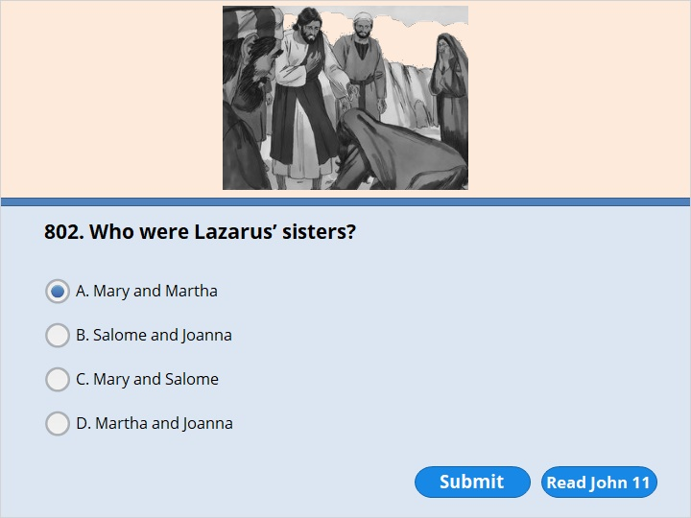
NEXT

Slide 219
NEXT

Slide 220
John 11:1
A man named Lazarus was sick. He was from Bethany, the village where Mary and her sister Martha lived.

Slide 221
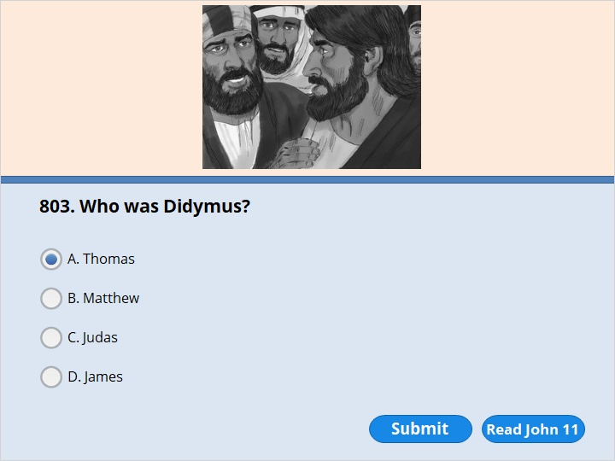
NEXT

Slide 222
NEXT

Slide 223
John 11:16
Then Thomas, who was also called Didymus, spoke to the rest of the disciples. “Let us go also,” he said. “Then we can die with Jesus.”

Slide 224
NEXT

Slide 225
NEXT

Slide 226
John 11:39
“Take away the stone,” he said. “But, Lord,” said Martha, the sister of the dead man, “by this time there is a bad smell. Lazarus has been in the tomb for four days.”

Slide 227
NEXT

Slide 228
NEXT

Slide 229
Mark 10:13
People were bringing little children to Jesus. They wanted him to place his hands on them to bless them. But the disciples told them to stop.

Slide 230
NEXT

Slide 231
NEXT

Slide 232
Mark 10:24
The disciples were amazed at his words. But Jesus said again, “Children, how hard it is to enter God’s kingdom! 25 Is it hard for a camel to go through the eye of a needle? It is even harder for someone who is rich to enter God’s kingdom!”

Slide 233
NEXT

Slide 234
NEXT

Slide 235
Mark 10:46
Jesus and his disciples came to Jericho. They were leaving the city. A large crowd was with them. A blind man was sitting by the side of the road begging. His name was Bartimaeus. Bartimaeus means Son of Timaeus.

Slide 236
NEXT

Slide 237
NEXT

Slide 238
Luke 18:16
But Jesus asked the children to come to him. “Let the little children come to me,” he said. “Don’t keep them away. God’s kingdom belongs to people like them. 17 What I’m about to tell you is true. Anyone who will not receive God’s kingdom like a little child will never enter it.”

Slide 239
NEXT

Slide 240
NEXT

Slide 241
Luke 18:18
A certain ruler asked Jesus a question. “Good teacher,” he said, “what must I do to receive eternal life?” 19 “Why do you call me good?” Jesus answered. “No one is good except God. 20 You know what the commandments say. ‘Do not commit adultery. Do not commit murder. Do not steal. Do not be a false witness. Honor your father and mother.’ ” (Exodus 20:12–16 ; Deuteronomy 5:16–20)
21 “I have obeyed all those commandments since I was a boy,” the ruler said. 22 When Jesus heard this, he said to him, “You are still missing one thing. Sell everything you have. Give the money to those who are poor. You will have treasure in heaven. Then come and follow me.” 23 When the ruler heard this, he became very sad. He was very rich.

Slide 242
NEXT

Slide 243
NEXT

Slide 244
Luke 19:1
Jesus entered Jericho and was passing through. 2 A man named Zacchaeus lived there. He was a chief tax collector and was very rich. 3 Zacchaeus wanted to see who Jesus was. But he was a short man. He could not see Jesus because of the crowd. 4 So he ran ahead and climbed a sycamore-fig tree. He wanted to see Jesus, who was coming that way.

Slide 245
NEXT

Slide 246
NEXT

Slide 247
Luke 19:2
A man named Zacchaeus lived there. He was a chief tax collector and was very rich. 3 Zacchaeus wanted to see who Jesus was. But he was a short man. He could not see Jesus because of the crowd. 4 So he ran ahead and climbed a sycamore-fig tree. He wanted to see Jesus, who was coming that way.

Slide 248
NEXT

Slide 249
NEXT

Slide 250
Luke 19:3
Zacchaeus wanted to see who Jesus was. But he was a short man. He could not see Jesus because of the crowd. 4 So he ran ahead and climbed a sycamore-fig tree. He wanted to see Jesus, who was coming that way.

Slide 251
NEXT

Slide 252
NEXT

Slide 253
Luke 19:4
So he ran ahead and climbed a sycamore-fig tree. He wanted to see Jesus, who was coming that way.

Slide 254
NEXT

Slide 255
NEXT

Slide 256
Luke 19:5
Jesus reached the spot where Zacchaeus was. He looked up and said, “Zacchaeus, come down at once. I must stay at your house today.” 6 So Zacchaeus came down at once and welcomed him gladly.

Slide 257
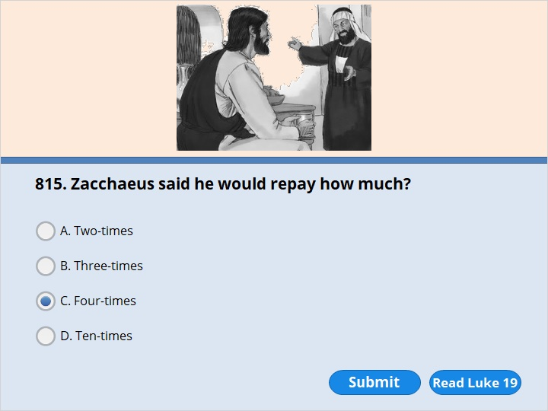
NEXT

Slide 258
NEXT

Slide 259
Luke 19:8
But Zacchaeus stood up. He said, “Look, Lord! Here and now I give half of what I own to those who are poor. And if I have cheated anybody out of anything, I will pay it back. I will pay back four times the amount I took.”

Slide 260
NEXT

Slide 261
NEXT

Slide 262
Luke 19:40
“I tell you,” he replied, “if they keep quiet, the stones will cry out.”

Slide 263
NEXT

Slide 264
NEXT

Slide 265
John 12:3
Then Mary took about a pint of pure nard. It was an expensive perfume. She poured it on Jesus’ feet and wiped them with her hair. The house was filled with the sweet smell of the perfume.

Slide 266
NEXT

Slide 267
NEXT

Slide 268
John 12:4
But Judas Iscariot didn’t like what Mary did. He was one of Jesus’ disciples. Later he was going to hand Jesus over to his enemies. Judas said, 5 “Why wasn’t this perfume sold? Why wasn’t the money given to poor people? It was worth a year’s pay.”

Slide 269
NEXT

Slide 270
NEXT

Slide 271
John 12:13
So they took branches from palm trees and went out to meet him. They shouted,
“Hosanna! ” “Blessed is the one who comes in the name of the Lord!” (Psalm 118:25,26) “Blessed is the king of Israel!”

Slide 272
NEXT

Slide 273
NEXT

Slide 274
Matthew 21:1
As they all approached Jerusalem, they came to Bethphage. It was on the Mount of Olives. Jesus sent out two disciples. 2 He said to them, “Go to the village ahead of you. As soon as you get there, you will find a donkey tied up. Her colt will be with her. Untie them and bring them to me. 3 If anyone says anything to you, say that the Lord needs them. The owner will send them right away.”

Slide 275
NEXT

Slide 276
NEXT

Slide 277
Matthew 21:13
He said to them, “It is written that the Lord said, ‘My house will be called a house where people can pray.’ (Isaiah 56:7) But you are making it ‘a den for robbers.’ ” (Jeremiah 7:11)

Slide 278
NEXT

Slide 279
NEXT

Slide 280
Zechariah 9:9
“City of Zion, be full of joy! People of Jerusalem, shout! See, your king comes to you. He always does what is right. He has won the victory. He is humble and riding on a donkey. He is sitting on a donkey’s colt.

Slide 281
NEXT

Slide 282
NEXT

Slide 283
Mark 11:15
When Jesus reached Jerusalem, he entered the temple courtyard. He began to drive out those who were buying and selling there. He turned over the tables of the people who were exchanging money. He also turned over the benches of those who were selling doves.

Slide 284
NEXT

Slide 285
NEXT

Slide 286
Mark 11:13
Not too far away, he saw a fig tree. It was covered with leaves. He went to find out if it had any fruit. When he reached it, he found nothing but leaves. It was not the season for figs. 14 Then Jesus said to the tree, “May no one ever eat fruit from you again!” And his disciples heard him say it.

Slide 287
NEXT

Slide 288
NEXT

Slide 289
Matthew 22:21
“Caesar’s,” they replied. Then he said to them, “So give back to Caesar what belongs to Caesar. And give back to God what belongs to God.” 22 When they heard this, they were amazed. So they left him and went away.

Slide 290
NEXT

Slide 291
NEXT

Slide 292
Mark 12:30
Love the Lord your God with all your heart and with all your soul. Love him with all your mind and with all your strength.’ (Deuteronomy 6:4,5)

Slide 293
NEXT

Slide 294
NEXT

Slide 295
Mark 12:31
And here is the second one. ‘Love your neighbor as you love yourself.’

Slide 296
NEXT

Slide 297
NEXT

Slide 298
Matthew 24:37
Remember how it was in the days of Noah. It will be the same when the Son of Man comes.

Slide 299
NEXT

Slide 300
NEXT

Slide 301
Luke 21:1
As Jesus looked up, he saw rich people putting their gifts into the temple offering boxes. 2 He also saw a poor widow put in two very small copper coins. 3 “What I’m about to tell you is true,” Jesus said. “That poor widow has put in more than all the others. 4 All these other people gave a lot because they are rich. But even though she is poor, she put in everything. She had nothing left to live on.”

Slide 302
NEXT

Slide 303
NEXT

Slide 304
Luke 21:24
Some will be killed by the sword. Others will be taken as prisoners to all the nations. Jerusalem will be taken over by Gentiles until the times of the Gentiles come to an end.

Slide 305
NEXT

Slide 306
NEXT

Slide 307
Luke 21:33
Heaven and earth will pass away. But my words will never pass away.

Slide 308
NEXT

Slide 309
NEXT

Slide 310
Mark 14:3
Jesus was in Bethany. He was at the table in the home of Simon, who had a skin disease. A woman came with a special sealed jar. It contained very expensive perfume made out of pure nard. She broke the jar open and poured the perfume on Jesus’ head.

Slide 312
Our goal is not only for you to be able to study God’s Word, but also give you a way to teach and share with other people.
We pray God will bless your time in His Word!
WWW.Mark732.org
For more information and for further training: Contact
Rev. Dr. John Reinke
At RevReinke@gmail.com
or 608-436-9600 (voice/text)
Material Copyright ©Mark732
Bible Verses are from the New International Readers Version - NIrV
Pictures: Copyright © Language Recordings Inc (Australia). Used by permission
Material Copyright ©Mark732

