Slide 1
Our goal is not only for you to be able to study God’s Word, but also give you a way to teach and share with other people.
We pray God will bless your time in His Word!
WWW.Mark732.org
For more information and for further training: Contact
Rev. Dr. John Reinke
At RevReinke@gmail.com
or 608-436-9600 (voice/text)
Material Copyright ©Mark732
Bible Verses are from the New International Readers Version - NIrV
Pictures: Copyright © Language Recordings Inc (Australia). Used by permission
Material Copyright ©Mark732

Slide 3
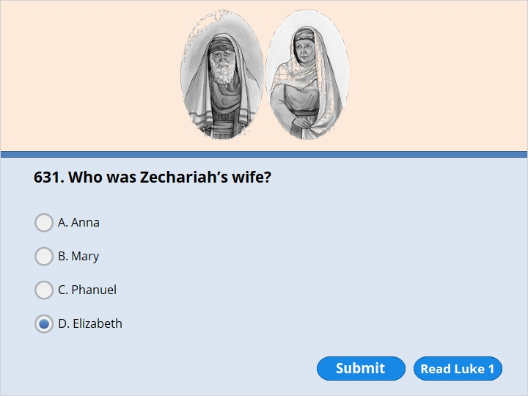
NEXT

Slide 4
NEXT

Slide 5
Luke 1:5
Herod was king of Judea. During the time he was ruling, there was a priest named Zechariah. He belonged to a group of priests named after Abijah. His wife Elizabeth also came from the family line of Aaron.

Slide 6
NEXT

Slide 7
NEXT

Slide 8
Luke 1:13
But the angel said to him, “Do not be afraid, Zechariah. Your prayer has been heard. Your wife Elizabeth will have a child. It will be a boy, and you must call him John. 14 He will be a joy and delight to you. His birth will make many people very glad. 15 He will be important in the sight of the Lord. He must never drink wine or other such drinks. He will be filled with the Holy Spirit even before he is born. 16 He will bring back many of the people of Israel to the Lord their God. 17 And he will prepare the way for the Lord. He will have the same spirit and power that Elijah had. He will bring peace between parents and their children. He will teach people who don’t obey to be wise and do what is right. In this way, he will prepare a people who are ready for the Lord.”

Slide 9
NEXT

Slide 10
NEXT

Slide 11
Luke 1:19
The angel said to him, “I am Gabriel. I serve God. I have been sent to speak to you and to tell you this good news. 20 And now you will have to be silent. You will not be able to speak until after John is born. That’s because you did not believe my words. They will come true at the time God has chosen.”

Slide 12
NEXT

Slide 13
NEXT

Slide 14
Luke 1:19
The angel said to him, “I am Gabriel. I serve God. I have been sent to speak to you and to tell you this good news. 20 And now you will have to be silent. You will not be able to speak until after John is born. That’s because you did not believe my words. They will come true at the time God has chosen.”

Slide 15
NEXT

Slide 16
NEXT

Slide 17
Luke 1:59
On the eighth day, they came to have the child circumcised. They were going to name him Zechariah, like his father. 60 But his mother spoke up. “No!” she said. “He must be called John.”

Slide 18
NEXT

Slide 19
NEXT

Slide 20
Luke 1:26
In the sixth month after Elizabeth had become pregnant, God sent the angel Gabriel to Nazareth, a town in Galilee. 27 He was sent to a virgin. The girl was engaged to a man named Joseph. He came from the family line of David. The virgin’s name was Mary. 28 The angel greeted her and said, “The Lord has blessed you in a special way. He is with you.”

Slide 21
NEXT

Slide 22
NEXT

Slide 23
Luke 1:36
Your relative Elizabeth will have a child even though she is old. People thought she could not have children. But she has been pregnant for six months now.

Slide 24
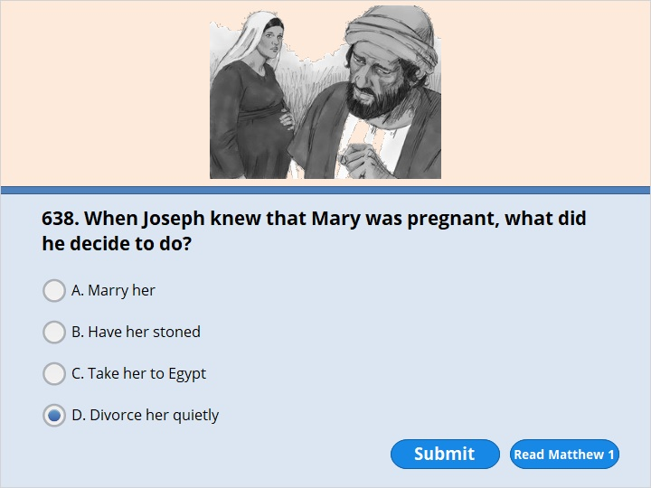
NEXT

Slide 25
NEXT

Slide 26
Matthew 1:18
This is how the birth of Jesus the Messiah came about. His mother Mary and Joseph had promised to get married. But before they started to live together, it became clear that she was going to have a baby. She became pregnant by the power of the Holy Spirit. 19 Her husband Joseph was faithful to the law. But he did not want to put her to shame in public. So he planned to divorce her quietly.

Slide 27
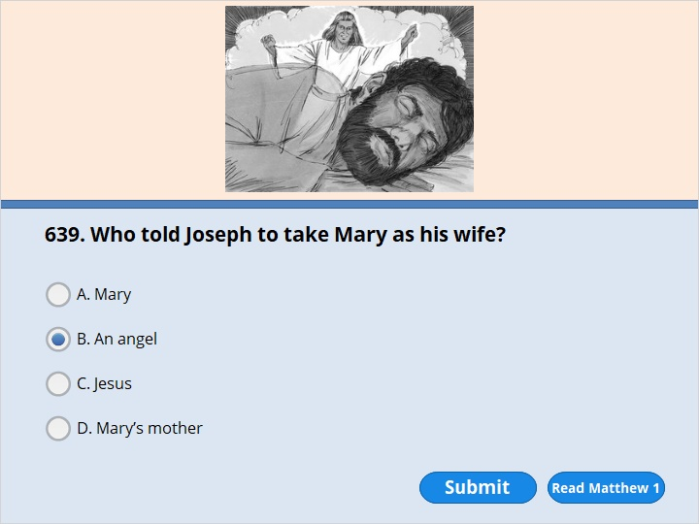
NEXT

Slide 28
NEXT

Slide 29
Matthew 1:20
But as Joseph was thinking about this, an angel of the Lord appeared to him in a dream. The angel said, “Joseph, son of David, don’t be afraid to take Mary home as your wife. The baby inside her is from the Holy Spirit. 21 She is going to have a son. You must give him the name Jesus. That’s because he will save his people from their sins.”

Slide 30
NEXT

Slide 31
NEXT

Slide 32
Matthew 1:22
All this took place to bring about what the Lord had said would happen. He had said through the prophet, 23 “The virgin is going to have a baby. She will give birth to a son. And he will be called Immanuel.” (Isaiah 7:14) The name Immanuel means “God with us.”

Slide 33
NEXT

Slide 34
NEXT

Slide 35
Luke 2:4
So Joseph went also. He went from the town of Nazareth in Galilee to Judea. That is where Bethlehem, the town of David, was. Joseph went there because he belonged to the family line of David.

Slide 36
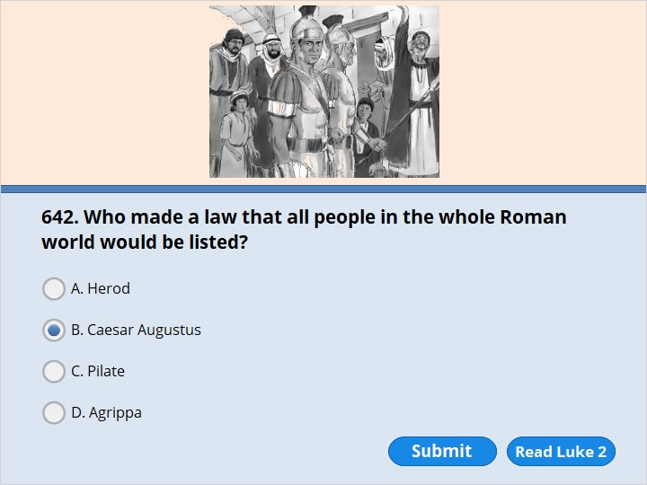
NEXT

Slide 37
NEXT

Slide 38
Luke 2:1
In those days, Caesar Augustus made a law. It required that a list be made of everyone in the whole Roman world. 2 It was the first time a list was made of the people while Quirinius was governor of Syria. 3 Everyone went to their own town to be listed.

Slide 39
NEXT

Slide 40
NEXT

Slide 41
Luke 2:1
In those days, Caesar Augustus made a law. It required that a list be made of everyone in the whole Roman world. 2 It was the first time a list was made of the people while Quirinius was governor of Syria. 3 Everyone went to their own town to be listed.

Slide 42
NEXT

Slide 43
NEXT

Slide 44
Luke 2:4
So Joseph went also. He went from the town of Nazareth in Galilee to Judea. That is where Bethlehem, the town of David, was. Joseph went there because he belonged to the family line of David.

Slide 45
NEXT

Slide 46
NEXT

Slide 47
Luke 2:4
So Joseph went also. He went from the town of Nazareth in Galilee to Judea. That is where Bethlehem, the town of David, was. Joseph went there because he belonged to the family line of David.

Slide 48
NEXT

Slide 49
NEXT

Slide 50
Luke 2:4
So Joseph went also. He went from the town of Nazareth in Galilee to Judea. That is where Bethlehem, the town of David, was. Joseph went there because he belonged to the family line of David.

Slide 51
NEXT

Slide 52
NEXT

Slide 53
Luke 2:16
So they hurried off and found Mary and Joseph and the baby. The baby was lying in the manger.

Slide 54
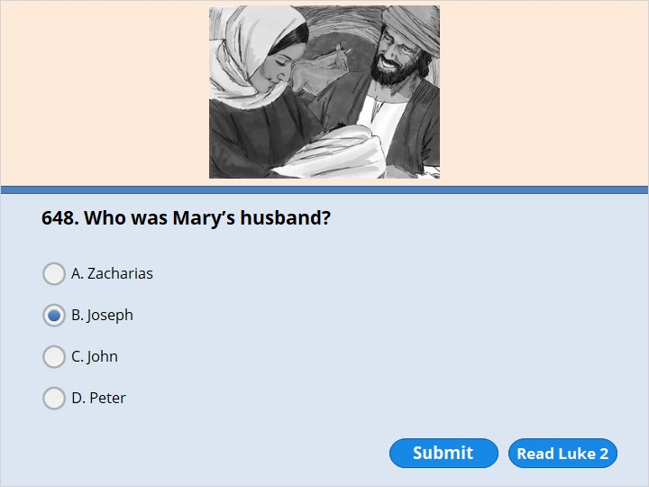
NEXT

Slide 55
NEXT

Slide 56
Luke 2:4
So Joseph went also. He went from the town of Nazareth in Galilee to Judea. That is where Bethlehem, the town of David, was. Joseph went there because he belonged to the family line of David. 5 He went there with Mary to be listed. Mary was engaged to him. She was expecting a baby.

Slide 57
NEXT

Slide 58
NEXT

Slide 59
Luke 2:7
She gave birth to her first baby. It was a boy. She wrapped him in large strips of cloth. Then she placed him in a manger. That’s because there was no guest room where they could stay.

Slide 60
NEXT

Slide 61
NEXT

Slide 62
Luke 2:8
There were shepherds living out in the fields nearby. It was night, and they were taking care of their sheep. 9 An angel of the Lord appeared to them. And the glory of the Lord shone around them. They were terrified. 10 But the angel said to them, “Do not be afraid. I bring you good news. It will bring great joy for all the people. 11 Today in the town of David a Savior has been born to you. He is the Messiah, the Lord. 12 Here is how you will know I am telling you the truth. You will find a baby wrapped in strips of cloth and lying in a manger.”

Slide 63
NEXT

Slide 64
NEXT

Slide 65
Luke 2:13
Suddenly a large group of angels from heaven also appeared. They were praising God. They said, 14 “May glory be given to God in the highest heaven! And may peace be given to those he is pleased with on earth!”

Slide 66
NEXT

Slide 67
NEXT

Slide 68
Luke 2:15
The angels left and went into heaven. Then the shepherds said to one another, “Let’s go to Bethlehem. Let’s see this thing that has happened, which the Lord has told us about.”

Slide 69
NEXT

Slide 70
NEXT

Slide 71
Luke 2:21
When the child was eight days old, he was circumcised. At the same time he was named Jesus. This was the name the angel had given him before his mother became pregnant.

Slide 72
NEXT

Slide 73
NEXT

Slide 74
Luke 2:25
In Jerusalem there was a man named Simeon. He was a good and godly man. He was waiting for God’s promise to Israel to come true. The Holy Spirit was with him. 26 The Spirit had told Simeon that he would not die before he had seen the Lord’s Messiah.

Slide 75
NEXT

Slide 76
NEXT

Slide 77
Luke 2:36
There was also a prophet named Anna. She was the daughter of Penuel from the tribe of Asher. Anna was very old. After getting married, she lived with her husband seven years. 37 Then she was a widow until she was 84. She never left the temple. She worshiped night and day, praying and going without food.

Slide 78
NEXT

Slide 79
NEXT

Slide 80
Luke 2:41
Every year Jesus’ parents went to Jerusalem for the Passover Feast. 42 When Jesus was 12 years old, they went up to the feast as usual. 43 After the feast was over, his parents left to go back home. The boy Jesus stayed behind in Jerusalem. But they were not aware of it.

Slide 81
NEXT

Slide 82
NEXT

Slide 83
Luke 2:46
After three days they found him in the temple courtyard. He was sitting with the teachers. He was listening to them and asking them questions.

Slide 84
NEXT

Slide 85
NEXT

Slide 86
Luke 2:48
When his parents saw him, they were amazed. His mother said to him, “Son, why have you treated us like this? Your father and I have been worried about you. We have been looking for you everywhere.” 49 “Why were you looking for me?” he asked. “Didn’t you know I had to be in my Father’s house?” 50 But they did not understand what he meant by that.

Slide 87
NEXT

Slide 88
NEXT

Slide 89
Matthew 2:1
Jesus was born in Bethlehem in Judea. This happened while Herod was king of Judea. After Jesus’ birth, Wise Men from the east came to Jerusalem. 2 They asked, “Where is the child who has been born to be king of the Jews? We saw his star when it rose. Now we have come to worship him.”

Slide 90
NEXT

Slide 91
NEXT

Slide 92
Matthew 2:1
Jesus was born in Bethlehem in Judea. This happened while Herod was king of Judea. After Jesus’ birth, Wise Men from the east came to Jerusalem. 2 They asked, “Where is the child who has been born to be king of the Jews? We saw his star when it rose. Now we have come to worship him.”

Slide 93
NEXT

Slide 94
NEXT

Slide 95
Matthew 2:1
Jesus was born in Bethlehem in Judea. This happened while Herod was king of Judea. After Jesus’ birth, Wise Men from the east came to Jerusalem. 2 They asked, “Where is the child who has been born to be king of the Jews? We saw his star when it rose. Now we have come to worship him.”

Slide 96
NEXT

Slide 97
NEXT

Slide 98
Matthew 2:11
The Wise Men went to the house. There they saw the child with his mother Mary. They bowed down and worshiped him. Then they opened their treasures. They gave him gold, frankincense and myrrh.

Slide 99
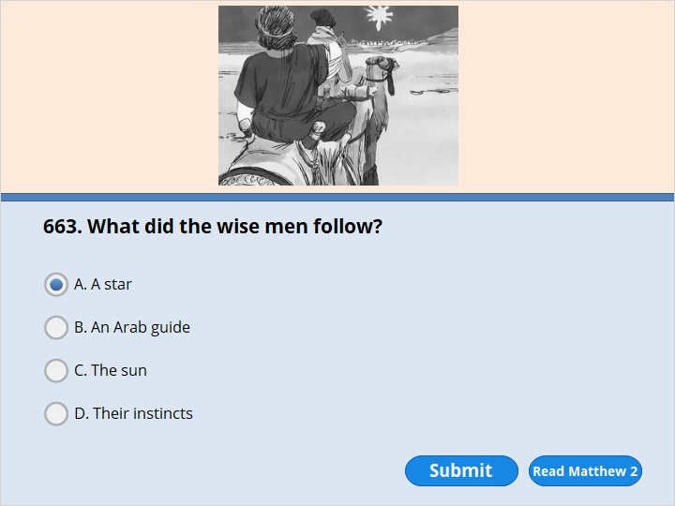
NEXT

Slide 100
NEXT

Slide 101
Matthew 2:1
Jesus was born in Bethlehem in Judea. This happened while Herod was king of Judea. After Jesus’ birth, Wise Men from the east came to Jerusalem. 2 They asked, “Where is the child who has been born to be king of the Jews? We saw his star when it rose. Now we have come to worship him.”

Slide 102
NEXT

Slide 103
NEXT

Slide 104
Matthew 2:6
“ ‘But you, Bethlehem, in the land of Judah,
are certainly not the least important among the towns of Judah.
A ruler will come out of you.
He will rule my people Israel like a shepherd.’ ” (Micah 5:2)

Slide 105
NEXT

Slide 106
NEXT

Slide 107
Matthew 2:1
Jesus was born in Bethlehem in Judea. This happened while Herod was king of Judea. After Jesus’ birth, Wise Men from the east came to Jerusalem. 2 They asked, “Where is the child who has been born to be king of the Jews? We saw his star when it rose. Now we have come to worship him.”

Slide 108
NEXT

Slide 109
NEXT

Slide 110
Matthew 2:7
Then Herod secretly called for the Wise Men. He found out from them exactly when the star had appeared. 8 He sent them to Bethlehem. He said, “Go and search carefully for the child. As soon as you find him, report it to me. Then I can go and worship him too.”

Slide 111
NEXT

Slide 112
NEXT

Slide 113
Matthew 2:11
The Wise Men went to the house. There they saw the child with his mother Mary. They bowed down and worshiped him. Then they opened their treasures. They gave him gold, frankincense and myrrh.

Slide 114
NEXT

Slide 115
NEXT

Slide 116
Matthew 2:12
But God warned them in a dream not to go back to Herod. So they returned to their country on a different road.

Slide 117
NEXT

Slide 118
NEXT

Slide 119
Matthew 2:13
When the Wise Men had left, Joseph had a dream. In the dream an angel of the Lord appeared to Joseph. “Get up!” the angel said. “Take the child and his mother and escape to Egypt. Stay there until I tell you to come back. Herod is going to search for the child. He wants to kill him.”

Slide 120
NEXT

Slide 121
NEXT

Slide 122
Matthew 2:16
Herod realized that the Wise Men had tricked him. So he became very angry. He gave orders about Bethlehem and the area around it. He ordered all the boys two years old and under to be killed. This agreed with the time when the Wise Men had seen the star.

Slide 123
NEXT

Slide 124
NEXT

Slide 125
Matthew 2:19
After Herod died, Joseph had a dream while he was still in Egypt. In the dream an angel of the Lord appeared to him. 20 The angel said, “Get up! Take the child and his mother. Go to the land of Israel. The people who were trying to kill the child are dead.”

Slide 126
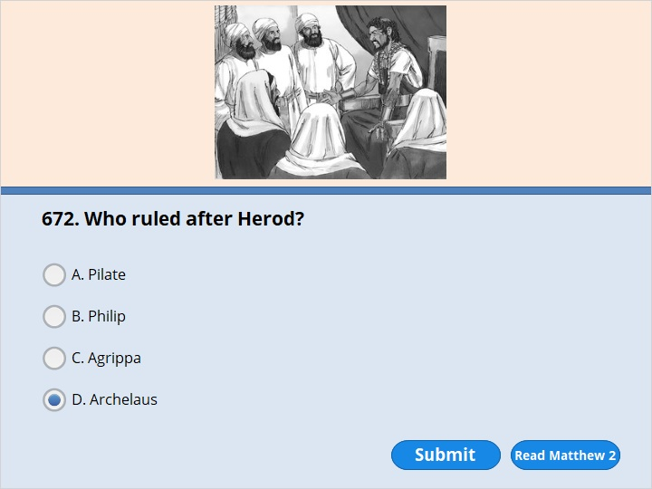
NEXT

Slide 127
NEXT

Slide 128
Matthew 2:22
But then he heard that Archelaus was king of Judea. Archelaus was ruling in place of his father Herod. This made Joseph afraid to go there. Joseph had been warned in a dream. So he went back to the land of Galilee instead.

Slide 129
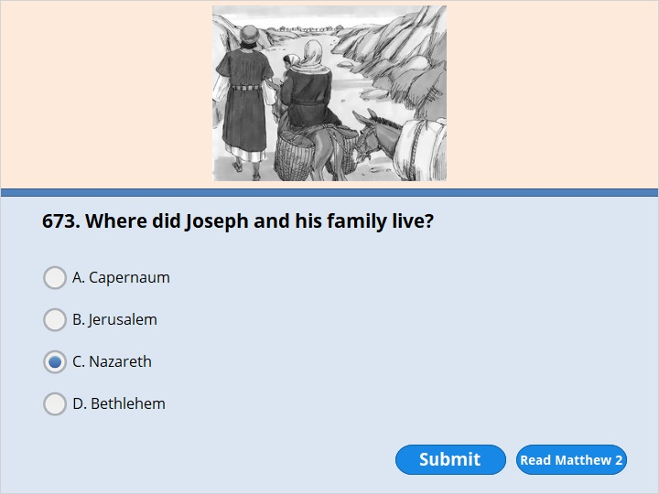
NEXT

Slide 130
NEXT

Slide 131
Matthew 2:22
But then he heard that Archelaus was king of Judea. Archelaus was ruling in place of his father Herod. This made Joseph afraid to go there. Joseph had been warned in a dream. So he went back to the land of Galilee instead. 23 There he lived in a town called Nazareth. So what the prophets had said about Jesus came true. They had said that he would be called a Nazarene.

Slide 132
NEXT

Slide 133
NEXT

Slide 134
Luke 3:2
Annas and Caiaphas were high priests. At that time God’s word came to John, son of Zechariah, in the desert. 3 He went into all the countryside around the Jordan River. There he preached that people should be baptized and turn away from their sins. Then God would forgive them. 4 Here is what is written in the book of Isaiah the prophet. It says, (continue )

Slide 135
“A messenger is calling out in the desert,
‘Prepare the way for the Lord.
Make straight paths for him.
5 Every valley will be filled in.
Every mountain and hill will be made level.
The crooked roads will become straight.
The rough ways will become smooth.
6 And all people will see God’s salvation.’ ” (Isaiah 40:3–5)

Slide 136
NEXT

Slide 137
NEXT

Slide 138
Luke 3:23 Jesus was about 30 years old when he began his special work for God and others. It was thought that he was the son of Joseph. Joseph was the son of Heli.

Slide 139
NEXT

Slide 140
NEXT

Slide 141
Matthew 3:7
John saw many Pharisees and Sadducees coming to where he was baptizing. He said to them, “You are like a nest of poisonous snakes! Who warned you to escape the coming of God’s anger? 8 Live in a way that shows you have turned away from your sins. 9 Don’t think you can say to yourselves, ‘Abraham is our father.’ I tell you, God can raise up children for Abraham even from these stones. 10 The ax is ready to cut the roots of the trees. All the trees that don’t produce good fruit will be cut down. They will be thrown into the fire.

Slide 142
NEXT

Slide 143
NEXT

Slide 144
Matthew 3:11
“I baptize you with water, calling you to turn away from your sins. But after me, someone is coming who is more powerful than I am. I’m not worthy to carry his sandals. He will baptize you with the Holy Spirit and fire.

Slide 145
NEXT

Slide 146
NEXT

Slide 147
Matthew 3:13
Jesus came from Galilee to the Jordan River. He wanted to be baptized by John.

Slide 148
NEXT

Slide 149
NEXT

Slide 150
Matthew 3:16
As soon as Jesus was baptized, he came up out of the water. At that moment heaven was opened. Jesus saw the Spirit of God coming down on him like a dove. 17 A voice from heaven said, “This is my Son, and I love him. I am very pleased with him.”

Slide 151
NEXT

Slide 152
NEXT

Slide 153
Matthew 4:2
After 40 days and 40 nights of going without eating, Jesus was hungry.

Slide 154
NEXT

Slide 155
NEXT

Slide 156
Matthew 4:3
The tempter came to him. He said, “If you are the Son of God, tell these stones to become bread.”
4 Jesus answered, “It is written, ‘Man must not live only on bread. He must also live on every word that comes from the mouth of God.’ ” (Deuteronomy 8:3)

Slide 157
NEXT

Slide 158
NEXT

Slide 159
Matthew 4:5
Then the devil took Jesus to the holy city. He had him stand on the highest point of the temple. 6 “If you are the Son of God,” he said, “throw yourself down. It is written,
“ ‘The Lord will command his angels to take good care of you. They will lift you up in their hands. Then you won’t trip over a stone.’ ” (Psalm 91:11,12)
7 Jesus answered him, “It is also written, ‘Do not test the Lord your God.’ ” (Deuteronomy 6:16)

Slide 160
NEXT

Slide 161
NEXT

Slide 162
Matthew 4:8
Finally, the devil took Jesus to a very high mountain. He showed him all the kingdoms of the world and their glory. 9 “If you bow down and worship me,” he said, “I will give you all this.”
10 Jesus said to him, “Get away from me, Satan! It is written, ‘Worship the Lord your God. He is the only one you should serve.’ ” (Deuteronomy 6:13)

Slide 163
NEXT

Slide 164
NEXT

Slide 165
Matthew 4:4 Jesus answered, “It is written, ‘Man must not live only on bread. He must also live on every word that comes from the mouth of God.’ ” (Deuteronomy 8:3)
Matthew 4:7 Jesus answered him, “It is also written, ‘Do not test the Lord your God.’ ” (Deuteronomy 6:16)
Matthew 4:10 Jesus said to him, “Get away from me, Satan! It is written, ‘Worship the Lord your God. He is the only one you should serve.’ ” (Deuteronomy 6:13)

Slide 166
NEXT

Slide 167
NEXT

Slide 168
Matthew 4:18
One day Jesus was walking beside the Sea of Galilee. There he saw two brothers, Simon Peter and his brother Andrew. They were throwing a net into the lake, because they were fishermen. 19 “Come and follow me,” Jesus said. “I will send you out to fish for people.” 20 At once they left their nets and followed him.

Slide 169
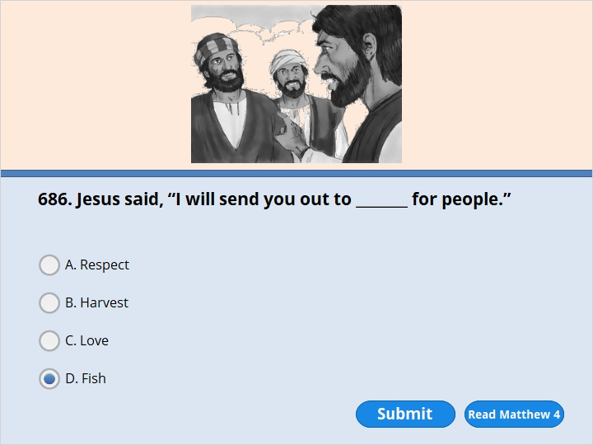
NEXT

Slide 170
NEXT

Slide 171
Matthew 4:19
“Come and follow me,” Jesus said. “I will send you out to fish for people.” 20 At once they left their nets and followed him.

Slide 172
NEXT

Slide 173
NEXT

Slide 174
Matthew 4:21
Going on from there, he saw two other brothers. They were James, son of Zebedee, and his brother John. They were in a boat with their father Zebedee. As they were preparing their nets, Jesus called out to them. 22 Right away they left the boat and their father and followed Jesus.

Slide 175
NEXT

Slide 176
NEXT

Slide 177
Matthew 4:21
Going on from there, he saw two other brothers. They were James, son of Zebedee, and his brother John. They were in a boat with their father Zebedee. As they were preparing their nets, Jesus called out to them. 22 Right away they left the boat and their father and followed Jesus.

Slide 178
NEXT

Slide 179
NEXT

Slide 180
John 1:29
The next day John saw Jesus coming toward him. John said, “Look! The Lamb of God! He takes away the sin of the world! 30 This is the one I was talking about. I said, ‘A man who comes after me is more important than I am. That’s because he existed before I was born.’ 31 I did not know him. But God wants to make it clear to Israel who this person is. That’s the reason I came baptizing with water.”

Slide 181
NEXT

Slide 182
NEXT

Slide 183
John 1:40
Andrew was Simon Peter’s brother. Andrew was one of the two disciples who heard what John had said. He had also followed Jesus.

Slide 184
NEXT

Slide 185
NEXT

Slide 186
John 1:40
Andrew was Simon Peter’s brother. Andrew was one of the two disciples who heard what John had said. He had also followed Jesus.

Slide 187
NEXT

Slide 188
NEXT

Slide 189
John 1:41
The first thing Andrew did was to find his brother Simon. He told him, “We have found the Messiah.” Messiah means Christ.

Slide 190
NEXT

Slide 191
NEXT

Slide 192
John 1:42
And he brought Simon to Jesus. Jesus looked at him and said, “You are Simon, son of John. You will be called Cephas.” Cephas means Peter, or Rock.

Slide 193
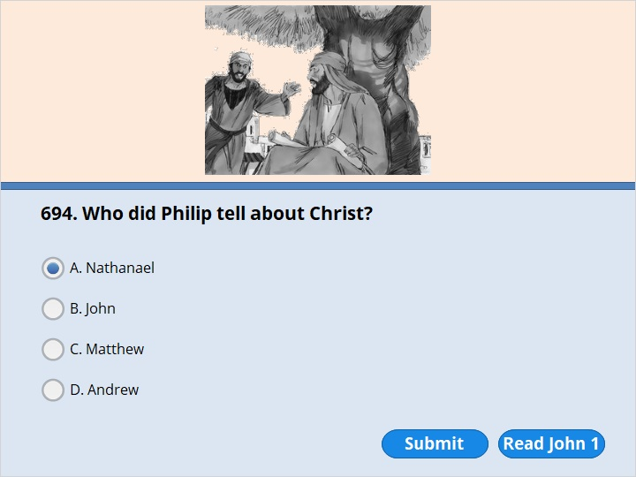
NEXT

Slide 194
NEXT

Slide 195
John 1:45
Philip found Nathanael and told him, “We have found the one whom Moses wrote about in the Law. The prophets also wrote about him. He is Jesus of Nazareth, the son of Joseph.”

Slide 196
NEXT

Slide 197
NEXT

Slide 198
John 2:11
What Jesus did here in Cana in Galilee was the first of his signs. Jesus showed his glory by doing this sign. And his disciples believed in him.

Slide 199
NEXT

Slide 200
NEXT

Slide 201
John 2:7
Jesus said to the servants, “Fill the jars with water.” So they filled them to the top.
8 Then he told them, “Now dip some out. Take it to the person in charge of the dinner.”
They did what he said. 9 The person in charge tasted the water that had been turned into wine. He didn’t realize where it had come from. But the servants who had brought the water knew. Then the person in charge called the groom to one side.

Slide 202
NEXT

Slide 203
NEXT

Slide 204
John 3:1
There was a Pharisee named Nicodemus. He was one of the Jewish rulers. 2 He came to Jesus at night and said, “Rabbi, we know that you are a teacher who has come from God. We know that God is with you. If he weren’t, you couldn’t do the signs you are doing.”

Slide 205
NEXT

Slide 206
NEXT

Slide 207
John 3:14
Moses lifted up the snake in the desert. In the same way, the Son of Man must also be lifted up.

Slide 208
NEXT

Slide 209
NEXT

Slide 210
John 4:4
Jesus had to go through Samaria. 5 He came to a town in Samaria called Sychar. It was near the piece of land Jacob had given his son Joseph.

Slide 211
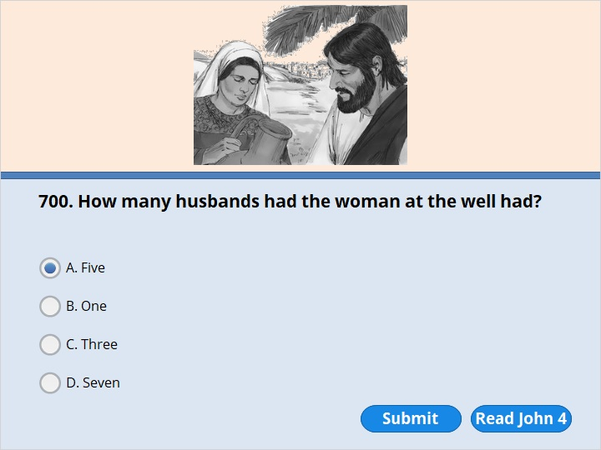
NEXT

Slide 212
NEXT

Slide 213
John 4:17
“I have no husband,” she replied.
Jesus said to her, “You are right when you say you have no husband. 18 The fact is, you have had five husbands. And the man you live with now is not your husband. What you have just said is very true.”

Slide 214
NEXT

Slide 215
NEXT

Slide 216
Luke 5:1
One day Jesus was standing by the Sea of Galilee. The people crowded around him and listened to the word of God. 2 Jesus saw two boats at the edge of the water. They had been left there by the fishermen, who were washing their nets. 3 He got into the boat that belonged to Simon. Jesus asked him to go out a little way from shore. Then he sat down in the boat and taught the people.

Slide 217
NEXT

Slide 218
NEXT

Slide 219
Luke 5:8
When Simon Peter saw this, he fell at Jesus’ knees. “Go away from me, Lord!” he said. “I am a sinful man!” 9 He and everyone with him were amazed at the number of fish they had caught. 10 So were James and John, the sons of Zebedee, who worked with Simon.

Slide 220
NEXT

Slide 221
NEXT

Slide 222
Luke 5:29
Then Levi gave a huge banquet for Jesus at his house. A large crowd of tax collectors and others were eating with them. 30 But the Pharisees and their teachers of the law complained to Jesus’ disciples. They said, “Why do you eat and drink with tax collectors and sinners?”

Slide 223
NEXT

Slide 224
NEXT

Slide 225
Luke 5:27
After this, Jesus left the house. He saw a tax collector sitting at the tax booth. The man’s name was Levi. “Follow me,” Jesus said to him. 28 Levi got up, left everything and followed him.

Slide 226
NEXT

Slide 227
NEXT

Slide 228
Matthew 9:9
As Jesus went on from there, he saw a man named Matthew. He was sitting at the tax collector’s booth. “Follow me,” Jesus told him. Matthew got up and followed him.
Mark 2:14
As he walked along he saw Levi, the son of Alphaeus. Levi was sitting at the tax collector’s booth. “Follow me,” Jesus told him. Levi got up and followed him.

Slide 229
NEXT

Slide 230
NEXT

Slide 231
Mark 2:14
As he walked along he saw Levi, the son of Alphaeus. Levi was sitting at the tax collector’s booth. “Follow me,” Jesus told him. Levi got up and followed him.

Slide 232
NEXT

Slide 233
NEXT

Slide 234
Mark 3:1
Another time Jesus went into the synagogue. A man with a weak and twisted hand was there. 2 Some Pharisees were trying to find fault with Jesus. They watched him closely. They wanted to see if he would heal the man on the Sabbath day. 3 Jesus spoke to the man with the weak and twisted hand. “Stand up in front of everyone,” he said.

Slide 235
NEXT

Slide 236
NEXT

Slide 237
Mark 3:17
There were James, son of Zebedee, and his brother John. Jesus gave them the name Boanerges. Boanerges means Sons of Thunder.

Slide 238
NEXT

Slide 239
NEXT

Slide 240
Mark 3:17
There were James, son of Zebedee, and his brother John. Jesus gave them the name Boanerges. Boanerges means Sons of Thunder.

Slide 241
NEXT

Slide 242
NEXT

Slide 243
Mark 3:14
He appointed 12 of them so that they would be with him. He would also send them out to preach. 15 And he gave them authority to drive out demons. 16 So Jesus appointed the 12 disciples.

Slide 244
NEXT

Slide 245
NEXT

Slide 246
John 5:2
In Jerusalem near the Sheep Gate is a pool. In the Aramaic language it is called Bethesda. It is surrounded by five rows of columns with a roof over them. 3-4 Here a great number of disabled people used to lie down. Among them were those who were blind, those who could not walk, and those who could hardly move. 5 One person was there who had not been able to walk for 38 years. 6 Jesus saw him lying there. He knew that the man had been in that condition for a long time. So he asked him, “Do you want to get well?”
7 “Sir,” the disabled man replied, “I have no one to help me into the pool when an angel stirs up the water. I try to get in, but someone else always goes down ahead of me.”

Slide 247
NEXT

Slide 248
NEXT

Slide 249
John 5:5
ne person was there who had not been able to walk for 38 years. 6 Jesus saw him lying there. He knew that the man had been in that condition for a long time. So he asked him, “Do you want to get well?”

Slide 250
NEXT

Slide 251
NEXT

Slide 252
Matthew 5:3
“Blessed are those who are spiritually needy. The kingdom of heaven belongs to them.

Slide 253
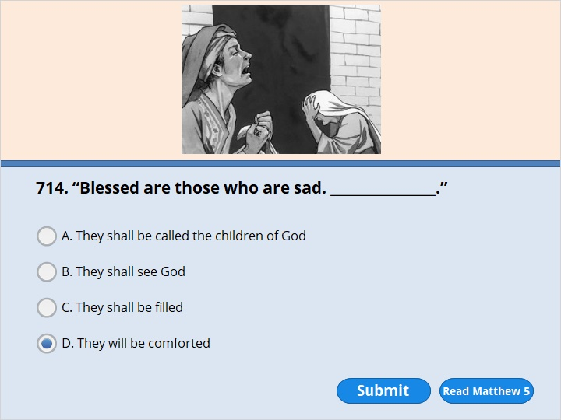
NEXT

Slide 254
NEXT

Slide 255
Matthew 5:4
Blessed are those who are sad. They will be comforted

Slide 256
NEXT

Slide 257
NEXT

Slide 258
Matthew 5:5
Blessed are those who are humble. They will be given the earth.

Slide 259
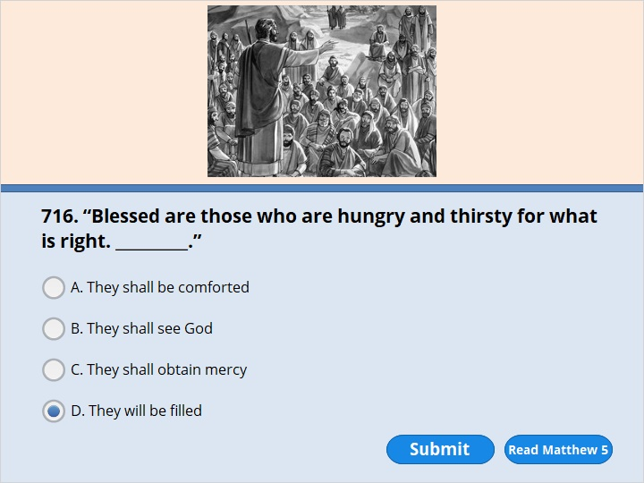
NEXT

Slide 260
NEXT

Slide 261
Matthew 5:6
Blessed are those who are hungry and thirsty for what is right. They will be filled.

Slide 262
NEXT

Slide 263
NEXT

Slide 264
Matthew 5:7
Blessed are those who show mercy. They will be shown mercy.

Slide 265
NEXT

Slide 266
NEXT

Slide 267
Matthew 5:8
Blessed are those whose hearts are pure. They will see God.

Slide 268
NEXT

Slide 269
NEXT

Slide 270
Matthew 5:9
Blessed are those who make peace. They will be called children of God.

Slide 271
NEXT

Slide 272
NEXT

Slide 273
Matthew 5:10
Blessed are those who suffer for doing what is right. The kingdom of heaven belongs to them.

Slide 274
NEXT

Slide 275
NEXT

Slide 276
Matthew 5:11
“Blessed are you when people make fun of you and hurt you because of me. You are also blessed when they tell all kinds of evil lies about you because of me. 12 Be joyful and glad. Your reward in heaven is great. In the same way, people hurt the prophets who lived long ago.

Slide 277
NEXT

Slide 278
NEXT

Slide 279
Matthew 5:13
“You are the salt of the earth. But suppose the salt loses its saltiness. How can it be made salty again? It is no longer good for anything. It will be thrown out. People will walk all over it. 14 “You are the light of the world. A town built on a hill can’t be hidden. 15 Also, people do not light a lamp and put it under a bowl. Instead, they put it on its stand. Then it gives light to everyone in the house. 16 In the same way, let your light shine so others can see it. Then they will see the good things you do. And they will bring glory to your Father who is in heaven.

Slide 280
NEXT

Slide 281
NEXT

Slide 282
Matthew 5:43
“You have heard that it was said, ‘Love your neighbor. (Leviticus 19:18) Hate your enemy.’ 44 But here is what I tell you. Love your enemies. Pray for those who hurt you.

Slide 283
NEXT

Slide 284
NEXT

Slide 285
Matthew 6:26
Look at the birds of the air. They don’t plant or gather crops. They don’t put away crops in storerooms. But your Father who is in heaven feeds them. Aren’t you worth much more than they are? 27 Can you add even one hour to your life by worrying?

Slide 286
NEXT

Slide 287
NEXT

Slide 288
Matthew 6:28
“And why do you worry about clothes? See how the wild flowers grow. They don’t work or make clothing. 29 But here is what I tell you. Not even Solomon in all his royal robes was dressed like one of these flowers.

Slide 289
NEXT

Slide 290
NEXT

Slide 291
Matthew 6:33
But put God’s kingdom first. Do what he wants you to do. Then all those things will also be given to you.

Slide 292
NEXT

Slide 293
NEXT

Slide 294
Matthew 7:24
“So then, everyone who hears my words and puts them into practice is like a wise man. He builds his house on the rock. 25 The rain comes down. The water rises. The winds blow and beat against that house. But it does not fall. It is built on the rock. 26 But everyone who hears my words and does not put them into practice is like a foolish man. He builds his house on sand. 27 The rain comes down. The water rises. The winds blow and beat against that house. And it falls with a loud crash.”

Slide 295
NEXT

Slide 296
NEXT

Slide 297
Matthew 7:24
“So then, everyone who hears my words and puts them into practice is like a wise man. He builds his house on the rock. 25 The rain comes down. The water rises. The winds blow and beat against that house. But it does not fall. It is built on the rock. 26 But everyone who hears my words and does not put them into practice is like a foolish man. He builds his house on sand. 27 The rain comes down. The water rises. The winds blow and beat against that house. And it falls with a loud crash.”

Slide 298
NEXT

Slide 299
NEXT

Slide 300
Matthew 8:8
The commander replied, “Lord, I am not good enough to have you come into my house. But just say the word, and my servant will be healed. 9 I myself am a man under authority. And I have soldiers who obey my orders. I tell this one, ‘Go,’ and he goes. I tell that one, ‘Come,’ and he comes. I say to my slave, ‘Do this,’ and he does it.”

Slide 301
NEXT

Slide 302
NEXT

Slide 303
Matthew 8:14
When Jesus came into Peter’s house, he saw Peter’s mother-in-law. She was lying in bed. She had a fever. 15 Jesus touched her hand, and the fever left her. She got up and began to serve him.

Slide 305
Our goal is not only for you to be able to study God’s Word, but also give you a way to teach and share with other people.
We pray God will bless your time in His Word!
WWW.Mark732.org
For more information and for further training: Contact
Rev. Dr. John Reinke
At RevReinke@gmail.com
or 608-436-9600 (voice/text)
Material Copyright ©Mark732
Bible Verses are from the New International Readers Version - NIrV
Pictures: Copyright © Language Recordings Inc (Australia). Used by permission
Material Copyright ©Mark732

