Slide 1
Our goal is not only for you to be able to study God’s Word, but also give you a way to teach and share with other people.
We pray God will bless your time in His Word!
WWW.Mark732.org
For more information and for further training: Contact
Rev. Dr. John Reinke
At RevReinke@gmail.com
or 608-436-9600 (voice/text)
Material Copyright ©Mark732
Bible Verses are from the New International Readers Version - NIrV
Pictures: Copyright © Language Recordings Inc (Australia). Used by permission
Material Copyright ©Mark732

Slide 2
NEXT

Slide 3
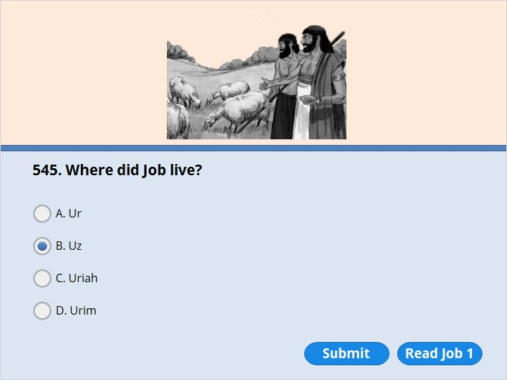
NEXT

Slide 4
NEXT

Slide 5
Job 1:1
There was a man who lived in the land of Uz. His name was Job. He was honest. He did what was right. He had respect for God and avoided evil.

Slide 6
NEXT

Slide 7
NEXT

Slide 8
Job 1:6
One day angels came to the Lord. Satan also came with them. 7 The Lord said to Satan, “Where have you come from?”
Satan answered, “From traveling all around the earth. I’ve been going from one end of it to the other.”

Slide 9
NEXT

Slide 10
NEXT

Slide 11
Job 1:9
“You always give Job everything he needs,” Satan replied. “That’s why he has respect for you. 10 Haven’t you guarded him and his family? Haven’t you taken care of everything he has? You have blessed everything he does. His flocks and herds are spread all through the land. 11 But now reach out your hand and strike down everything he has. Then I’m sure he will speak evil things against you. In fact, he’ll do it right in front of you.” 12 The Lord said to Satan, “All right. I am handing everything he has over to you. But do not touch the man himself.”

Slide 12
NEXT

Slide 13
NEXT

Slide 14
Job 1:13
One day Job’s sons and daughters were at their oldest brother’s house. They were enjoying good food and drinking wine. 14 During that time a messenger came to Job. He said, “The oxen were plowing. The donkeys were eating grass near them. 15 Then the Sabeans attacked us and carried off the animals. They killed some of the servants with their swords. I’m the only one who has escaped to tell you!”
16 While he was still speaking, a second messenger came. He said, “God sent lightning from the sky. It struck the sheep and killed them. It burned up some of the servants. I’m the only one who has escaped to tell you!” (continue )

Slide 15
17 While he was still speaking, a third messenger came. He said, “The Chaldeans separated themselves into three groups. They attacked your camels and carried them off. They killed the rest of the servants with their swords. I’m the only one who has escaped to tell you!”
18 While he was still speaking, a fourth messenger came. He said, “Your sons and daughters were at their oldest brother’s house. They were enjoying good food and drinking wine. 19 Suddenly a strong wind blew in from the desert. It struck the four corners of the house. The house fell down on your children. Now all of them are dead. I’m the only one who has escaped to tell you!”

Slide 16
NEXT

Slide 17
NEXT

Slide 18
Job 2:6
The Lord said to Satan, “All right. I am handing him over to you. But you must spare his life.”

Slide 19
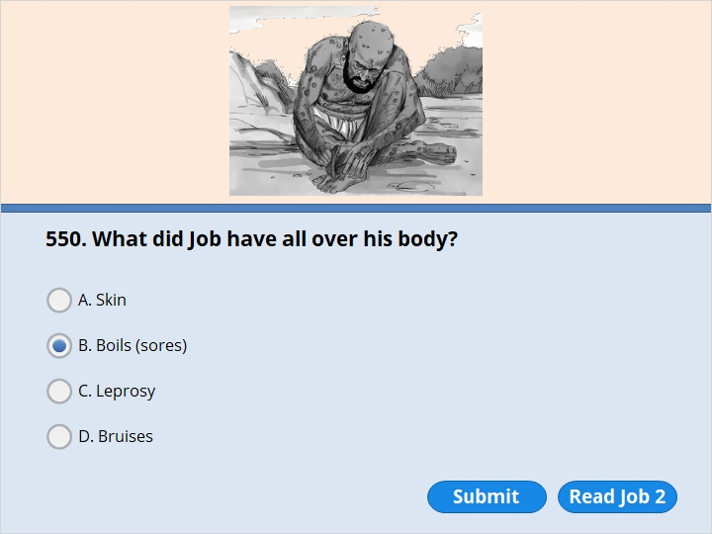
NEXT

Slide 20
NEXT

Slide 21
Job 2:7
Then Satan left the Lord and went on his way. He sent painful sores on Job. They covered him from the bottom of his feet to the top of his head. 8 He got part of a broken pot. He used it to scrape his skin. He did it while he was sitting in ashes.

Slide 22
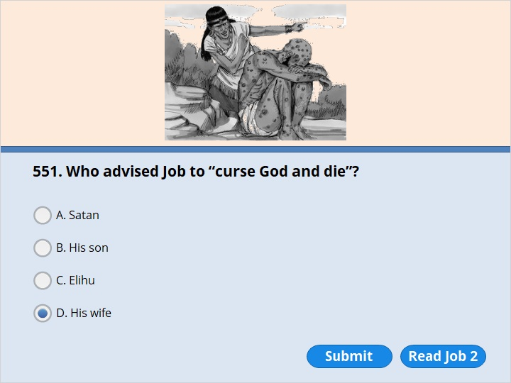
NEXT

Slide 23
NEXT

Slide 24
Job 2:9
His wife said to him, “Are you still continuing to be faithful to the Lord? Speak evil things against him and die!”

Slide 25
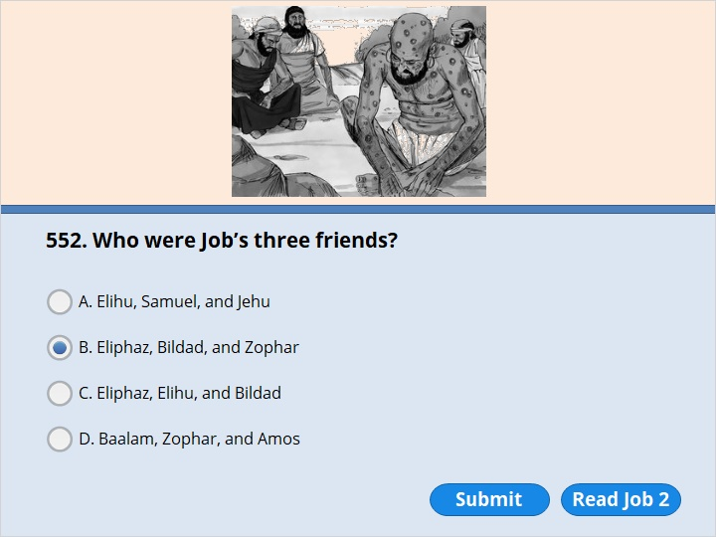
NEXT

Slide 26
NEXT

Slide 27
Job 2:11
Job had three friends named Eliphaz the Temanite, Bildad the Shuhite, and Zophar the Naamathite. They heard about all the troubles that had come to Job. So they started out from their homes. They had agreed to meet together. They wanted to go and show their concern for Job. They wanted to comfort him.

Slide 28
NEXT

Slide 29
NEXT

Slide 30
Job 2:13
Then they sat down on the ground with him for seven days and seven nights. No one said a word to him. That’s because they saw how much he was suffering.

Slide 31
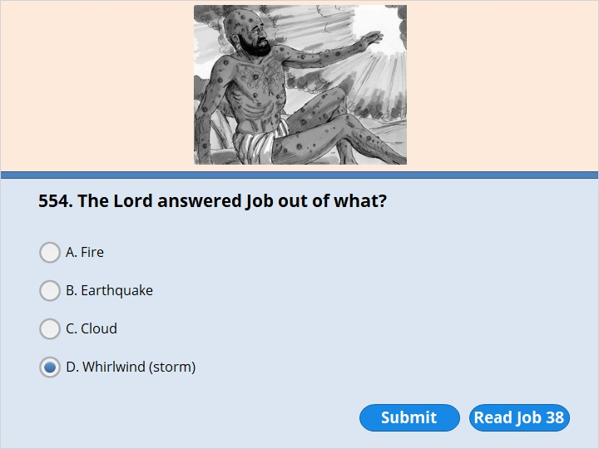
NEXT

Slide 32
NEXT

Slide 33
Job 38:1
The Lord spoke to Job out of a storm. He said, 2 “Who do you think you are to disagree with my plans? You do not know what you are talking about. 3 Get ready to stand up for yourself. I will ask you some questions. Then I want you to answer me.

Slide 34
NEXT

Slide 35
NEXT

Slide 36
Job 42:7
After the Lord finished speaking to Job, he spoke to Eliphaz the Temanite. He said, “I am angry with you and your two friends. You have not said what is true about me, as my servant Job has. 8 So now get seven bulls and seven rams. Go to my servant Job. Then sacrifice a burnt offering for yourselves. My servant Job will pray for you. And I will accept his prayer. I will not punish you for saying the foolish things you said. You have not said what is true about me, as my servant Job has.” 9 So Eliphaz the Temanite, Bildad the Shuhite, and Zophar the Naamathite did what the Lord told them to do. And the Lord accepted Job’s prayer.

Slide 37
NEXT

Slide 38
NEXT

Slide 39
Job 42:10
After Job had prayed for his friends, the Lord made him successful again. He gave him twice as much as he had before. 11 All his brothers and sisters and everyone who had known him before came to see him. They ate with him in his house. They showed their concern for him. They comforted him because of all the troubles the Lord had brought on him. Each one gave him a piece of silver and a gold ring.

Slide 40
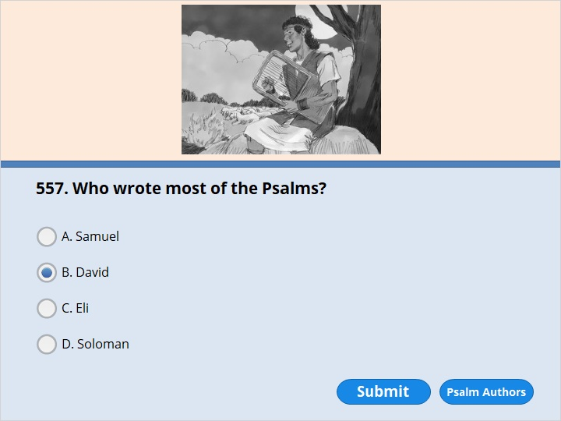
NEXT

Slide 41
NEXT

Slide 42
Following are the authors and the number of Psalms attributed to them:
David, 73
Asaph, 12
Sons of Korah, 9
Solomon, 2
Heman, 1
Ethan, 1
Moses, 1
anonymous, 51

Slide 43
NEXT

Slide 44
NEXT

Slide 45
Psalm 23:5
You prepare a feast for me
right in front of my enemies.
You pour oil on my head.
My cup runs over.

Slide 46
NEXT

Slide 47
NEXT

Slide 48
Proverbs 1:1
These are the proverbs of Solomon. He was the son of David and the king of Israel.

Slide 49
NEXT

Slide 50
NEXT

Slide 51
Proverbs 9:10
If you want to become wise, you must begin by respecting the Lord. To know the Holy One is to gain understanding.

Slide 52
NEXT

Slide 53
NEXT

Slide 54
Proverbs 15:1
A gentle answer turns anger away. But mean words stir up anger.

Slide 55
NEXT

Slide 56
NEXT

Slide 57
Proverbs 31:1
These are the sayings of King Lemuel. His mother taught them to him. These sayings came from God.

Slide 58
NEXT

Slide 59
NEXT

Slide 60
Ecclesiastes 1:2
“Meaningless! Everything is meaningless!” says the Teacher. “Everything is completely meaningless! Nothing has any meaning.”

Slide 61
NEXT

Slide 62
NEXT

Slide 63
Ecclesiastes 3:1
There is a time for everything. There’s a time for everything that is done on earth.

Slide 64
NEXT

Slide 65
NEXT

Slide 66
Isaiah 2:4
He will judge between the nations.
He’ll settle problems among many of them.
They will hammer their swords into plows.
They’ll hammer their spears into pruning tools.
Nations will not go to war against one another.
They won’t even train to fight anymore.

Slide 67
NEXT

Slide 68
NEXT

Slide 69
Isaiah 6:1
In the year that King Uzziah died, I saw the Lord. He was seated on his throne. His long robe filled the temple. He was highly honored.

Slide 70
NEXT

Slide 71
NEXT

Slide 72
Isaiah 6:2
Above him were seraphs. Each of them had six wings. With two wings they covered their faces. With two wings they covered their feet. And with two wings they were flying. 3 They were calling out to one another. They were saying,
“Holy, holy, holy is the Lord who rules over all. The whole earth is full of his glory.”

Slide 73
NEXT

Slide 74
NEXT

Slide 75
Isaiah 7:14
The Lord himself will give you a sign. The virgin is going to have a baby. She will give birth to a son. And he will be called Immanuel.

Slide 76
NEXT

Slide 77
NEXT

Slide 78
Isaiah 8:3
Then I went and slept with my wife, who was a prophet. She became pregnant and had a baby boy. The Lord said to me, “Name him Maher-Shalal-Hash-Baz.

Slide 79
NEXT

Slide 80
NEXT

Slide 81
Isaiah 53:4
He suffered the things we should have suffered.
He took on himself the pain that should have been ours.
But we thought God was punishing him.
We thought God was wounding him and making him suffer.
5 But the servant was pierced because we had sinned.
He was crushed because we had done what was evil.
He was punished to make us whole again.
His wounds have healed us.

Slide 82
NEXT

Slide 83
NEXT

Slide 84
Jeremiah 21:8
“Tell the people, ‘The Lord says, “I am offering you a choice. You can choose the way that leads to life. Or you can choose the way that leads to death. 9 Those who stay in this city will die of war, hunger or plague. But suppose some go out and give themselves up to the Babylonians attacking you. They will live. They will escape with their lives. 10 I have decided to do this city harm and not good,” announces the Lord. “It will be handed over to the king of Babylon. And he will destroy it with fire.” ’

Slide 85
NEXT

Slide 86
NEXT

Slide 87
Jeremiah 25:11
This whole country will become dry and empty. And these nations will serve the king of Babylon for 70 years.

Slide 88
NEXT

Slide 89
NEXT

Slide 90
Jeremiah 36:4
So Jeremiah sent for Baruch, the son of Neriah. Jeremiah told him to write down all the words the Lord had spoken to him. And Baruch wrote them on the scroll.

Slide 91
NEXT

Slide 92
NEXT

Slide 93
Jeremiah 37:11
The armies of Babylon had pulled back from Jerusalem because of Pharaoh’s army. 12 So Jeremiah started to leave the city. He was planning to go to the territory of Benjamin. Jeremiah wanted to get his share of the property among the people there. 13 He got as far as the Benjamin Gate. But the captain of the guard arrested him. He said, “You are going over to the side of the Babylonians!” The captain’s name was Irijah, the son of Shelemiah. Shelemiah was the son of Hananiah.

Slide 94
NEXT

Slide 95
NEXT

Slide 96
Jeremiah 37:14
Jeremiah said to Irijah, “That isn’t true! I’m not going to the side of the Babylonians.” But Irijah wouldn’t listen to him. Instead, he arrested Jeremiah. He brought Jeremiah to the officials. 15 They were angry with him. So they had him beaten. Then they took him to the house of Jonathan the secretary. It had been made into a prison. That’s where they put Jeremiah.

Slide 97
NEXT

Slide 98
NEXT

Slide 99
Jeremiah 43:6
Johanan and the other officers also led away many people Nebuzaradan had left at Mizpah. They included men, women and children. They also included the king’s daughters. Nebuzaradan had left them with Gedaliah, the son of Ahikam. They also took Jeremiah the prophet and Baruch son of Neriah along with them. Nebuzaradan was commander of the royal guard. Ahikam was the son of Shaphan. 7 So the Jewish leaders disobeyed the Lord. They took everyone to Egypt. They went all the way to Tahpanhes.

Slide 100
NEXT

Slide 101
NEXT

Slide 102
That's right! You selected the correct response.

Slide 103
NEXT

Slide 104
NEXT

Slide 105
Ezekiel 1:1
I was 30 years old. I was with my people. We had been taken away from our country. We were by the Kebar River in the land of Babylon. On the fifth day of the fourth month, the heavens were opened. I saw visions of God.

Slide 106
NEXT

Slide 107
NEXT

Slide 108
Ezekiel 1:3
A message from the Lord came to me. I was by the Kebar River in Babylon. The power of the Lord came on me there. I am Ezekiel the priest, the son of Buzi.

Slide 109
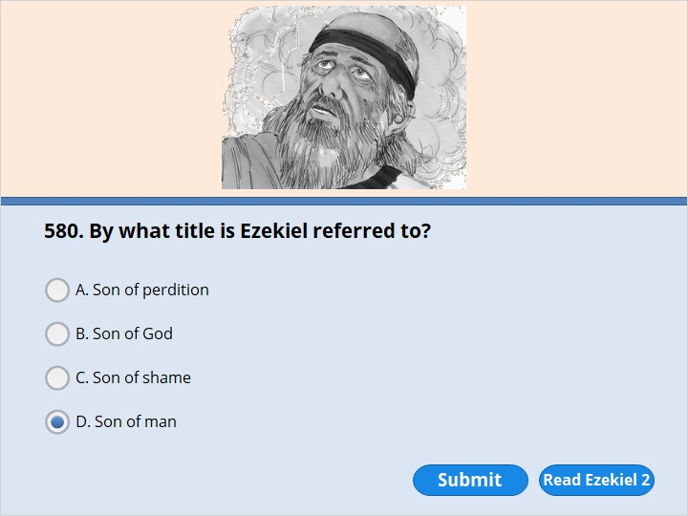
NEXT

Slide 110
NEXT

Slide 111
Ezekiel 2:1
He said to me, “Son of man, stand up on your feet. I will speak to you.” 2 As he spoke, the Spirit of the Lord came into me. He raised me to my feet. I heard him speaking to me.

Slide 112
NEXT

Slide 113
NEXT

Slide 114
Ezekiel 3:1
The Lord said to me, “Son of man, eat what is in front of you. Eat this scroll. Then go and speak to the people of Israel.” 2 So I opened my mouth. And he gave me the scroll to eat.

Slide 115
NEXT

Slide 116
NEXT

Slide 117
Ezekiel 37:1
The power of the Lord came on me. His Spirit brought me away from my home. He put me down in the middle of a valley. It was full of bones. 2 He led me back and forth among them. I saw a huge number of bones in the valley. The bones were very dry. 3 The Lord asked me, “Son of man, can these bones live?”

Slide 118
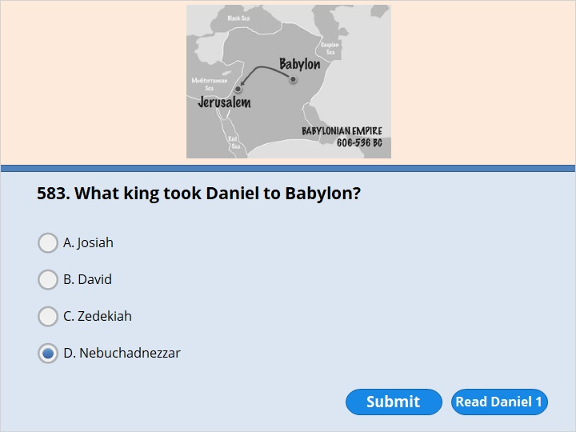
NEXT

Slide 119
NEXT

Slide 120
Daniel 1:1
It was the third year that Jehoiakim was king of Judah. Nebuchadnezzar, king of Babylon, came to Jerusalem. His armies surrounded the city and attacked it. 2 The Lord handed Jehoiakim, the king of Judah, over to him. Nebuchadnezzar also took some of the objects from God’s temple. He carried them off to the temple of his god in Babylon. He put them among the treasures of his god.

Slide 121
NEXT

Slide 122
NEXT

Slide 123
Daniel 1:6
Some of the men chosen were from Judah. Their names were Daniel, Hananiah, Mishael and Azariah. 7 The chief official gave them new names. He gave Daniel the name Belteshazzar. He gave Hananiah the name Shadrach. He gave Mishael the name Meshach. And he gave Azariah the name Abednego.

Slide 124
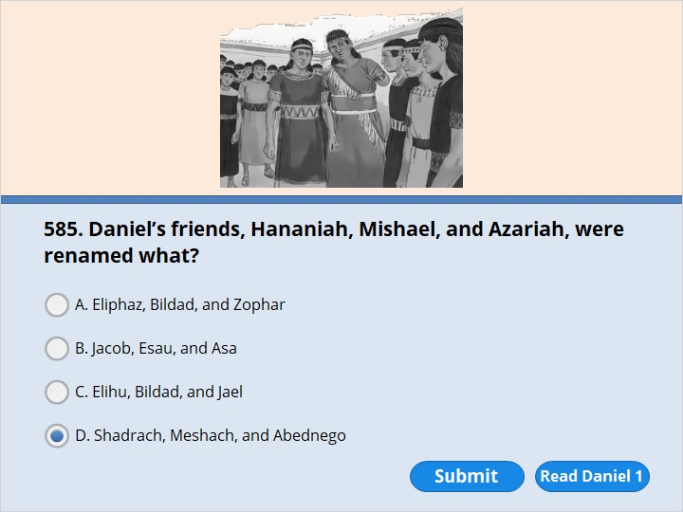
NEXT

Slide 125
NEXT

Slide 126
Daniel 1:6
Some of the men chosen were from Judah. Their names were Daniel, Hananiah, Mishael and Azariah. 7 The chief official gave them new names. He gave Daniel the name Belteshazzar. He gave Hananiah the name Shadrach. He gave Mishael the name Meshach. And he gave Azariah the name Abednego.

Slide 127
NEXT

Slide 128
NEXT

Slide 129
Daniel 2:31
“King Nebuchadnezzar, you looked up and saw a large statue standing in front of you. It was huge. It shone brightly. And it terrified you. 32 The head of the statue was made out of pure gold. Its chest and arms were made out of silver. Its stomach and thighs were made out of bronze. 33 Its legs were made out of iron. And its feet were partly iron and partly baked clay. 34 While you were watching, a rock was cut out. But human hands didn’t do it. It struck the statue on its feet of iron and clay. It smashed them. 35 Then the iron and clay were broken to pieces. So were the bronze, silver and gold. All of them were broken to pieces. They became like straw on a threshing floor at harvest time. The wind blew them away without leaving a trace. But the rock that struck the statue became a huge mountain. It filled the whole earth.

Slide 130
NEXT

Slide 131
NEXT

Slide 132
Daniel 2:31
“King Nebuchadnezzar, you looked up and saw a large statue standing in front of you. It was huge. It shone brightly. And it terrified you. 32 The head of the statue was made out of pure gold. Its chest and arms were made out of silver. Its stomach and thighs were made out of bronze. 33 Its legs were made out of iron. And its feet were partly iron and partly baked clay. 34 While you were watching, a rock was cut out. But human hands didn’t do it. It struck the statue on its feet of iron and clay. It smashed them. 35 Then the iron and clay were broken to pieces. So were the bronze, silver and gold. All of them were broken to pieces. They became like straw on a threshing floor at harvest time. The wind blew them away without leaving a trace. But the rock that struck the statue became a huge mountain. It filled the whole earth.

Slide 133
NEXT

Slide 134
NEXT

Slide 135
Daniel 2:31
“King Nebuchadnezzar, you looked up and saw a large statue standing in front of you. It was huge. It shone brightly. And it terrified you. 32 The head of the statue was made out of pure gold. Its chest and arms were made out of silver. Its stomach and thighs were made out of bronze. 33 Its legs were made out of iron. And its feet were partly iron and partly baked clay. 34 While you were watching, a rock was cut out. But human hands didn’t do it. It struck the statue on its feet of iron and clay. It smashed them. 35 Then the iron and clay were broken to pieces. So were the bronze, silver and gold. All of them were broken to pieces. They became like straw on a threshing floor at harvest time. The wind blew them away without leaving a trace. But the rock that struck the statue became a huge mountain. It filled the whole earth.

Slide 136
NEXT

Slide 137
NEXT

Slide 138
Daniel 2:31
“King Nebuchadnezzar, you looked up and saw a large statue standing in front of you. It was huge. It shone brightly. And it terrified you. 32 The head of the statue was made out of pure gold. Its chest and arms were made out of silver. Its stomach and thighs were made out of bronze. 33 Its legs were made out of iron. And its feet were partly iron and partly baked clay. 34 While you were watching, a rock was cut out. But human hands didn’t do it. It struck the statue on its feet of iron and clay. It smashed them. 35 Then the iron and clay were broken to pieces. So were the bronze, silver and gold. All of them were broken to pieces. They became like straw on a threshing floor at harvest time. The wind blew them away without leaving a trace. But the rock that struck the statue became a huge mountain. It filled the whole earth.

Slide 139
NEXT

Slide 140
NEXT

Slide 141
Daniel 2:31
“King Nebuchadnezzar, you looked up and saw a large statue standing in front of you. It was huge. It shone brightly. And it terrified you. 32 The head of the statue was made out of pure gold. Its chest and arms were made out of silver. Its stomach and thighs were made out of bronze. 33 Its legs were made out of iron. And its feet were partly iron and partly baked clay. 34 While you were watching, a rock was cut out. But human hands didn’t do it. It struck the statue on its feet of iron and clay. It smashed them. 35 Then the iron and clay were broken to pieces. So were the bronze, silver and gold. All of them were broken to pieces. They became like straw on a threshing floor at harvest time. The wind blew them away without leaving a trace. But the rock that struck the statue became a huge mountain. It filled the whole earth.

Slide 142
NEXT

Slide 143
NEXT

Slide 144
Daniel 2:31
“King Nebuchadnezzar, you looked up and saw a large statue standing in front of you. It was huge. It shone brightly. And it terrified you. 32 The head of the statue was made out of pure gold. Its chest and arms were made out of silver. Its stomach and thighs were made out of bronze. 33 Its legs were made out of iron. And its feet were partly iron and partly baked clay. 34 While you were watching, a rock was cut out. But human hands didn’t do it. It struck the statue on its feet of iron and clay. It smashed them. 35 Then the iron and clay were broken to pieces. So were the bronze, silver and gold. All of them were broken to pieces. They became like straw on a threshing floor at harvest time. The wind blew them away without leaving a trace. But the rock that struck the statue became a huge mountain. It filled the whole earth.

Slide 145
NEXT

Slide 146
NEXT

Slide 147
Daniel 3:1
King Nebuchadnezzar made a gold statue. It was 90 feet tall and 9 feet wide. He set it up on the plain of Dura near the city of Babylon.

Slide 148
NEXT

Slide 149
NEXT

Slide 150
Daniel 3:4
Then a messenger called out loudly, “Listen, you people who come from every nation! Pay attention, you who speak other languages! Here is what the king commands you to do. 5 You will soon hear the sound of horns and flutes. You will hear zithers, lyres, harps and pipes. In fact, you will hear all kinds of music. When you do, you must fall down and worship the gold statue. That is the statue that King Nebuchadnezzar has set up. 6 If you don’t, you will be thrown into a blazing furnace right away.”

Slide 151
NEXT

Slide 152
NEXT

Slide 153
Daniel 3:8
At this time some people who studied the heavens came forward. They spoke against the Jews. 9 They said, “King Nebuchadnezzar, may you live forever! 10 Your Majesty has commanded everyone to fall down and worship the gold statue. You told them to do it when they heard the horns, flutes, zithers, lyres, harps, pipes and other musical instruments. 11 If they didn’t, they would be thrown into a blazing furnace. 12 But you have appointed some Jews to help Daniel govern Babylon and the towns around it. Their names are Shadrach, Meshach and Abednego. They don’t pay any attention to you, King Nebuchadnezzar. They don’t serve your gods. And they refuse to worship the gold statue you have set up.”

Slide 154
NEXT

Slide 155
NEXT

Slide 156
Daniel 3:20
He also gave some of the strongest soldiers in his army a command. He ordered them to tie up Shadrach, Meshach and Abednego. Then he told his men to throw them into the blazing furnace. 21 So they were tied up. Then they were thrown into the furnace. They were wearing their robes, pants, turbans and other clothes.

Slide 157
NEXT

Slide 158
NEXT

Slide 159
Daniel 3:22
The king’s command was carried out quickly. The furnace was so hot that its flames killed the soldiers who threw Shadrach, Meshach and Abednego into it.

Slide 160
NEXT

Slide 161
NEXT

Slide 162
Daniel 3:25
The king said, “Look! I see four men walking around in the fire. They aren’t tied up. And the fire hasn’t even harmed them. The fourth man looks like a son of the gods.”

Slide 163
NEXT

Slide 164
NEXT

Slide 165
Daniel 3:26
Then the king approached the opening of the blazing furnace. He shouted, “Shadrach, Meshach and Abednego, come out! You who serve the Most High God, come here!”

Slide 166
NEXT

Slide 167
NEXT

Slide 168
Daniel 3:30
Then the king honored Shadrach, Meshach and Abednego. He gave them higher positions in the city of Babylon and the towns around it.

Slide 169
NEXT

Slide 170
NEXT

Slide 171
Daniel 5:1-6
5 King Belshazzar gave a great banquet for a thousand of his nobles and drank wine with them. 2 While Belshazzar was drinking his wine, he gave orders to bring in the gold and silver goblets that Nebuchadnezzar his father[a] had taken from the temple in Jerusalem, so that the king and his nobles, his wives and his concubines might drink from them. 3 So they brought in the gold goblets that had been taken from the temple of God in Jerusalem, and the king and his nobles, his wives and his concubines drank from them. 4 As they drank the wine, they praised the gods of gold and silver, of bronze, iron, wood and stone.
CONTINUE TO NEXT PAGE…

Slide 172
5 Suddenly the fingers of a human hand appeared and wrote on the plaster of the wall, near the lampstand in the royal palace. The king watched the hand as it wrote. 6 His face turned pale and he was so frightened that his legs became weak and his knees were knocking.

Slide 173
NEXT

Slide 174
NEXT

Slide 175
Daniel 5:13-17
13 So Daniel was brought before the king, and the king said to him, “Are you Daniel, one of the exiles my father the king brought from Judah? 14 I have heard that the spirit of the gods is in you and that you have insight, intelligence and outstanding wisdom. 15 The wise men and enchanters were brought before me to read this writing and tell me what it means, but they could not explain it. 16 Now I have heard that you are able to give interpretations and to solve difficult problems. If you can read this writing and tell me what it means, you will be clothed in purple and have a gold chain placed around your neck, and you will be made the third highest ruler in the kingdom.”
CONTINUE TO NEXT PAGE…

Slide 176
17 Then Daniel answered the king, “You may keep your gifts for yourself and give your rewards to someone else. Nevertheless, I will read the writing for the king and tell him what it means.

Slide 177
NEXT

Slide 178
NEXT

Slide 179
Daniel 5:30
That very night Belshazzar, the king of Babylon, was killed. 31 His kingdom was given to Darius the Mede. Darius was 62 years old.

Slide 180
NEXT

Slide 181
NEXT

Slide 182
Daniel 5:30
That very night Belshazzar, the king of Babylon, was killed. 31 His kingdom was given to Darius the Mede. Darius was 62 years old.

Slide 183
NEXT

Slide 184
NEXT

Slide 185
Daniel 6:16
So the king gave the order. Daniel was brought out and thrown into the lions’ den. The king said to him, “You always serve your God faithfully. So may he save you!”

Slide 186
NEXT

Slide 187
NEXT

Slide 188
Daniel 6:11
Some of the other royal officials went to where Daniel was staying. They saw him praying and asking God for help. 12 So they went to the king. They spoke to him about his royal order. They said, “Your Majesty, didn’t you sign an official order? It said that for the next 30 days your people could pray only to you. They could not pray to anyone else, whether god or human being. If they did, they would be thrown into the lions’ den.”
The king answered, “The order must still be obeyed. It’s what the law of the Medes and Persians requires. So it can’t be changed.”

Slide 189
NEXT

Slide 190
NEXT

Slide 191
Daniel 6:21
Daniel answered, “Your Majesty, may you live forever! 22 My God sent his angel. And his angel shut the mouths of the lions. They haven’t hurt me at all. That’s because I haven’t done anything wrong in God’s sight. I’ve never done anything wrong to you either, Your Majesty.”

Slide 192
NEXT

Slide 193
NEXT

Slide 194
Daniel 6:24
Then the king gave another order. The men who had said bad things about Daniel were brought in. They were thrown into the lions’ den. So were their wives and children. Before they hit the bottom of the den, the lions attacked them. And the lions crushed all their bones.

Slide 195
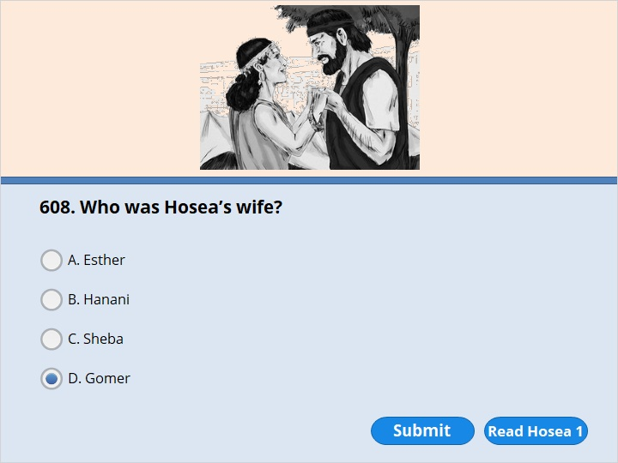
NEXT

Slide 196
NEXT

Slide 197
Hosea 1:2
The Lord began to speak through Hosea. He said to him, “Go. Marry a woman who has sex with anyone she wants. Have children with her. Do this because the people of the land are like that kind of wife. They have not been faithful to me.” 3 So Hosea married Gomer. She was the daughter of Diblaim. Gomer became pregnant and had a son by Hosea.
You did not select the correct response.

Slide 198
NEXT

Slide 199
NEXT

Slide 200
Hosea 8:7
The Lord says,
“Worshiping other gods is like worshiping the wind.
It is like planting worthless seeds.
Assyria is like a windstorm.
That is all my people will harvest.
There are no heads of grain
on the stems that will come up.
So they will not produce any flour.
Even if they did produce grain,
the Assyrians would eat all of it up.

Slide 201
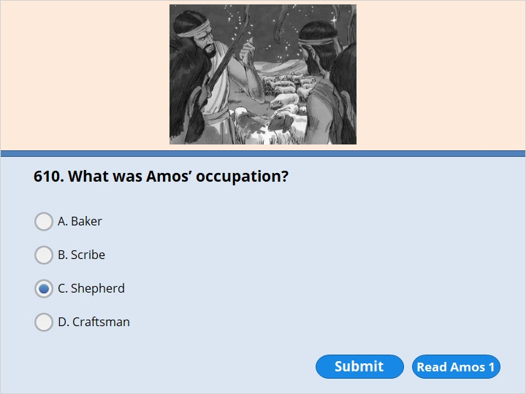
NEXT

Slide 202
NEXT

Slide 203
Amos 1:1
These are the words of Amos. He was a shepherd from the town of Tekoa. Here is the vision he saw concerning Israel. It came to him two years before the earthquake. At that time Uzziah was king of Judah. Jeroboam, the son of Jehoash, was king of Israel. Here are the words of Amos

Slide 204
NEXT

Slide 205
NEXT

Slide 206
Amos 8:11
The Lord and King announces,
“The days are coming
when I will send hunger through the land.
But people will not be hungry for food.
They will not be thirsty for water.
Instead, they will be hungry
to hear a message from me.

Slide 207
NEXT

Slide 208
NEXT

Slide 209
Obadiah 1:1 1
This is the vision about Edom that Obadiah had.
Here is what the Lord and King says about Edom.
We’ve heard a message from the Lord.
A messenger was sent to the nations.
The Lord told him to say,
“Get up! Let us go and make war against Edom.”

Slide 210
NEXT

Slide 211
NEXT

Slide 212
Jonah 1:1
A message from the Lord came to Jonah, the son of Amittai. The Lord said, 2 “Go to the great city of Nineveh. Preach against it. The sins of its people have come to my attention.”

Slide 213
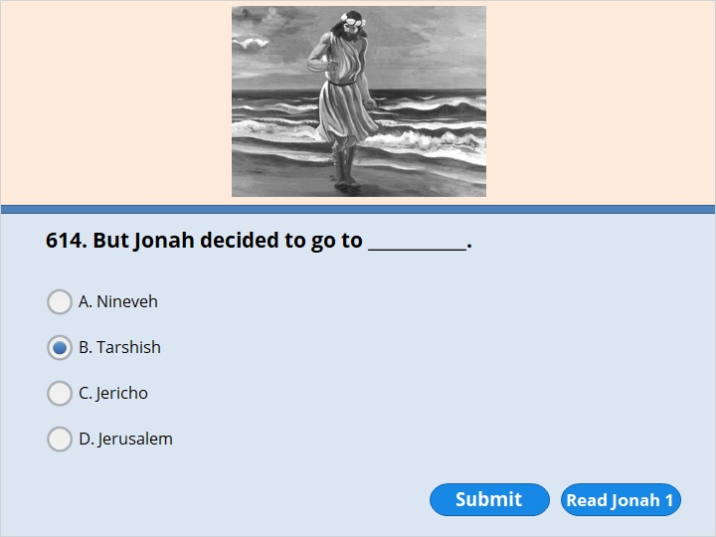
NEXT

Slide 214
NEXT

Slide 215
Jonah 1:3
But Jonah ran away from the Lord. He headed for Tarshish. So he went down to the port of Joppa. There he found a ship that was going to Tarshish. He paid the fare and went on board. Then he sailed for Tarshish. He was running away from the Lord.

Slide 216
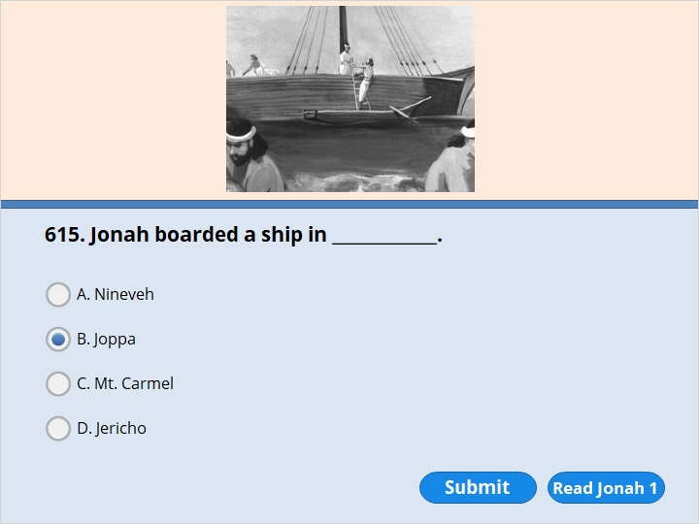
NEXT

Slide 217
NEXT

Slide 218
Jonah 1:3
But Jonah ran away from the Lord. He headed for Tarshish. So he went down to the port of Joppa. There he found a ship that was going to Tarshish. He paid the fare and went on board. Then he sailed for Tarshish. He was running away from the Lord

Slide 219
NEXT

Slide 220
NEXT

Slide 221
Jonah 1:7
Here is what the sailors said to one another. “Someone is to blame for getting us into all this trouble. Come. Let’s cast lots to find out who it is.” So they did. And Jonah was picked. 8 They asked him, “What terrible thing have you done to bring all this trouble on us? Tell us. What do you do for a living? Where do you come from? What is your country? What people do you belong to?”

Slide 222
NEXT

Slide 223
NEXT

Slide 224
Jonah 1:15
Then they took Jonah and threw him overboard. And the stormy sea became calm. 16 The men saw what had happened. Then they began to have great respect for the Lord. They offered a sacrifice to him. And they made promises to him.

Slide 225
NEXT

Slide 226
NEXT

Slide 227
Jonah 1:17
Now the Lord sent a huge fish to swallow Jonah. And Jonah was in the belly of the fish for three days and three nights.

Slide 228
NEXT

Slide 229
NEXT

Slide 230
Jonah 1:17
Now the Lord sent a huge fish to swallow Jonah. And Jonah was in the belly of the fish for three days and three nights.

Slide 231
NEXT

Slide 232
NEXT

Slide 233
Jonah 2:10
The Lord gave the fish a command. And it spit Jonah up onto dry land.

Slide 234
NEXT

Slide 235
NEXT

Slide 236
Jonah 3:3
Jonah obeyed the Lord. He went to Nineveh. It was a very large city. In fact, it took about three days to go through it. 4 Jonah began by going one whole day into the city. As he went, he announced, “In 40 days Nineveh will be destroyed.”

Slide 237
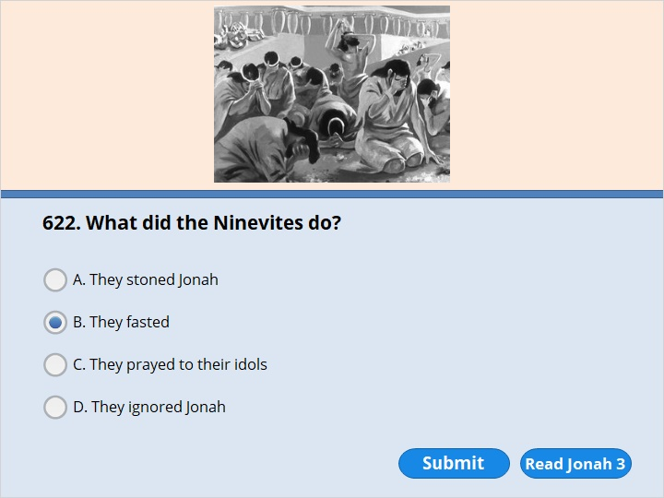
NEXT

Slide 238
NEXT

Slide 239
Jonah 3:5
The people of Nineveh believed God’s warning. So they decided not to eat any food for a while. And all of them put on the rough clothing people wear when they’re sad. That’s what everyone did, from the least important of them to the most important.

Slide 240
NEXT

Slide 241
NEXT

Slide 242
Jonah 3:10
God saw what they did. He saw that they stopped doing what was evil. So he took pity on them. He didn’t destroy them as he had said he would.

Slide 243
NEXT

Slide 244
NEXT

Slide 245
Jonah 4:1
But to Jonah this seemed very wrong. He became angry. 2 He prayed to the Lord. Here is what Jonah said to him. “Lord, isn’t this exactly what I thought would happen when I was still at home? That is what I tried to prevent by running away to Tarshish. I knew that you are gracious. You are tender and kind. You are slow to get angry. You are full of love. You are a God who takes pity on people. You don’t want to destroy them. 3 Lord, take away my life. I’d rather die than live.”

Slide 246
NEXT

Slide 247
NEXT

Slide 248
Jonah 4:10
But the Lord said, “You have been concerned about this plant. But you did not take care of it. You did not make it grow. It grew up in one night and died the next. 11 And shouldn’t I show concern for the great city of Nineveh? It has more than 120,000 people. They can’t tell right from wrong. Nineveh also has a lot of animals.”

Slide 249
NEXT

Slide 250
NEXT

Slide 251
Micah 5:2
he Lord says,
“Bethlehem Ephrathah, you might not be
an important town in the nation of Judah.
But out of you will come for me
a ruler over Israel.
His family line goes back
to the early years of your nation.
It goes all the way back
to days of long ago.”

Slide 252
NEXT

Slide 253
NEXT

Slide 254
Nahum 1:1
Here is a prophecy the Lord gave Nahum, who was from the town of Elkosh. The prophecy came in a vision and is written in a book. The prophecy is about Nineveh.

Slide 255
NEXT

Slide 256
NEXT

Slide 257
Habakkuk 1:6
I am going to send the armies of Babylon to attack you.
They are very mean. They move quickly.
They sweep across the whole earth.
They take over homes
that do not belong to them.

Slide 258
NEXT

Slide 259
NEXT

Slide 260
Haggai 1:1
A message from the Lord came to Haggai the prophet. Haggai gave it to Zerubbabel and Joshua. Zerubbabel was governor of Judah and the son of Shealtiel. Joshua was high priest and the son of Jozadak. The message came on the first day of the sixth month of the second year that Darius was king of Persia. Here is what Haggai said.
2 Here is what the Lord who rules over all says. “The people of Judah say, ‘It’s not yet time to rebuild the Lord’s temple.’ ”

Slide 261
NEXT

Slide 262
NEXT

Slide 263
Malachi 3:8
“Will a mere human being dare to steal from God? But you rob me!
“You ask, ‘How are we robbing you?’
“By holding back your offerings. You also steal from me when you do not bring me a tenth of everything you produce. 9 So you are under my curse. In fact, your whole nation is under my curse. That is because you are robbing me.

Slide 265
Our goal is not only for you to be able to study God’s Word, but also give you a way to teach and share with other people.
We pray God will bless your time in His Word!
WWW.Mark732.org
For more information and for further training: Contact
Rev. Dr. John Reinke
At RevReinke@gmail.com
or 608-436-9600 (voice/text)
Material Copyright ©Mark732
Bible Verses are from the New International Readers Version - NIrV
Pictures: Copyright © Language Recordings Inc (Australia). Used by permission
Material Copyright ©Mark732

