Slide 1
Our goal is not only for you to be able to study God’s Word, but also give you a way to teach and share with other people.
We pray God will bless your time in His Word!
WWW.Mark732.org
For more information and for further training: Contact
Rev. Dr. John Reinke
At RevReinke@gmail.com
or 608-436-9600 (voice/text)
Material Copyright ©Mark732
Bible Verses are from the New International Readers Version - NIrV
Pictures: Copyright © Language Recordings Inc (Australia). Used by permission
Material Copyright ©Mark732

Slide 3
NEXT

Slide 4
NEXT

Slide 5
1 Kings 1:1
King David was now very old. He couldn’t keep warm even when blankets were spread over him. 2 So his attendants spoke to him. They said, “You are our king and master. Please let us try to find a young virgin to serve you. She can take care of you. She can lie down beside you to keep you warm.”
3 So David’s attendants looked all over Israel for a beautiful young woman. They found Abishag. She was from the town of Shunem. They brought her to the king. 4 The woman was very beautiful. She took care of the king and served him. But the king didn’t have sex with her.

Slide 6
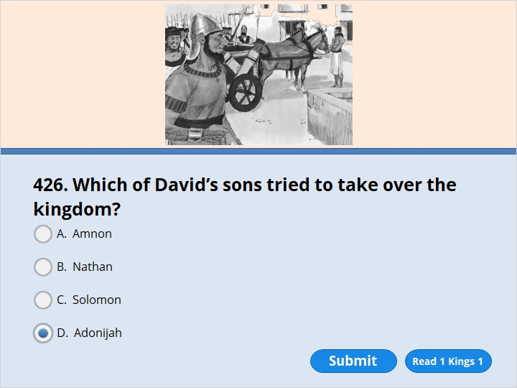
NEXT

Slide 7
NEXT

Slide 8
1 Kings 1:5
Adonijah was the son of David and his wife Haggith. He came forward and announced, “I’m going to be the next king.” So he got chariots and horses ready. He also got 50 men to run in front of him.
You did not select the correct response.

Slide 9
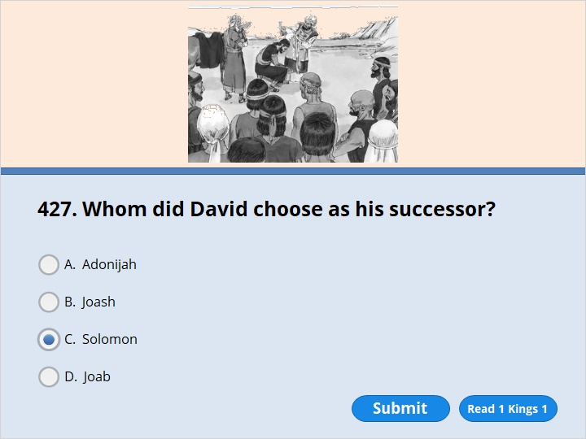
NEXT

Slide 10
NEXT

Slide 11
1 Kings 1:32
King David said, “Tell Zadok the priest and Nathan the prophet to come in. Also tell Benaiah, the son of Jehoiada, to come.” So they came to the king. 33 He said to them, “Take my officials with you. Have my son Solomon get on my own mule. Take him down to the Gihon spring. 34 Have Zadok the priest and Nathan the prophet anoint him as king over Israel there. Blow a trumpet. Shout, ‘May King Solomon live a long time!’ 35 Then come back up to the city with him. Have him sit on my throne. He will rule in my place. I’ve appointed him ruler over Israel and Judah.”

Slide 12
NEXT

Slide 13
NEXT

Slide 14
1 Kings 2:15
He said, “As you know, the kingdom belonged to me. The whole nation of Israel thought of me as their king. But now things have changed. The kingdom belongs to my brother. The Lord has given it to him. 16 But I have a favor to ask of you. Don’t say no to me.”
“Go ahead,” she said.
17 So he continued, “Please ask King Solomon for a favor. He won’t say no to you. Ask him to give me Abishag from Shunem to be my wife.”
18 “All right,” Bathsheba replied. “I’ll speak to the king for you.”

Slide 15
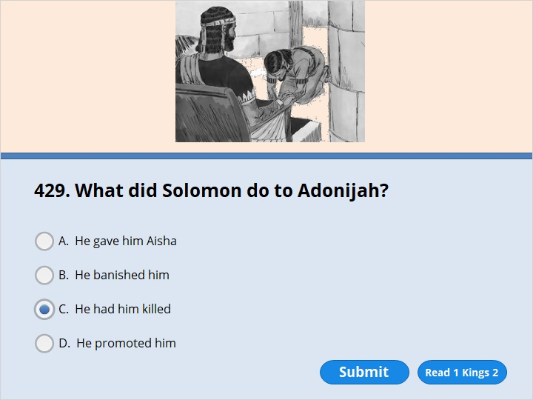
NEXT

Slide 16
NEXT

Slide 17
1 Kings 2:23
Then King Solomon made a promise in the name of the Lord. He said, “Adonijah will pay with his life because of what he has asked for. If he doesn’t, may God punish me greatly. 24 The Lord has made my position as king secure. I’m sitting on the throne of my father David. The Lord has built a royal house for me, just as he promised. You can be sure that the Lord lives. And you can be just as sure that Adonijah will be put to death today.” 25 So King Solomon gave the order to Benaiah, the son of Jehoiada. Benaiah struck down Adonijah, and he died.

Slide 18
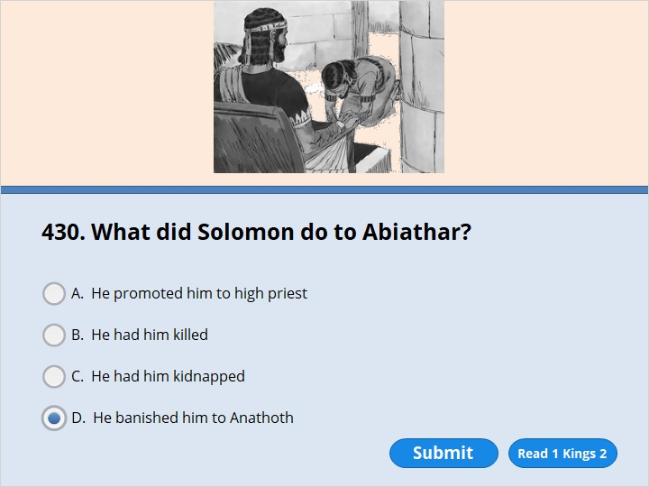
NEXT

Slide 19
NEXT

Slide 20
1 Kings 2:26
The king spoke to Abiathar the priest. He said, “Go back to your fields in Anathoth. You should really be put to death. But I won’t have it done now. That’s because you carried the ark of the Lord and King. You did it for my father David. You shared all of his hard times.” 27 So Solomon wouldn’t let Abiathar serve as a priest of the Lord anymore. That’s how the message the Lord had spoken at Shiloh came true. He had spoken it about the family of Eli.

Slide 21
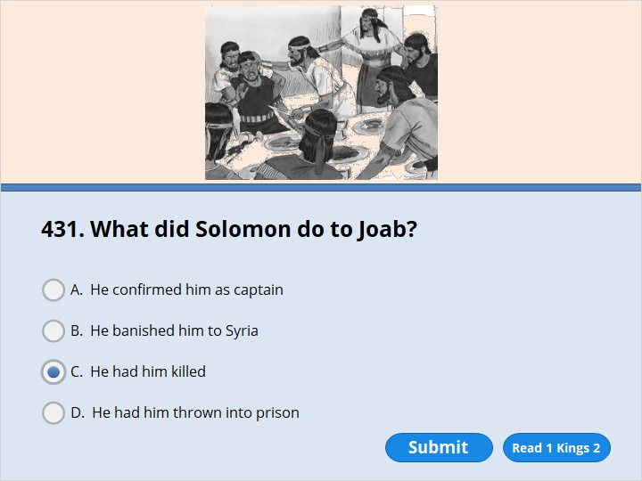
NEXT

Slide 22
NEXT

Slide 23
1 Kings 2:31
Then the king commanded Benaiah, “Do as he says. Strike him down and bury him, and so clear me and my whole family of the guilt of the innocent blood that Joab shed. 32 The Lord will repay him for the blood he shed, because without my father David knowing it he attacked two men and killed them with the sword. Both of them—Abner son of Ner, commander of Israel’s army, and Amasa son of Jether, commander of Judah’s army—were better men and more upright than he. 33 May the guilt of their blood rest on the head of Joab and his descendants forever. But on David and his descendants, his house and his throne, may there be the Lord’s peace forever.”
34 So Benaiah son of Jehoiada went up and struck down Joab and killed him, and he was buried at his home out in the country.

Slide 24
NEXT

Slide 25
NEXT

Slide 26
1 Kings 2:36
Then the king sent for Shimei and said to him, “Build yourself a house in Jerusalem and live there, but do not go anywhere else. 37 The day you leave and cross the Kidron Valley, you can be sure you will die; your blood will be on your own head.”
38 Shimei answered the king, “What you say is good. Your servant will do as my lord the king has said.” And Shimei stayed in Jerusalem for a long time.

Slide 27
NEXT

Slide 28
NEXT

Slide 29
1 Kings 2:42
the king summoned Shimei and said to him, “Did I not make you swear by the Lord and warn you, ‘On the day you leave to go anywhere else, you can be sure you will die’? At that time you said to me, ‘What you say is good. I will obey.’ 43 Why then did you not keep your oath to the Lord and obey the command I gave you?”
44 The king also said to Shimei, “You know in your heart all the wrong you did to my father David. Now the Lord will repay you for your wrongdoing. 45 But King Solomon will be blessed, and David’s throne will remain secure before the Lord forever.”
46 Then the king gave the order to Benaiah son of Jehoiada, and he went out and struck Shimei down and he died.

Slide 30
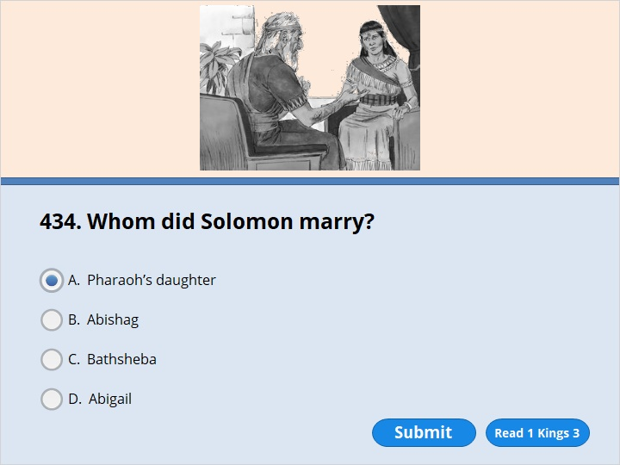
NEXT

Slide 31
NEXT

Slide 32
1 Kings 3:1
Solomon made an alliance with Pharaoh king of Egypt and married his daughter. He brought her to the City of David until he finished building his palace and the temple of the Lord, and the wall around Jerusalem.

Slide 33
NEXT

Slide 34
NEXT

Slide 35
1 Kings 3:7
“Now, Lord my God, you have made your servant king in place of my father David. But I am only a little child and do not know how to carry out my duties. 8 Your servant is here among the people you have chosen, a great people, too numerous to count or number. 9 So give your servant a discerning heart to govern your people and to distinguish between right and wrong. For who is able to govern this great people of yours?”

Slide 36
NEXT

Slide 37
NEXT

Slide 38
1 Kings 3:10
The Lord was pleased that Solomon had asked for this. 11 So God said to him, “Since you have asked for this and not for long life or wealth for yourself, nor have asked for the death of your enemies but for discernment in administering justice, 12 I will do what you have asked. I will give you a wise and discerning heart, so that there will never have been anyone like you, nor will there ever be. 13 Moreover, I will give you what you have not asked for—both wealth and honor—so that in your lifetime you will have no equal among kings. 14 And if you walk in obedience to me and keep my decrees and commands as David your father did, I will give you a long life.” 15 Then Solomon awoke—and he realized it had been a dream.

Slide 39
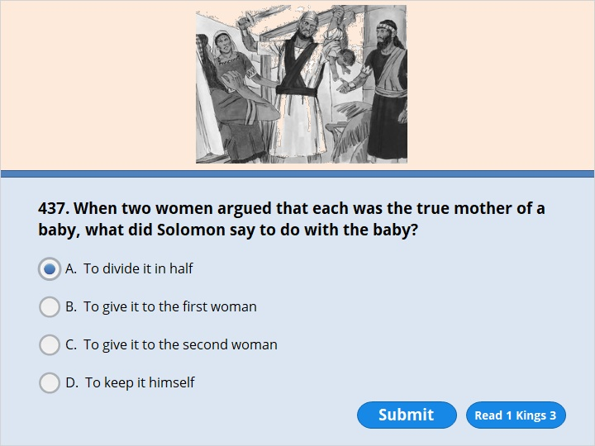
NEXT

Slide 40
NEXT

Slide 41
1 Kings 3:24
Then the king said, “Bring me a sword.” So they brought a sword for the king. 25 He then gave an order: “Cut the living child in two and give half to one and half to the other.”
26 The woman whose son was alive was deeply moved out of love for her son and said to the king, “Please, my lord, give her the living baby! Don’t kill him!”
But the other said, “Neither I nor you shall have him. Cut him in two!”

Slide 42
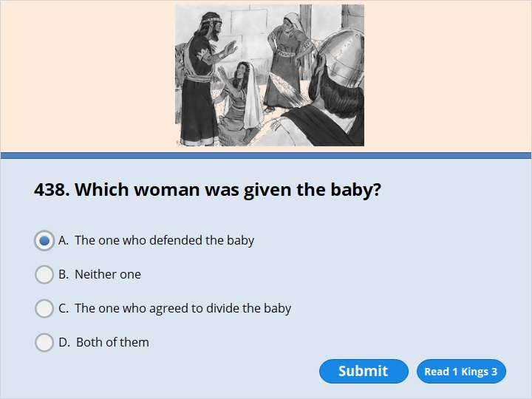
NEXT

Slide 43
NEXT

Slide 44
1 Kings 3:26
The woman whose son was alive was deeply moved out of love for her son and said to the king, “Please, my lord, give her the living baby! Don’t kill him!”
But the other said, “Neither I nor you shall have him. Cut him in two!”
27 Then the king gave his ruling: “Give the living baby to the first woman. Do not kill him; she is his mother.”

Slide 45
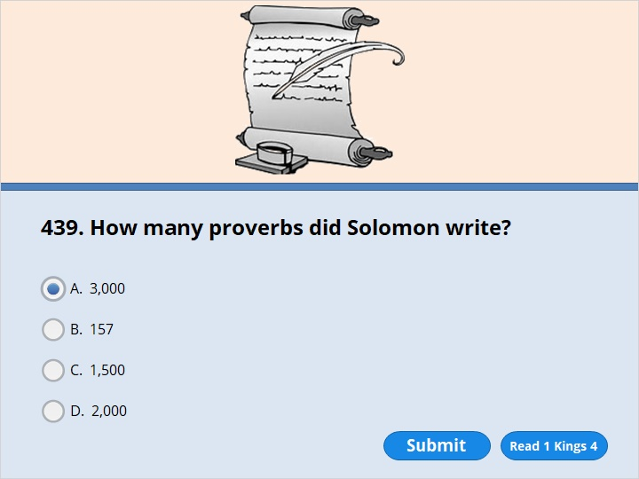
NEXT

Slide 46
NEXT

Slide 47
1 Kings 4:32
He spoke three thousand proverbs and his songs numbered a thousand and five.

Slide 48
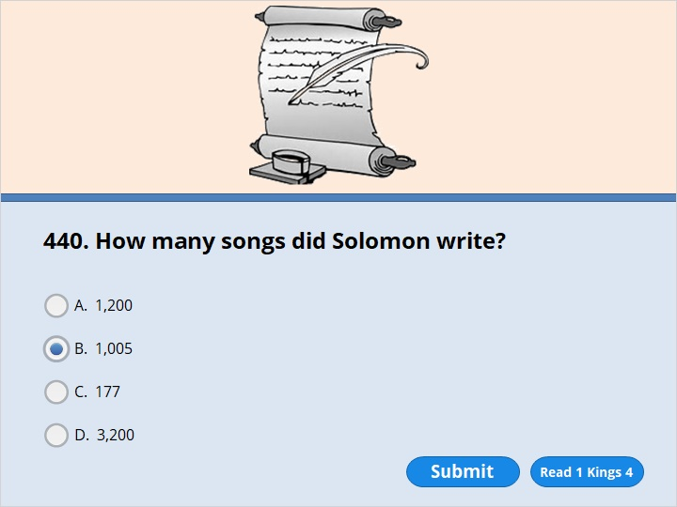
NEXT

Slide 49
NEXT

Slide 50
1 Kings 4:32
He spoke three thousand proverbs and his songs numbered a thousand and five.

Slide 51
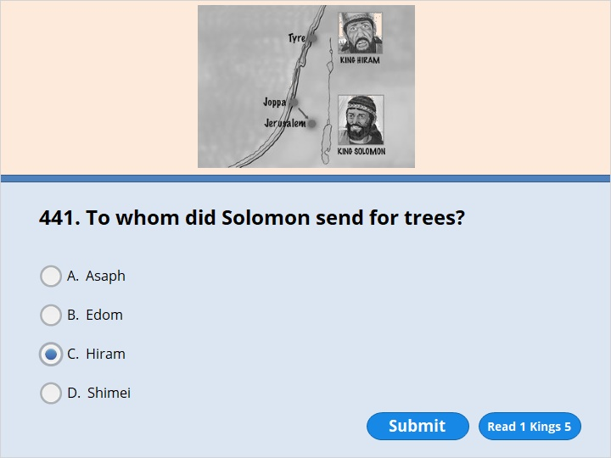
NEXT

Slide 52
NEXT

Slide 53
1 Kings 5:1
When Hiram king of Tyre heard that Solomon had been anointed king to succeed his father David, he sent his envoys to Solomon, because he had always been on friendly terms with David. 2 Solomon sent back this message to Hiram: 3 “You know that because of the wars waged against my father David from all sides, he could not build a temple for the Name of the Lord his God until the Lord put his enemies under his feet. 4 But now the Lord my God has given me rest on every side, and there is no adversary or disaster. 5 I intend, therefore, to build a temple for the Name of the Lord my God, as the Lord told my father David, when he said, ‘Your son whom I will put on the throne in your place will build the temple for my Name.’ 6 “So give orders that cedars of Lebanon be cut for me. My men will work with yours, and I will pay you for your men whatever wages you set. You know that we have no one so skilled in felling timber as the Sidonians.”

Slide 54
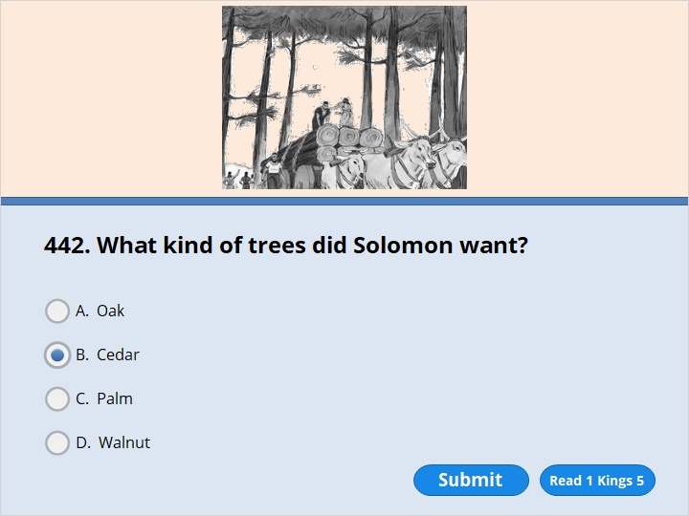
NEXT

Slide 55
NEXT

Slide 56
1 Kings 5:1
When Hiram king of Tyre heard that Solomon had been anointed king to succeed his father David, he sent his envoys to Solomon, because he had always been on friendly terms with David. 2 Solomon sent back this message to Hiram: 3 “You know that because of the wars waged against my father David from all sides, he could not build a temple for the Name of the Lord his God until the Lord put his enemies under his feet. 4 But now the Lord my God has given me rest on every side, and there is no adversary or disaster. 5 I intend, therefore, to build a temple for the Name of the Lord my God, as the Lord told my father David, when he said, ‘Your son whom I will put on the throne in your place will build the temple for my Name.’ 6 “So give orders that cedars of Lebanon be cut for me. My men will work with yours, and I will pay you for your men whatever wages you set. You know that we have no one so skilled in felling timber as the Sidonians.”

Slide 57
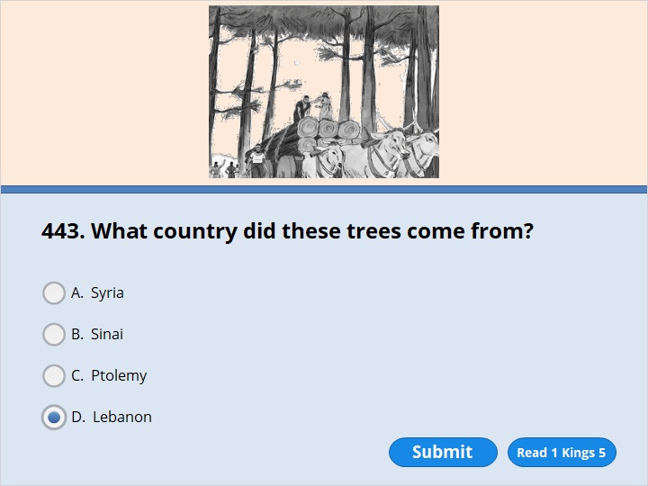
NEXT

Slide 58
NEXT

Slide 59
1 Kings 5:1
When Hiram king of Tyre heard that Solomon had been anointed king to succeed his father David, he sent his envoys to Solomon, because he had always been on friendly terms with David. 2 Solomon sent back this message to Hiram: 3 “You know that because of the wars waged against my father David from all sides, he could not build a temple for the Name of the Lord his God until the Lord put his enemies under his feet. 4 But now the Lord my God has given me rest on every side, and there is no adversary or disaster. 5 I intend, therefore, to build a temple for the Name of the Lord my God, as the Lord told my father David, when he said, ‘Your son whom I will put on the throne in your place will build the temple for my Name.’ 6 “So give orders that cedars of Lebanon be cut for me. My men will work with yours, and I will pay you for your men whatever wages you set. You know that we have no one so skilled in felling timber as the Sidonians.”

Slide 60
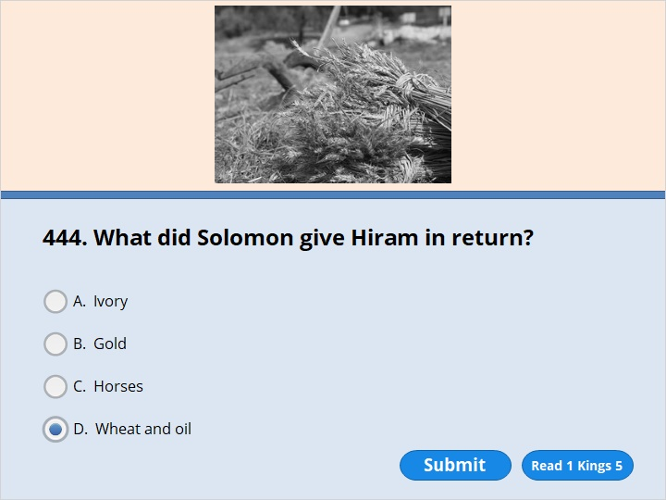
NEXT

Slide 61
NEXT

Slide 62
1 Kings 5:10
In this way Hiram kept Solomon supplied with all the cedar and juniper logs he wanted, 11 and Solomon gave Hiram twenty thousand cors[b] of wheat as food for his household, in addition to twenty thousand baths[c][d] of pressed olive oil. Solomon continued to do this for Hiram year after year.

Slide 63
NEXT

Slide 64
NEXT

Slide 65
1 Kings 6:1
In the four hundred and eightieth[a] year after the Israelites came out of Egypt, in the fourth year of Solomon’s reign over Israel, in the month of Ziv, the second month, he began to build the temple of the Lord.

Slide 66
NEXT

Slide 67
NEXT

Slide 68
2 Chronicles 7:1
When Solomon finished praying, fire came down from heaven and consumed the burnt offering and the sacrifices, and the glory of the Lord filled the temple.

Slide 69
NEXT

Slide 70
NEXT

Slide 71
1 Kings 7:1
But it took Solomon 13 years to finish constructing his palace and the other buildings related to it.

Slide 72
NEXT

Slide 73
NEXT

Slide 74
1 Kings 10:1
The queen of Sheba heard about how famous Solomon was. She also heard about how he served and worshiped the Lord. So she came to test Solomon with hard questions. 2 She arrived in Jerusalem with a very large group of attendants.

Slide 75
NEXT

Slide 76
NEXT

Slide 77
1 Kings 12:1
Rehoboam went to the city of Shechem. All the Israelites had gone there to make him king.

Slide 78
NEXT

Slide 79
NEXT

Slide 80
1 Kings 12:20
All the Israelites heard that Jeroboam had returned. They sent for him. They wanted him to meet with the whole community. Then they made him king over the entire nation of Israel. Only the tribe of Judah remained true to David’s royal family.

Slide 81
NEXT

Slide 82
NEXT

Slide 83
1 Kings 12:28
So King Jeroboam asked for advice. Then he made two golden statues that looked like calves. He said to the people, “It’s too hard for you to go up to Jerusalem. Israel, here are your gods who brought you up out of Egypt.” 29 He set up one statue in Bethel. He set up the other one in Dan. 30 What Jeroboam did was sinful. And it caused Israel to sin. The people came to worship the statue at Bethel. They went all the way to Dan to worship the statue that was there.

Slide 84
NEXT

Slide 85
NEXT

Slide 86
1 Kings 12:28
So King Jeroboam asked for advice. Then he made two golden statues that looked like calves. He said to the people, “It’s too hard for you to go up to Jerusalem. Israel, here are your gods who brought you up out of Egypt.” 29 He set up one statue in Bethel. He set up the other one in Dan. 30 What Jeroboam did was sinful. And it caused Israel to sin. The people came to worship the statue at Bethel. They went all the way to Dan to worship the statue that was there.

Slide 87
NEXT

Slide 88
NEXT

Slide 89
1 Kings 16:23
Omri became king of Israel. It was in the 31st year that Asa was king of Judah. Omri ruled for 12 years. He ruled in Tirzah for six of those years. 24 He bought the hill of Samaria from Shemer. He weighed out 150 pounds of silver for it. Then he built a city on the hill. He called it Samaria. He named it after Shemer. Shemer had owned the hill before him.

Slide 90
NEXT

Slide 91
NEXT

Slide 92
1 Kings 16:34
In Ahab’s time, Hiel from Bethel rebuilt Jericho. When he laid its foundations, it cost him the life of his oldest son Abiram. When he set up its gates, it cost him the life of his youngest son Segub. That’s what the Lord had said would happen. He had spoken it through Joshua, the son of Nun.

Slide 93
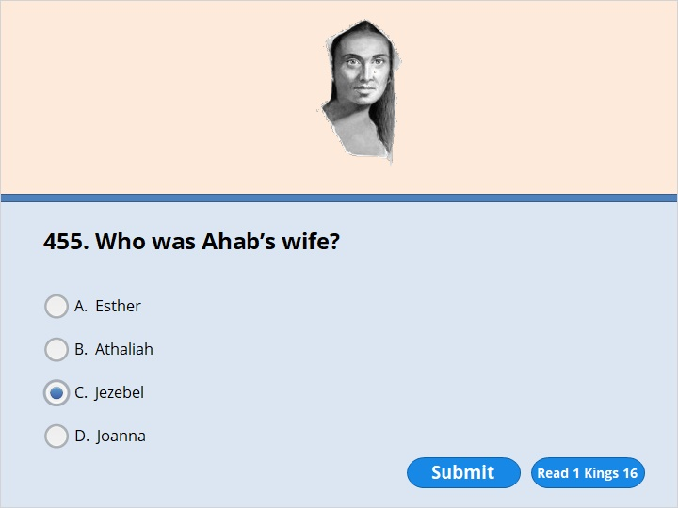
NEXT

Slide 94
NEXT

Slide 95
1 Kings 16:30
Ahab, the son of Omri, did what was evil in the sight of the Lord. He did more evil things than any of the kings who had ruled before him. 31 He thought it was only a small thing to commit the sins Jeroboam, the son of Nebat, had committed. Ahab also married Jezebel. She was Ethbaal’s daughter. Ethbaal was king of the people of Sidon. Ahab began to serve the god named Baal and worship him.

Slide 96
NEXT

Slide 97
NEXT

Slide 98
1 Kings 17:1
Elijah was from Tishbe in the land of Gilead. He said to Ahab, “I serve the Lord. He is the God of Israel. You can be sure that he lives. And you can be just as sure that there won’t be any dew or rain on the whole land. There won’t be any during the next few years. It won’t come until I say so.”

Slide 99
NEXT

Slide 100
NEXT

Slide 101
1 Kings 17:6
The ravens brought him bread and meat in the morning. They also brought him bread and meat in the evening. He drank water from the brook.

Slide 102
NEXT

Slide 103
NEXT

Slide 104
1 Kings 17:10
So Elijah went to Zarephath. He came to the town gate. A widow was there gathering sticks. He called out to her. He asked, “Would you bring me a little water in a jar? I need a drink.” 11 She went to get the water. Then he called out to her, “Please bring me a piece of bread too.”

Slide 105
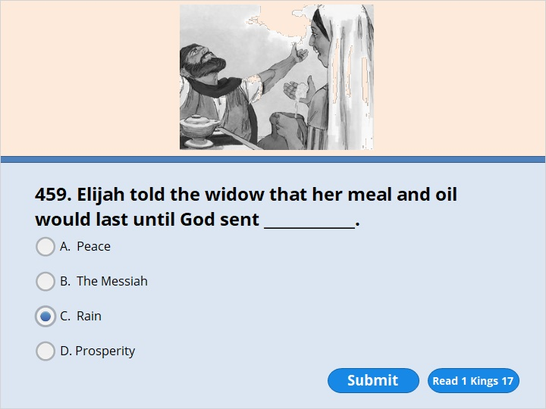
NEXT

Slide 106
NEXT

Slide 107
1 Kings 17:13
Elijah said to her, “Don’t be afraid. Go home. Do what you have said. But first make a small loaf of bread for me. Make it out of what you have. Bring it to me. Then make some for yourself and your son. 14 The Lord is the God of Israel. He says, ‘The jar of flour will not be used up. The jug will always have oil in it. You will have flour and oil until the day the Lord sends rain on the land.’ ”

Slide 108
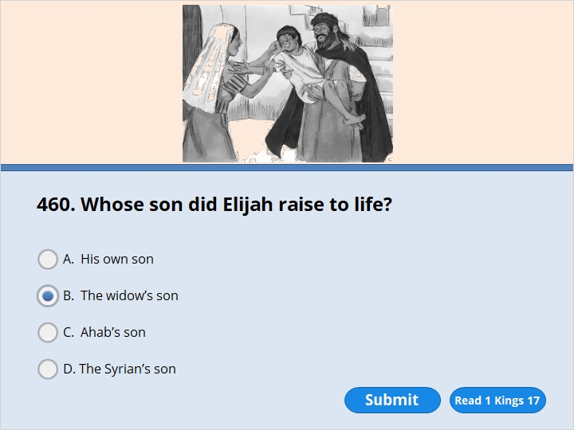
NEXT

Slide 109
NEXT

Slide 110
1 Kings 17:20
Then Elijah cried out to the Lord. He said, “Lord my God, I’m staying with this widow. Have you brought pain and sorrow even to her? Have you caused her son to die?” 21 Then he lay down on the boy three times. He cried out to the Lord. He said, “Lord my God, give this boy’s life back to him!”
22 The Lord answered Elijah’s prayer. He gave the boy’s life back to him. So the boy lived. 23 Elijah picked up the boy. He carried him down from the upstairs room into the house. He gave him to his mother. He said, “Look! Your son is alive!”

Slide 111
NEXT

Slide 112
NEXT

Slide 113
1 Kings 18:18
“I haven’t made trouble for Israel,” Elijah replied. “But you and your father’s family have. You have turned away from the Lord’s commands. You have followed gods that are named Baal. 19 Now send for people from all over Israel. Tell them to meet me on Mount Carmel. And bring the 450 prophets of the god named Baal. Also bring the 400 prophets of the female god named Asherah. All of them eat at Jezebel’s table.”

Slide 114
NEXT

Slide 115
NEXT

Slide 116
1 Kings 18:22
Then Elijah said to them, “I’m the only one of the Lord’s prophets left. But Baal has 450 prophets. 23 Get two bulls for us. Let Baal’s prophets choose one for themselves. Let them cut it into pieces. Then let them put it on the wood. But don’t let them set fire to it. I’ll prepare the other bull. I’ll put it on the wood. But I won’t set fire to it. 24 Then you pray to your god. And I’ll pray to the Lord. The god who answers by sending fire down is the one and only God.”

Slide 117
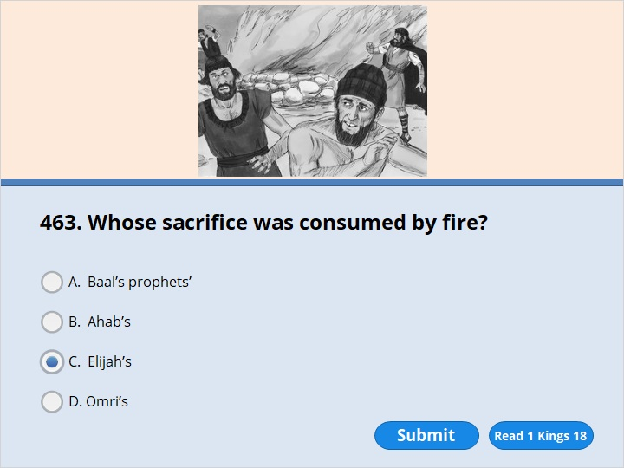
NEXT

Slide 118
NEXT

Slide 119
1 Kings 18:36
When it was time to offer the evening sacrifice, the prophet Elijah stepped forward. He prayed, “Lord, you are the God of Abraham, Isaac and Israel. Today let everyone know that you are God in Israel. Let them know I’m your servant. Let them know I’ve done all these things because you commanded me to. 37 Answer me. Lord, answer me. Then these people will know that you are the one and only God. They’ll know that you are turning their hearts back to you again.”
38 The fire of the Lord came down. It burned up the sacrifice. It burned up the wood and the stones and the soil. It even dried up the water in the ditch.

Slide 120
NEXT

Slide 121
NEXT

Slide 122
1 Kings 18:40
Then Elijah commanded them, “Grab the prophets of Baal. Don’t let a single one of them get away!” So they grabbed them. Elijah had them brought down to the Kishon Valley. There he had them put to death.

Slide 123
NEXT

Slide 124
NEXT

Slide 125
1 Kings 18:41
Elijah said to Ahab, “Go. Eat and drink. I can hear the sound of a heavy rain.” 42 So Ahab went off to eat and drink. But Elijah climbed to the top of Mount Carmel. He bent down toward the ground. Then he put his face between his knees.
43 “Go and look toward the sea,” he told his servant. So he went up and looked.
“I don’t see anything there,” he said.
Seven times Elijah said, “Go back.”
44 The seventh time the servant said, “I see a cloud. It’s as small as a man’s hand. It’s coming up over the sea.”
Elijah said, “Go to Ahab. Tell him, ‘Tie your chariot to your horse. Go down to Jezreel before the rain stops you.’ ”

Slide 126
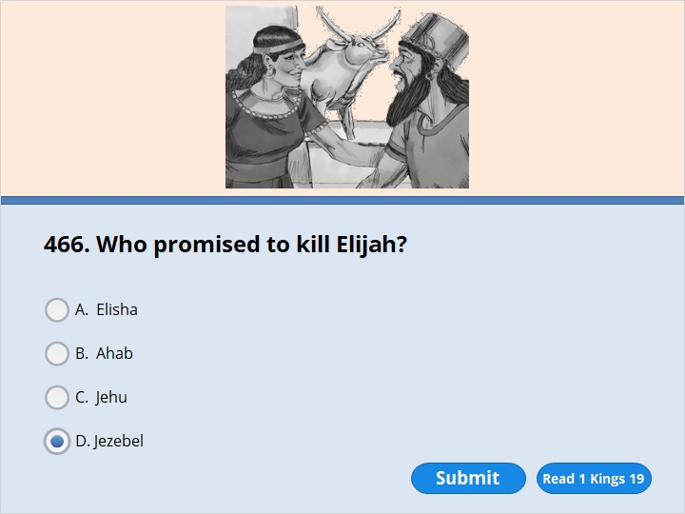
NEXT

Slide 127
NEXT

Slide 128
1 Kings 19:1
Ahab told Jezebel everything Elijah had done. He told her how Elijah had killed all the prophets of Baal with his sword. 2 So Jezebel sent a message to Elijah. She said, “You can be sure that I will kill you, just as I killed the other prophets. I’ll do it by this time tomorrow. If I don’t, may the gods punish me greatly.”

Slide 129
NEXT

Slide 130
NEXT

Slide 131
1 Kings 19:3
Elijah was afraid. So he ran for his life. He came to Beersheba in Judah. He left his servant there. 4 Then he traveled for one day into the desert. He came to a small bush. He sat down under it. He prayed that he would die. “Lord, I’ve had enough,” he said. “Take my life. I’m no better than my people of long ago.” 5 Then he lay down under the bush. And he fell asleep.
Suddenly an angel touched him. The angel said, “Get up and eat.”

Slide 132
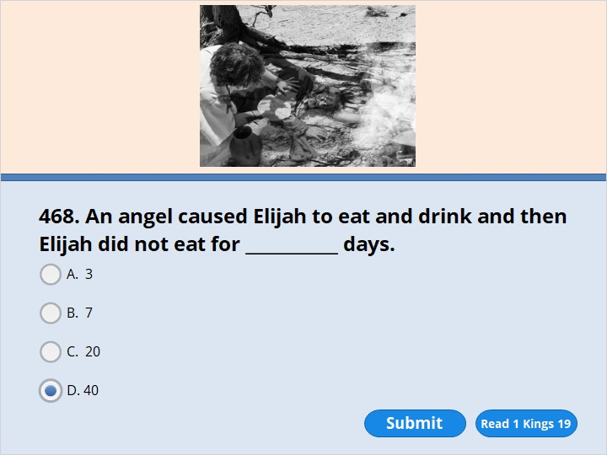
NEXT

Slide 133
NEXT

Slide 134
1 Kings 19:7
The angel of the Lord came to him a second time. He touched him and said, “Get up and eat. Your journey will be long and hard.” 8 So he got up. He ate and drank. The food gave him new strength. He traveled for 40 days and 40 nights. He kept going until he arrived at Horeb. It was the mountain of God. 9 There he went into a cave and spent the night.

Slide 135
NEXT

Slide 136
NEXT

Slide 137
1 Kings 19:12
After the earthquake a fire came. But the Lord wasn’t in the fire. And after the fire there was only a gentle whisper. 13 When Elijah heard it, he pulled his coat over his face. He went out and stood at the entrance to the cave.
Then a voice said to him, “Elijah, what are you doing here?”

Slide 138
NEXT

Slide 139
NEXT

Slide 140
1 Kings 19:15
The Lord said to him, “Go back the way you came. Go to the Desert of Damascus. When you get there, anoint Hazael as king over Aram. 16 Also anoint Jehu as king over Israel. He is the son of Nimshi. And anoint Elisha from Abel Meholah as the next prophet after you. He is the son of Shaphat. 17 Jehu will put to death anyone who escapes Hazael’s sword. And Elisha will put to death anyone who escapes Jehu’s sword. 18 But I will keep 7,000 people in Israel for myself. They have not bowed down to Baal. And they have not kissed him.”

Slide 141
NEXT

Slide 142
NEXT

Slide 143
1 Kings 19:15
The Lord said to him, “Go back the way you came. Go to the Desert of Damascus. When you get there, anoint Hazael as king over Aram. 16 Also anoint Jehu as king over Israel. He is the son of Nimshi. And anoint Elisha from Abel Meholah as the next prophet after you. He is the son of Shaphat. 17 Jehu will put to death anyone who escapes Hazael’s sword. And Elisha will put to death anyone who escapes Jehu’s sword. 18 But I will keep 7,000 people in Israel for myself. They have not bowed down to Baal. And they have not kissed him.”

Slide 144
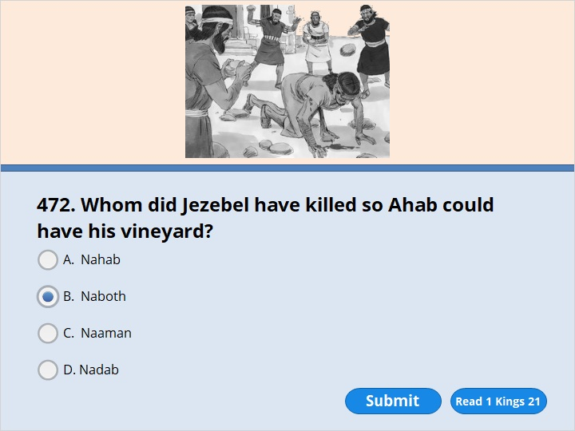
NEXT

Slide 145
NEXT

Slide 146
1 Kings 21:14
Then they sent a message to Jezebel. They said, “Naboth is dead. We killed him by throwing stones at him.”
15 Jezebel heard that Naboth had been killed. As soon as she heard it, she said to Ahab, “Get up. Take over the vineyard of Naboth from Jezreel. It’s the one he wouldn’t sell to you. He isn’t alive anymore. He’s dead.” 16 Ahab heard that Naboth was dead. So Ahab got up and went down to take over Naboth’s vineyard.

Slide 147
NEXT

Slide 148
NEXT

Slide 149
2 Kings 2:7
Fifty men from the group of prophets followed them. The men stopped and stood not far away from them. They faced the place where Elijah and Elisha had stopped at the Jordan River. 8 Elijah rolled up his coat. Then he struck the water with it. The water parted to the right and to the left. The two of them went across the river on dry ground.

Slide 150
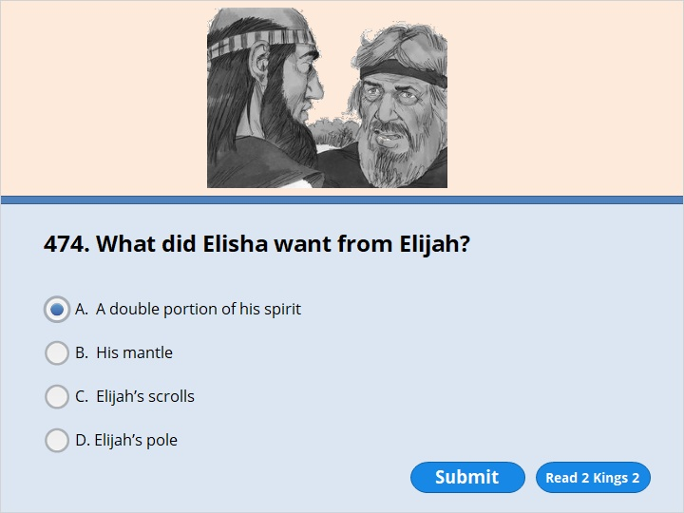
NEXT

Slide 151
NEXT

Slide 152
2 Kings 2:9
After they had gone across, Elijah said to Elisha, “Tell me. What can I do for you before I’m taken away from you?”
“Please give me a double share of your spirit,” Elisha replied.

Slide 153
NEXT

Slide 154
NEXT

Slide 155
2 Kings 2:10
“You have asked me for something that’s very hard to do,” Elijah said. “But suppose you see me when I’m taken away from you. Then you will receive what you have asked for. If you don’t see me, you won’t receive it.”

Slide 156
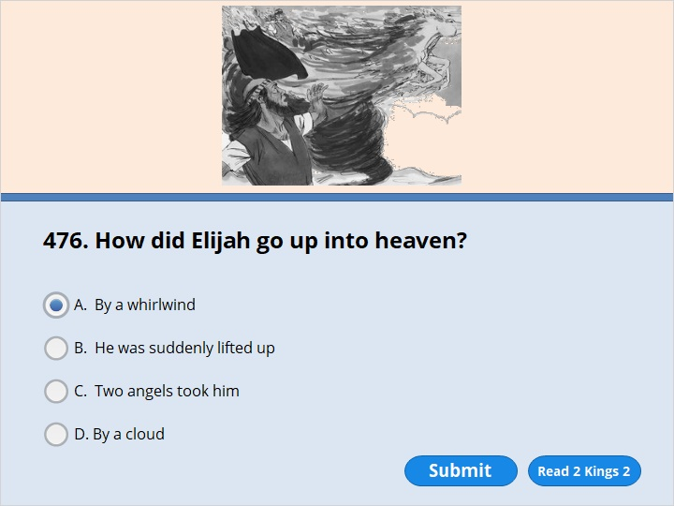
NEXT

Slide 157
NEXT

Slide 158
2 Kings 2:11
They kept walking along and talking together. Suddenly there appeared a chariot and horses made of fire. The chariot and horses came between the two men. Then Elijah went up to heaven in a strong wind. 12 Elisha saw it and cried out to Elijah, “My father! You are like a father to me! You, Elijah, are the true chariots and horsemen of Israel!” Elisha didn’t see Elijah anymore. Then Elisha took hold of his own garment and tore it in two.

Slide 159
NEXT

Slide 160
NEXT

Slide 161
2 Kings 2:13
He picked up the coat that had fallen from Elijah. He went back and stood on the bank of the Jordan River. 14 Then he struck the water with Elijah’s coat. “Where is the power of the Lord?” he asked. “Where is the power of the God of Elijah?” When Elisha struck the water, it parted to the right and to the left. He went across the river.

Slide 162
NEXT

Slide 163
NEXT

Slide 164
2 Kings 2:21
Then he went out to the spring. He threw the salt into it. He told the people, “The Lord says, ‘I have made this water pure. It will never cause death again. It will never keep the land from producing crops again.’ ” 22 The water has stayed pure to this day. That’s what Elisha had said would happen.

Slide 165
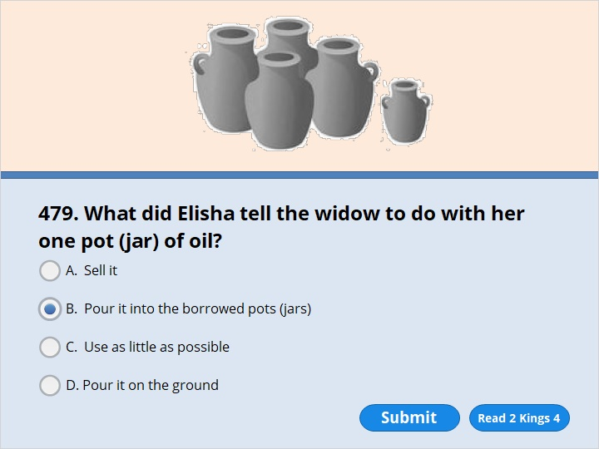
NEXT

Slide 166
NEXT

Slide 167
2 Kings 4:3
Elisha said, “Go around to all your neighbors. Ask them for empty jars. Get as many as you can. 4 Then go inside your house. Shut the door behind you and your sons. Pour oil into all the jars. As each jar is filled, put it over to one side.”

Slide 168
NEXT

Slide 169
NEXT

Slide 170
2 Kings 4:8
One day Elisha went to the town of Shunem. A rich woman lived there. She begged him to stay and have a meal. So every time he came by, he stopped there to eat. 9 The woman said to her husband, “That man often comes by here. I know that he is a holy man of God. 10 Let’s make a small room for him on the roof. We’ll put a bed and a table in it. We’ll also put a chair and a lamp in it. Then he can stay there when he comes to visit us.”

Slide 171
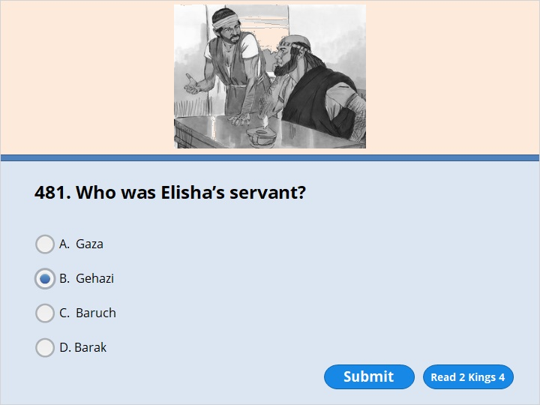
NEXT

Slide 172
NEXT

Slide 173
2 Kings 4:11
One day Elisha came. He went up to his room and lay down there. 12 He said to his servant Gehazi, “Go and get the woman from Shunem.” So he did. She stood in front of Elisha. 13 He said to Gehazi, “Tell her, ‘You have gone to a lot of trouble for us. Now what can we do for you? Can we speak to the king for you? Or can we speak to the commander of the army for you?’ ”

Slide 174
NEXT

Slide 175
NEXT

Slide 176
2 Kings 4:40
The stew was poured out for the men. They began to eat it. But then they cried out, “Man of God, the food in that pot will kill us!” They couldn’t eat it.
41 Elisha said, “Get some flour.” He put it in the pot. He said, “Serve it to the men to eat.” Then there wasn’t anything in the pot that could harm them.

Slide 177
NEXT

Slide 178
NEXT

Slide 179
2 Kings 5:1
Naaman was army commander of the king of Aram. He was very important to his master and was highly respected. That’s because the Lord had helped him win the battle over Aram’s enemies. He was a brave soldier. But he had a skin disease.

Slide 180
NEXT

Slide 181
NEXT

Slide 182
2 Kings 5:1
Naaman was army commander of the king of Aram. He was very important to his master and was highly respected. That’s because the Lord had helped him win the battle over Aram’s enemies. He was a brave soldier. But he had a skin disease.

Slide 183
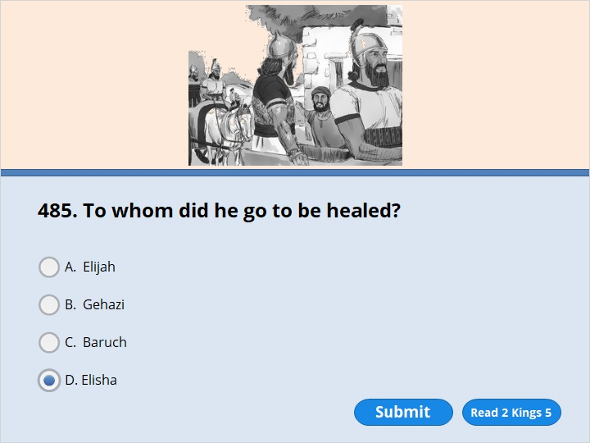
NEXT

Slide 184
NEXT

Slide 185
2 Kings 5:9
So Naaman went to see Elisha. He took his horses and chariots with him. He stopped at the door of Elisha’s house. 10 Elisha sent a messenger out to him. The messenger said, “Go! Wash yourself in the Jordan River seven times. Then your skin will be healed. You will be pure and ‘clean’ again.”

Slide 186
NEXT

Slide 187
NEXT

Slide 188
2 Kings 5:9
So Naaman went to see Elisha. He took his horses and chariots with him. He stopped at the door of Elisha’s house. 10 Elisha sent a messenger out to him. The messenger said, “Go! Wash yourself in the Jordan River seven times. Then your skin will be healed. You will be pure and ‘clean’ again.”

Slide 189
NEXT

Slide 190
NEXT

Slide 191
2 Kings 5:13
Naaman’s servants went over to him. They said, “You are like a father to us. What if Elisha the prophet had told you to do some great thing? Wouldn’t you have done it? But he only said, ‘Wash yourself. Then you will be pure and “clean.” ’ You should be even more willing to do that!”

Slide 192
NEXT

Slide 193
NEXT

Slide 194
2 Kings 5:14
So Naaman went down to the Jordan River. He dipped himself in it seven times. He did exactly what the man of God had told him to do. Then his skin was made pure again. It became “clean” like the skin of a young boy.

Slide 195
NEXT

Slide 196
NEXT

Slide 197
2 Kings 5:20
Gehazi was the servant of Elisha, the man of God. Gehazi said to himself, “My master was too easy on Naaman from Aram. He should have accepted the gift Naaman brought. I’m going to run after him. I’m going to get something from him. And that’s just as sure as the Lord is alive.”
21 Gehazi hurried after Naaman. Naaman saw him running toward him. So he got down from the chariot to greet him. “Is everything all right?” he asked.
22 “Everything is all right,” Gehazi answered. “My master sent me to say, ‘Two young men from the group of the prophets have just come to me. They’ve come from the hill country of Ephraim. Please give them 75 pounds of silver and two sets of clothes.’ ”
23 “I wish you would take twice as much silver,” said Naaman. He begged Gehazi to accept it.

Slide 198
NEXT

Slide 199
NEXT

Slide 200
2 Kings 5:26
But Elisha said to him, “Didn’t my spirit go with you? I know that the man got down from his chariot to greet you. Is this the time for you to accept money or clothes? Is it the time to take olive groves, vineyards, flocks or herds? Is it the time to accept male and female slaves? 27 You and your children after you will have Naaman’s skin disease forever.” Then Gehazi left Elisha. And he had Naaman’s skin disease. His skin had become as white as snow.

Slide 201
NEXT

Slide 202
NEXT

Slide 203
2 Kings 6:5
One of them was cutting down a tree. The iron blade of his ax fell into the water. “Oh no, master!” he cried out. “This ax was borrowed!”
6 The man of God asked, “Where did the blade fall?” He showed Elisha the place. Then Elisha cut a stick and threw it there. That made the iron blade float. 7 “Take it out of the water,” he said. So the man reached out and took it.

Slide 204
NEXT

Slide 205
NEXT

Slide 206
2 Kings 13:20
Elisha died and was buried. Some robbers from Moab used to enter the country of Israel every spring. 21 One day some Israelites were burying a man. Suddenly they saw a group of robbers. So they threw the man’s body into Elisha’s tomb. The body touched Elisha’s bones. When it did, the man came back to life again. He stood up on his feet.

Slide 207
NEXT

Slide 208
NEXT

Slide 209
2 Kings 13:23
But the Lord helped Israel. He was tender and kind to them. He showed concern for them. He did all these things because of the covenant he had made with Abraham, Isaac and Jacob. To this day he hasn’t been willing to destroy Israel. And he hasn’t driven them out of his land.

Slide 210
NEXT

Slide 211
NEXT

Slide 212
2 Kings 17:6
Finally, the king of Assyria captured Samaria. It was in the ninth year of Hoshea. The king of Assyria took the Israelites away from their own land. He sent them off to Assyria. He made some of them live in Halah. He made others live in Gozan on the Habor River. And he made others live in the towns of the Medes.

Slide 213
NEXT

Slide 214
NEXT

Slide 215
2 Kings 18:19
The field commander said to them, “Give Hezekiah this message. Tell him,
“ ‘Sennacherib is the great king of Assyria. He says, “Why are you putting your faith in what your king says? 20 You say you have a military plan. You say you have a strong army. But your words don’t mean anything. Who are you depending on? Why don’t you want to stay under my control? 21 Look, I know you are depending on Egypt. Why are you doing that? Egypt is nothing but a broken papyrus stem. Try leaning on it. It will only cut your hand. Pharaoh, the king of Egypt, is just like that to everyone who depends on him. 22 But suppose you say to me, ‘We are depending on the Lord our God.’ Didn’t Hezekiah remove your god’s high places and altars? Didn’t Hezekiah say to the people of Judah and Jerusalem, ‘You must worship at the altar in Jerusalem’?

Slide 216
NEXT

Slide 217
NEXT

Slide 218
2 Kings 19:1
When King Hezekiah heard what the field commander had said, he tore his clothes. He put on the rough clothing people wear when they’re sad. Then he went into the Lord’s temple. 2 Hezekiah sent Eliakim, who was in charge of the palace, to Isaiah the prophet. Isaiah was the son of Amoz. Hezekiah also sent to Isaiah the leading priests and Shebna the secretary. All of them were wearing the same rough clothing.

Slide 219
NEXT

Slide 220
NEXT

Slide 221
2 Kings 19:35
That night the angel of the Lord went into the camp of the Assyrians. He put to death 185,000 people there. The people of Jerusalem got up the next morning and looked out at the camp. There were all the dead bodies! 36 So Sennacherib, the king of Assyria, took the army tents down. Then he left. He returned to Nineveh and stayed there.

Slide 222
NEXT

Slide 223
NEXT

Slide 224
2 Kings 20:5
“Go back and speak to Hezekiah. He is the ruler of my people. Tell him, ‘The Lord, the God of King David, says, “I have heard your prayer. I have seen your tears. And I will heal you. On the third day from now you will go up to my temple. 6 I will add 15 years to your life. And I will save you and this city from the power of the king of Assyria. I will guard this city. I will do it for myself. And I will do it for my servant David.” ’ ”

Slide 225
NEXT

Slide 226
NEXT

Slide 227
2 Kings 20:9
Isaiah answered, “The Lord will do what he has promised. Here is his sign to you. Do you want the shadow the sun makes to go forward ten steps? Or do you want it to go back ten steps?”
10 “It’s easy for the shadow to go forward ten steps,” said Hezekiah. “So have it go back ten steps.”

Slide 228
NEXT

Slide 229
NEXT

Slide 230
2 Kings 20:14
Then Isaiah the prophet went to King Hezekiah. He asked him, “What did those men say? Where did they come from?”
“They came from a land far away,” Hezekiah said. “They came from Babylon.”
15 The prophet asked, “What did they see in your palace?”
“They saw everything in my palace,” Hezekiah said. “I showed them all my treasures.”

Slide 231
NEXT

Slide 232
NEXT

Slide 233
2 Kings 20:19
“The message the Lord has spoken through you is good,” Hezekiah replied. He thought, “There will be peace and safety while I’m still living.”

Slide 234
NEXT

Slide 235
NEXT

Slide 236
2 Kings 22:1
Josiah was eight years old when he became king. He ruled in Jerusalem for 31 years. His mother’s name was Jedidah. She was the daughter of Adaiah. She was from Bozkath. 2 Josiah did what was right in the eyes of the Lord. He lived the way King David had lived. He didn’t turn away from it to the right or the left.

Slide 237
NEXT

Slide 238
NEXT

Slide 239
2 Kings 22:8
Hilkiah the high priest spoke to Shaphan the secretary. Hilkiah said, “I’ve found the Book of the Law in the Lord’s temple.” Hilkiah gave it to Shaphan, who read it. 9 Then Shaphan went to King Josiah. Shaphan told him, “Your officials have paid out the money that was in the Lord’s temple. They’ve put it in the care of the workers and directors there.” 10 Shaphan continued, “Hilkiah the priest has given me a book.” Shaphan read some of it to the king.

Slide 240
NEXT

Slide 241
NEXT

Slide 242
2 Kings 24:1
During Jehoiakim’s rule, Nebuchadnezzar marched into the land and attacked it. He was king of Babylon. He became Jehoiakim’s master for three years. But then Jehoiakim decided he didn’t want to remain under Nebuchadnezzar’s control.

Slide 243
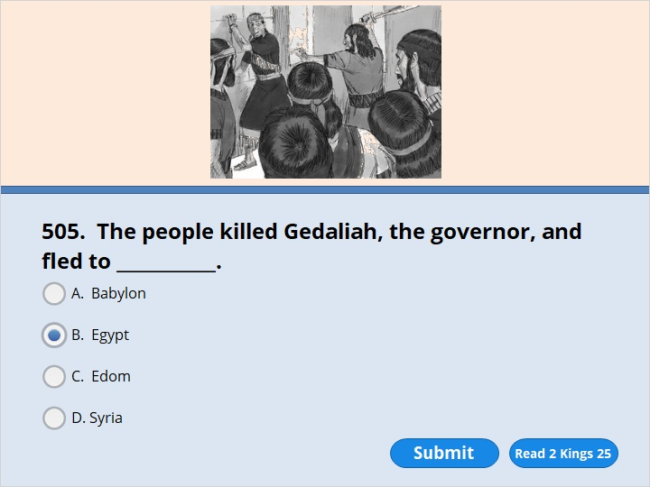
NEXT

Slide 244
NEXT

Slide 245
2 Kings 25:25
But in the seventh month Ishmael, the son of Nethaniah, came with ten men. He killed Gedaliah. He also killed the people of Judah and the Babylonians who were with Gedaliah at Mizpah. Nethaniah was the son of Elishama. Ishmael was a member of the royal family. 26 After he had killed Gedaliah, all the people ran away to Egypt. Everyone from the least important of them to the most important ran away. The army officers went with them. All of them went to Egypt because they were afraid of the Babylonians.

Slide 246
NEXT

Slide 247
NEXT

Slide 248
Ezra 1:2
“Cyrus, the king of Persia, says,“ ‘The Lord is the God of heaven. He has given me all the kingdoms on earth. He has appointed me to build a temple for him at Jerusalem in Judah. 3 Any of his people among you may go up to Jerusalem and build the Lord’s temple. He is the God of Israel. He is the God who is in Jerusalem. And may their God be with them. 4 The people still left alive in every place must bring gifts to the people going. They must provide silver and gold to the people going up to Jerusalem. The people must bring goods and livestock. They should also bring any offerings they choose to. All those gifts will be for God’s temple in Jerusalem.’ ”

Slide 249
NEXT

Slide 250
NEXT

Slide 251
Ezra 3:3
The Israelites had made their homes in their towns. In the seventh month all of them gathered together in Jerusalem. 2 Then Joshua began to build the altar for burnt offerings to honor the God of Israel. Joshua was the son of Jozadak. The other priests helped Joshua. So did Zerubbabel and his men. They built the altar according to what is written in the Law of Moses. Moses was a man of God. Zerubbabel was the son of Shealtiel.

Slide 252
NEXT

Slide 253
NEXT

Slide 254
Ezra 2:2
Nebuchadnezzar had taken many Jews away from the land of Judah. He had forced them to go to Babylon as prisoners. Now they returned to Jerusalem and Judah. All of them went back to their own towns. Nebuchadnezzar was king of Babylon. 2 The leaders of the Jews included Zerubbabel, Joshua, Nehemiah, Seraiah and Reelaiah. They also included Mordecai, Bilshan, Mispar, Bigvai, Rehum and Baanah.

Slide 255
NEXT

Slide 256
NEXT

Slide 257
Ezra 5:1
Haggai and Zechariah, the prophets, prophesied to the Jews in Judah and Jerusalem. They spoke to them in the name of the God of Israel. God had spoken to those prophets. Zechariah belonged to the family line of Iddo.

Slide 258
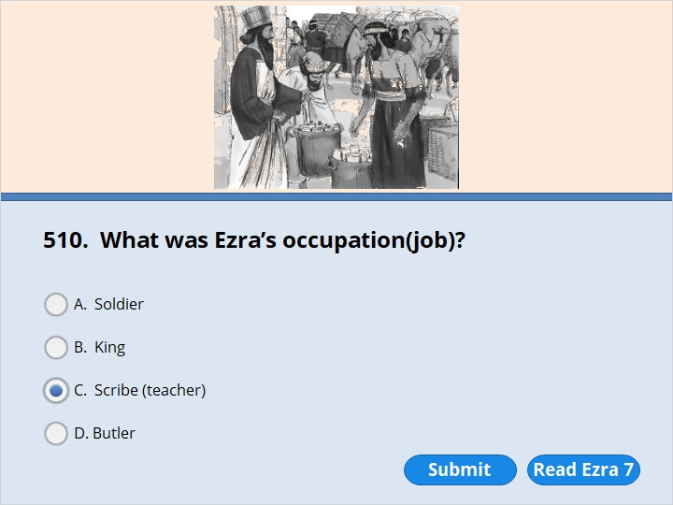
NEXT

Slide 259
NEXT

Slide 260
Ezra 7:6
So Ezra came up from Babylon. He was a teacher who knew the Law of Moses very well. The Lord, the God of Israel, had given Israel that law. The king had given Ezra everything he asked for. That’s because the Lord his God helped him. 7 Some of the Israelites came up to Jerusalem too. They included priests, Levites and musicians. They also included the temple servants and those who guarded the temple gates. It was in the seventh year that Artaxerxes was king.

Slide 261
NEXT

Slide 262
NEXT

Slide 263
Ezra 9:1
After all these things had been done, the leaders came to me. They said, “The people of Israel have committed sins. Even the priests and Levites have sinned. They haven’t kept themselves separate from the nations around them. The Lord hates the practices of those nations. He hates what the Canaanites, Hittites, Perizzites and Jebusites do. He also hates what the Ammonites, Moabites, Egyptians and Amorites do. 2 The men of Israel have married the daughters of some of those people. They’ve also taken some of those women for their sons to marry. So they’ve mixed our holy nation with the nations around us. We leaders and officials have also married women who don’t worship the Lord. By doing this, we have led the way in breaking our covenant with the Lord.”

Slide 264
NEXT

Slide 265
NEXT

Slide 266
Nehemiah 1:1
These are the words of Nehemiah. He was the son of Hakaliah.
I was in the fort of Susa. I was there in the 20th year that Artaxerxes was king. It was in the month of Kislev.

Slide 267
NEXT

Slide 268
NEXT

Slide 269
Nehemiah 1:10
“Lord, they are your people. They serve you. You used your great strength and mighty hand to set them free from Egypt. 11 Lord, please pay careful attention to my prayer. Listen to the prayers of all of us. We take delight in bringing honor to your name. Give me success today when I bring my request to King Artaxerxes.”
I was the king’s wine taster.

Slide 270
NEXT

Slide 271
NEXT

Slide 272
Nehemiah 2:1
Wine was brought in for King Artaxerxes. It was the month of Nisan in the 20th year of his rule. I got the wine and gave it to him. I hadn’t been sad in front of him before. But now I was. 2 So the king asked me, “Why are you looking so sad? You aren’t sick. You must be feeling very sad.” I was really afraid. 3 But I said to the king, “May you live forever! Why shouldn’t I look sad? The city where my people of long ago are buried has been destroyed. And fire has burned up its gates.”

Slide 273
NEXT

Slide 274
NEXT

Slide 275
Nehemiah 2:4
The king said to me, “What do you want?”
I prayed to the God of heaven. 5 Then I answered the king, “Are you pleased with me, King Artaxerxes? If it pleases you, send me to Judah. Let me go to the city of Jerusalem. That’s where my people are buried. I want to rebuild it.”

Slide 276
NEXT

Slide 277
NEXT

Slide 278
Nehemiah 2:10
Sanballat and Tobiah heard about what was happening. Sanballat was a Horonite. Tobiah was an official from Ammon. They were very upset that someone had come to help the Israelites.

Slide 279
NEXT

Slide 280
NEXT

Slide 281
Nehemiah 6:14
You are my God. Remember what Tobiah and Sanballat have done. Also remember the prophet Noadiah. She and the rest of the prophets have been trying to scare me. 15 So the city wall was completed on the 25th day of the month of Elul. It was finished in 52 days.

Slide 282
NEXT

Slide 283
NEXT

Slide 284
Esther 1:1
King Xerxes ruled over the 127 territories in his kingdom. They reached from India all the way to Cush. Here is what happened during the time Xerxes ruled over the whole Persian kingdom.

Slide 285
NEXT

Slide 286
NEXT

Slide 287
Esther 1:1
King Xerxes ruled over the 127 territories in his kingdom. They reached from India all the way to Cush. Here is what happened during the time Xerxes ruled over the whole Persian kingdom.

Slide 288
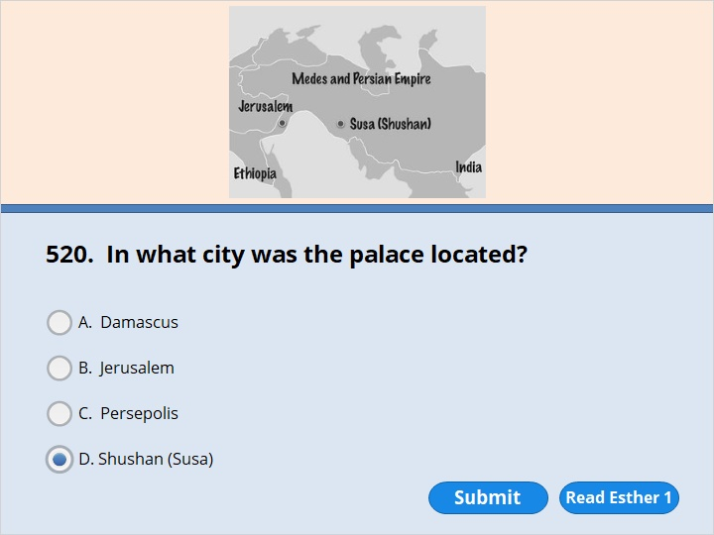
NEXT

Slide 289
NEXT

Slide 290
Esther 1:2
He was ruling from his royal throne in the fort of Susa.

Slide 291
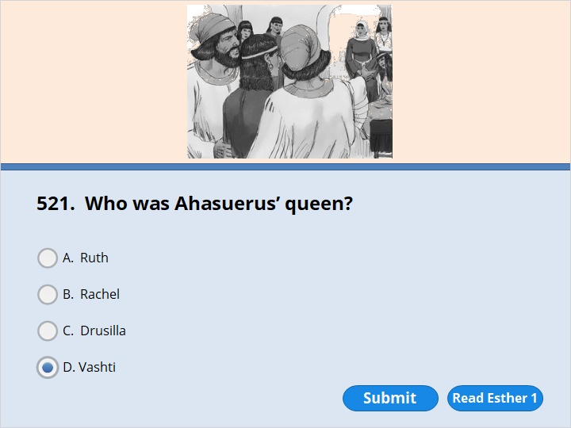
NEXT

Slide 292
NEXT

Slide 293
Esther 1:9
Queen Vashti also gave a feast. Only women were invited. It was held in the royal palace of King Xerxes.

Slide 294
NEXT

Slide 295
NEXT

Slide 296
Esther 1:11
King Xerxes told them to bring Queen Vashti to him. He wanted her to come wearing her royal crown. He wanted to show off her beauty to the people and nobles. She was lovely to look at. 12 The attendants told Queen Vashti what the king had ordered her to do. But she refused to come. So the king became very angry.

Slide 297
NEXT

Slide 298
NEXT

Slide 299
Esther 2:17
The king liked Esther more than he liked any of the other women. She pleased him more than any of the other virgins. So he put a royal crown on her head. He made her queen in Vashti’s place.

Slide 300
NEXT

Slide 301
NEXT

Slide 302
Esther 2:7
Mordecai had a cousin named Hadassah. He had raised her because she didn’t have a father or mother. Hadassah was also called Esther. She had a lovely figure and was very beautiful. Mordecai had adopted her as his own daughter. He had done it when her father and mother died.

Slide 303
NEXT

Slide 304
NEXT

Slide 305
Esther 2:7
Mordecai had a cousin named Hadassah. He had raised her because she didn’t have a father or mother. Hadassah was also called Esther. She had a lovely figure and was very beautiful. Mordecai had adopted her as his own daughter. He had done it when her father and mother died.

Slide 306
NEXT

Slide 307
NEXT

Slide 308
Esther 2:7
Mordecai had a cousin named Hadassah. He had raised her because she didn’t have a father or mother. Hadassah was also called Esther. She had a lovely figure and was very beautiful. Mordecai had adopted her as his own daughter. He had done it when her father and mother died.

Slide 309
NEXT

Slide 310
NEXT

Slide 311
Esther 2:21
Bigthana and Teresh were two of the king’s officers. They guarded the door of the royal palace. They became angry with King Xerxes. So they decided to kill him. They made their evil plans while Mordecai was sitting at the palace gate. 22 So Mordecai found out about it and told Queen Esther. Then she reported it to the king. She told him that Mordecai had uncovered the plans against him.

Slide 312
NEXT

Slide 313
NEXT

Slide 314
Esther 2:21
Bigthana and Teresh were two of the king’s officers. They guarded the door of the royal palace. They became angry with King Xerxes. So they decided to kill him. They made their evil plans while Mordecai was sitting at the palace gate. 22 So Mordecai found out about it and told Queen Esther. Then she reported it to the king. She told him that Mordecai had uncovered the plans against him.

Slide 315
NEXT

Slide 316
NEXT

Slide 317
Esther 3:1
After those events, King Xerxes honored Haman. Haman was the son of Hammedatha. He was from the family line of Agag. The king gave Haman a higher position than he had before. He gave him a seat of honor. It was higher than the positions any of the other nobles had.

Slide 318
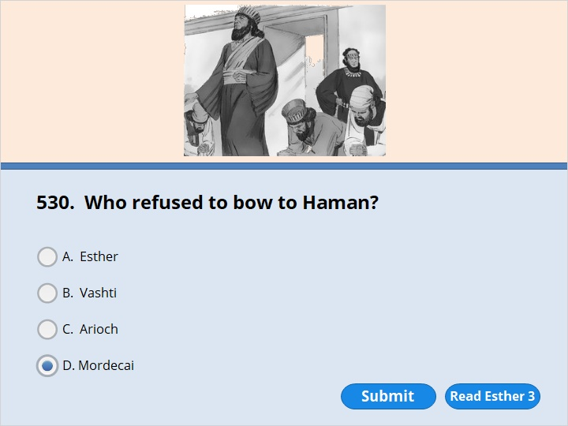
NEXT

Slide 319
NEXT

Slide 320
Esther 3:2
All the royal officials at the palace gate got down on their knees. They gave honor to Haman. That’s because the king had commanded them to do it. But Mordecai refused to get down on his knees. He wouldn’t give Haman any honor at all.

Slide 321
NEXT

Slide 322
NEXT

Slide 323
Esther 3:8
Then Haman said to King Xerxes, “Certain people are scattered among the nations. They live in all the territories in your kingdom. They keep themselves separate from everyone else. Their practices are different from the practices of all other people. They don’t obey your laws. It really isn’t good for you to put up with them. 9 If it pleases you, give the order to destroy them. I’ll even add 375 tons of silver to the king’s officials for the royal treasures.” 10 So the king took his ring off his finger. The ring had his royal seal on it. He gave the ring to Haman. Haman was the son of Hammedatha, the Agagite. Haman was the enemy of the Jews. 11 “Keep the money,” the king said to Haman. “Do what you want to with those people.”

Slide 324
NEXT

Slide 325
NEXT

Slide 326
Esther 4:10
Then Esther directed him to give an answer to Mordecai. She told him to say, 11 “There is a certain law that everyone knows about. All the king’s officials know about it. The people in the royal territories know about it. It applies to any man or woman who approaches the king in the inner courtyard without being sent for. It says they must be put to death. But there is a way out. Suppose the king reaches out his gold scepter toward them. Then their lives will be spared. But 30 days have gone by since the king sent for me.”

Slide 327
NEXT

Slide 328
NEXT

Slide 329
Esther 4:15
Then Esther sent a reply to Mordecai. She said, 16 “Go. Gather together all the Jews who are in Susa. And fast for my benefit. Don’t eat or drink anything for three days. Don’t do it night or day. I and my attendants will fast just as you do. Then I’ll go to the king. I’ll do it even though it’s against the law. And if I have to die, I’ll die.”

Slide 330
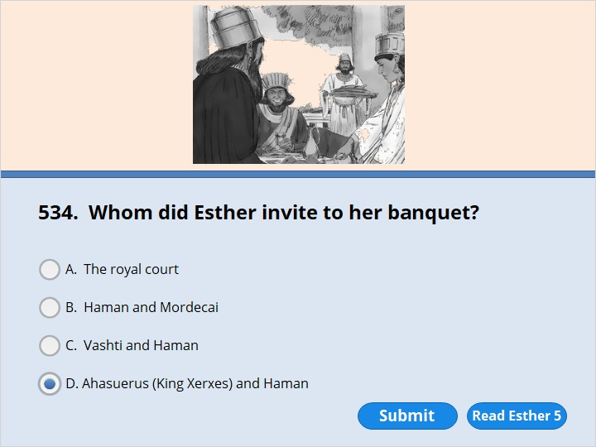
NEXT

Slide 331
NEXT

Slide 332
Esther 5:4
Esther replied, “King Xerxes, if it pleases you, come to a feast today. I’ve prepared it for you. Please have Haman come with you.”

Slide 333
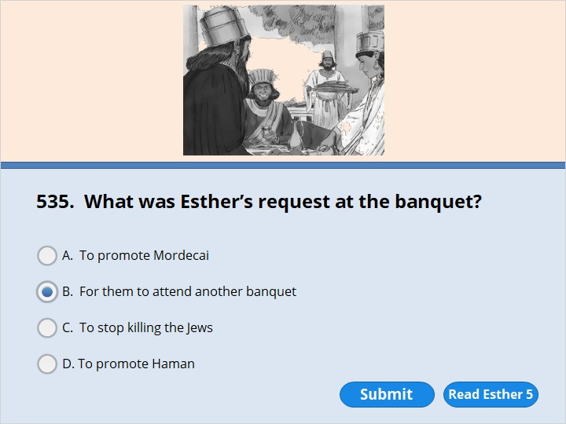
NEXT

Slide 334
NEXT

Slide 335
Esther 5:7
Esther replied, “Here is what I want. Here is my appeal to you. 8 I hope you will be pleased to give me what I want. And I hope you will be pleased to listen to my appeal. If you are, I’d like you and Haman to come tomorrow to the feast I’ll prepare for you. Then I’ll answer your question.”

Slide 336
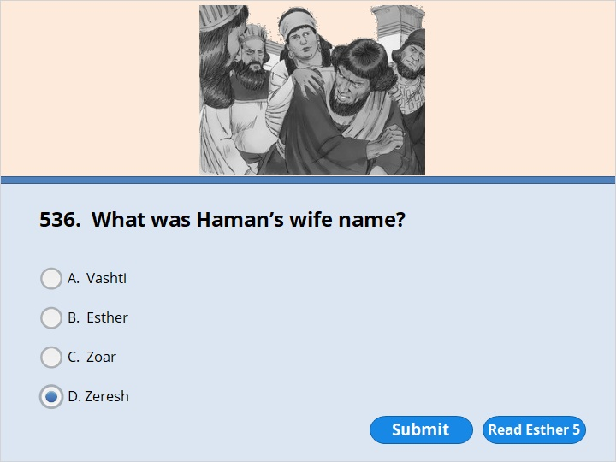
NEXT

Slide 337
NEXT

Slide 338
Esther 5:10
But Haman was able to control himself. He went on home. Haman called together his friends and his wife Zeresh.

Slide 339
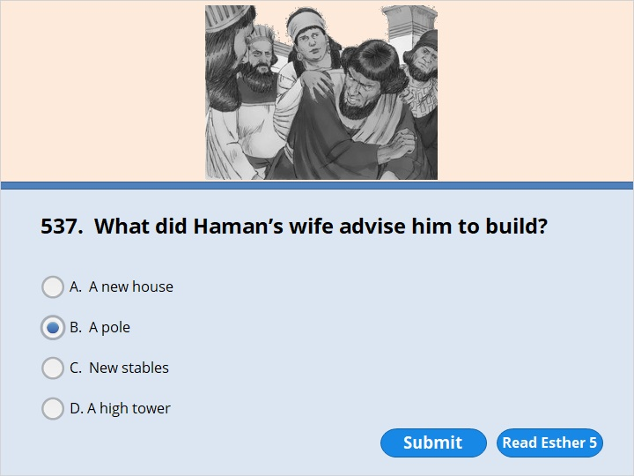
NEXT

Slide 340
NEXT

Slide 341
Esther 5:14
Haman’s wife Zeresh and all his friends said to him, “Get a pole. In the morning, ask the king to have Mordecai put to death. Have the pole stuck through his body. Set it up at a place where it will be 75 feet above the ground. Everyone will be able to see it there. Then go to the feast with the king. Have a good time.” Haman was delighted with that suggestion. So he got the pole ready.

Slide 342
NEXT

Slide 343
NEXT

Slide 344
Esther 6:1
That night the king couldn’t sleep. So he ordered the official records of his rule to be brought in. He ordered someone to read them to him. 2 What Mordecai had done was written there. He had uncovered the plans of Bigthana and Teresh. They were two of the king’s officers who guarded the door of the royal palace. They had decided to kill King Xerxes. 3 “What great honor has Mordecai received for doing that?” the king asked. “Nothing has been done for him,” his attendants answered.

Slide 345
NEXT

Slide 346
NEXT

Slide 347
Esther 6:11
So Haman got the robe and the horse. He put the robe on Mordecai. And he led him on horseback through the city streets. He walked along in front of him and announced, “This is what is done for the man the king wants to honor!”

Slide 348
NEXT

Slide 349
NEXT

Slide 350
Esther 7:3
Then Queen Esther answered, “Your Majesty, I hope you will be pleased to let me live. That’s what I want. Please spare my people. That’s my appeal to you.

Slide 351
NEXT

Slide 352
NEXT

Slide 353
Esther 7:9
Then Harbona said, “There’s a pole standing near Haman’s house. He has prepared it for Mordecai. Mordecai is the one who spoke up to help you. Haman had planned to have him put to death. He was going to have the pole stuck through his body. Then he was going to set it up at a place where it would be 75 feet above the ground.” Harbona was one of the officials who attended the king. The king said to his men, “Put Haman to death! Stick the pole through his body! Set it up where everyone can see it!” 10 So they did. And they used the pole Haman had prepared for Mordecai. Then the king’s anger calmed down.

Slide 354
NEXT

Slide 355
NEXT

Slide 356
Esther 8:1
That same day King Xerxes gave Queen Esther everything Haman had owned. Haman had been the enemy of the Jews. Esther had told the king that Mordecai was her cousin. So Mordecai came to see the king. 2 The king took his ring off. It had his royal mark on it. He had taken it back from Haman. Now he gave it to Mordecai. And Esther put Mordecai in charge of everything Haman had owned.

Slide 357
NEXT

Slide 358
NEXT

Slide 359
Esther 9:5
The Jews struck down with swords all their enemies. They killed them and destroyed them. They did what they pleased to those who hated them.

Slide 360
NEXT

Slide 361
NEXT

Slide 362
Esther 9:28
The days should be remembered and celebrated. They should be remembered by every family for all time to come. They should be celebrated in every territory and in every city. The Jews should never stop celebrating the days of Purim. Their children after them should always remember these days.

Slide 364
Our goal is not only for you to be able to study God’s Word, but also give you a way to teach and share with other people.
We pray God will bless your time in His Word!
WWW.Mark732.org
For more information and for further training: Contact
Rev. Dr. John Reinke
At RevReinke@gmail.com
or 608-436-9600 (voice/text)
Material Copyright ©Mark732
Bible Verses are from the New International Readers Version - NIrV
Pictures: Copyright © Language Recordings Inc (Australia). Used by permission
Material Copyright ©Mark732

