Slide 1
Our goal is not only for you to be able to study God’s Word, but also give you a way to teach and share with other people.
We pray God will bless your time in His Word!
WWW.Mark732.org
For more information and for further training: Contact
Rev. Dr. John Reinke
At RevReinke@gmail.com
or 608-436-9600 (voice/text)
Material Copyright ©Mark732
Bible Verses are from the New International Readers Version - NIrV
Pictures: Copyright © Language Recordings Inc (Australia). Used by permission
Material Copyright ©Mark732

Slide 2
NEXT

Slide 3
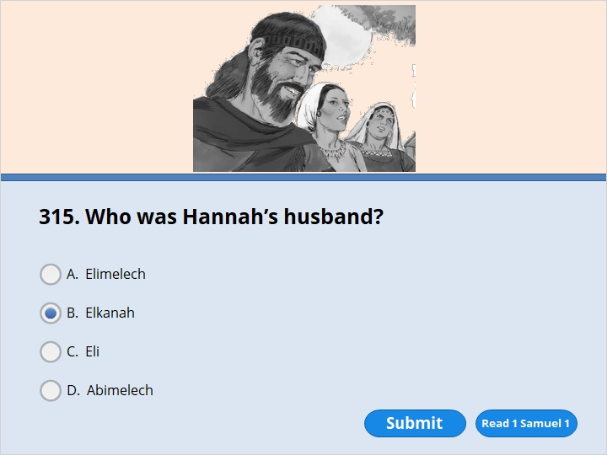
NEXT

Slide 4
NEXT

Slide 5
1 Samuel 1:1
A certain man from Ramathaim in the hill country of Ephraim was named Elkanah. He was the son of Jeroham. Jeroham was the son of Elihu. Elihu was the son of Tohu. Tohu was the son of Zuph. Elkanah belonged to the family line of Zuph. Elkanah lived in the territory of Ephraim. 2 Elkanah had two wives. One was named Hannah. The other was named Peninnah. Peninnah had children, but Hannah didn’t.

Slide 6
NEXT

Slide 7
NEXT

Slide 8
1 Samuel 1:11
She made a promise to him. She said, “Lord, you rule over all. Please see how I’m suffering! Show concern for me! Don’t forget about me! Please give me a son! If you do, I’ll give him back to the Lord. Then he will serve the Lord all the days of his life. He’ll never use a razor on his head. He’ll never cut his hair.”

Slide 9
NEXT

Slide 10
NEXT

Slide 11
1 Samuel 1:12
As Hannah kept on praying to the Lord, Eli watched her lips.

Slide 12
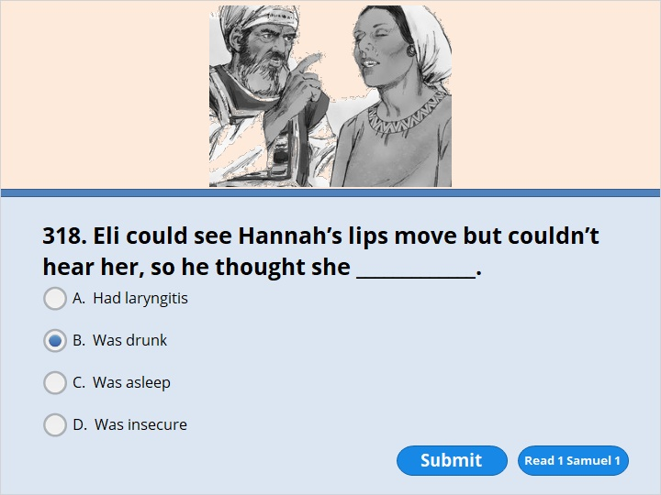
NEXT

Slide 13
NEXT

Slide 14
1 Samuel 1:13
She was praying in her heart. Her lips were moving. But she wasn’t making a sound. Eli thought Hannah was drunk. 14 He said to her, “How long are you going to stay drunk? Stop drinking your wine.”

Slide 15
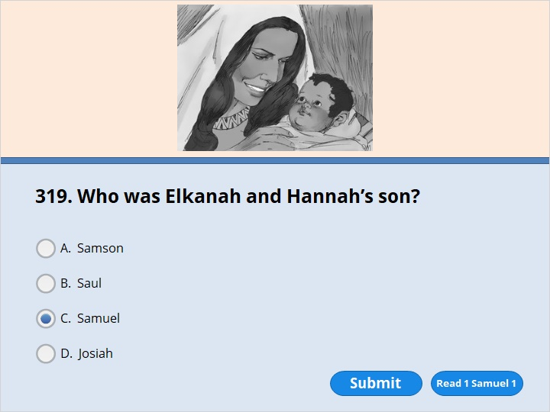
NEXT

Slide 16
NEXT

Slide 17
1 Samuel 1:20
So after some time, Hannah became pregnant. She had a baby boy. She said, “I asked the Lord for him.” So she named him Samuel.

Slide 18
NEXT

Slide 19
NEXT

Slide 20
1 Samuel 2:19
Each year his mother made him a little robe. She took it to him when she went up to Shiloh with her husband. She did it when her husband went to offer the yearly sacrifice.

Slide 21
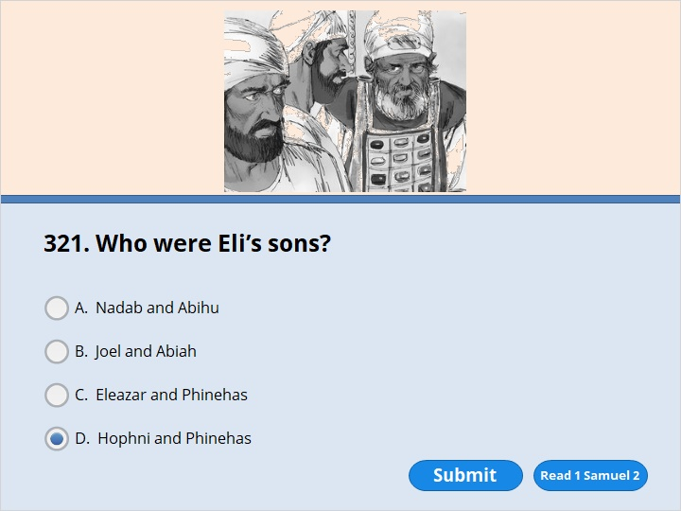
NEXT

Slide 22
NEXT

Slide 23
1 Samuel 2:34
“ ‘Something is going to happen to your two sons, Hophni and Phinehas. When it does, it will show you that what I am saying is true. They will both die on the same day.

Slide 24
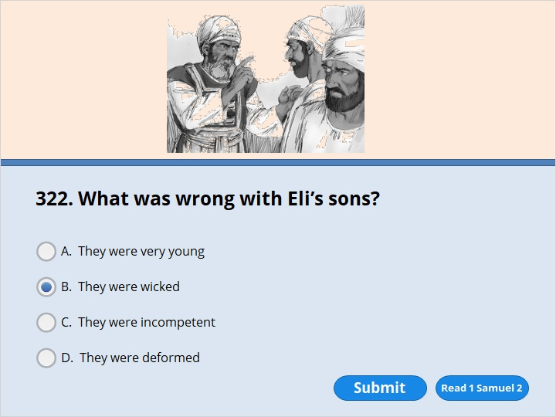
NEXT

Slide 25
NEXT

Slide 26
1 Samuel 2:23
So Eli said to his sons, “Why are you doing these things? All the people are telling me about the evil things you are doing. 24 No, my sons. The report I hear isn’t good. And it’s spreading among the Lord’s people. 25 If a person sins against someone else, God can help that sinner. But if anyone sins against the Lord, who can help them?” In spite of what their father Eli said, his sons didn’t pay any attention to his warning. That’s because the Lord had already decided to put them to death.

Slide 27
NEXT

Slide 28
NEXT

Slide 29
1 Samuel 2:34
“ ‘Something is going to happen to your two sons, Hophni and Phinehas. When it does, it will show you that what I am saying is true. They will both die on the same day.

Slide 30
NEXT

Slide 31
NEXT

Slide 32
1 Samuel 3:4
The Lord called out to Samuel. Samuel answered, “Here I am.” 5 He ran over to Eli and said, “Here I am. You called out to me.” But Eli said, “I didn’t call you. Go back and lie down.” So he went and lay down.

Slide 33
NEXT

Slide 34
NEXT

Slide 35
1 Samuel 3:8
The Lord called out for the third time. He said, “Samuel!” Samuel got up and went to Eli. He said, “Here I am. You called out to me.” Then Eli realized that the Lord was calling the boy.

Slide 36
NEXT

Slide 37
NEXT

Slide 38
1 Samuel 3:13
I told Eli I would punish his family forever. He knew his sons were sinning. He knew they were saying bad things about me. In spite of that, he did not stop them.

Slide 39
NEXT

Slide 40
NEXT

Slide 41
1 Samuel 4:2
The Philistines brought their forces together to fight against Israel. As the fighting spread, the Israelites lost the battle to the Philistines. The Philistines killed about 4,000 of them on the field of battle. 3 The rest of the Israelite soldiers returned to camp. Then the elders asked them, “Why did the Lord let the Philistines win the battle over us today? Let’s bring the ark of the Lord’s covenant from Shiloh. Let’s take it with us. Then the Lord will save us from the power of our enemies.”

Slide 42
NEXT

Slide 43
NEXT

Slide 44
1 Samuel 4:11
The ark of God was captured. And Eli’s two sons Hophni and Phinehas died.

Slide 45
NEXT

Slide 46
NEXT

Slide 47
1 Samuel 4:18
When the man spoke about the ark of God, Eli fell backward off his chair. He had been sitting by the side of the gate. When he fell, he broke his neck and died. He was old and fat. He had led Israel for 40 years.

Slide 48
NEXT

Slide 49
NEXT

Slide 50
1 Samuel 6:1
The ark of the Lord had been in Philistine territory for seven months. 2 The Philistines called for the priests and for those who practice evil magic. They wanted their advice. They said to them, “What should we do with the ark of the Lord? Tell us how we should send it back to its place.”

Slide 51
NEXT

Slide 52
NEXT

Slide 53
1 Samuel 8:5
They said to him, “You are old. Your sons don’t live as you do. So appoint a king to lead us. We want a king just like the kings all the other nations have.”

Slide 54
NEXT

Slide 55
NEXT

Slide 56
1 Samuel 9:1
There was a man named Kish from the tribe of Benjamin. Kish was a very important person. He was the son of Abiel, the son of Zeror. Zeror was the son of Bekorath, the son of Aphiah from the tribe of Benjamin. 2 Kish had a son named Saul. Saul was a handsome young man. He was more handsome than anyone in Israel. And he was a head taller than anyone else.

Slide 57
NEXT

Slide 58
NEXT

Slide 59
1 Samuel 9:21
Saul answered, “But I’m from the tribe of Benjamin. It’s the smallest tribe in Israel. And my family group is the least important in the whole tribe of Benjamin. So why are you saying that to me?”

Slide 60
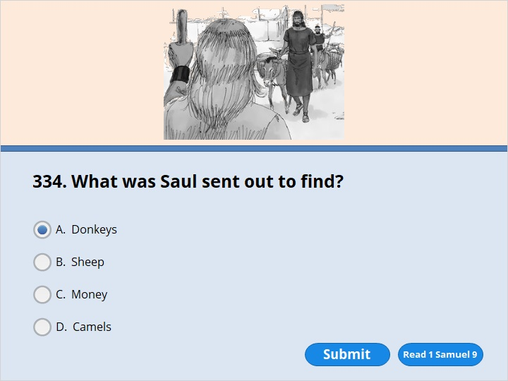
NEXT

Slide 61
NEXT

Slide 62
1 Samuel 9:3
The donkeys that belonged to Saul’s father Kish were lost. So Kish spoke to his son Saul. He said, “Go and look for the donkeys. Take one of the servants with you.”

Slide 63
NEXT

Slide 64
NEXT

Slide 65
1 Samuel 9:9
In Israel, prophets used to be called seers. So if someone wanted to ask God for advice, they would say, “Come on. Let’s go to the seer.”

Slide 66
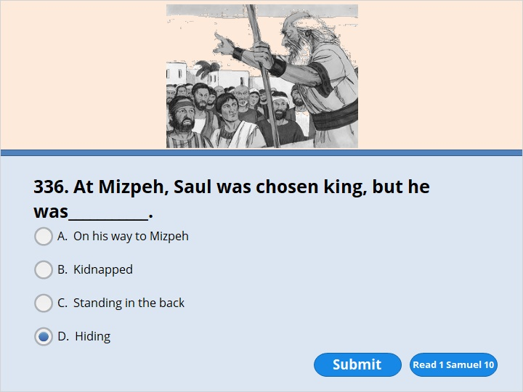
NEXT

Slide 67
NEXT

Slide 68
1 Samuel 10:20
Then Samuel had each tribe of Israel come forward. The tribe of Benjamin was chosen by casting lots. 21 Next he had the tribe of Benjamin come forward, family group by family group. Matri’s group was chosen. Finally Saul, the son of Kish, was chosen. But when people looked for him, they realized he wasn’t there. 22 They needed more help from the Lord. So they asked him, “Has the man come here yet?”
The Lord said, “Yes. He has hidden himself among the supplies.”

Slide 69
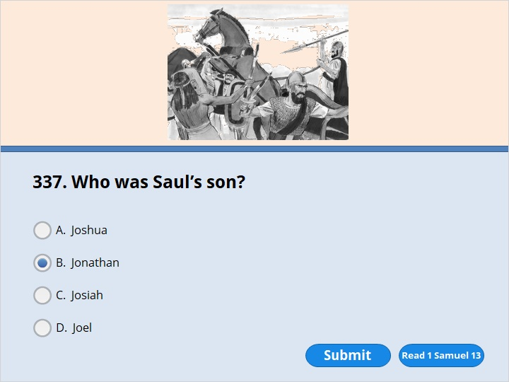
NEXT

Slide 70
NEXT

Slide 71
1 Samuel 13:16
Saul and his son Jonathan were staying in Gibeah in the land of Benjamin. The men who remained in the army were there with them. At the same time, the Philistines camped at Mikmash.

Slide 72
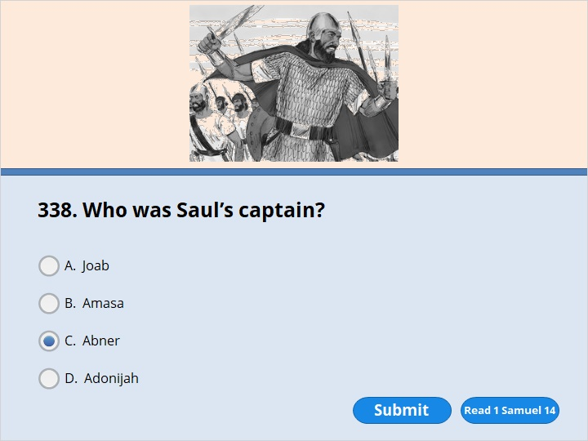
NEXT

Slide 73
NEXT

Slide 74
1 Samuel 14:50
Saul’s wife was named Ahinoam. She was the daughter of Ahimaaz. The commander of Saul’s army was named Abner. He was the son of Ner. Ner was Saul’s uncle.

Slide 75
NEXT

Slide 76
NEXT

Slide 77
1 Samuel 16:1
The Lord said to Samuel, “How long will you be filled with sorrow because of Saul? I have refused to have him as king over Israel. Fill your animal horn with olive oil and go on your way. I am sending you to Jesse in Bethlehem. I have chosen one of his sons to be king.”

Slide 78
NEXT

Slide 79
NEXT

Slide 80
1 Samuel 16:13
So Samuel got the animal horn that was filled with olive oil. He anointed David in front of his brothers. From that day on, the Spirit of the Lord came powerfully on David. Samuel went back to Ramah.

Slide 81
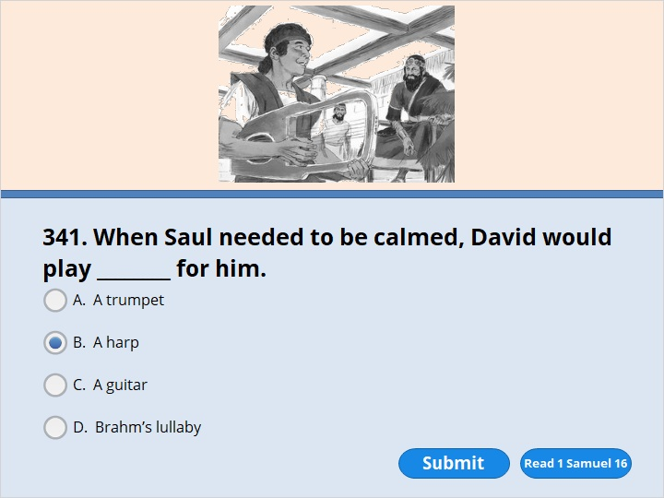
NEXT

Slide 82
NEXT

Slide 83
1 Samuel 16:23
When the evil spirit sent by God would come on Saul, David would get his harp and play it. That would help Saul. He would feel better, and the evil spirit would leave him.

Slide 84
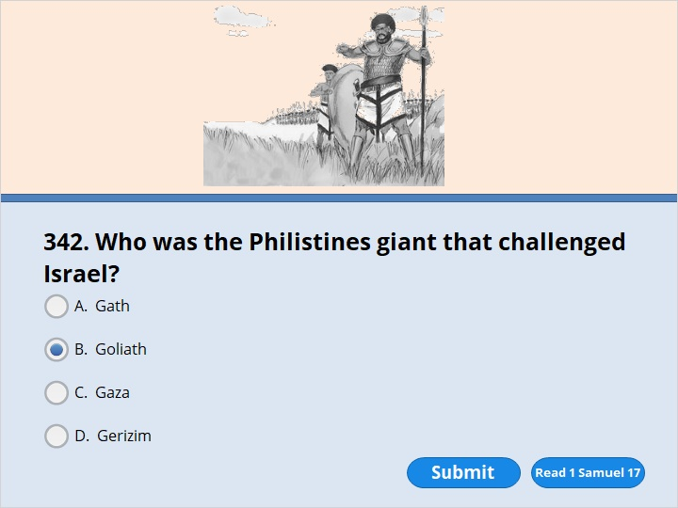
NEXT

Slide 85
NEXT

Slide 86
1 Samuel 17:8
Goliath stood there and shouted to the soldiers of Israel. He said, “Why do you come out and line up for battle? I’m a Philistine. You are servants of Saul. Choose one of your men. Have him come down and face me. 9 If he’s able to fight and kill me, we’ll become your slaves. But if I win and kill him, you will become our slaves and serve us.” 10 Goliath continued, “This day I dare the soldiers of Israel to send a man down to fight against me.” 11 Saul and the whole army of Israel heard what the Philistine said. They were terrified.

Slide 87
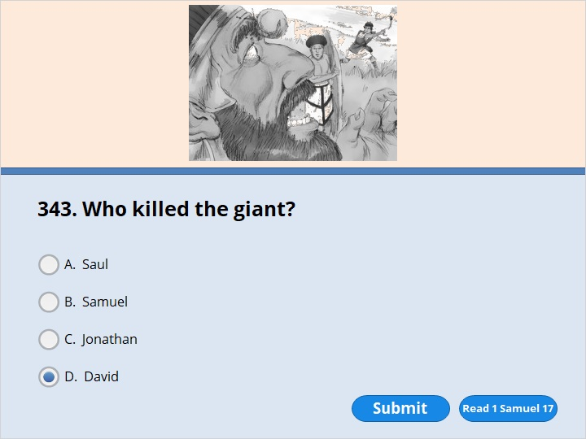
NEXT

Slide 88
NEXT

Slide 89
1 Samuel 17:50
So David won the fight against Goliath with a sling and a stone. He struck down the Philistine and killed him. He did it without even using a sword.

Slide 90
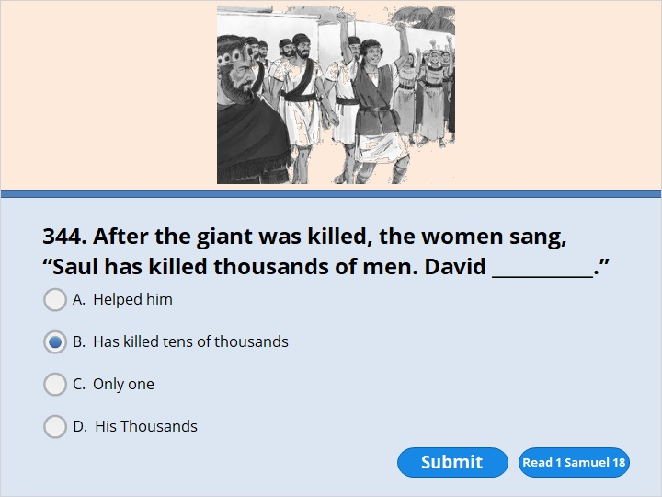
NEXT

Slide 91
NEXT

Slide 92
1 Samuel 18:6
After David had killed Goliath, the men of Israel returned home. The women came out of all the towns of Israel to meet King Saul. They danced and sang joyful songs. They played harps and tambourines. 7 As they danced, they sang, “Saul has killed thousands of men. David has killed tens of thousands.”

Slide 93
NEXT

Slide 94
NEXT

Slide 95
1 Samuel 18:10
The next day an evil spirit sent by God came powerfully on Saul. Saul began to prophesy in his house. At that same time David began to play the harp, just as he usually did. Saul was holding a spear. 11 He threw it at David. As he did, he said to himself, “I’ll pin David to the wall.” But David got away from him twice.

Slide 96
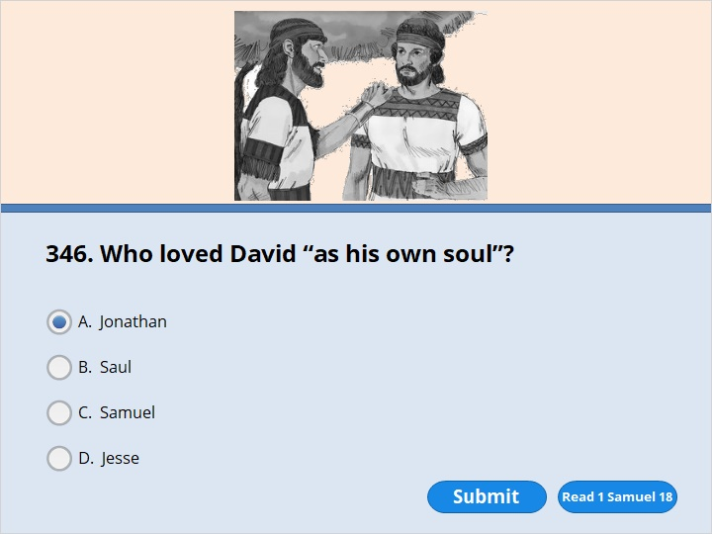
NEXT

Slide 97
NEXT

Slide 98
1 Samuel 18:1
David finished talking with Saul. After that, Jonathan and David became close friends. Jonathan loved David just as he loved himself.

Slide 99
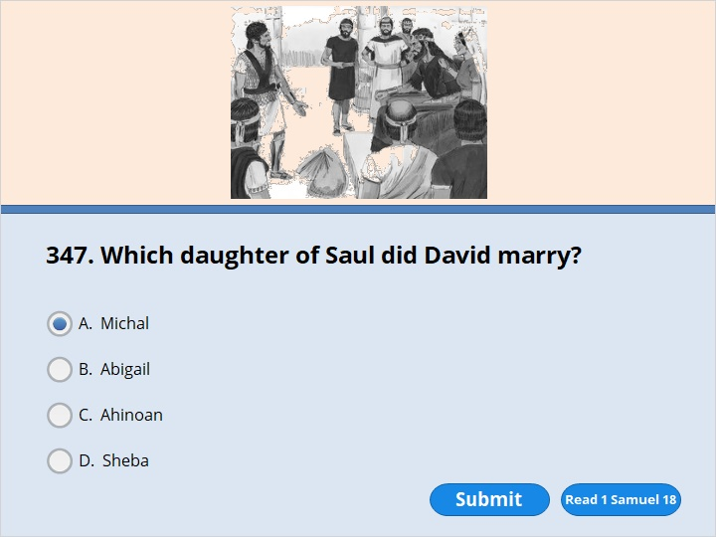
NEXT

Slide 100
NEXT

Slide 101
1 Samuel 18:27
David and his men went out and killed 200 Philistines. They circumcised the Philistines. Then David brought back all the skins. They counted out the full number and gave them to the king. By doing that, David could become the king’s son-in-law. So Saul gave David his daughter Michal to be his wife.

Slide 102
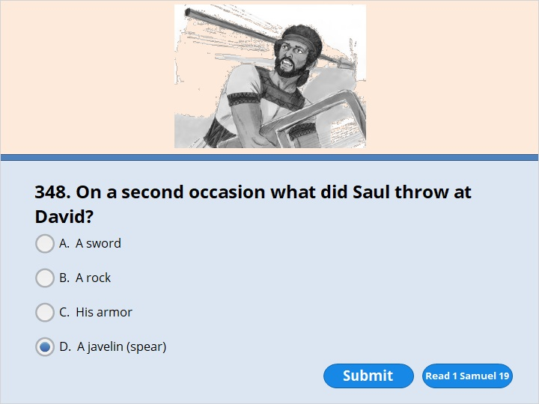
NEXT

Slide 103
NEXT

Slide 104
1 Samuel 19:10
Saul tried to pin him to the wall with his spear. But David got away from him just as Saul drove the spear into the wall. That night David escaped.

Slide 105
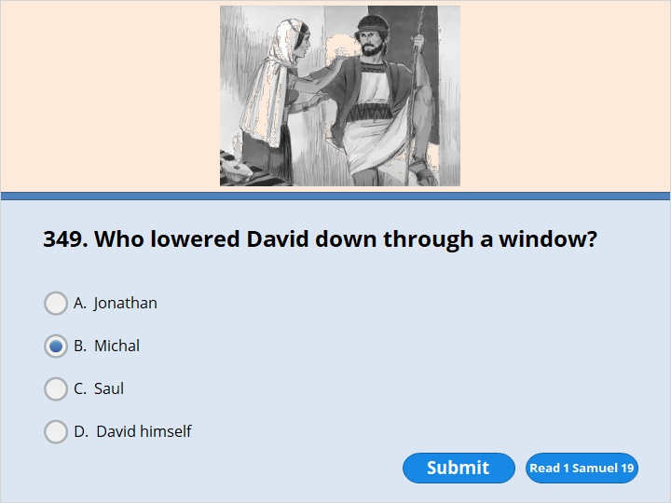
NEXT

Slide 106
NEXT

Slide 107
1 Samuel 19:12
So Michal helped David escape through a window. He ran and got away.

Slide 108
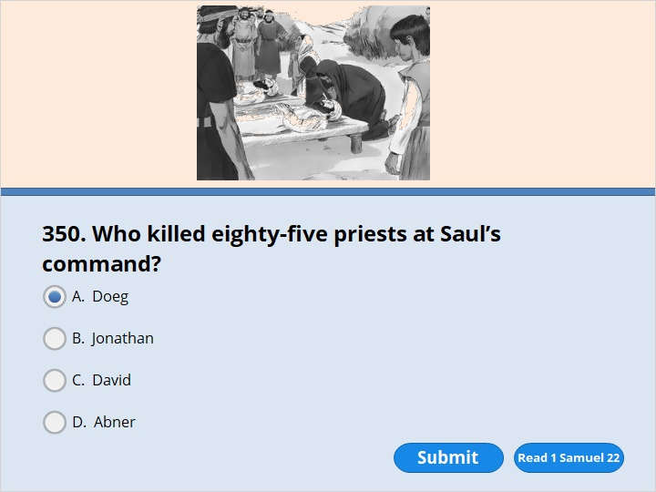
NEXT

Slide 109
NEXT

Slide 110
1 Samuel 22:18
Then the king ordered Doeg, “You go and strike down the priests.” So Doeg, the Edomite, went and struck them down. That day he killed 85 priests who wore linen aprons.

Slide 111
NEXT

Slide 112
NEXT

Slide 113
1 Samuel 22:20
But Abiathar, a son of Ahimelek, escaped. Ahimelek was the son of Ahitub. Abiathar ran away and joined David. 21 He told David that Saul had killed the priests of the Lord.

Slide 114
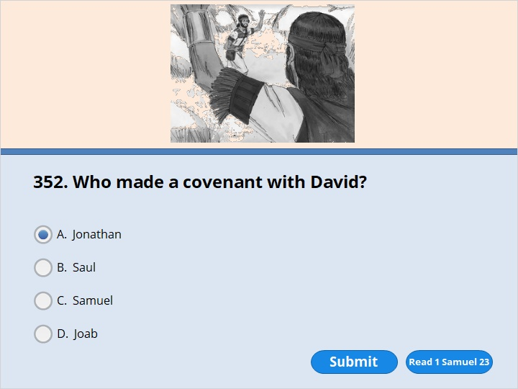
NEXT

Slide 115
NEXT

Slide 116
1 Samuel 23:16
Saul’s son Jonathan went to David at Horesh. He told David that God would make him strong. 17 “Don’t be afraid,” he said. “My father Saul won’t harm you. You will be king over Israel. And I will be next in command. Even my father Saul knows this.” 18 The two of them made a covenant of friendship in front of the Lord. Then Jonathan went home. But David remained at Horesh.

Slide 117
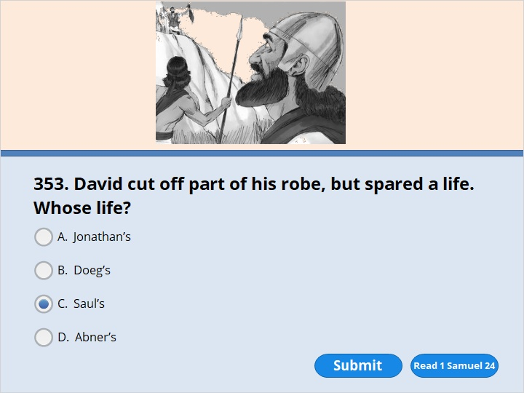
NEXT

Slide 118
NEXT

Slide 119
1 Samuel 24:4
David’s men said, “This is the day the Lord told you about. He said to you, ‘I will hand your enemy over to you. Then you can deal with him as you want to.’ ” So David came up close to Saul without being seen. He cut off a corner of Saul’s robe.

Slide 120
NEXT

Slide 121
NEXT

Slide 122
1 Samuel 24:9
He said to Saul, “Why do you listen when men say, ‘David is trying to harm you’? 10 This day you have seen with your own eyes how the Lord handed you over to me in the cave. Some of my men begged me to kill you. But I didn’t. I said, ‘I will never lay my hand on my master. He is the Lord’s anointed king.’ 11 Look, my father! Look at this piece of your robe in my hand! I cut off the corner of your robe. But I didn’t kill you. See, there is nothing in my hand that shows I am guilty of doing anything wrong. I haven’t turned against you. I haven’t done anything to harm you. But you are hunting me down. You want to kill me.

Slide 123
NEXT

Slide 124
NEXT

Slide 125
1 Samuel 25:1
When Samuel died, the whole nation of Israel gathered together. They were filled with sorrow because he was dead. They buried him at his home in Ramah. Then David went down into the Desert of Paran.

Slide 126
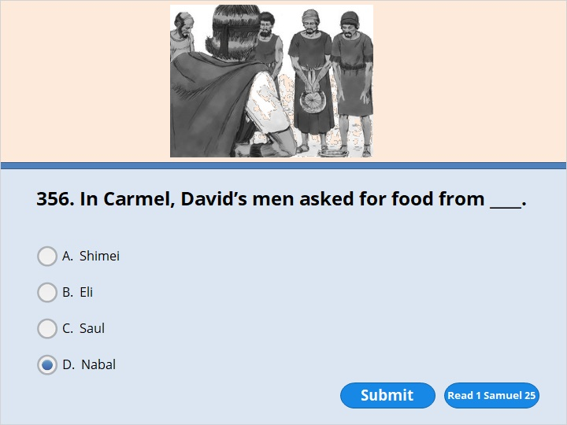
NEXT

Slide 127
NEXT

Slide 128
1 Samuel 25:10
Nabal answered David’s servants, “Who is this David? Who is this son of Jesse? Many servants are running away from their masters these days. 11 Why should I give away my bread and water? Why should I give away the meat I’ve prepared for those who clip the wool off my sheep? Why should I give food to men who come from who knows where?”

Slide 129
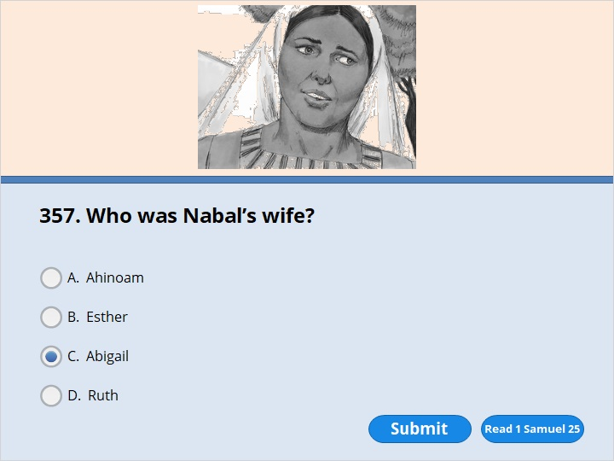
NEXT

Slide 130
NEXT

Slide 131
1 Samuel 25:3
His name was Nabal. His wife’s name was Abigail. She was a wise and beautiful woman. But her husband was rude and mean in the way he treated others. He was from the family of Caleb.

Slide 132
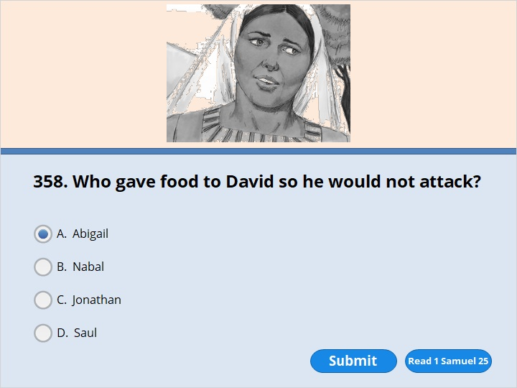
NEXT

Slide 133
NEXT

Slide 134
1 Samuel 25:18
Abigail didn’t waste any time. She got 200 loaves of bread and two bottles of wine. The bottles were made out of animal skins. She got five sheep that were ready to be cooked. She got a bushel of grain that had been cooked. She got 100 raisin cakes. And she got 200 cakes of pressed figs. She loaded all of it on the backs of donkeys. 19 Then she told her servants, “Go on ahead. I’ll follow you.” But she didn’t tell her husband Nabal about it.

Slide 135
NEXT

Slide 136
NEXT

Slide 137
1 Samuel 25:38
About ten days later, the Lord struck Nabal down. And he died.

Slide 138
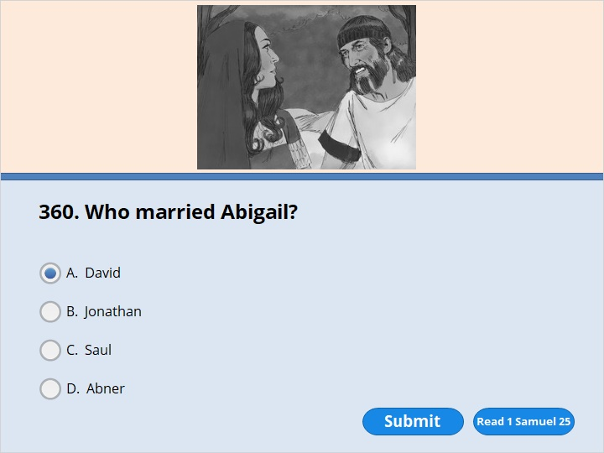
NEXT

Slide 139
NEXT

Slide 140
1 Samuel 25:42
Abigail quickly got on a donkey and went with David’s messengers. Her five female servants went with her. She became David’s wife.

Slide 141
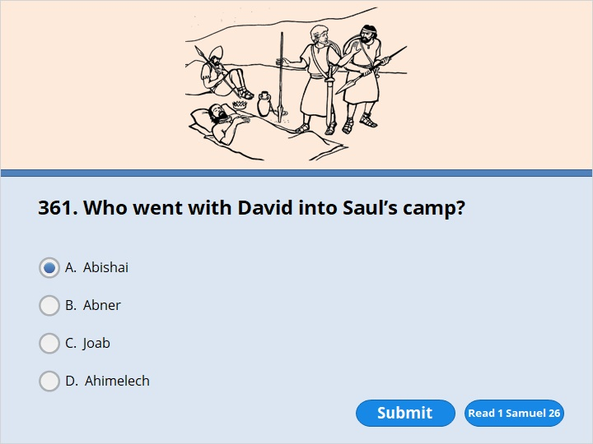
NEXT

Slide 142
NEXT

Slide 143
1 Samuel 26:7
So that night David and Abishai went into the camp. They found Saul lying asleep inside the camp. His spear was stuck in the ground near his head. Abner and the soldiers were lying asleep around him.

Slide 144
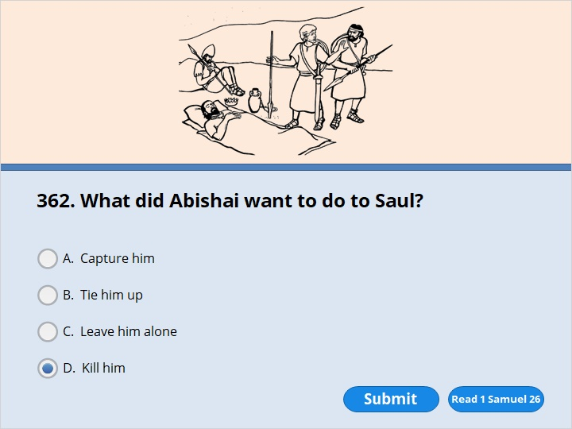
NEXT

Slide 145
NEXT

Slide 146
1 Samuel 26:8
Abishai said to David, “Today God has handed your enemy over to you. So let me pin him to the ground. I can do it with one jab of the spear. I won’t even have to strike him twice.” 9 But David said to Abishai, “Don’t destroy him! No one can do any harm to the Lord’s anointed king and not be guilty. 10 You can be sure that the Lord lives,” he said. “And you can be just as sure that the Lord himself will strike Saul down. Perhaps he’ll die a natural death. Or perhaps he’ll go into battle and be killed. 11 May the Lord keep me from doing anything to harm his anointed king. Now get the spear and water jug that are near his head. Then let’s leave.”

Slide 147
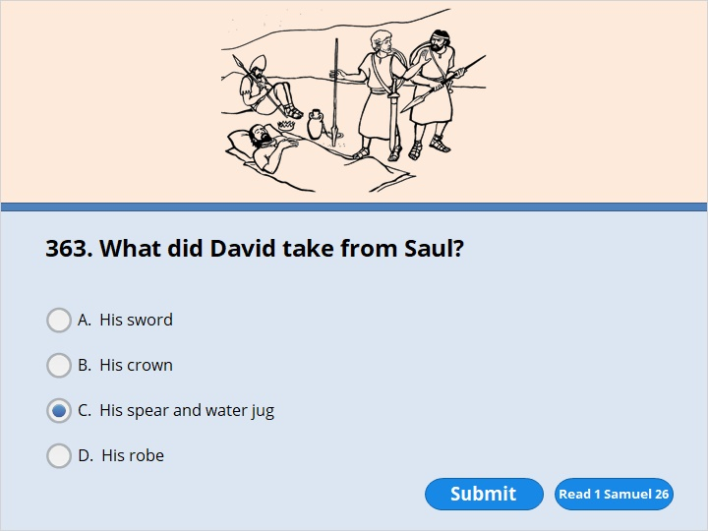
NEXT

Slide 148
NEXT

Slide 149
1 Samuel 26:12
So David took the spear and water jug that were near Saul’s head. Then he and Abishai left. No one saw them. No one knew about what they had done. In fact, no one even woke up. Everyone was sleeping. That’s because the Lord had put them into a deep sleep.

Slide 150
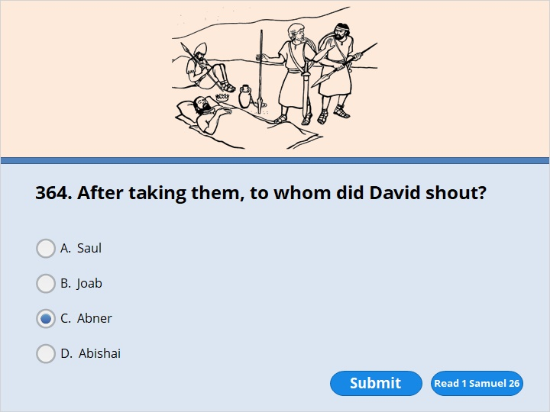
NEXT

Slide 151
NEXT

Slide 152
1 Samuel 26:14
He called out to the army and to Abner, the son of Ner. He said, “Abner! Aren’t you going to answer me?”
Abner replied, “Who is calling out to the king?”

Slide 153
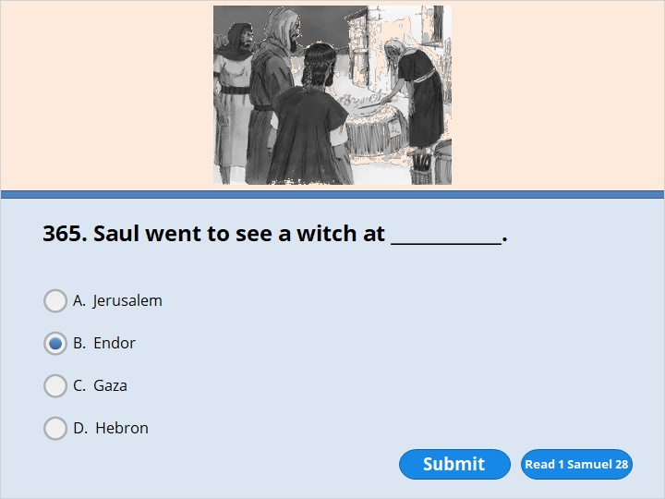
NEXT

Slide 154
NEXT

Slide 155
1 Samuel 28:7
Saul spoke to his attendants. He said, “Find me a woman who gets messages from those who have died. Then I can go and ask her some questions.”
“There’s a woman like that in Endor,” they said.

Slide 156
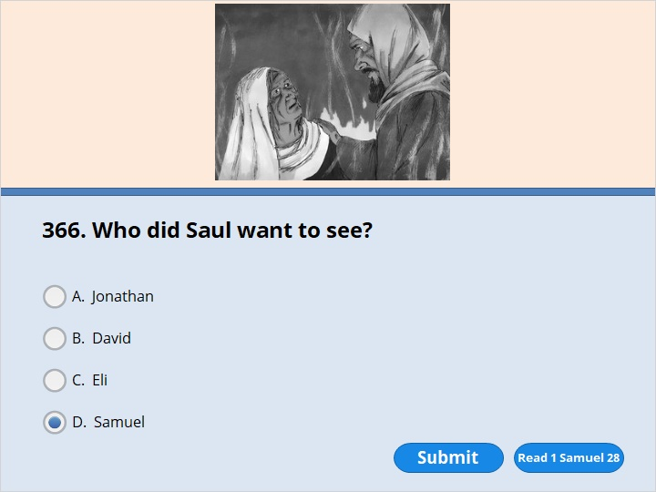
NEXT

Slide 157
NEXT

Slide 158
1 Samuel 28:11
Then the woman asked, “Whose spirit should I bring up for you?”
“Bring Samuel up,” he said.

Slide 159
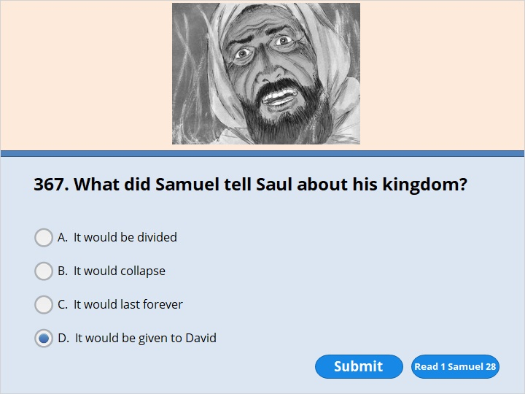
NEXT

Slide 160
NEXT

Slide 161
1 Samuel 28:16
Samuel said, “The Lord has left you. He has become your enemy. So why are you asking me what you should do? 17 The Lord has spoken through me and has done what he said he would do. The Lord has torn the kingdom out of your hands. He has given it to one of your neighbors. He has given it to David. 18 You didn’t obey the Lord. You didn’t show his great anger against the Amalekites by destroying them. So he’s punishing you today. 19 He will hand both Israel and you over to the Philistines. Tomorrow you and your sons will be down here with me. The Lord will also hand Israel’s army over to the Philistines.”

Slide 162
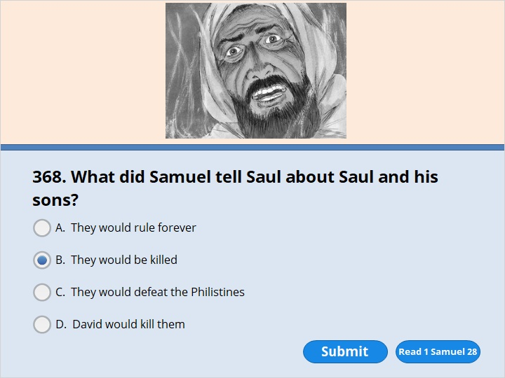
NEXT

Slide 163
NEXT

Slide 164
1 Samuel 28:16
Samuel said, “The Lord has left you. He has become your enemy. So why are you asking me what you should do? 17 The Lord has spoken through me and has done what he said he would do. The Lord has torn the kingdom out of your hands. He has given it to one of your neighbors. He has given it to David. 18 You didn’t obey the Lord. You didn’t show his great anger against the Amalekites by destroying them. So he’s punishing you today. 19 He will hand both Israel and you over to the Philistines. Tomorrow you and your sons will be down here with me. The Lord will also hand Israel’s army over to the Philistines.”

Slide 165
NEXT

Slide 166
NEXT

Slide 167
1 Samuel 31:1
The Philistines fought against the Israelites. The Israelites ran away from them. But many Israelites were killed on Mount Gilboa. 2 The Philistines kept chasing Saul and his sons. They killed his sons Jonathan, Abinadab and Malki-Shua. 3 The fighting was heavy around Saul. Men who were armed with bows and arrows caught up with him. They shot their arrows at him and wounded him badly.

Slide 168
NEXT

Slide 169
NEXT

Slide 170
1 Samuel 31:4
Saul spoke to the man carrying his armor. He said, “Pull out your sword. Stick it through me. If you don’t, these fellows who aren’t circumcised will come. They’ll stick their swords through me and hurt me badly.” But the man was terrified. He wouldn’t do it. So Saul took his own sword and fell on it.

Slide 171
NEXT

Slide 172
NEXT

Slide 173
1 Samuel 31:5
The man saw that Saul was dead. So he fell on his own sword and died with him. 6 Saul and his three sons died together that same day. The man who carried his armor also died with them that day. So did all of Saul’s men.

Slide 174
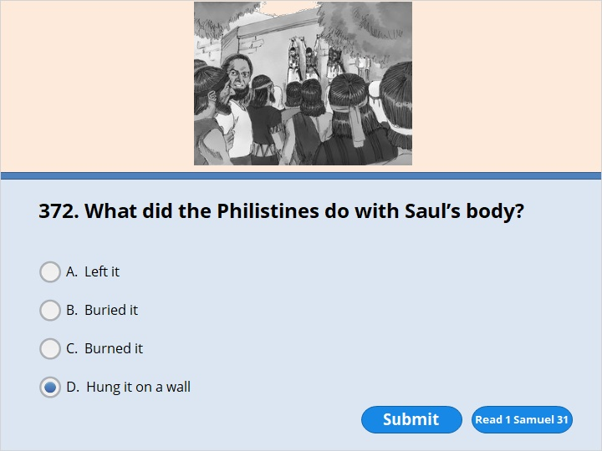
NEXT

Slide 175
NEXT

Slide 176
1 Samuel 31:10
They put Saul’s armor in the temple where they had set up statues of female gods that were named Ashtoreth. They hung his body up on the wall of Beth Shan.

Slide 177
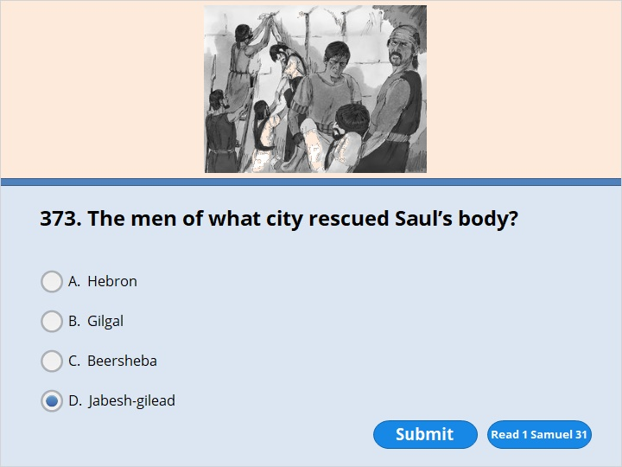
NEXT

Slide 178
NEXT

Slide 179
1 Samuel 31:11
The people of Jabesh Gilead heard about what the Philistines had done to Saul. 12 So all their brave men marched through the night to Beth Shan. They took down the bodies of Saul and his sons from the wall of Beth Shan. They brought them to Jabesh. There they burned them. 13 Then they got the bones of Saul and his sons and buried them under a tamarisk tree at Jabesh. They didn’t eat anything for seven days.

Slide 180
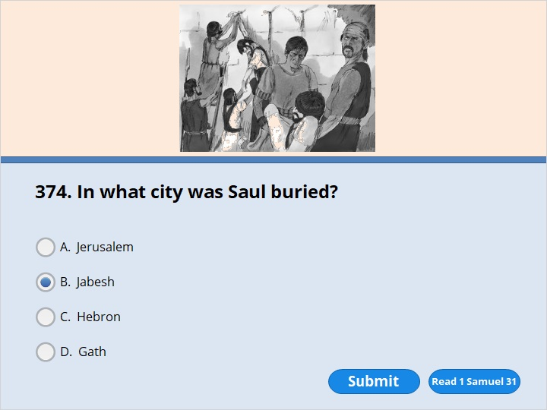
NEXT

Slide 181
NEXT

Slide 182
1 Samuel 31:11
The people of Jabesh Gilead heard about what the Philistines had done to Saul. 12 So all their brave men marched through the night to Beth Shan. They took down the bodies of Saul and his sons from the wall of Beth Shan. They brought them to Jabesh. There they burned them. 13 Then they got the bones of Saul and his sons and buried them under a tamarisk tree at Jabesh. They didn’t eat anything for seven days.

Slide 183
NEXT

Slide 184
NEXT

Slide 185
2 Samuel 2:4
Then the men of Judah came to Hebron. There they anointed David to be king over the people of Judah. David was told that the men from Jabesh Gilead had buried Saul’s body.

Slide 186
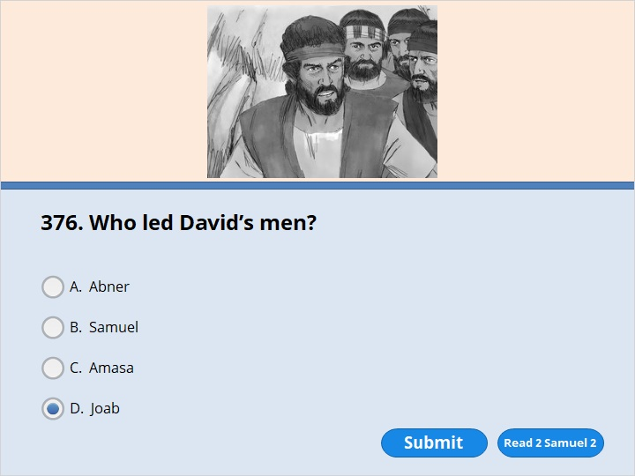
NEXT

Slide 187
NEXT

Slide 188
2 Samuel 2:12
Abner, the son of Ner, left Mahanaim and went to Gibeon. The men of Ish-Bosheth, the son of Saul, went with him. 13 Joab, the son of Zeruiah, and David’s men also went out. All of them met at the pool in Gibeon. One group sat down on one side of the pool. The other group sat on the other side.

Slide 189
NEXT

Slide 190
NEXT

Slide 191
2 Samuel 5:4
David was 30 years old when he became king. He ruled for 40 years. 5 In Hebron he ruled over Judah for seven and a half years. In Jerusalem he ruled over all of Israel and Judah for 33 years.

Slide 192
NEXT

Slide 193
NEXT

Slide 194
2 Samuel 5:4
David was 30 years old when he became king. He ruled for 40 years. 5 In Hebron he ruled over Judah for seven and a half years. In Jerusalem he ruled over all of Israel and Judah for 33 years.

Slide 195
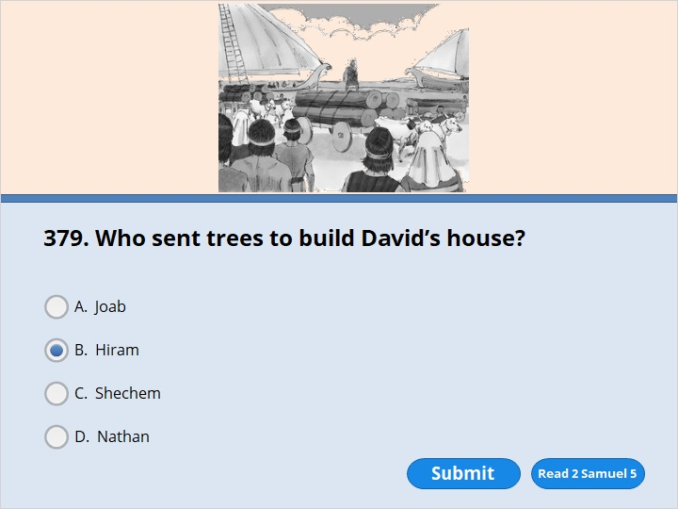
NEXT

Slide 196
NEXT

Slide 197
2 Samuel 5:11
Hiram was king of Tyre. He sent messengers to David. He sent cedar logs along with them. He also sent skilled workers. They worked with wood and stone. They built a palace for David.

Slide 198
NEXT

Slide 199
NEXT

Slide 200
2 Samuel 6:17
The ark of the Lord was brought into Jerusalem. It was put in its place in the tent David had set up for it. David sacrificed burnt offerings and friendship offerings to the Lord.

Slide 201
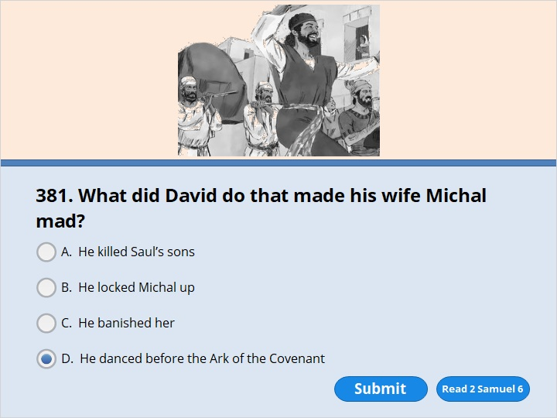
NEXT

Slide 202
NEXT

Slide 203
2 Samuel 6:16
The ark of the Lord was brought into the City of David. Saul’s daughter Michal was watching from a window. She saw King David leaping and dancing in front of the Lord. That made her hate him in her heart.

Slide 204
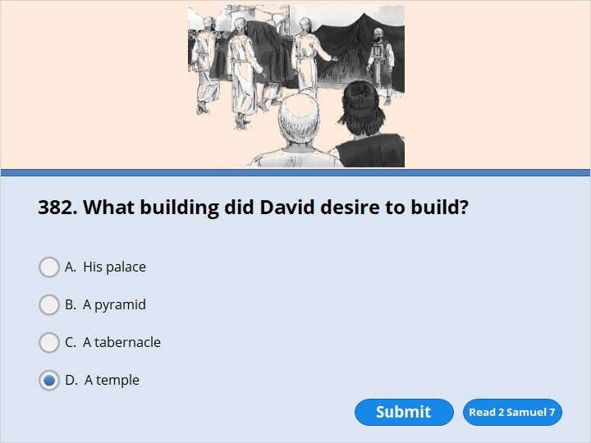
NEXT

Slide 205
NEXT

Slide 206
2 Samuel 7:5
“Go and speak to my servant David. Tell him, ‘The Lord says, “Are you the one to build me a house to live in?

Slide 207
NEXT

Slide 208
NEXT

Slide 209
2 Samuel 7:17
Nathan reported to David all the words that the Lord had spoken to him.

Slide 210
NEXT

Slide 211
NEXT

Slide 212
1 Chronicles 28:3
But God said to me, ‘You are not the one who will build a house for my Name. That is because you are a fighting man. You have spilled people’s blood.’

Slide 213
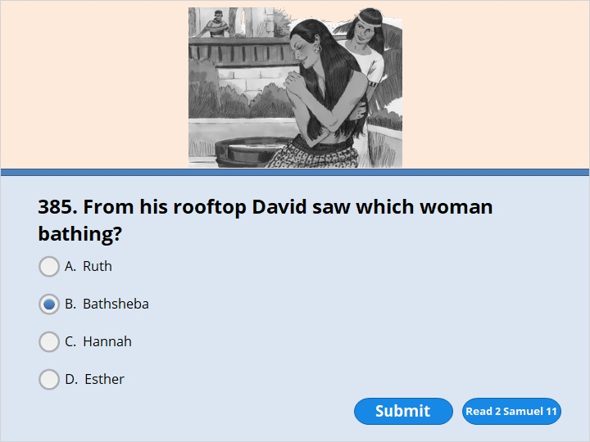
NEXT

Slide 214
NEXT

Slide 215
2 Samuel 11:2
One evening David got up from his bed. He walked around on the roof of his palace. From the roof he saw a woman taking a bath. She was very beautiful. 3 David sent a messenger to find out who she was. The messenger returned and said, “She is Bathsheba. She’s the daughter of Eliam. She’s the wife of Uriah. He’s a Hittite.”

Slide 216
NEXT

Slide 217
NEXT

Slide 218
2 Samuel 11:2
One evening David got up from his bed. He walked around on the roof of his palace. From the roof he saw a woman taking a bath. She was very beautiful. 3 David sent a messenger to find out who she was. The messenger returned and said, “She is Bathsheba. She’s the daughter of Eliam. She’s the wife of Uriah. He’s a Hittite.”

Slide 219
NEXT

Slide 220
NEXT

Slide 221
2 Samuel 11:5
Later, Bathsheba found out she was pregnant. She sent a message to David. She said, “I’m pregnant.”
6 So David sent a message to Joab. David said, “Send me Uriah, the Hittite.” Joab sent him to David.

Slide 222
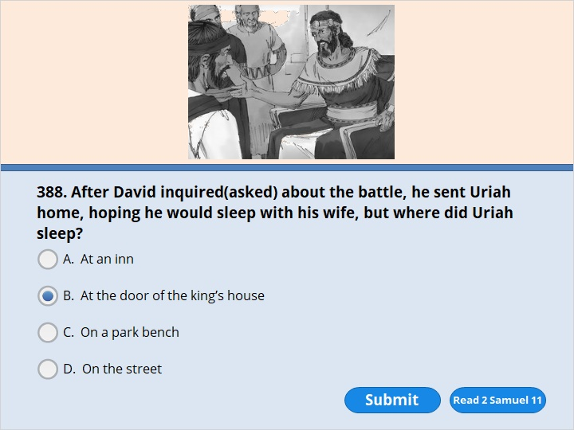
NEXT

Slide 223
NEXT

Slide 224
2 Samuel 11:9
But Uriah didn’t go home. Instead, he slept at the entrance to the palace. He stayed there with all his master’s servants.

Slide 225
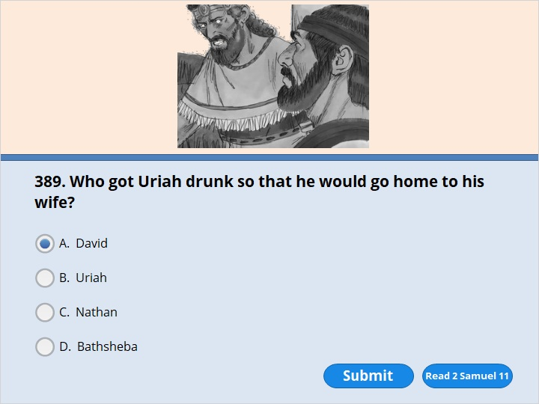
NEXT

Slide 226
NEXT

Slide 227
2 Samuel 11:13
David invited Uriah to eat and drink with him. David got him drunk. But Uriah still didn’t go home. In the evening he went out and slept on his mat. He stayed there among his master’s servants.

Slide 228
NEXT

Slide 229
NEXT

Slide 230
2 Samuel 11:14
The next morning David wrote a letter to Joab. He sent it along with Uriah. 15 In it he wrote, “Put Uriah out in front. That’s where the fighting is the heaviest. Then pull your men back from him. When you do, the Ammonites will strike him down and kill him.”

Slide 231
NEXT

Slide 232
NEXT

Slide 233
2 Samuel 11:26
Uriah’s wife heard that her husband was dead. She mourned over him. 27 When her time of sadness was over, David had her brought to his house. She became his wife. And she had a son by him. But the Lord wasn’t pleased with what David had done.

Slide 234
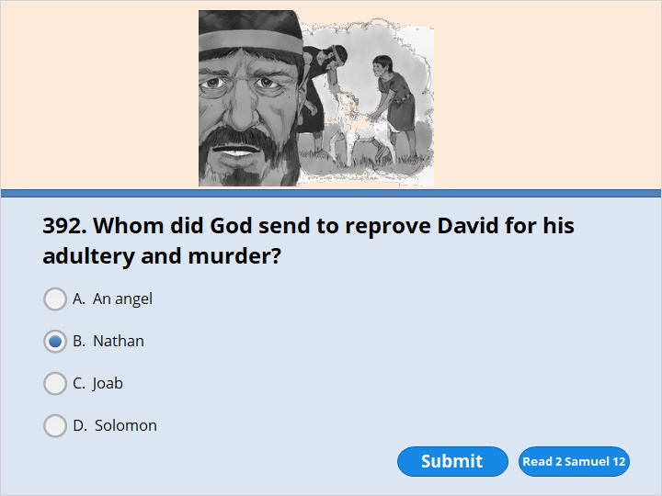
NEXT

Slide 235
NEXT

Slide 236
2 Samuel 12:1
The Lord sent the prophet Nathan to David. When Nathan came to him, he said, “Two men lived in the same town. One was rich. The other was poor. 2 The rich man had a very large number of sheep and cattle. 3 But all the poor man had was one little female lamb. He had bought it. He raised it. It grew up with him and his children. It shared his food. It drank from his cup. It even slept in his arms. It was just like a daughter to him. 4 “One day a traveler came to the rich man. The rich man wanted to prepare a meal for him. But he didn’t want to kill one of his own sheep or cattle. Instead, he took the little female lamb that belonged to the poor man. Then the rich man cooked it for the traveler who had come to him.”

Slide 237
NEXT

Slide 238
NEXT

Slide 239
2 Samuel 12:7
Then Nathan said to David, “You are the man! The Lord, the God of Israel, says, ‘I anointed you king over Israel. I saved you from Saul.

Slide 240
NEXT

Slide 241
NEXT

Slide 242
2 Samuel 12:13
Then David said to Nathan, “I have sinned against the Lord.” Nathan replied, “The Lord has taken away your sin. You aren’t going to die. 14 But you have dared to show great disrespect for the Lord. So the son who has been born to you will die.”

Slide 243
NEXT

Slide 244
NEXT

Slide 245
2 Samuel 12:24
Then David comforted his wife Bathsheba. He went to her and slept with her. Some time later she had a son. He was given the name Solomon. The Lord loved him.

Slide 246
NEXT

Slide 247
NEXT

Slide 248
2 Samuel 12:25
So the Lord sent a message through Nathan the prophet. The Lord said, “Name the boy Jedidiah.”

Slide 249
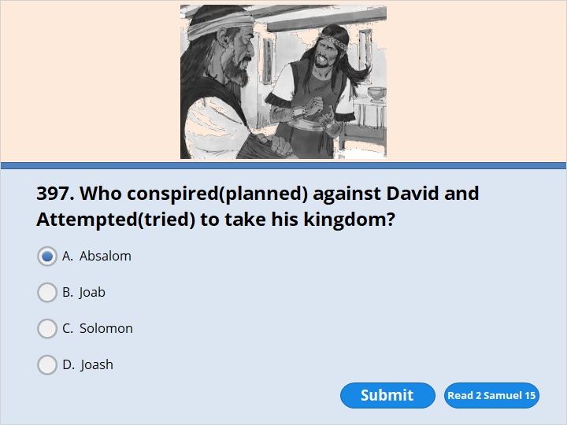
NEXT

Slide 250
NEXT

Slide 251
2 Samuel 15:10
Then Absalom sent messengers secretly to all the tribes of Israel. They said, “Listen for the sound of trumpets. As soon as you hear them, say, ‘Absalom has become king in Hebron.’

Slide 252
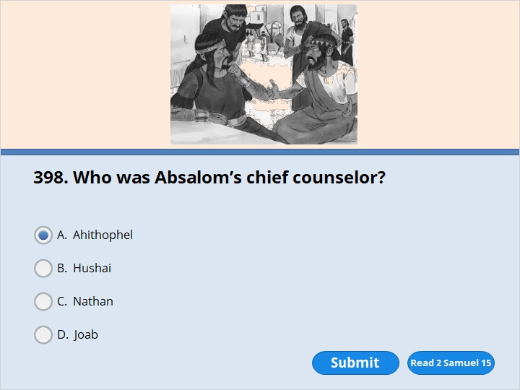
NEXT

Slide 253
NEXT

Slide 254
2 Samuel 15:12
While Absalom was offering sacrifices, he sent for Ahithophel. Ahithophel was David’s adviser. He came to Absalom from Giloh, his hometown. The number of people who followed Absalom kept growing. So he became more and more able to carry out his plans against David.

Slide 255
NEXT

Slide 256
NEXT

Slide 257
2 Samuel 15:37
So David’s trusted friend Hushai went to Jerusalem. He arrived just as Absalom was entering the city.

Slide 258
NEXT

Slide 259
NEXT

Slide 260
2 Samuel 16:5
King David approached Bahurim. As he did, a man came out toward him. The man was from the same family group that Saul was from. His name was Shimei. He was the son of Gera. As he came out of the town, he cursed David. 6 He threw stones at David and all his officials. He did it even though all the troops and the special guard were there. They were to the right and left of David.

Slide 261
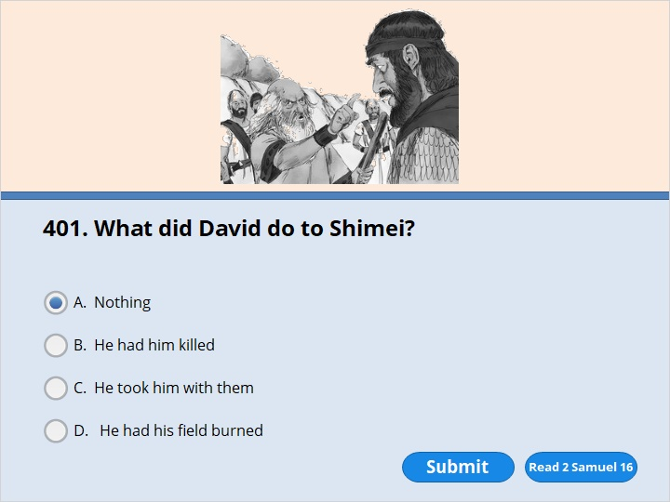
NEXT

Slide 262
NEXT

Slide 263
2 Samuel 16:11
Then David spoke to Abishai and all his officials. He said, “My very own son Absalom is trying to kill me. How much more should this man from Benjamin want to kill me! Leave him alone. Let him curse. The Lord has told him to do it. 12 Maybe the Lord will see how much I’m suffering. Maybe he’ll bring back to me his covenant blessing instead of his curse I’m hearing today.”

Slide 264
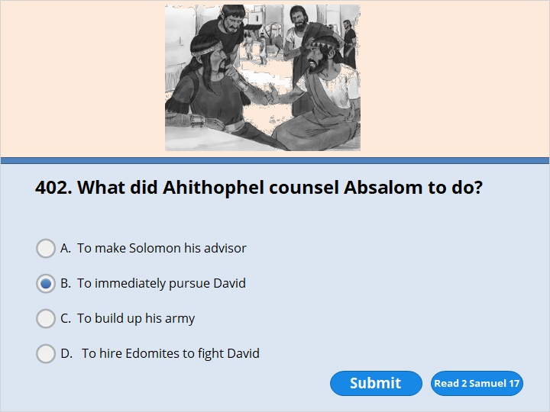
NEXT

Slide 265
NEXT

Slide 266
2 Samuel 17:1
One day Ahithophel said to Absalom, “Here’s what I suggest. Choose 12,000 men. Start out tonight and go after David. 2 Attack him while he’s tired and weak. Fill him with terror. Then all the people with him will run away. Don’t strike down anyone except the king. 3 Bring all the other people back. After the man you want to kill is dead, everyone else will return to you. And none of the people will be harmed.” 4 Ahithophel’s plan seemed good to Absalom. It also seemed good to all the elders of Israel.

Slide 267
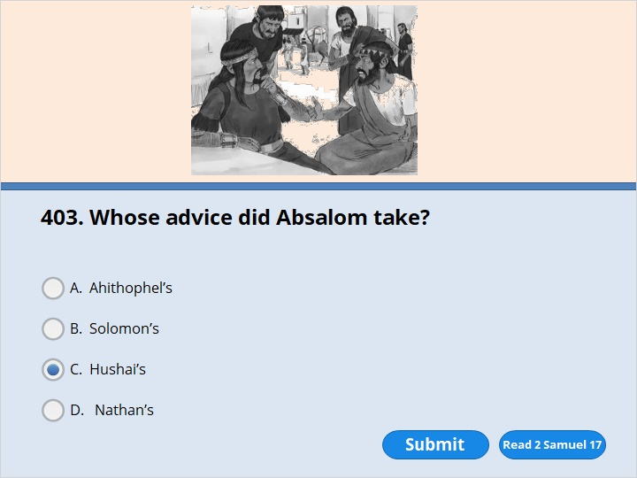
NEXT

Slide 268
NEXT

Slide 269
2 Samuel 17:14
Absalom and all the men of Israel agreed. They said, “The advice of Hushai, the Arkite, is better than the advice of Ahithophel.” The Lord had decided that Ahithophel’s good advice would fail. The Lord wanted to bring horrible trouble on Absalom.

Slide 270
NEXT

Slide 271
NEXT

Slide 272
2 Samuel 17:23
Ahithophel saw that his advice wasn’t being followed. So he put a saddle on his donkey. He started out for his house in his hometown. When he arrived, he made everything ready for his death. He made out his will. Then he killed himself. And so he died and was buried in his father’s tomb.

Slide 273
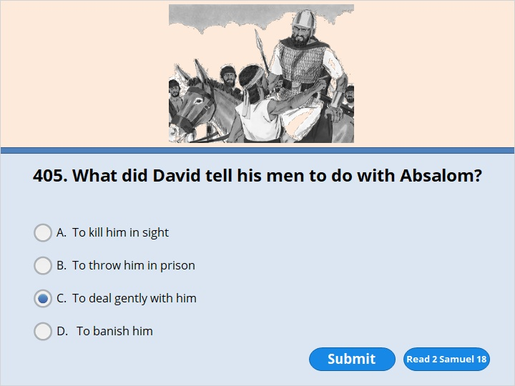
NEXT

Slide 274
NEXT

Slide 275
2 Samuel 18:5
The king gave an order to Joab, Abishai and Ittai. He commanded them, “Be gentle with the young man Absalom. Do it for me.” All the troops heard the king give the commanders that order about Absalom.

Slide 276
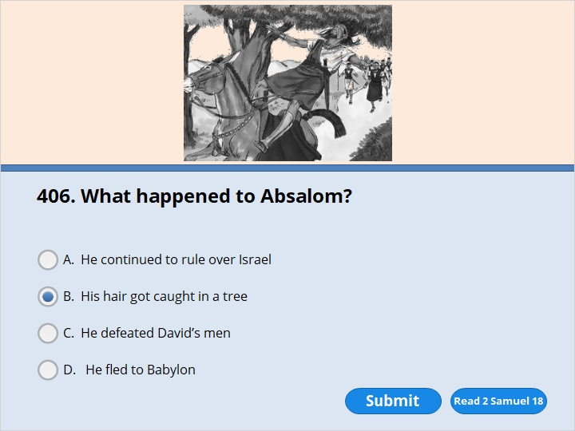
NEXT

Slide 277
NEXT

Slide 278
2 Samuel 18:9
Absalom happened to come across some of David’s men. He was riding his mule. The mule went under the thick branches of a large oak tree. Absalom’s hair got caught in the tree. He was left hanging in the air. The mule he was riding kept on going.

Slide 279
NEXT

Slide 280
NEXT

Slide 281
2 Samuel 18:14
Joab said, “I’m not going to waste any more time on you.” So he got three javelins. Then he went over and plunged them into Absalom’s heart. He did it while Absalom was still hanging there alive in the oak tree. 15 Ten of the men carrying Joab’s armor surrounded Absalom. They struck him and killed him.

Slide 282
NEXT

Slide 283
NEXT

Slide 284
2 Samuel 19:15
Then the king returned. He went as far as the Jordan River.
The men of Judah had come to Gilgal to welcome the king back. They had come to bring him across the Jordan. 16 Shimei, the son of Gera, was among them. Shimei was from Bahurim in the territory of Benjamin. He hurried down to welcome King David back.

Slide 285
NEXT

Slide 286
NEXT

Slide 287
2 Samuel 19:39
So all the people went across the Jordan River. Then the king crossed over. The king kissed Barzillai and said goodbye to him. And Barzillai went back home.

Slide 288
NEXT

Slide 289
NEXT

Slide 290
2 Samuel 20:1
An evil man who always stirred up trouble happened to be in Gilgal. His name was Sheba, the son of Bikri. Sheba was from the tribe of Benjamin. He blew his trumpet. Then he shouted,
“We don’t have any share in David’s kingdom! Jesse’s son is not our king! Men of Israel, every one of you go back home!”

Slide 291
NEXT

Slide 292
NEXT

Slide 293
2 Samuel 20:9
Joab said to Amasa, “How are you, my friend?” Then Joab reached out his right hand. He took hold of Amasa’s beard to kiss him. 10 Amasa didn’t notice the dagger in Joab’s left hand. Joab stuck it into his stomach. His insides spilled out on the ground. Joab didn’t have to stab him again. Amasa was already dead. Then Joab and his brother Abishai went after Sheba, the son of Bikri.

Slide 294
NEXT

Slide 295
NEXT

Slide 296
2 Samuel 20:15
Joab and all his troops came to Abel Beth Maakah. They surrounded it because Sheba was there. They built a ramp up to the city. It stood against the outer wall. They pounded the wall with huge logs to bring it down.
2 Samuel 20:22
Then the woman gave her wise advice to all the people in the city. They cut off the head of Sheba, the son of Bikri. They threw it down to Joab. So he blew his trumpet. Then his men pulled back from the city. Each of them returned to his home. And Joab went back to the king in Jerusalem.

Slide 297
NEXT

Slide 298
NEXT

Slide 299
2 Samuel 21:19
In another battle against the Philistines at Gob, Elhanan killed Goliath’s brother. Elhanan was the son of Jair from Bethlehem. Goliath was from the city of Gath. His spear was as big as a weaver’s rod.

Slide 300
NEXT

Slide 301
NEXT

Slide 302
2 Samuel 21:20
There was still another battle. It took place at Gath. A huge man lived there. He had six fingers on each hand and six toes on each foot. So the total number of his toes and fingers was 24.

Slide 303
NEXT

Slide 304
NEXT

Slide 305
2 Samuel 24:1
The Lord was very angry with Israel. He stirred up David against them. He said, “Go! Count the men of Israel and Judah.” 2 So the king spoke to Joab and the army commanders with him. He said, “Go all through the territories of the tribes of Israel. Go from the town of Dan all the way to Beersheba. Count the fighting men. Then I’ll know how many there are.”

Slide 306
NEXT

Slide 307
NEXT

Slide 308
2 Samuel 24:1
The Lord was very angry with Israel. He stirred up David against them. He said, “Go! Count the men of Israel and Judah.” 2 So the king spoke to Joab and the army commanders with him. He said, “Go all through the territories of the tribes of Israel. Go from the town of Dan all the way to Beersheba. Count the fighting men. Then I’ll know how many there are.”

Slide 309
NEXT

Slide 310
NEXT

Slide 311
2 Samuel 24:11
Before David got up the next morning, a message from the Lord came to Gad the prophet. He was David’s seer. The message said, 12 “Go and tell David, ‘The Lord says, “I could punish you in three different ways. Choose one of them for me to use against you.” ’ ”

Slide 312
NEXT

Slide 313
NEXT

Slide 314
2 Samuel 24:13
So Gad went to David. He said to him, “Take your choice. Do you want three years when there won’t be enough food in your land? Or do you want three months when you will run away from your enemies while they chase you? Or do you want three days when there will be a plague in your land? Think it over. Then take your pick. Tell me how to answer the one who sent me.”

Slide 315
NEXT

Slide 316
NEXT

Slide 317
2 Samuel 24:13
So Gad went to David. He said to him, “Take your choice. Do you want three years when there won’t be enough food in your land? Or do you want three months when you will run away from your enemies while they chase you? Or do you want three days when there will be a plague in your land? Think it over. Then take your pick. Tell me how to answer the one who sent me.”

Slide 318
NEXT

Slide 319
NEXT

Slide 320
2 Samuel 24:13
So Gad went to David. He said to him, “Take your choice. Do you want three years when there won’t be enough food in your land? Or do you want three months when you will run away from your enemies while they chase you? Or do you want three days when there will be a plague in your land? Think it over. Then take your pick. Tell me how to answer the one who sent me.”

Slide 321
NEXT

Slide 322
NEXT

Slide 323
2 Samuel 24:15
So the Lord sent a plague on Israel. It lasted from that morning until he decided to end it. From Dan all the way to Beersheba 70,000 people died.

Slide 324
NEXT

Slide 325
NEXT

Slide 326
2 Samuel 24:16
The angel reached his hand out to destroy Jerusalem. But the Lord stopped sending the plague. So he spoke to the angel who was making the people suffer. He said, “That is enough! Do not kill any more people.” The angel of the Lord was at Araunah’s threshing floor. Araunah was from the city of Jebus.

Slide 327
NEXT

Slide 328
NEXT

Slide 329
2 Samuel 24:25
David built an altar there to honor the Lord. He sacrificed burnt offerings and friendship offerings. Then the Lord answered David’s prayer and blessed the land. The plague on Israel was stopped.

Slide 330
NEXT

Slide 331
NEXT

Slide 332
2 Samuel 24:22
Araunah said to David, “Take anything you wish. Offer it up. Here are oxen for the burnt offering. Here are threshing sleds. And here are wooden collars from the necks of the oxen. Use all the wood to burn the offering. 23 Your Majesty, I’ll give all of it to you.” Araunah continued, “And may the Lord your God accept you.”

Slide 334
Our goal is not only for you to be able to study God’s Word, but also give you a way to teach and share with other people.
We pray God will bless your time in His Word!
WWW.Mark732.org
For more information and for further training: Contact
Rev. Dr. John Reinke
At RevReinke@gmail.com
or 608-436-9600 (voice/text)
Material Copyright ©Mark732
Bible Verses are from the New International Readers Version - NIrV
Pictures: Copyright © Language Recordings Inc (Australia). Used by permission
Material Copyright ©Mark732

