Slide 1
Our goal is not only for you to be able to study God’s Word, but also give you a way to teach and share with other people.
We pray God will bless your time in His Word!
WWW.Mark732.org
For more information and for further training: Contact
Rev. Dr. John Reinke
At RevReinke@gmail.com
or 608-436-9600 (voice/text)
Material Copyright ©Mark732
Bible Verses are from the New International Readers Version - NIrV
Pictures: Copyright © Language Recordings Inc (Australia). Used by permission
Material Copyright ©Mark732

Slide 2
NEXT

Slide 3
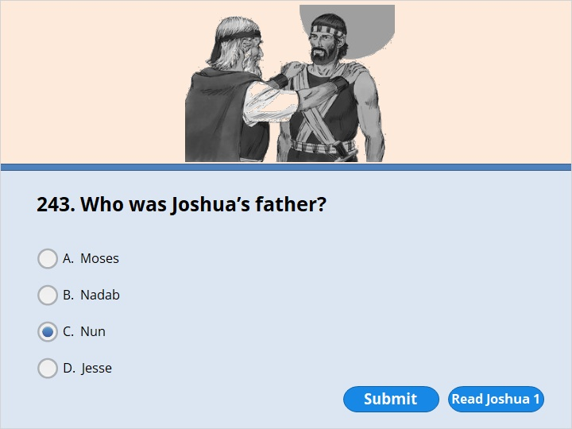
NEXT

Slide 4
NEXT

Slide 5
Joshua 1:1
Moses, the servant of the Lord, died. After that, the Lord spoke to Joshua, the son of Nun.

Slide 6
NEXT

Slide 7
NEXT

Slide 8
Joshua 2:1
Joshua, the son of Nun, sent two spies from Shittim. He sent them in secret. He said to them, “Go and look over the land. Most of all, check out Jericho.” So they went to Jericho. They stayed at the house of a prostitute. Her name was Rahab.

Slide 9
NEXT

Slide 10
NEXT

Slide 11
Joshua 2:1
Joshua, the son of Nun, sent two spies from Shittim. He sent them in secret. He said to them, “Go and look over the land. Most of all, check out Jericho.” So they went to Jericho. They stayed at the house of a prostitute. Her name was Rahab.

Slide 12
NEXT

Slide 13
NEXT

Slide 14
Joshua 2:12
“Now then, please give me your word. Promise me in the name of the Lord that you will be kind to my family. I’ve been kind to you. Promise me 13 that you will spare the lives of my father and mother. Spare my brothers and sisters. Also spare everyone in their families. Promise that you won’t put any of us to death.”

Slide 15
NEXT

Slide 16
NEXT

Slide 17
Joshua 2:15
The house Rahab lived in was part of the city wall. So she let the spies down by a rope through the window. 16 She said to them, “Go up into the hills. The men chasing you won’t be able to find you. Hide yourselves there for three days until they return. Then you can go on your way.”

Slide 18
NEXT

Slide 19
NEXT

Slide 20
Joshua 2:17
The spies had said to her, “You made us give our word. But we won’t keep our promise 18 unless you do what we say. When we enter the land, you must tie this bright red rope in the window. Tie it in the window you let us down through. Bring your father and mother into your house. Also bring in your brothers and everyone else in your family.

Slide 21
NEXT

Slide 22
NEXT

Slide 23
Joshua 2:17
The spies had said to her, “You made us give our word. But we won’t keep our promise 18 unless you do what we say. When we enter the land, you must tie this bright red rope in the window. Tie it in the window you let us down through. Bring your father and mother into your house. Also bring in your brothers and everyone else in your family.

Slide 24
NEXT

Slide 25
NEXT

Slide 26
Joshua 3:14
So the people took their tents down. They prepared to go across the Jordan River. The priests carrying the ark of the covenant went ahead of them. 15 The water of the Jordan was going over its banks. It always does that at the time the crops are being gathered. The priests came to the river. Their feet touched the water’s edge. 16 Right away the water coming down the river stopped flowing. It piled up far away at a town called Adam near Zarethan. The water flowing down to the Dead Sea was completely cut off. So the people went across the Jordan River opposite Jericho. 17 The priests carried the ark of the covenant of the Lord. They stopped in the middle of the river and stood on dry ground. They stayed there until the whole nation of Israel had gone across on dry ground.

Slide 27
NEXT

Slide 28
NEXT

Slide 29
Joshua 4:3
Tell them to get 12 stones from the middle of the river. They must pick them up from right where the priests stood. They must carry the stones over with all of you. And they must put them down at the place where you will stay tonight.”

Slide 30
NEXT

Slide 31
NEXT

Slide 32
Joshua 4:9
Joshua also piled up 12 stones in the middle of the river. He piled them up right where the priests who carried the ark of the covenant had stood. And they are still there to this very day.

Slide 33
NEXT

Slide 34
NEXT

Slide 35
Joshua 4:19
On the tenth day of the first month the people went up out of the Jordan River. They camped at Gilgal on the eastern border of Jericho. 20 Joshua set up the 12 stones at Gilgal. They were the ones the people had taken out of the Jordan. 21 Then he spoke to the Israelites. He said, “In days to come, your children after you will ask their parents, ‘What do these stones mean?’

Slide 36
NEXT

Slide 37
NEXT

Slide 38
Joshua 5:10
The Israelites celebrated the Passover Feast. They observed it on the evening of the 14th day of the month. They did it while they were camped at Gilgal on the plains around Jericho.

Slide 39
NEXT

Slide 40
NEXT

Slide 41
Joshua 5:12
The manna stopped coming down the day after they ate the food grown in the land. The Israelites didn’t have manna anymore. Instead, that year they ate food grown in Canaan.

Slide 42
NEXT

Slide 43
NEXT

Slide 44
Joshua 6:3
March around the city once with all your fighting men. In fact, do it for six days. 4 Have seven priests get trumpets made out of rams’ horns. They must carry them in front of the ark. On the seventh day, march around the city seven times. Tell the priests to blow the trumpets as you march.

Slide 45
NEXT

Slide 46
NEXT

Slide 47
Joshua 6:3
March around the city once with all your fighting men. In fact, do it for six days. 4 Have seven priests get trumpets made out of rams’ horns. They must carry them in front of the ark. On the seventh day, march around the city seven times. Tell the priests to blow the trumpets as you march.

Slide 48
NEXT

Slide 49
NEXT

Slide 50
Joshua 6:3
March around the city once with all your fighting men. In fact, do it for six days. 4 Have seven priests get trumpets made out of rams’ horns. They must carry them in front of the ark. On the seventh day, march around the city seven times. Tell the priests to blow the trumpets as you march.

Slide 51
NEXT

Slide 52
NEXT

Slide 53
Joshua 6:3
March around the city once with all your fighting men. In fact, do it for six days. 4 Have seven priests get trumpets made out of rams’ horns. They must carry them in front of the ark. On the seventh day, march around the city seven times. Tell the priests to blow the trumpets as you march.

Slide 54
NEXT

Slide 55
NEXT

Slide 56
Joshua 6:4
Have seven priests get trumpets made out of rams’ horns. They must carry them in front of the ark. On the seventh day, march around the city seven times. Tell the priests to blow the trumpets as you march. 5 You will hear them blow a long blast on the trumpets. When you do, tell the whole army to give a loud shout. The wall of the city will fall down. Then the whole army will march up to the city. Everyone will go straight in.”

Slide 57
NEXT

Slide 58
NEXT

Slide 59
Joshua 6:20
The priests blew the trumpets. As soon as the army heard the sound, they gave a loud shout. Then the wall fell down. Everyone charged straight in. So they took the city.

Slide 60
NEXT

Slide 61
NEXT

Slide 62
Joshua 6:22
Then Joshua spoke to the two men who had gone in to check out the land. He said, “Go into the prostitute’s house. Bring her out. Also bring out everyone with her. That’s what you promised her you would do.” 23 So the young men who had checked out the land went into Rahab’s house. They brought her out along with her parents and brothers and sisters. They brought out everyone else there with her. They put them in a place outside the camp of Israel.

Slide 63
NEXT

Slide 64
NEXT

Slide 65
Joshua 8:26
Joshua continued to hold out his javelin toward Ai. He didn’t lower his hand until he and his men had totally destroyed everyone who lived there.

Slide 66
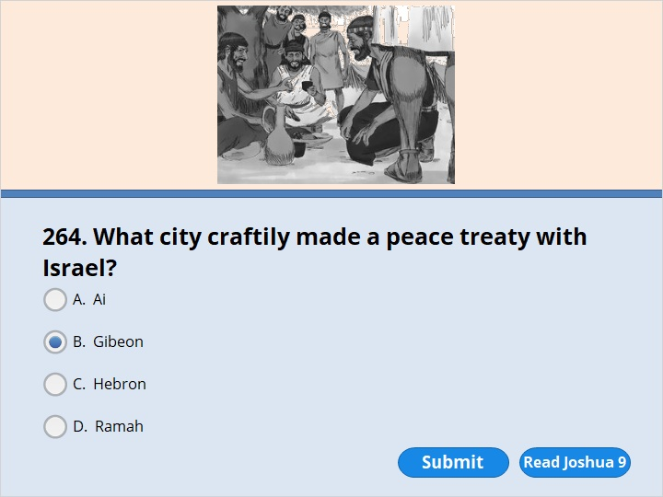
NEXT

Slide 67
NEXT

Slide 68
Joshua 9:3
The people of Gibeon heard about what Joshua had done to Jericho and Ai. 4 So they decided to trick the Israelites. They packed supplies as if they were going on a long trip. They loaded their donkeys with old sacks and old wineskins. The wineskins were cracked but had been mended. 5 They put worn-out sandals on their feet. The sandals had been patched. They also wore old clothes. All the bread they took along was dry and moldy. 6 They went to Joshua in the camp at Gilgal. They spoke to him and the Israelites. They said, “We’ve come from a country that’s far away. Make a peace treaty with us.”

Slide 69
NEXT

Slide 70
NEXT

Slide 71
Joshua 10:11
The Amorites tried to escape as Israel marched toward them. They ran down the road from Beth Horon to Azekah. Then the Lord threw large hailstones down on them. The hailstones killed more of them than the swords of the Israelites did.

Slide 72
NEXT

Slide 73
NEXT

Slide 74
Joshua 10:12
So the Lord gave the Amorites over to Israel. On that day Joshua spoke to the Lord while the Israelites were listening. He said, “Sun, stand still over Gibeon. And you, moon, stand still over the Valley of Aijalon.”
13 So the sun stood still. The moon stopped. They didn’t move again until the nation won the battle over its enemies.

Slide 75
NEXT

Slide 76
NEXT

Slide 77
Joshua 10:12
So the Lord gave the Amorites over to Israel. On that day Joshua spoke to the Lord while the Israelites were listening. He said, “Sun, stand still over Gibeon. And you, moon, stand still over the Valley of Aijalon.”
13 So the sun stood still. The moon stopped. They didn’t move again until the nation won the battle over its enemies.

Slide 78
NEXT

Slide 79
NEXT

Slide 80
Joshua 13:14
Moses hadn’t given any share of the land to the tribe of Levi. That’s because the food offerings are their share. Those offerings are presented to the Lord, the God of Israel. Moses gave the Levites what he had promised them.

Slide 81
NEXT

Slide 82
NEXT

Slide 83
Joshua 22:1
Joshua sent for the tribes of Reuben and Gad and half of the tribe of Manasseh. 2 He said to them, “You have done everything that Moses, the servant of the Lord, commanded. You have also obeyed everything I commanded. 3 For a long time now you haven’t deserted the other Israelites. Instead, you have done what the Lord your God sent you to do. You have obeyed him right up to this day. 4 Now the Lord your God has given the other tribes peace and rest. That’s what he promised to do. So return to your homes. They are in the land that Moses, the servant of the Lord, gave you. It’s on the east side of the Jordan River.

Slide 84
NEXT

Slide 85
NEXT

Slide 86
Joshua 22:13
The Israelites sent Phinehas the priest to the land of Gilead. Phinehas was the son of Eleazar. They sent him to the tribes of Reuben and Gad and half of the tribe of Manasseh.

Slide 87
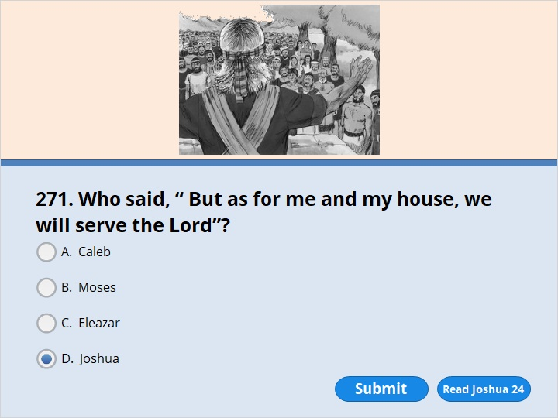
NEXT

Slide 88
NEXT

Slide 89
Joshua 24:14
“So have respect for the Lord. Serve him. Be completely faithful to him. Throw away the gods your people worshiped east of the Euphrates River and in Egypt. Serve the Lord. 15 But suppose you don’t want to serve him. Then choose for yourselves right now whom you will serve. You can choose the gods your people served east of the Euphrates River. Or you can serve the gods of the Amorites. After all, you are living in their land. But as for me and my family, we will serve the Lord.” (continue )

Slide 90
16 Then the people answered Joshua, “We would never desert the Lord! We would never serve other gods! 17 The Lord our God himself brought us and our parents up out of Egypt. He brought us out of that land where we were slaves. With our own eyes, we saw those great signs he did. He kept us safe on our entire journey. He kept us safe as we traveled through all the nations. 18 He drove them out to make room for us. That included the Amorites. They also lived in the land. We too will serve the Lord. That’s because he is our God.”

Slide 91
NEXT

Slide 92
NEXT

Slide 93
Joshua 24:29
Then Joshua, the servant of the Lord, died. He was the son of Nun. He was 110 years old when he died. 30 His people buried him at Timnath Serah on his own property. It’s north of Mount Gaash in the hill country of Ephraim.

Slide 94
NEXT

Slide 95
NEXT

Slide 96
Joshua 24:32
The Israelites had brought Joseph’s bones up from Egypt. They buried his bones at Shechem in the piece of land Jacob had bought. He had bought it from the sons of Hamor. He had paid 100 pieces of silver for it. Hamor was the father of Shechem. That piece of land became the share that belonged to Joseph’s children after him.

Slide 97
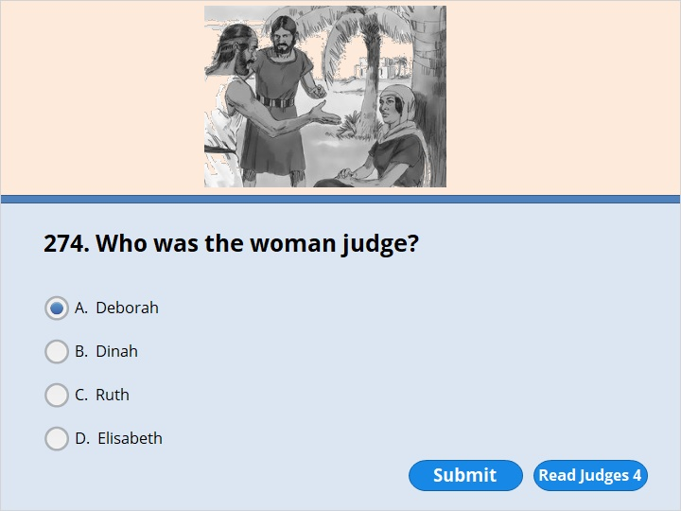
NEXT

Slide 98
NEXT

Slide 99
Judges 4:4
Deborah was a prophet. She was the wife of Lappidoth. She was leading Israel at that time. 5 Under the Palm Tree of Deborah she served the people as their judge. That place was between Ramah and Bethel in the hill country of Ephraim. The Israelites went up to her there. They came to have her decide cases for them. She settled matters between them.

Slide 100
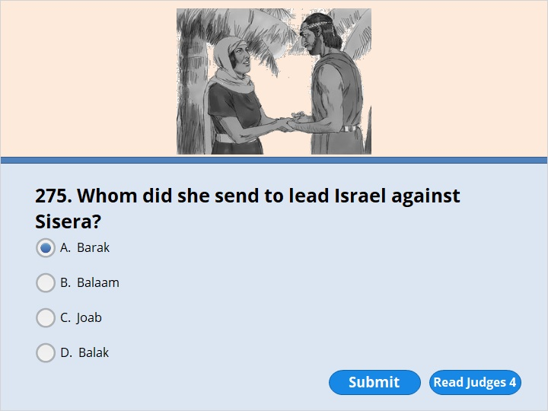
NEXT

Slide 101
NEXT

Slide 102
Judges 4:6
Deborah sent for Barak. He was the son of Abinoam. Barak was from Kedesh in the land of Naphtali. Deborah said to Barak, “The Lord, the God of Israel, is giving you a command. He says, ‘Go! Take 10,000 men from the tribes of Naphtali and Zebulun with you. Then lead them up to Mount Tabor. 7 I will lead Sisera into a trap. He is the commander of Jabin’s army. I will bring him, his chariots and his troops to the Kishon River. There I will hand him over to you.’ ”

Slide 103
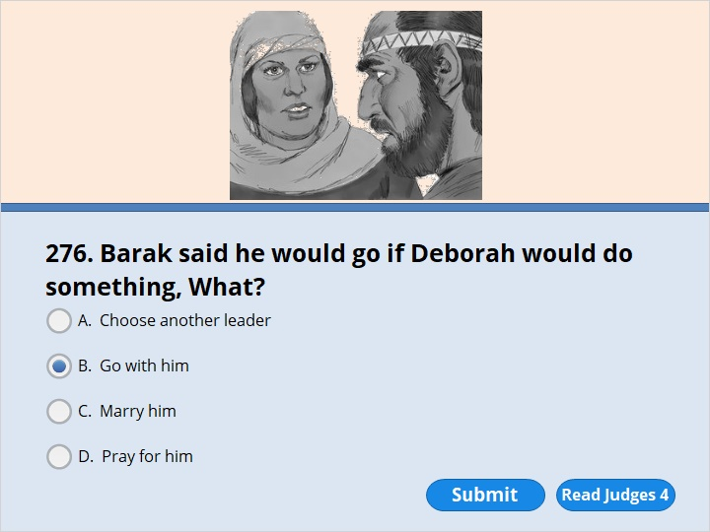
NEXT

Slide 104
NEXT

Slide 105
Judges 4:8
Barak said to her, “If you go with me, I’ll go. But if you don’t go with me, I won’t go.”

Slide 106
NEXT

Slide 107
NEXT

Slide 108
Judges 4:18
Jael went out to meet Sisera. “Come in, sir,” she said. “Come right in. Don’t be afraid.” So he entered her tent. Then she covered him with a blanket.
19 “I’m thirsty,” he said. “Please give me some water.” So Jael opened a bottle of milk. The bottle was made out of animal skin. She gave him a drink of milk. Then she covered him up again.
20 “Stand in the doorway of the tent,” he told her. “Someone might come by and ask you, ‘Is anyone in there?’ If that happens, say ‘No.’ ”
21 But Heber’s wife Jael picked up a tent stake and a hammer. She went quietly over to Sisera. He was lying there, fast asleep. He was very tired. She drove the stake through his head right into the ground. So he died.

Slide 109
NEXT

Slide 110
NEXT

Slide 111
Judges 6:11
The angel of the Lord came. He sat down under an oak tree in Ophrah. The tree belonged to Joash. He was from the family line of Abiezer. Gideon was threshing wheat in a winepress at Ophrah. He was the son of Joash. Gideon was threshing in a winepress to hide the wheat from the Midianites. 12 The angel of the Lord appeared to Gideon. He said, “Mighty warrior, the Lord is with you.”

Slide 112
NEXT

Slide 113
NEXT

Slide 114
Judges 6:36
Gideon said to God, “You promised you would use me to save Israel. 37 Please do something for me. I’ll put a piece of wool on the threshing floor. Suppose dew is only on the wool tomorrow morning. And suppose the ground all around it is dry. Then I will know that you will use me to save Israel. I’ll know that your promise will come true.” 38 And that’s what happened. Gideon got up early the next day. He squeezed the dew out of the wool. The water filled a bowl.

Slide 115
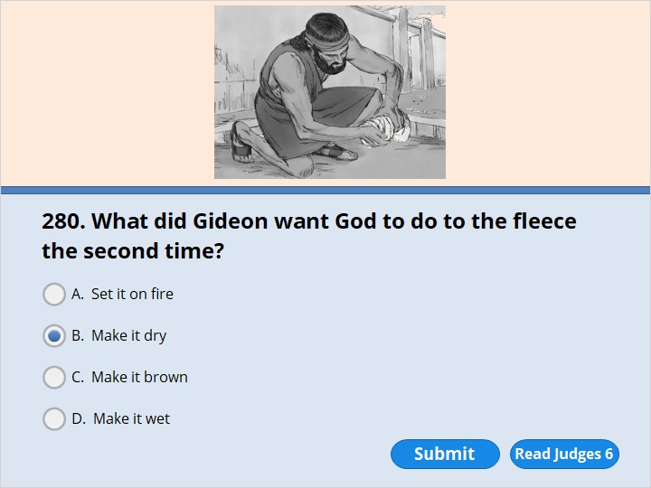
NEXT

Slide 116
NEXT

Slide 117
Judges 6:39
Then Gideon said to God, “Don’t be angry with me. Let me ask you for just one more thing. Let me use the wool for one more test. But this time make the wool dry. And let the ground be covered with dew.” 40 So that night God did it. Only the wool was dry. The ground all around it was covered with dew.

Slide 118
NEXT

Slide 119
NEXT

Slide 120
Judges 7:7
The Lord spoke to Gideon. He said, “With the help of the 300 men who lapped up the water I will save you. I will hand the Midianites over to you. Let all the other men go home.” 8 So Gideon sent those Israelites home. But he kept the 300 men. They took over the supplies and trumpets the others had left.
The Midianites had set up their camp in the valley below where Gideon was.

Slide 121
NEXT

Slide 122
NEXT

Slide 123
Judges 7:16
Gideon separated the 300 men into three fighting groups. He put a trumpet and an empty jar into the hands of each man. And he put a torch inside each jar.

Slide 124
NEXT

Slide 125
NEXT

Slide 126
Judges 11:1
Jephthah was a mighty warrior. He was from the land of Gilead. His father’s name was Gilead. Jephthah’s mother was a prostitute. 2 Gilead’s wife also had sons by him. When they had grown up, they drove Jephthah away. “You aren’t going to get any share of our family’s property,” they said. “You are the son of another woman.”

Slide 127
NEXT

Slide 128
NEXT

Slide 129
Judges 11:8
The elders of Gilead replied to him. “You are right,” they said. “That’s why we’re turning to you now. Come with us and fight against the Ammonites. Then you will rule over all of us who live in Gilead.”
9 Jephthah said, “Suppose you take me back to fight against the Ammonites. And suppose the Lord gives me victory over them. Then will I really be your leader?”
10 The elders of Gilead replied, “The Lord is our witness. We’ll certainly do as you say.” 11 So Jephthah went with the elders of Gilead. And the people made him their leader and commander. He went to Mizpah. There he repeated to the Lord everything he had said.

Slide 130
NEXT

Slide 131
NEXT

Slide 132
Judges 11:30
Jephthah made a promise to the Lord. Jephthah said, “Hand the Ammonites over to me. 31 If you do, here’s what I’ll do when I come back from winning the battle. Anything that comes out the door of my house to meet me will belong to the Lord. I will sacrifice it as a burnt offering.”

Slide 133
NEXT

Slide 134
NEXT

Slide 135
Judges 11:34
Jephthah returned to his home in Mizpah. And guess who came out to meet him. It was his daughter! She was dancing to the beat of tambourines. She was his only child. He didn’t have any other sons or daughters. 35 When Jephthah saw her, he was so upset that he tore his clothes. He cried out, “Oh no, my daughter! You have filled me with trouble and sorrow. I’ve made a promise to the Lord. And I can’t break it.”

Slide 136
NEXT

Slide 137
NEXT

Slide 138
Judges 12:6
Then they would say, “All right. Say ‘Shibboleth.’ ” If he said “Sibboleth,” the way he said the word would give him away. He couldn’t say it correctly. So they would grab him. Then they would kill him at one of the places where people go across the Jordan. At that time, 42,000 men of Ephraim were killed.

Slide 139
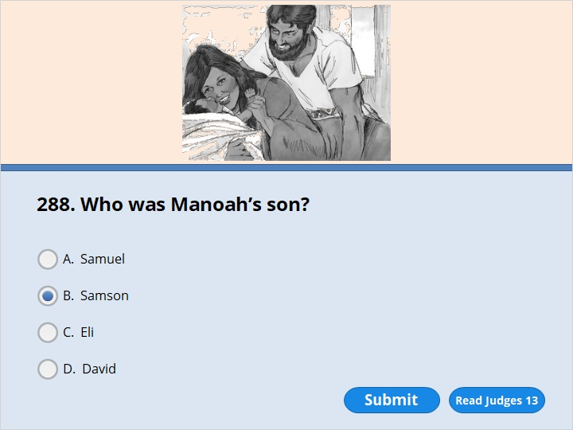
NEXT

Slide 140
NEXT

Slide 141
Judges 13:21
The angel of the Lord didn’t show himself again to Manoah and his wife. Then Manoah realized it was the angel of the Lord.
22 “We’re going to die!” he said to his wife. “We’ve seen God!”
23 But his wife answered, “The Lord doesn’t want to kill us. If he did, he wouldn’t have accepted a burnt offering and a grain offering from us. He wouldn’t have shown us all these things. He wouldn’t have told us we’re going to have a son.”
24 Later, the woman had a baby boy. She named him Samson. As he grew up, the Lord blessed him.

Slide 142
NEXT

Slide 143
NEXT

Slide 144
Judges 13:2
A certain man from Zorah was named Manoah. He was from the tribe of Dan. Manoah had a wife who wasn’t able to have children. 3 The angel of the Lord appeared to Manoah’s wife. He said, “You are not able to have children. But you are going to become pregnant. You will have a baby boy.

Slide 145
NEXT

Slide 146
NEXT

Slide 147
Judges 13:20
A flame blazed up from the altar toward heaven. The angel of the Lord rose up in the flame. When Manoah and his wife saw it, they fell with their faces to the ground.

Slide 148
NEXT

Slide 149
NEXT

Slide 150
Judges 14:5
Samson went down to Timnah. His father and mother went with him. They approached the vineyards of Timnah. Suddenly a young lion came roaring toward Samson. 6 Then the Spirit of the Lord came powerfully on Samson. So he tore the lion apart with his bare hands. He did it as easily as he might have torn a young goat apart. But he didn’t tell his father or mother what he had done.

Slide 151
NEXT

Slide 152
NEXT

Slide 153
Judges 14:8
Some time later, he was going back to marry her. But he turned off the road to look at the lion’s dead body. He saw large numbers of bees and some honey in it.

Slide 154
NEXT

Slide 155
NEXT

Slide 156
Judges 14:15
On the fourth day they spoke to Samson’s wife. “Get your husband to explain the riddle for us,” they said. “If you don’t, we’ll burn you to death. We’ll burn up everyone in your family. Did you invite us here to steal our property?”
16 Then Samson’s wife threw herself on him. She sobbed, “You hate me! You don’t really love me. You have given my people a riddle. But you haven’t told me the answer.”
“I haven’t even explained it to my father or mother,” he replied. “So why should I explain it to you?” 17 She cried during the whole seven days the feast was going on. So on the seventh day he finally told her the answer to the riddle. That’s because she kept on asking him to tell her. Then she explained the riddle to her people.

Slide 157
NEXT

Slide 158
NEXT

Slide 159
Judges 15:4
So he went out and caught 300 foxes. He tied them in pairs by their tails. Then he tied a torch to each pair of tails. 5 He lit the torches. He let the foxes loose in the fields of grain that belonged to the Philistines. He burned up the grain that had been cut and stacked. He burned up the grain that was still growing. He also burned up the vineyards and olive trees.

Slide 160
NEXT

Slide 161
NEXT

Slide 162
Judges 15:15
He found a fresh jawbone of a donkey. He grabbed it and struck down 1,000 men. 16 Then Samson said, “By using a donkey’s jawbone I’ve made them look like donkeys. By using a donkey’s jawbone I’ve struck down 1,000 men.”

Slide 163
NEXT

Slide 164
NEXT

Slide 165
Judges 16:3
But Samson stayed there only until the middle of the night. Then he got up. He took hold of the doors of the city gate. He also took hold of the two doorposts. He tore them loose, together with their metal bar. He picked them up and put them on his shoulders. Then he carried them to the top of the hill that faces Hebron.

Slide 166
NEXT

Slide 167
NEXT

Slide 168
Judges 16:4
Some time later, Samson fell in love again. The woman lived in the Valley of Sorek. Her name was Delilah.

Slide 169
NEXT

Slide 170
NEXT

Slide 171
Judges 16:6
So Delilah said to Samson, “Tell me the secret of why you are so strong. Tell me how you can be tied up and controlled.”
7 Samson answered her, “Let someone tie me up with seven new bowstrings. They must be strings that aren’t completely dry. Then I’ll become as weak as any other man.”

Slide 172
NEXT

Slide 173
NEXT

Slide 174
Judges 16:10
Delilah spoke to Samson again. “You have made me look foolish,” she said. “You told me a lie. Come on. Tell me how you can be tied up.”
11 Samson said, “Let someone tie me tightly with new ropes. They must be ropes that have never been used. Then I’ll become as weak as any other man.”

Slide 175
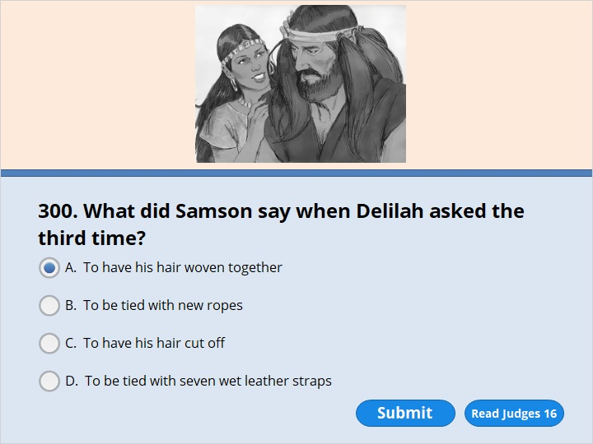
NEXT

Slide 176
NEXT

Slide 177
Judges 16:13
Delilah spoke to Samson again. “All this time you have been making me look foolish,” she said. “You have been telling me lies. This time really tell me how you can be tied up.”
He replied, “Weave the seven braids of my hair into the cloth on a loom. Then tighten the cloth with a pin. If you do, I’ll become as weak as any other man.” So while Samson was sleeping, Delilah took hold of the seven braids of his hair. She wove them into the cloth on a loom. 14 Then she tightened the cloth with a pin.
Again she called out to him, “Samson! The Philistines are attacking you!” He woke up from his sleep. He pulled up the pin and the loom, together with the cloth.

Slide 178
NEXT

Slide 179
NEXT

Slide 180
Judges 16:17
So he told her everything. He said, “My hair has never been cut. That’s because I’ve been a Nazirite since the day I was born. A Nazirite is set apart to God. If you shave my head, I won’t be strong anymore. I’ll become as weak as any other man.”

Slide 181
NEXT

Slide 182
NEXT

Slide 183
Judges 16:19
Delilah got Samson to go to sleep on her lap. Then she called for someone to shave off the seven braids of his hair. That’s how she began to bring Samson under her control. And he wasn’t strong anymore.

Slide 184
NEXT

Slide 185
NEXT

Slide 186
Judges 16:27
The temple was crowded with men and women. All the Philistine rulers were there. About 3,000 men and women were on the roof. They were watching Samson put on a show.
28 Then he prayed to the Lord. Samson said, “Lord and King, show me that you still have concern for me. Please, God, make me strong just one more time. Let me pay the Philistines back for what they did to my two eyes. Let me do it with only one blow.” 29 Then Samson reached toward the two pillars that were in the middle of the temple. They were the ones that held up the temple. He put his right hand on one of them. He put his left hand on the other. He leaned hard against them. 30 Samson said, “Let me die together with the Philistines!” Then he pushed with all his might. The temple came down on the rulers. It fell on all the people in it. So Samson killed many more Philistines when he died than he did while he lived.

Slide 187
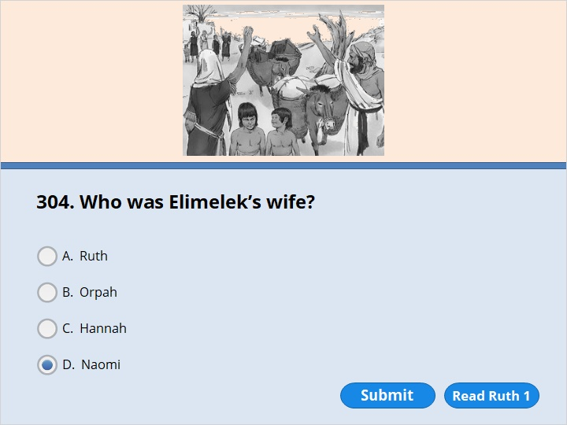
NEXT

Slide 188
NEXT

Slide 189
Ruth 1:2
The man’s name was Elimelek. His wife’s name was Naomi. The names of his two sons were Mahlon and Kilion. They were from the tribe of Ephraim. Their home had been in Bethlehem in Judah. They went to Moab and lived there.

Slide 190
NEXT

Slide 191
NEXT

Slide 192
Ruth 1:1
There was a time when Israel didn’t have kings to rule over them. But they had leaders to help them. This is a story about some things that happened during that time. There wasn’t enough food in the land of Judah. So a man went to live for a while in the country of Moab. He was from Bethlehem in Judah. His wife and two sons went with him.

Slide 193
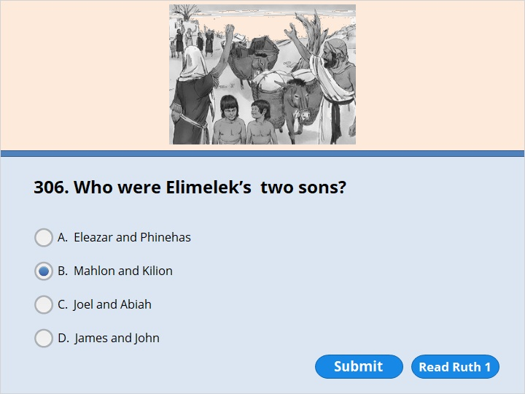
NEXT

Slide 194
NEXT

Slide 195
Ruth 1:2
The man’s name was Elimelek. His wife’s name was Naomi. The names of his two sons were Mahlon and Kilion. They were from the tribe of Ephraim. Their home had been in Bethlehem in Judah. They went to Moab and lived there.

Slide 196
NEXT

Slide 197
NEXT

Slide 198
Ruth 1:1
There was a time when Israel didn’t have kings to rule over them. But they had leaders to help them. This is a story about some things that happened during that time. There wasn’t enough food in the land of Judah. So a man went to live for a while in the country of Moab. He was from Bethlehem in Judah. His wife and two sons went with him.

Slide 199
NEXT

Slide 200
NEXT

Slide 201
Ruth 1:3
Naomi’s husband Elimelek died. So she was left with her two sons. 4 They married women from Moab. One was named Orpah. The other was named Ruth. Naomi’s family lived in Moab for about ten years. 5 Then Mahlon and Kilion also died. So Naomi was left without her two sons and her husband.

Slide 202
NEXT

Slide 203
NEXT

Slide 204
Ruth 1:16
But Ruth replied, “Don’t try to make me leave you and go back. Where you go I’ll go. Where you stay I’ll stay. Your people will be my people. Your God will be my God.

Slide 205
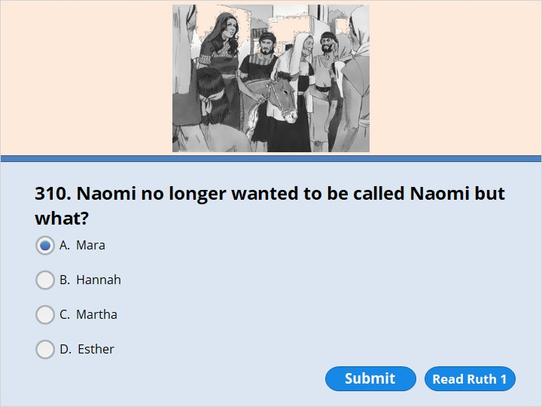
NEXT

Slide 206
NEXT

Slide 207
Ruth 1:20
“Don’t call me Naomi,” she told them. “Call me Mara. The Mighty One has made my life very bitter.

Slide 208
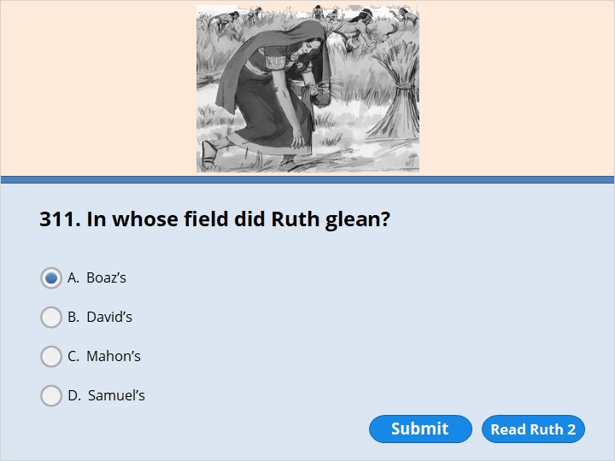
NEXT

Slide 209
NEXT

Slide 210
Ruth 2:3
So Ruth went out to a field and began to pick up grain. She worked behind those cutting and gathering the grain. As it turned out, she was working in a field that belonged to Boaz. He was from the family of Elimelek.

Slide 211
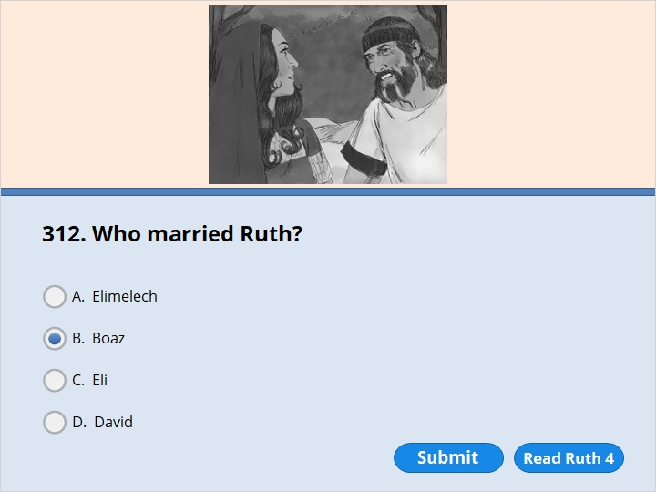
NEXT

Slide 212
NEXT

Slide 213
Ruth 4:9
Then Boaz said to the elders and all the people, “Today you are witnesses. You have seen that I have bought land from Naomi. I have bought all the property that had belonged to Elimelek, Kilion and Mahlon. 10 I’ve also taken Ruth, who is from Moab, to become my wife. She is Mahlon’s widow. I’ve decided to marry her so the dead man’s name will stay with his property. Now his name won’t disappear from his family line or from his hometown. Today you are witnesses!”

Slide 214
NEXT

Slide 215
NEXT

Slide 216
Ruth 4:18
Here is the family line of Perez.Perez was the father of Hezron. 19 Hezron was the father of Ram. Ram was the father of Amminadab. 20 Amminadab was the father of Nahshon. Nahshon was the father of Salmon. 21 Salmon was the father of Boaz. Boaz was the father of Obed. 22 Obed was the father of Jesse. And Jesse was the father of David.

Slide 217
NEXT

Slide 218
NEXT

Slide 219
Ruth 4:18
Here is the family line of Perez.
Perez was the father of Hezron.
19 Hezron was the father of Ram.
Ram was the father of Amminadab.
20 Amminadab was the father of Nahshon.
Nahshon was the father of Salmon.
21 Salmon was the father of Boaz.
Boaz was the father of Obed.
22 Obed was the father of Jesse.
And Jesse was the father of David.

Slide 221
Our goal is not only for you to be able to study God’s Word, but also give you a way to teach and share with other people.
We pray God will bless your time in His Word!
WWW.Mark732.org
For more information and for further training: Contact
Rev. Dr. John Reinke
At RevReinke@gmail.com
or 608-436-9600 (voice/text)
Material Copyright ©Mark732
Bible Verses are from the New International Readers Version - NIrV
Pictures: Copyright © Language Recordings Inc (Australia). Used by permission
Material Copyright ©Mark732

