Slide 1
Our goal is not only for you to be able to study God’s Word, but also give you a way to teach and share with other people.
We pray God will bless your time in His Word!
WWW.Mark732.org

Slide 2
WWW.Mark732.org
For more information and for further training: Contact
Rev. Dr. John Reinke
At RevReinke@gmail.com
or 608-436-9600 (voice/text)
Material Copyright ©Mark732

Slide 3
NEXT

Slide 4
NEXT

Slide 5
NEXT

Slide 6
Exodus 1:8-10
8 Then a new king came to power in Egypt. Joseph didn’t mean anything to him. 9 “Look,” he said to his people. “The Israelites are far too many for us. 10 Come. We must deal with them carefully. If we don’t, there will be even more of them. Then if war breaks out, they’ll join our enemies. They’ll fight against us and leave the country.”

Slide 7
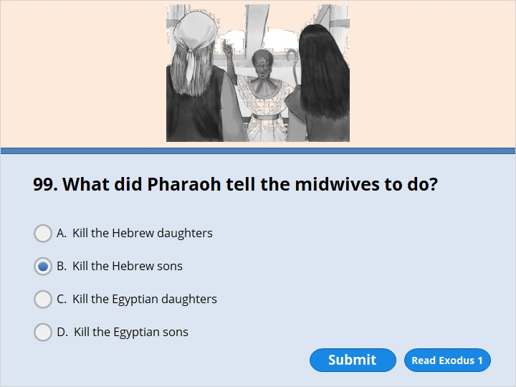
NEXT

Slide 8
NEXT

Slide 9
Exodus 1:15-16
15 There were two Hebrew women named Shiphrah and Puah. They helped other women having babies. The king of Egypt spoke to them. He said, 16 “You are the ones who help the other Hebrew women. Watch them when they get into a sitting position to have their babies. Kill the boys. Let the girls live.”

Slide 10
NEXT

Slide 11
NEXT

Slide 12
Exodus 1:18-19
18 Then the king of Egypt sent for the women. He asked them, “Why have you done this? Why have you let the boys live?”
19 The women answered Pharaoh, “Hebrew women are not like the women of Egypt. They are strong. They have their babies before we get there.”

Slide 13
NEXT

Slide 14
NEXT

Slide 15
Exodus 1:22
Then Pharaoh gave an order to all his people. He said, “You must throw every Hebrew baby boy into the Nile River. But let every Hebrew baby girl live.”

Slide 16
NEXT

Slide 17
NEXT

Slide 18
Exodus 2:1-2
Moses Is Born
2 A man and a woman from the tribe of Levi got married. 2 She became pregnant and had a son by her husband.

Slide 19
NEXT

Slide 20
NEXT

Slide 21
Exodus 2:1-2
1 A man and a woman from the tribe of Levi got married. 2 She became pregnant and had a son by her husband. She saw that her baby was a fine child. And she hid him for three months.

Slide 22
NEXT

Slide 23
NEXT

Slide 24
Exodus 2:3
After that, she couldn’t hide him any longer. So she got a basket made out of the stems of tall grass. She coated the basket with tar. She placed the child in the basket. Then she put it in the tall grass that grew along the bank of the Nile River.

Slide 25
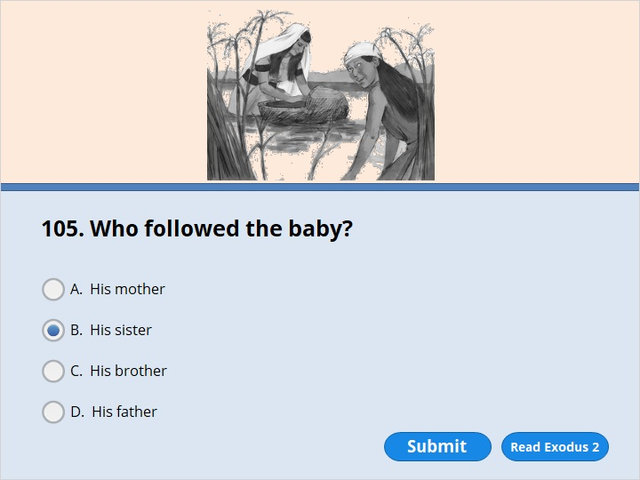
NEXT

Slide 26
NEXT

Slide 27
Exodus 2:4
The child’s sister wasn’t very far away. She wanted to see what would happen to him.

Slide 28
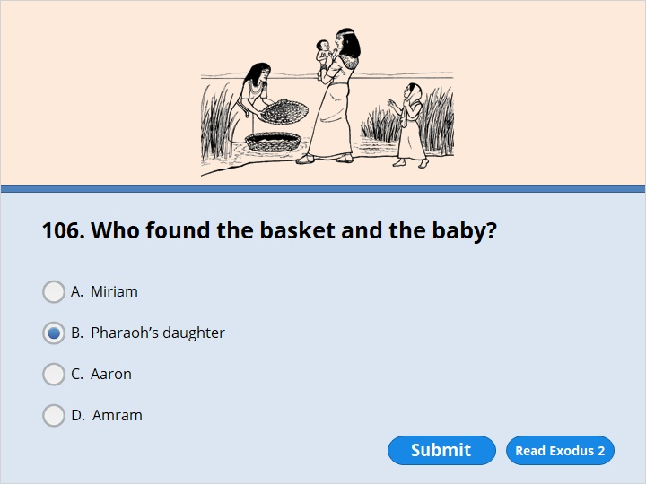
NEXT

Slide 29
NEXT

Slide 30
Exodus 2:5-6
5 Pharaoh’s daughter went down to the Nile River to take a bath. Her attendants were walking along the river bank. She saw the basket in the tall grass. So she sent her female slave to get it. 6 When she opened it, Pharaoh’s daughter saw the baby. He was crying. She felt sorry for him. “This is one of the Hebrew babies,” she said.

Slide 31
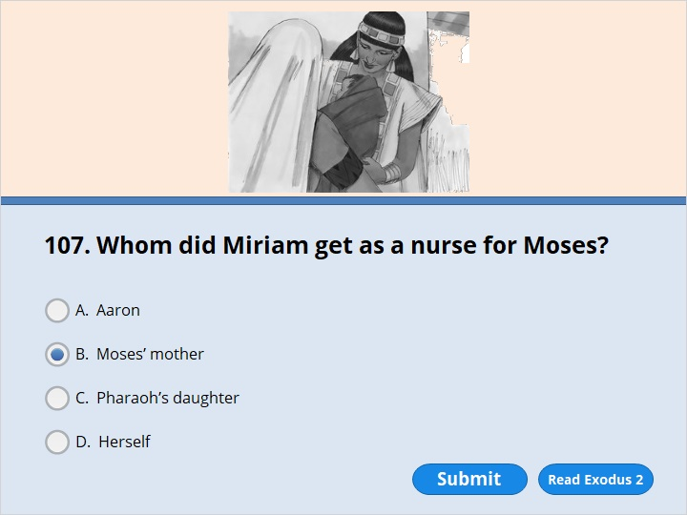
NEXT

Slide 32
NEXT

Slide 33
Exodus 2:7-9
7 Then his sister spoke to Pharaoh’s daughter. She asked, “Do you want me to go and get one of the Hebrew women? She could breast-feed the baby for you.”
8 “Yes. Go,” she answered. So the girl went and got the baby’s mother. 9 Pharaoh’s daughter said to her, “Take this baby and feed him for me. I’ll pay you.” So the woman took the baby and fed him.

Slide 34
NEXT

Slide 35
NEXT

Slide 36
Exodus 2:10
When the child grew older, she took him to Pharaoh’s daughter. And he became her son. She named him Moses. She said, “I pulled him out of the water.”

Slide 37
NEXT

Slide 38
NEXT

Slide 39
Exodus 2:11-12
11 Moses grew up. One day, he went out to where his own people were. He watched them while they were hard at work. He saw an Egyptian hitting a Hebrew man. The man was one of Moses’ own people. 12 Moses looked around and didn’t see anyone. So he killed the Egyptian. Then he hid his body in the sand.

Slide 40
NEXT

Slide 41
NEXT

Slide 42
Exodus 2:13
The next day Moses went out again. He saw two Hebrew men fighting. He asked the one who had started the fight a question. He said, “Why are you hitting another Hebrew man?”

Slide 43
NEXT

Slide 44
NEXT

Slide 45
Exodus 2:14
The man said, “Who made you ruler and judge over us? Are you thinking about killing me as you killed the Egyptian?” Then Moses became afraid. He thought, “People must have heard about what I did.”

Slide 46
NEXT

Slide 47
NEXT

Slide 48
Exodus 2:15
When Pharaoh heard about what had happened, he tried to kill Moses. But Moses escaped from Pharaoh and went to live in Midian. There he sat down by a well.

Slide 49
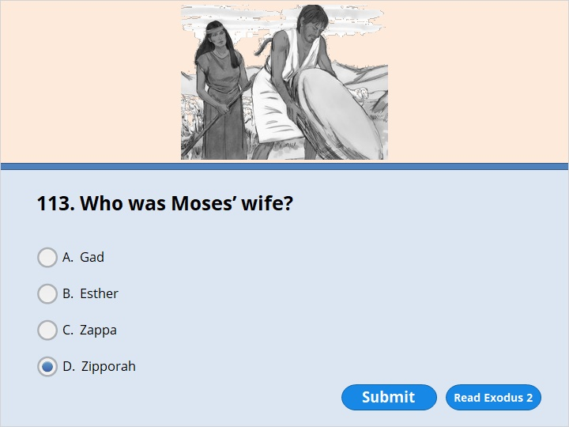
NEXT

Slide 50
NEXT

Slide 51
Exodus 2:21
Moses agreed to stay with the man. And the man gave his daughter Zipporah to Moses to be his wife.

Slide 52
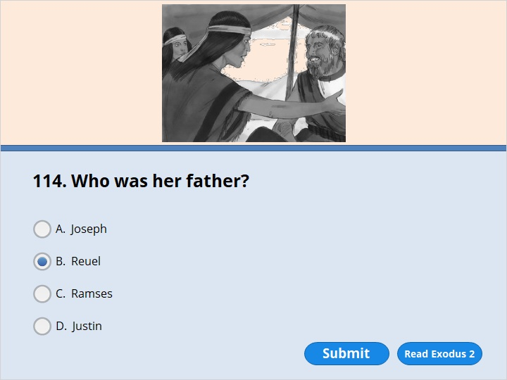
NEXT

Slide 53
NEXT

Slide 54
Exodus 2:18
The girls returned to their father Reuel. He asked them, “Why have you returned so early today?”

Slide 55
NEXT

Slide 56
NEXT

Slide 57
Exodus 2:22
Zipporah had a son by him. Moses named him Gershom. That’s because Moses said, “I’m an outsider in a strange land.”

Slide 58
NEXT

Slide 59
NEXT

Slide 60
Exodus 3:1
Moses was taking care of the flock of his father-in-law Jethro. Jethro was the priest of Midian. Moses led the flock to the western side of the desert. He came to Horeb. It was the mountain of God.

Slide 61
NEXT

Slide 62
NEXT

Slide 63
Exodus 3:2-3
2 There the angel of the Lord appeared to him from inside a burning bush. Moses saw that the bush was on fire. But it didn’t burn up. 3 So Moses thought, “I’ll go over and see this strange sight. Why doesn’t the bush burn up?”

Slide 64
NEXT

Slide 65
NEXT

Slide 66
Exodus 3:1-3
1 Moses was taking care of the flock of his father-in-law Jethro. Jethro was the priest of Midian. Moses led the flock to the western side of the desert. He came to Horeb. It was the mountain of God. 2 There the angel of the Lord appeared to him from inside a burning bush. Moses saw that the bush was on fire. But it didn’t burn up. 3 So Moses thought, “I’ll go over and see this strange sight. Why doesn’t the bush burn up?”

Slide 67
NEXT

Slide 68
NEXT

Slide 69
Exodus 3:7-10
7 The Lord said, “I have seen how my people are suffering in Egypt. I have heard them cry out because of their slave drivers. I am concerned about their suffering. 8 So I have come down to save them from the Egyptians. I will bring them up out of that land. I will bring them into a good land. It has a lot of room. It is a land that has plenty of milk and honey. The Canaanites, Hittites, Amorites, Perizzites, Hivites and Jebusites live there. 9 And now Israel’s cry for help has reached me. I have seen how badly the Egyptians are treating them. 10 So now, go. I am sending you to Pharaoh. I want you to bring the Israelites out of Egypt. They are my people.”

Slide 70
NEXT

Slide 71
NEXT

Slide 72
Exodus 3:7-10
7 The Lord said, “I have seen how my people are suffering in Egypt. I have heard them cry out because of their slave drivers. I am concerned about their suffering. 8 So I have come down to save them from the Egyptians. I will bring them up out of that land. I will bring them into a good land. It has a lot of room. It is a land that has plenty of milk and honey. The Canaanites, Hittites, Amorites, Perizzites, Hivites and Jebusites live there. 9 And now Israel’s cry for help has reached me. I have seen how badly the Egyptians are treating them. 10 So now, go. I am sending you to Pharaoh. I want you to bring the Israelites out of Egypt. They are my people.”

Slide 73
NEXT

Slide 74
NEXT

Slide 75
Exodus 4:14-17
14 Then the Lord became very angry with Moses. He said, “What about your brother, Aaron the Levite? I know he can speak well. He is already on his way to meet you. He will be glad to see you. 15 Speak to him. Tell him what to say. I will help both of you speak. I will teach you what to do. 16 He will speak to the people for you. He will be like your mouth. And you will be like God to him. 17 But take this walking stick in your hand. You will be able to do signs with it.”

Slide 76
NEXT

Slide 77
NEXT

Slide 78
Exodus 4:27-28
27 The Lord said to Aaron, “Go into the desert to see Moses.” So Aaron greeted Moses at the mountain of God and kissed him. 28 Then Moses told Aaron everything the Lord had sent him to say. Moses also told him about all the signs the Lord had commanded him to do.

Slide 79
NEXT

Slide 80
NEXT

Slide 81
Exodus 5:2
Pharaoh said, “Who is the Lord? Why should I obey him? Why should I let Israel go? I don’t even know the Lord. And I won’t let Israel go.”

Slide 82
NEXT

Slide 83
NEXT

Slide 84
Exodus 6:20
Amram married his father’s sister Jochebed. Aaron and Moses were members of Amram’s family line.

Slide 85
NEXT

Slide 86
NEXT

Slide 87
Exodus 7:7
Moses was 80 years old and Aaron was 83 when they spoke to Pharaoh.

Slide 88
NEXT

Slide 89
NEXT

Slide 90
Exodus 7:11-12
11 Then Pharaoh sent for wise men and people who do evil magic. By doing their magic tricks, the Egyptian magicians did the same things Aaron had done. 12 Each one threw down his walking stick. Each stick turned into a snake. But Aaron’s walking stick swallowed theirs up.

Slide 91
NEXT

Slide 92
NEXT

Slide 93
Exodus 7:11-12
11 Then Pharaoh sent for wise men and people who do evil magic. By doing their magic tricks, the Egyptian magicians did the same things Aaron had done. 12 Each one threw down his walking stick. Each stick turned into a snake. But Aaron’s walking stick swallowed theirs up.

Slide 94
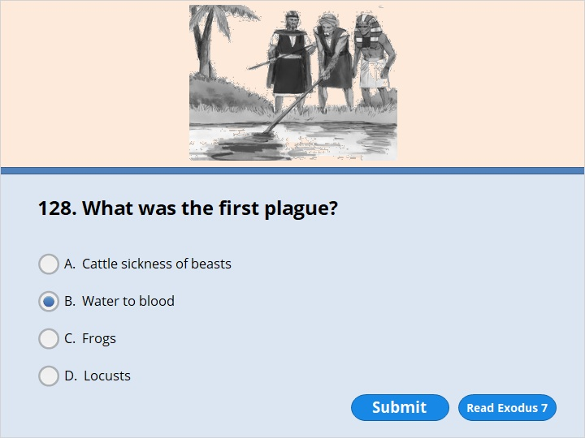
NEXT

Slide 95
NEXT

Slide 96
Exodus 7:20
Moses and Aaron did exactly as the Lord had commanded them. Aaron held out his staff in front of Pharaoh and his officials. He struck the water of the Nile River. And all the water turned into blood.

Slide 97
NEXT

Slide 98
NEXT

Slide 99
Exodus 8:6-7
6 So Aaron reached out his hand over the waters of Egypt. The frogs came up and covered the land. 7 But the magicians did the same things by doing their magic tricks. They also made frogs come up on the land of Egypt.

Slide 100
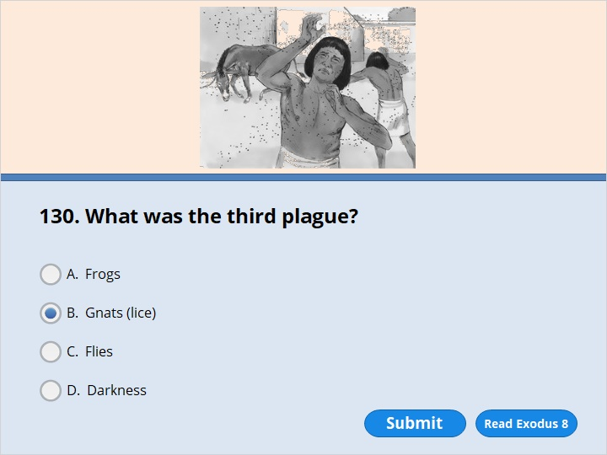
NEXT

Slide 101
NEXT

Slide 102
Exodus 8:17
So they did it. Aaron reached out the stick that was in his hand. He struck the dust on the ground with it. The dust all over the land of Egypt turned into gnats. They landed on people and animals alike.

Slide 103
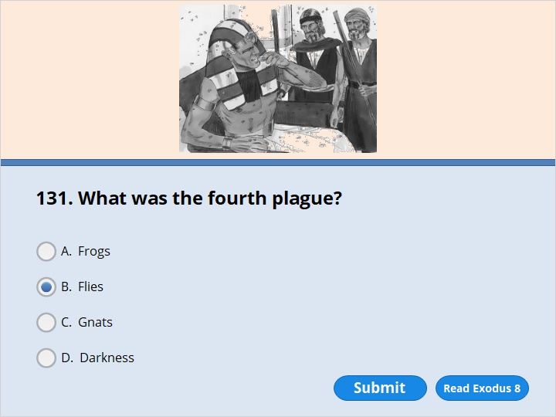
NEXT

Slide 104
NEXT

Slide 105
Exodus 8:24
So the Lord did it. Huge numbers of flies poured into Pharaoh’s palace. They came into the homes of his officials. All over Egypt the flies destroyed the land.

Slide 106
NEXT

Slide 107
NEXT

Slide 108
Exodus 7:20-22
20 Moses and Aaron did exactly as the Lord had commanded them. Aaron held out his staff in front of Pharaoh and his officials. He struck the water of the Nile River. And all the water turned into blood. 21 The fish in the Nile died. The river smelled so bad the Egyptians couldn’t drink its water. There was blood everywhere in Egypt. 22 But the Egyptian magicians did the same things by doing their magic tricks.
Exodus 8:6-7
6 So Aaron reached out his hand over the waters of Egypt. The frogs came up and covered the land. 7 But the magicians did the same things by doing their magic tricks. They also made frogs come up on the land of Egypt.

Slide 109
NEXT

Slide 110
NEXT

Slide 111
Exodus 8:22-23
22 “ ‘ “But on that day I will treat the area of Goshen differently from yours. That is where my people live. There will not be large numbers of flies in Goshen. Then you will know that I, the Lord, am in this land. 23 I will treat my people differently from yours. This sign will take place tomorrow.” ’ ”

Slide 112
NEXT

Slide 113
NEXT

Slide 114
Exodus 9:5-7
5 The Lord set a time for the plague. He said, “Tomorrow I will send it on the land.” 6 So the next day the Lord sent it. All the livestock of the Egyptians died. But not one animal that belonged to the Israelites died. 7 Pharaoh searched and found out what had happened. He discovered that not even one animal that belonged to the Israelites had died. But he was still very stubborn. He wouldn’t let the people go.

Slide 115
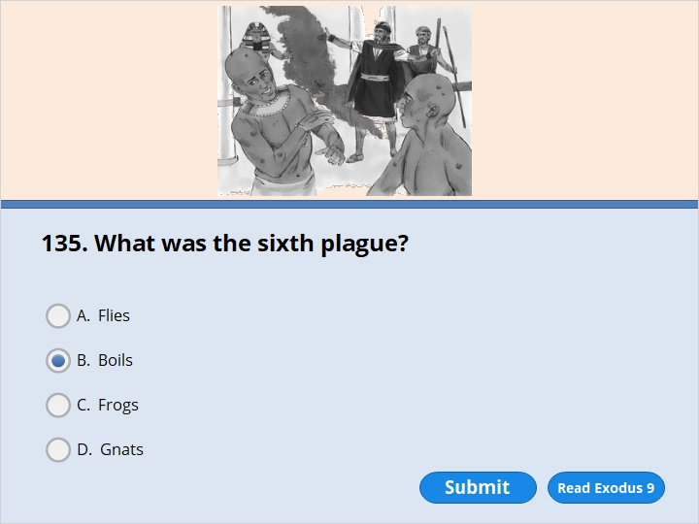
NEXT

Slide 116
NEXT

Slide 117
Exodus 9:10-11
10 So Moses and Aaron took ashes from a furnace and stood in front of Pharaoh. Moses tossed them into the air. Then boils broke out on people and animals alike. 11 The bodies of all the Egyptians were covered with boils. The magicians couldn’t stand in front of Moses because of the boils that were all over them.

Slide 118
NEXT

Slide 119
NEXT

Slide 120
Exodus 9:23
Moses reached out his walking stick toward the sky. Then the Lord sent thunder and hail. Lightning flashed down to the ground. The Lord rained hail on the land of Egypt.

Slide 121
NEXT

Slide 122
NEXT

Slide 123
Exodus 10:13-14
13 So Moses reached out his walking stick over Egypt. Then the Lord made an east wind blow across the land. It blew all that day and all that night. By morning the wind had brought the locusts. 14 Large numbers of them came down in every part of Egypt. There had never been a plague of locusts like it before. And there will never be one like it again.

Slide 124
NEXT

Slide 125
NEXT

Slide 126
Exodus 10:22-23
22 So Moses reached out his hand toward the sky. Then complete darkness covered Egypt for three days. 23 No one could see anyone else or go anywhere for three days. But all the people of Israel had light where they lived.

Slide 127
NEXT

Slide 128
NEXT

Slide 129
READ
Exodus 12
The First Passover Sacrifice

Slide 130
NEXT

Slide 131
NEXT

Slide 132
Exodus 12:21-22
21 Then Moses sent for all the elders of Israel. He said to them, “Go at once. Choose the animals for your families. Each family must kill a Passover lamb. 22 Get a branch of a hyssop plant. Dip it into the blood in the bowl. Put some of the blood on the top and on both sides of the doorframe. None of you can go out of the door of your house until morning.

Slide 133
NEXT

Slide 134
NEXT

Slide 135
Exodus 12:21, 29
21 Then Moses sent for all the elders of Israel. He said to them, “Go at once. Choose the animals for your families. Each family must kill a Passover lamb.
……
29 At midnight the Lord struck down every oldest son in Egypt. He killed the oldest son of Pharaoh, who sat on the throne. He killed all the oldest sons of prisoners. He also killed all the male animals born first to their mothers among the livestock.

Slide 136
NEXT

Slide 137
NEXT

Slide 138
Exodus 12:21,29
21 Then Moses sent for all the elders of Israel. He said to them, “Go at once. Choose the animals for your families. Each family must kill a Passover lamb.
……
29 At midnight the Lord struck down every oldest son in Egypt. He killed the oldest son of Pharaoh, who sat on the throne. He killed all the oldest sons of prisoners. He also killed all the male animals born first to their mothers among the livestock.

Slide 139
NEXT

Slide 140
NEXT

Slide 141
Exodus 12:40
The Israelites lived in Egypt for 430 years.

Slide 142
NEXT

Slide 143
NEXT

Slide 144
Exodus 13:3-4
3 Then Moses said to the people, “Remember this day. It’s the day you came out of Egypt. That’s the land where you were slaves. The Lord used his mighty hand to bring you out of Egypt. Don’t eat anything with yeast in it. 4 You are leaving today. It’s the month of Aviv.

Slide 145
NEXT

Slide 146
NEXT

Slide 147
Exodus 13:19
Moses took the bones of Joseph along with him. Joseph had made the Israelites give their word to do this. He had said, “God will surely come to help you. When he does, you must carry my bones up from this place with you.” (Genesis 50:25)

Slide 148
NEXT

Slide 149
NEXT

Slide 150
Exodus 13:21-22
21 By day the Lord went ahead of them in a pillar of cloud. It guided them on their way. At night he led them with a pillar of fire. It gave them light. So they could travel by day or at night. 22 The pillar of cloud didn’t leave its place in front of the people during the day. And the pillar of fire didn’t leave its place at night.

Slide 151
NEXT

Slide 152
NEXT

Slide 153
Exodus 13:21-22
21 By day the Lord went ahead of them in a pillar of cloud. It guided them on their way. At night he led them with a pillar of fire. It gave them light. So they could travel by day or at night. 22 The pillar of cloud didn’t leave its place in front of the people during the day. And the pillar of fire didn’t leave its place at night.

Slide 154
NEXT

Slide 155
NEXT

Slide 156
Exodus 14:15-18
15 Then the Lord spoke to Moses. He said, “Why are you crying out to me? Tell the people of Israel to move on. 16 Hold out your walking stick. Reach out your hand over the Red Sea to divide the water. Then the people can go through the sea on dry ground. 17 I will make the Egyptians stubborn. They will go in after the Israelites. I will gain glory for myself because of what will happen to Pharaoh, his army, chariots and horsemen. 18 The Egyptians will know that I am the Lord. I will gain glory because of what will happen to Pharaoh, his chariots and his horsemen.”

Slide 157
NEXT

Slide 158
NEXT

Slide 159
Exodus 15:20
Aaron’s sister Miriam was a prophet. She took a tambourine in her hand. All the women followed her. They played tambourines and danced.

Slide 160
NEXT

Slide 161
NEXT

Slide 162
Exodus 15:20
Aaron’s sister Miriam was a prophet. She took a tambourine in her hand. All the women followed her. They played tambourines and danced.

Slide 163
NEXT

Slide 164
NEXT

Slide 165
Exodus 16:31-32
31 The people of Israel called the bread manna. It was white like coriander seeds. It tasted like wafers made with honey. 32 Moses said, “Here is what the Lord has commanded. He has said, ‘Get three pounds of manna. Keep it for all time to come. Then those who live after you will see the bread I gave you to eat in the desert. I gave it to you when I brought you out of Egypt.’ ”

Slide 166
NEXT

Slide 167
NEXT

Slide 168
Exodus 16:20
Some of them didn’t pay any attention to Moses. They kept part of it until morning. But it was full of maggots and began to stink. So Moses became angry with them.

Slide 169
NEXT

Slide 170
NEXT

Slide 171
Exodus 16:21-22
21 Each morning everyone gathered as much as they needed. But by the hottest time of the day, the thin flakes had melted away. 22 On the sixth day, the people gathered twice as much. It amounted to six pounds for each person. The leaders of the community came and reported that to Moses.

Slide 172
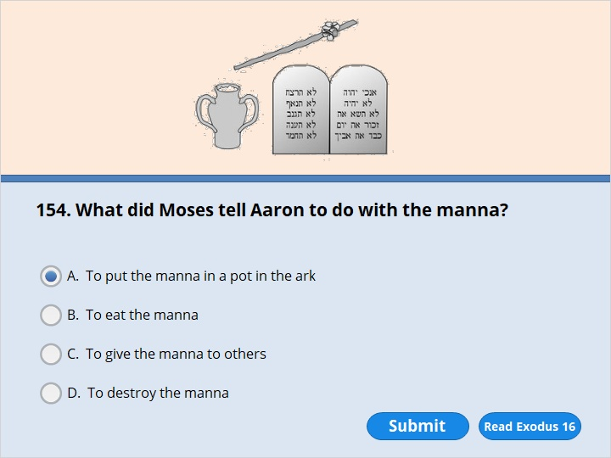
NEXT

Slide 173
NEXT

Slide 174
Exodus 16:33-34
33 So Moses said to Aaron, “Get a jar. Put three pounds of manna in it. Then place it in front of the Lord. Keep it there for all time to come.”
34 Aaron did exactly as the Lord had commanded Moses. He put the manna with the tablets of the covenant law. He put it there so it would be kept for all time to come.

Slide 175
NEXT

Slide 176
NEXT

Slide 177
Exodus 17:6
I will stand there in front of you by the rock at Mount Horeb. Hit the rock. Then water will come out of it for the people to drink.” So Moses hit the rock while the elders of Israel watched.

Slide 178
NEXT

Slide 179
NEXT

Slide 180
Exodus 17:8-9
8 The Amalekites came and attacked the Israelites at Rephidim. 9 Moses said to Joshua, “Choose some of our men. Then go out and fight against the Amalekites. Tomorrow I will stand on top of the hill. I’ll stand there holding the walking stick God gave me.”

Slide 181
NEXT

Slide 182
NEXT

Slide 183
Exodus 17:10-11
10 So Joshua fought against the Amalekites, just as Moses had ordered. Moses, Aaron and Hur went to the top of the hill. 11 As long as Moses held up his hand, the Israelites were winning. But every time he lowered his hands, the Amalekites began to win.

Slide 184
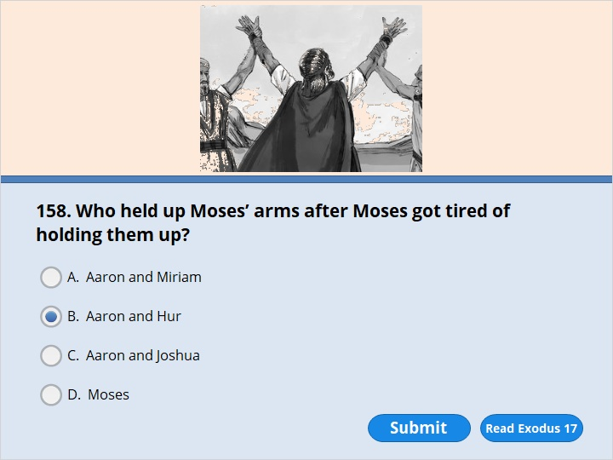
NEXT

Slide 185
NEXT

Slide 186
Exodus 17:12
When Moses’ arms got tired, Aaron and Hur got a stone and put it under him. Then he sat on it. Aaron and Hur held up his hands. Aaron was on one side, and Hur was on the other. Moses’ hands remained steady until sunset.

Slide 187
NEXT

Slide 188
NEXT

Slide 189
Exodus 18:2-4
2 Moses had sent his wife Zipporah to his father-in-law. So Jethro welcomed her 3 and her two sons. One son was named Gershom. That’s because Moses had said, “I’m an outsider in a strange land.” 4 The other was named Eliezer. That’s because Moses had said, “My father’s God helped me. He saved me from Pharaoh’s sword.”

Slide 190
NEXT

Slide 191
NEXT

Slide 192
Exodus 18:22-24
22 Let them serve the people as judges. But have them bring every hard case to you. They can decide the easy ones themselves. That will make your load lighter. They will share it with you. 23 If this is what God wants and if you do it, then you will be able to carry the load. And all these people will go home satisfied.”
24 Moses listened to his father-in-law. He did everything Jethro said.

Slide 193
NEXT

Slide 194
NEXT

Slide 195
Exodus 19:20
The Lord came down to the top of Mount Sinai. He told Moses to come to the top of the mountain. So Moses went up.
Read on to Exodus 20 where God gives His people the Ten Commandments.

Slide 196
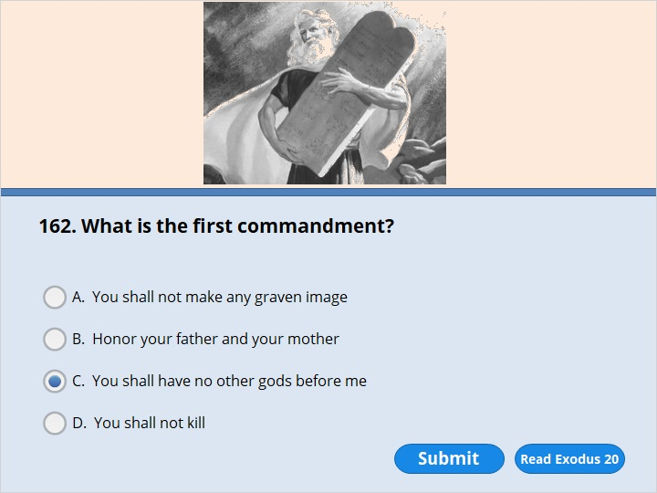
NEXT

Slide 197
NEXT

Slide 198
Exodus 20:3
“Do not put any other gods in place of me.

Slide 199
NEXT

Slide 200
NEXT

Slide 201
Exodus 20:7
“Do not misuse the name of the Lord your God. The Lord will find guilty anyone who misuses his name.

Slide 202
NEXT

Slide 203
NEXT

Slide 204
Exodus 20:8-11
8 “Remember to keep the Sabbath day holy. 9 Do all your work in six days. 10 But the seventh day is a sabbath to honor the Lord your God. Do not do any work on that day. The same command applies to your sons and daughters, your male and female servants, and your animals. It also applies to any outsiders who live in your towns. 11 In six days the Lord made the heavens, the earth, the sea and everything in them. But he rested on the seventh day. So the Lord blessed the Sabbath day and made it holy.

Slide 205
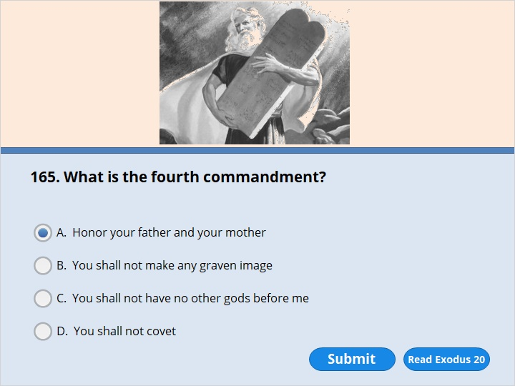
NEXT

Slide 206
NEXT

Slide 207
Exodus 20:12
“Honor your father and mother. Then you will live a long time in the land the Lord your God is giving you.

Slide 208
NEXT

Slide 209
NEXT

Slide 210
Exodus 20:13
“Do not murder.

Slide 211
NEXT

Slide 212
NEXT

Slide 213
Exodus 20:14
“Do not commit adultery.

Slide 214
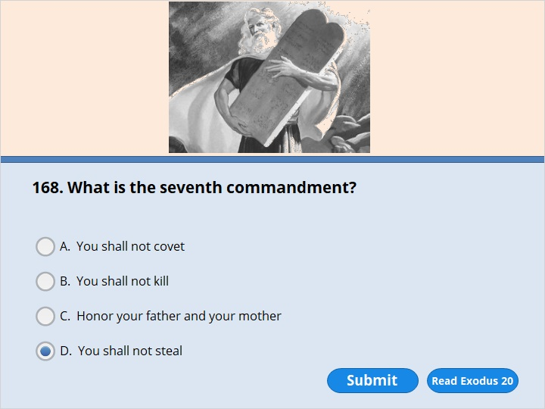
NEXT

Slide 215
NEXT

Slide 216
Exodus 20:15
“Do not steal.

Slide 217
NEXT

Slide 218
NEXT

Slide 219
Exodus 20:16
“Do not be a false witness against your neighbor.

Slide 220
NEXT

Slide 221
NEXT

Slide 222
Exodus 20:17
“Do not want to have anything your neighbor owns. Do not want to have your neighbor’s house, wife, male or female servant, ox or donkey.”

Slide 223
NEXT

Slide 224
NEXT

Slide 225
Exodus 20:17
“Do not want to have anything your neighbor owns. Do not want to have your neighbor’s house, wife, male or female servant, ox or donkey.”

Slide 226
NEXT

Slide 227
NEXT

Slide 228
Exodus 24:18
Moses entered the cloud as he went on up the mountain. He stayed on the mountain for 40 days and 40 nights.

Slide 229
NEXT

Slide 230
NEXT

Slide 231
Exodus 25:18-21
18 Make two cherubim out of hammered gold at the ends of the cover. 19 Put one of the cherubim on each end of it. Make the cherubim part of the cover itself. 20 They must have their wings spread up over the cover. The cherubim must face each other and look toward the cover. 21 Place the cover on top of the ark. I will give you the tablets of the covenant law. Put them in the ark.

Slide 232
NEXT

Slide 233
NEXT

Slide 234
Exodus 28:1-3
1 “Have your brother Aaron brought to you from among the Israelites. His sons Nadab, Abihu, Eleazar and Ithamar must also be brought. They will serve me as priests. 2 Make sacred clothes for your brother Aaron. When he is wearing them, people will honor him. They will have respect for him. 3 Speak to all the skilled workers. I have given them the skill to do this kind of work. Tell them to make clothes for Aaron. He will wear them when he is set apart to serve me as priest.

Slide 235
NEXT

Slide 236
NEXT

Slide 237
Exodus 28:1-3
1 “Have your brother Aaron brought to you from among the Israelites. His sons Nadab, Abihu, Eleazar and Ithamar must also be brought. They will serve me as priests. 2 Make sacred clothes for your brother Aaron. When he is wearing them, people will honor him. They will have respect for him. 3 Speak to all the skilled workers. I have given them the skill to do this kind of work. Tell them to make clothes for Aaron. He will wear them when he is set apart to serve me as priest.

Slide 238
NEXT

Slide 239
NEXT

Slide 240
Exodus 31:18
The Lord finished speaking to Moses on Mount Sinai. Then he gave him the two tablets of the covenant law. They were made out of stone. The words on them were written by the finger of God.

Slide 241
NEXT

Slide 242
NEXT

Slide 243
Exodus 32:1-3
1 The people saw that Moses took a long time to come down from the mountain. So they gathered around Aaron. They said to him, “Come. Make us a god that will lead us. This fellow Moses brought us up out of Egypt. But we don’t know what has happened to him.”
2 Aaron answered them, “Take the gold earrings off your wives, your sons and your daughters. Bring the earrings to me.” 3 So all the people took off their earrings. They brought them to Aaron. 4 He took what they gave him and made it into a metal statue of a god. It looked like a calf. Aaron shaped it with a tool. Then the people said, “Israel, here is your god who brought you up out of Egypt.”

Slide 244
NEXT

Slide 245
NEXT

Slide 246
Exodus 32:9
“I have seen these people,” the Lord said to Moses. “They are stubborn. 10 Now leave me alone. I will destroy them because of my great anger. Then I will make you into a great nation.”

Slide 247
NEXT

Slide 248
NEXT

Slide 249
Exodus 32:11
But Moses asked the Lord his God to have mercy on the people. “Lord,”

Slide 250
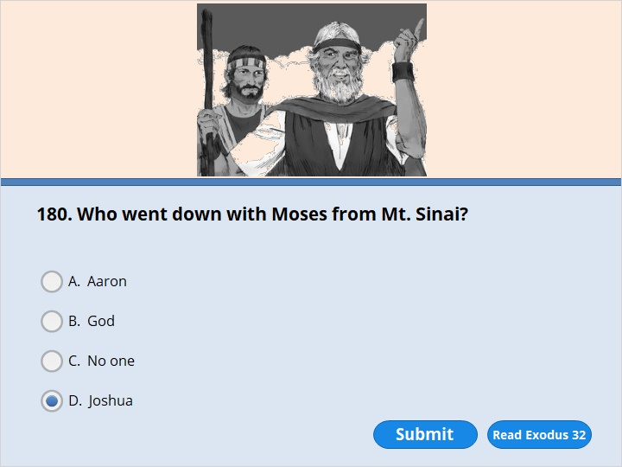
NEXT

Slide 251
NEXT

Slide 252
Exodus 32:15-17
15 Moses turned and went down the mountain. He had the two tablets of the covenant law in his hands. Words were written on both sides of the tablets, front and back. 16 The tablets were the work of God. The words had been written by God. They had been carved on the tablets.
17 Joshua heard the noise of the people shouting. So he said to Moses, “It sounds like war in the camp.”

Slide 253
NEXT

Slide 254
NEXT

Slide 255
Exodus 32:19
As Moses approached the camp, he saw the calf. He also saw the people dancing. So he was very angry. He threw the tablets out of his hands. They broke into pieces at the foot of the mountain.

Slide 256
NEXT

Slide 257
NEXT

Slide 258
Exodus 32:20
He took the calf the people had made. He burned it in the fire. Then he ground it into powder. He scattered it on the water. And he made the Israelites drink it.

Slide 259
NEXT

Slide 260
NEXT

Slide 261
Exodus 33:19-23
19 The Lord said, “I will make all my goodness pass in front of you. And I will announce my name, the Lord, in front of you. I will have mercy on whom I have mercy. And I will show love to those I love. 20 But you can’t see my face,” he said. “No one can see me and stay alive.”
21 The Lord continued, “There is a place near me where you can stand on a rock. 22 When my glory passes by, I will put you in an opening in the rock. I will cover you with my hand until I have passed by. 23 Then I will remove my hand. You will see my back. But my face must not be seen.”

Slide 262
NEXT

Slide 263
NEXT

Slide 264
Exodus 34:29-30
29 Moses came down from Mount Sinai. He had the two tablets of the covenant law in his hands. His face was shining because he had spoken with the Lord. But he didn’t realize it. 30 Aaron and all the people of Israel saw Moses. His face was shining. So they were afraid to come near him.

Slide 265
NEXT

Slide 266
NEXT

Slide 267
Exodus 34:33
Moses finished speaking to them. Then he covered his face with a veil.

Slide 268
NEXT

Slide 269
NEXT

Slide 270
Exodus 40:36-38
36 The Israelites continued their travels. Whenever the cloud lifted from above the holy tent, they started out. 37 But if the cloud didn’t lift, they did not start out. They stayed until the day it lifted. 38 So the cloud of the Lord was above the holy tent during the day. Fire was in the cloud at night. All the Israelites could see the cloud during all their travels.

Slide 271
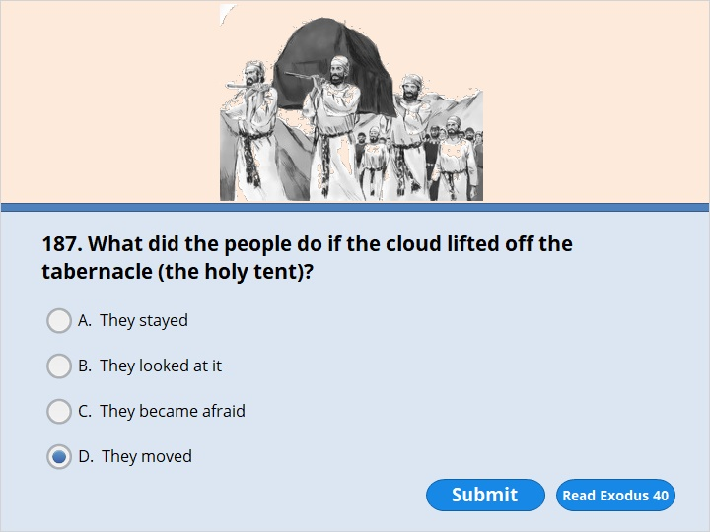
NEXT

Slide 272
NEXT

Slide 273
Exodus 40:36-38
36 The Israelites continued their travels. Whenever the cloud lifted from above the holy tent, they started out. 37 But if the cloud didn’t lift, they did not start out. They stayed until the day it lifted. 38 So the cloud of the Lord was above the holy tent during the day. Fire was in the cloud at night. All the Israelites could see the cloud during all their travels.

Slide 274
NEXT

Slide 275
NEXT

Slide 276
Numbers 1:2-4
2 “Count all the men of Israel. Make a list of them by their tribes and families. List every man by name. List them one by one. 3 Count all the men able to serve in the army. They must be 20 years old or more. I want you and Aaron to make a list of them group by group. 4 One man from each tribe must help you. Those who help must be the heads of their families.

Slide 277
NEXT

Slide 278
NEXT

Slide 279
Numbers 1:47
But the families of the tribe of Levi were not counted along with the others.

Slide 280
NEXT

Slide 281
NEXT

Slide 282
Numbers 1:48-50
48 The Lord had spoken to Moses. He had said, 49 “You must not count the men from the tribe of Levi. Do not include them when you list the other men of Israel. 50 Instead, put the Levites in charge of the holy tent. That is where the tablets of the covenant law are kept. The Levites will be in charge of everything that belongs to the holy tent. They must carry the tent and everything that belongs to it. They must take care of it. They must set up camp around it.

Slide 283
NEXT

Slide 284
NEXT

Slide 285
Numbers 2:3-29
3 The groups of the camp of Judah must be on the east side….5 The tribe of Issachar will camp next to them…..7 The tribe of Zebulun will be next.
10The groups of the camp of Reuben will be on the south side…..12 The tribe of Simeon will camp next to them…..14 The tribe of Gad will be next.
18 The groups of the camp of Ephraim will be on the west side. ….20 The tribe of Manasseh will be next to them. ….22 The tribe of Benjamin will be next.
25 The groups of the camp of Dan will be on the north side…..27 The tribe of Asher will camp next to them. ….29 The tribe of Naphtali will be next.

Slide 286
NEXT

Slide 287
NEXT

Slide 288
Numbers 3:4
But Nadab and Abihu made an offering to the Lord by using fire that wasn’t allowed. So they died in front of him. That happened in the Desert of Sinai.

Slide 289
NEXT

Slide 290
NEXT

Slide 291
Numbers 9:15
The holy tent was set up. It was the tent where the tablets of the covenant law were kept. On the day it was set up, the cloud covered it. From evening until morning the cloud above the tent looked like fire.

Slide 292
NEXT

Slide 293
NEXT

Slide 294
Numbers 9:15
The holy tent was set up. It was the tent where the tablets of the covenant law were kept. On the day it was set up, the cloud covered it. From evening until morning the cloud above the tent looked like fire.

Slide 295
NEXT

Slide 296
NEXT

Slide 297
Numbers 11:31-33
31 The Lord sent out a wind. It drove quail in from the Red Sea. It scattered them all around the camp. They were about three feet above the ground. They could be seen in every direction as far as a person could walk in a day. 32 The people went out all day and gathered quail. They gathered them all night and all the next day. No one gathered less than 60 bushels. Then they spread the quail out all around the camp. 33 But while the meat was still in their mouths, the Lord acted. Before the people could swallow it, he became very angry with them. He struck them with a terrible plague.

Slide 298
NEXT

Slide 299
NEXT

Slide 300
Numbers 12:1
Miriam and Aaron began to say bad things about Moses. That’s because Moses had married a woman from Cush.

Slide 301
NEXT

Slide 302
NEXT

Slide 303
Numbers 12:9-10
9 The Lord was very angry with them. And he left them.
10 When the cloud went up from above the tent, there stood Miriam. She had a disease that made her skin as white as snow. Aaron turned toward her. He saw that she had a skin disease.

Slide 304
NEXT

Slide 305
NEXT

Slide 306
Numbers 12:13-14
13 So Moses cried out to the Lord. He said, “Please, God, heal her!”
14 The Lord answered Moses.

Slide 307
NEXT

Slide 308
NEXT

Slide 309
Numbers 12:14-15
14 The Lord answered Moses. He said, “Suppose her father had spit in her face. Then she would have been put to shame for seven days. So keep her outside the camp for seven days. After that, you can bring her back.” 15 So Miriam was kept outside the camp for seven days. The people didn’t move on until she was brought back.

Slide 310
NEXT

Slide 311
NEXT

Slide 312
Numbers 13:17
Moses sent the 12 men to check out Canaan. He said, “Go up through the Negev Desert. Go on into the central hill country.

Slide 313
NEXT

Slide 314
NEXT

Slide 315
Numbers 13:23-25
23 The men came to the Valley of Eshkol. There they cut off a branch that had a single bunch of grapes on it. Two of them carried it on a pole between them. They carried some pomegranates and figs along with it. 24 That place was called the Valley of Eshkol. That’s because the men of Israel cut off a bunch of grapes there. 25 At the end of 40 days, the men returned from checking out the land.

Slide 316
NEXT

Slide 317
NEXT

Slide 318
Numbers 13:25
At the end of 40 days, the men returned from checking out the land.

Slide 319
NEXT

Slide 320
NEXT

Slide 321
Numbers 13:31-33
31 But the men who had gone up with him spoke. They said, “We can’t attack those people. They are stronger than we are.” 32 The men spread a bad report about the land among the Israelites. They said, “The land we checked out destroys those who live in it. All the people we saw there are very big and tall. 33 We saw the Nephilim there. We seemed like grasshoppers in our own eyes. And that’s also how we seemed to them.” The family line of Anak came from the Nephilim.

Slide 322
NEXT

Slide 323
NEXT

Slide 324
Numbers 14:6-9
6 Joshua, the son of Nun, tore his clothes. So did Caleb, the son of Jephunneh. Joshua and Caleb were two of the men who had checked out the land. 7 They spoke to the whole community of Israel. They said, “We passed through the land and checked it out. It’s very good. 8 If the Lord is pleased with us, he’ll lead us into that land. It’s a land that has plenty of milk and honey. He’ll give it to us. 9 But don’t refuse to obey him. And don’t be afraid of the people of the land. We will swallow them up. The Lord is with us. So nothing can save them. Don’t be afraid of them.”

Slide 325
NEXT

Slide 326
NEXT

Slide 327
Numbers 14:6-9
6 Joshua, the son of Nun, tore his clothes. So did Caleb, the son of Jephunneh. Joshua and Caleb were two of the men who had checked out the land. 7 They spoke to the whole community of Israel. They said, “We passed through the land and checked it out. It’s very good. 8 If the Lord is pleased with us, he’ll lead us into that land. It’s a land that has plenty of milk and honey. He’ll give it to us. 9 But don’t refuse to obey him. And don’t be afraid of the people of the land. We will swallow them up. The Lord is with us. So nothing can save them. Don’t be afraid of them.”

Slide 328
NEXT

Slide 329
NEXT

Slide 330
Numbers 14:11-12
11 The Lord said to Moses, “How long will these people not respect me? How long will they refuse to believe in me? They refuse even though I have done many signs among them. 12 So I will strike them down with a plague. I will destroy them. But I will make you into a greater and stronger nation than they are.”

Slide 331
NEXT

Slide 332
NEXT

Slide 333
Numbers 14:17-19
17 “Now, Lord, show your strength. You have said, 18 ‘I am the Lord. I am slow to get angry. I am full of love. I forgive those who sin. I forgive those who refuse to obey. But I do not let guilty people go without punishing them. I cause the sin of the parents to affect their children, grandchildren and great-grandchildren.’ 19 Lord, your love is great. So forgive the sin of these people. Forgive them just as you have done from the time they left Egypt until now.”

Slide 334
NEXT

Slide 335
NEXT

Slide 336
Numbers 14:29
You will die in this desert. Every one of you 20 years old or more will die. Every one of you who was counted in the list of the people will die. Every one of you who has spoken out against me will be wiped out.

Slide 337
NEXT

Slide 338
NEXT

Slide 339
Numbers 14:30
I lifted up my hand and promised to make this land your home. But now not all of you will enter the land. Caleb, the son of Jephunneh, will enter it. So will Joshua, the son of Nun. They are the only ones who will enter the land.

Slide 340
NEXT

Slide 341
NEXT

Slide 342
Numbers 14:25-33
25 The Amalekites and the Canaanites are living in the valleys. So turn back tomorrow. Start out toward the desert. Go along the way that leads to the Red Sea.”…
…………………………………………………………………..
33 Your children will be shepherds here for 40 years. They will suffer because you were not faithful. They will suffer until the last of your bodies lies here in the desert.

Slide 343
NEXT

Slide 344
NEXT

Slide 345
Numbers 14:34
For 40 years you will suffer for your sins. That is one year for each of the 40 days you checked out the land. You will know what it is like to have me against you.’

Slide 346
NEXT

Slide 347
NEXT

Slide 348
Numbers 14:36-37
36 So the Lord struck down the men Moses had sent to check out the land. They had returned and had spread a bad report about the land. And that had made the whole community speak out against Moses. 37 Those men were to blame for spreading the bad report. So the Lord struck them down. They died of a plague.

Slide 349
NEXT

Slide 350
NEXT

Slide 351
Numbers 16:1-2
1 Korah was the son of Izhar, the son of Kohath. Kohath was the son of Levi. Korah and certain men from the tribe of Reuben turned against Moses. The men from Reuben were Dathan, Abiram and On. Dathan and Abiram were the sons of Eliab. On was the son of Peleth. 2 All those men rose up against Moses. And 250 men of Israel joined them. All of them were known as leaders in the community. They had been appointed as members of the ruling body.

Slide 352
NEXT

Slide 353
NEXT

Slide 354
Numbers 16:23-34
23 Then the Lord spoke to Moses. He said, 24 “Tell the community, ‘Move away from the tents of Korah, Dathan and Abiram.’ ”
….
31 As soon as Moses finished saying all these words, what he had said came true. The ground under them broke open. 32 It opened its mouth. It swallowed up those men. In fact, it swallowed up everyone who lived in their houses. It swallowed all Korah’s men. And it swallowed up everything they owned. 33 They went down into the grave alive. Everything they owned went down with them. The ground closed over them and they died. And so they disappeared from the community. 34 All the Israelites around them heard their cries. They ran away from them. They shouted, “The ground is going to swallow us up too!”

Slide 355
NEXT

Slide 356
NEXT

Slide 357
Numbers 17:1-3
1 The Lord said to Moses, 2 “Speak to the Israelites. Get 12 walking sticks from them. Get one from the leader of each of Israel’s tribes. Write the name of each man on his walking stick. 3 Write Aaron’s name on Levi’s walking stick. There must be one stick for the head of each of Israel’s tribes.

Slide 358
NEXT

Slide 359
NEXT

Slide 360
Numbers 17:8
The next day Moses entered the tent. He looked at Aaron’s walking stick. It stood for the tribe of Levi. Moses saw that it had begun to grow new shoots. It had also produced buds and flowers and almonds.

Slide 361
NEXT

Slide 362
NEXT

Slide 363
Numbers 17:10-11
10 The Lord said to Moses, “Put Aaron’s walking stick back in front of the ark where the tablets of the covenant law are kept. The stick will be kept there as a warning to those who refuse to obey. They are never happy with what I do. Aaron’s walking stick will put an end to what they are saying. Then they will not die.” 11 Moses did just as the Lord commanded him.

Slide 364
NEXT

Slide 365
NEXT

Slide 366
Numbers 20:1
In the first month the whole community of Israel arrived at the Desert of Zin. They stayed at Kadesh. Miriam died and was buried there.

Slide 367
NEXT

Slide 368
NEXT

Slide 369
Numbers 20:7-8
7 The Lord said to Moses, 8 “Get your walking stick. You and your brother Aaron gather the people together. Then speak to that rock while everyone is watching. It will pour out its water. You will bring water out of the rock for the community. Then they and their livestock can drink it.”

Slide 370
NEXT

Slide 371
NEXT

Slide 372
Numbers 20:11
Then Moses raised his arm. He hit the rock twice with his walking stick. Water poured out. And the people and their livestock drank it.

Slide 373
NEXT

Slide 374
NEXT

Slide 375
Numbers 20:12
But the Lord spoke to Moses and Aaron. He said, “You did not trust in me enough to honor me. You did not honor me as the holy God in front of the Israelites. So you will not bring this community into the land I am giving them.”

Slide 376
NEXT

Slide 377
NEXT

Slide 378
Numbers 20:27-28
27 Moses did just as the Lord had commanded. The three men went up Mount Hor while the whole community was watching. 28 Moses took Aaron’s official robes off of him. He put them on Aaron’s son Eleazar. And Aaron died there on top of the mountain. Then Moses and Eleazar came down from the mountain.

Slide 379
NEXT

Slide 380
NEXT

Slide 381
Numbers 20:27-28
27 Moses did just as the Lord had commanded. The three men went up Mount Hor while the whole community was watching. 28 Moses took Aaron’s official robes off of him. He put them on Aaron’s son Eleazar. And Aaron died there on top of the mountain. Then Moses and Eleazar came down from the mountain.

Slide 382
NEXT

Slide 383
NEXT

Slide 384
Numbers 21:4-6
4 The Israelites traveled from Mount Hor along the way to the Red Sea. They wanted to go around Edom. But they grew tired on the way. 5 So they spoke against God and against Moses. They said, “Why have you brought us up out of Egypt? Do you want us to die here in the desert? We don’t have any bread! We don’t have any water! And we hate this awful food!”
6 Then the Lord sent poisonous snakes among the Israelites. The snakes bit them. Many of the people died.

Slide 385
NEXT

Slide 386
NEXT

Slide 387
Numbers 21:9
So Moses made a bronze snake. He put it up on a pole. Then anyone who was bitten by a snake and looked at the bronze snake remained alive.

Slide 388
NEXT

Slide 389
NEXT

Slide 390
Numbers 21:9
So Moses made a bronze snake. He put it up on a pole. Then anyone who was bitten by a snake and looked at the bronze snake remained alive.

Slide 391
NEXT

Slide 392
NEXT

Slide 393
Numbers 22:4-6
4 The Moabites spoke to the elders of Midian. They said, “This huge mob is going to destroy everything around us. They’ll lick it up as an ox licks up all the grass in the fields.”
Balak, the son of Zippor, was the king of Moab at that time. 5 He sent messengers to get Balaam. Balaam was the son of Beor. Balaam was at the city of Pethor near the Euphrates River. Pethor was in the land where Balaam had been born. Balak told the messengers to say to Balaam,
“A nation has come out of Egypt. They are covering the face of the land. They’ve set up camp next to me. 6 So come and put a curse on these people. They are too powerful for me. Maybe I’ll be able to win the battle over them. Maybe I’ll be able to drive them out of the land. I know that whoever you bless is blessed. And I know that whoever you cursed is cursed.”

Slide 394
NEXT

Slide 395
NEXT

Slide 396
Numbers 22:4-6
4 The Moabites spoke to the elders of Midian. They said, “This huge mob is going to destroy everything around us. They’ll lick it up as an ox licks up all the grass in the fields.”
Balak, the son of Zippor, was the king of Moab at that time. 5 He sent messengers to get Balaam. Balaam was the son of Beor. Balaam was at the city of Pethor near the Euphrates River. Pethor was in the land where Balaam had been born. Balak told the messengers to say to Balaam,
“A nation has come out of Egypt. They are covering the face of the land. They’ve set up camp next to me. 6 So come and put a curse on these people. They are too powerful for me. Maybe I’ll be able to win the battle over them. Maybe I’ll be able to drive them out of the land. I know that whoever you bless is blessed. And I know that whoever you cursed is cursed.”

Slide 397
NEXT

Slide 398
NEXT

Slide 399
Numbers 22:26-27
26 Then the angel of the Lord moved on ahead. He stood in a narrow place. There was no room to turn, either right or left. 27 The donkey saw the angel of the Lord. So it lay down under Balaam. That made him angry. He hit the donkey with his walking stick.

Slide 400
NEXT

Slide 401
NEXT

Slide 402
Numbers 22:27-28
27 The donkey saw the angel of the Lord. So it lay down under Balaam. That made him angry. He hit the donkey with his walking stick. 28 Then the Lord opened the donkey’s mouth. It said to Balaam, “What have I done to you? Why did you hit me these three times?”

Slide 403
NEXT

Slide 404
NEXT

Slide 405
Numbers 22:31
Then the Lord opened Balaam’s eyes. He saw the angel of the Lord standing in the road. He saw that the angel was holding a sword. The angel was ready for battle. So Balaam bowed down. He fell with his face to the ground.

Slide 406
NEXT

Slide 407
NEXT

Slide 408
Numbers 24:10
Then Balak became very angry with Balaam. He slapped his hands together. He said to Balaam, “I sent for you to put a curse on my enemies. But you have given them a blessing three times.

Slide 409
NEXT

Slide 410
NEXT

Slide 411
Numbers 27:18-21
18 So the Lord said to Moses, “Joshua, the son of Nun, has the ability to be a wise leader. Get him and place your hand on him. 19 Have him stand in front of Eleazar the priest and the whole community. Put him in charge while everyone is watching. 20 Give him some of your authority. Then the whole community of Israel will obey him. 21 Joshua will stand in front of Eleazar the priest. Eleazar will help him make decisions. Eleazar will get help from me by using the Urim. Joshua and the whole community of Israel must not make any move at all unless I command them to.”

Slide 412
NEXT

Slide 413
NEXT

Slide 414
Numbers 31:7-8
7 They fought against Midian, just as the Lord had commanded Moses. They killed every man. 8 Evi, Rekem, Zur, Hur and Reba were among the men they killed. Those men were the five kings of Midian. The Israelites also killed Balaam with their swords. Balaam was the son of Beor.

Slide 415
NEXT

Slide 416
NEXT

Slide 417
Numbers 33:39
Aaron was 123 years old when he died on Mount Hor.

Slide 418
NEXT

Slide 419
NEXT

Slide 420
Deuteronomy 11:29
The Lord your God will bring you into the land to take it over. When he does, you must announce the blessings from Mount Gerizim. You must announce the curses from Mount Ebal.

Slide 421
NEXT

Slide 422
NEXT

Slide 423
Deuteronomy 11:29
The Lord your God will bring you into the land to take it over. When he does, you must announce the blessings from Mount Gerizim. You must announce the curses from Mount Ebal.

Slide 424
NEXT

Slide 425
NEXT

Slide 426
Deuteronomy 17:16-17
16 The king must not get large numbers of horses for himself. He must not make the people return to Egypt to get more horses. The Lord has told you, “You must not go back there again.” 17 The king must not have many wives. If he does, they will lead him astray. He must not store up large amounts of silver and gold.

Slide 427
NEXT

Slide 428
NEXT

Slide 429
Deuteronomy 34:1-4
1 Moses climbed Mount Nebo. He went up from the plains of Moab to the highest slopes of Pisgah. It’s across from Jericho. At Pisgah the Lord showed him the whole land from Gilead all the way to Dan. 2 Moses saw the whole land of Naphtali. He saw the territory of Ephraim and Manasseh. The Lord showed him the whole land of Judah all the way to the Mediterranean Sea. 3 Moses saw the Negev Desert. He saw the whole area from the Valley of Jericho all the way to Zoar. Jericho was also known as The City of Palm Trees. 4 Then the Lord spoke to Moses. He said, “This is the land I promised to Abraham, Isaac and Jacob. I told them, ‘I will give this land to your children and their children.’ Moses, I have let you see it with your own eyes. But you will not go across the Jordan River to enter it.”

Slide 430
NEXT

Slide 431
NEXT

Slide 432
Deuteronomy 34:6-7
6 The Lord buried the body of Moses in Moab. His grave is in the valley across from Beth Peor. But to this day no one knows where his grave is. 7 Moses was 120 years old when he died. But his eyesight was still good. He was still very strong.

Slide 433
NEXT

Slide 434
NEXT

Slide 435
Deuteronomy 34:6-7
6 The Lord buried the body of Moses in Moab. His grave is in the valley across from Beth Peor. But to this day no one knows where his grave is. 7 Moses was 120 years old when he died. But his eyesight was still good. He was still very strong.

Slide 436
NEXT

Slide 437
NEXT

Slide 438
Deuteronomy 34:6-7
6 The Lord buried the body of Moses in Moab. His grave is in the valley across from Beth Peor. But to this day no one knows where his grave is. 7 Moses was 120 years old when he died. But his eyesight was still good. He was still very strong.

Slide 440
Our goal is not only for you to be able to study God’s Word, but also give you a way to teach and share with other people.
We pray God will bless your time in His Word!
WWW.Mark732.org

Slide 441
WWW.Mark732.org
For more information and for further training: Contact
Rev. Dr. John Reinke
At RevReinke@gmail.com
or 608-436-9600 (voice/text)
Material Copyright ©Mark732

