Slide 1
Our goal is not only for you to be able to study God’s Word, but also give you a way to teach and share with other people.
We pray God will bless your time in His Word!
WWW.Mark732.org
For more information and for further training: Contact
Rev. Dr. John Reinke
At RevReinke@gmail.com
or 608-436-9600 (voice/text)
Material Copyright ©Mark732
Bible Verses are from the New International Readers Version - NIrV
Pictures: Copyright © Language Recordings Inc (Australia). Used by permission
Material Copyright ©Mark732

Slide 2
NEXT

Slide 3
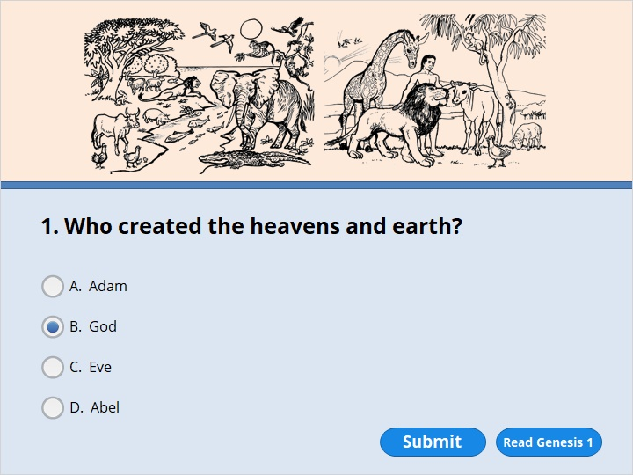
NEXT

Slide 4
NEXT

Slide 5
Genesis 1:1
In the beginning, God created the heavens and the earth.

Slide 6
NEXT

Slide 7
NEXT

Slide 8
Genesis 1:3
God said, “Let there be light.” And there was light. 4 God saw that the light was good. He separated the light from the darkness. 5 God called the light “day.” He called the darkness “night.” There was evening, and there was morning. It was day one.

Slide 9
NEXT

Slide 10
NEXT

Slide 11
Genesis 2:2
By the seventh day God had finished the work he had been doing. So on that day he rested from all his work.

Slide 12
NEXT

Slide 13
NEXT

Slide 14
Genesis 2:7
Then the Lord God formed a man. He made him out of the dust of the ground. God breathed the breath of life into him. And the man became a living person.

Slide 15
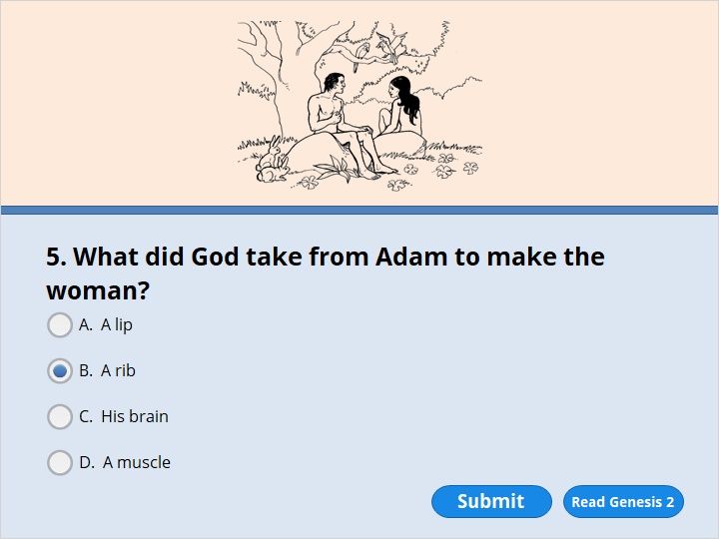
NEXT

Slide 16
NEXT

Slide 17
Genesis 2:21
So the Lord God caused him to fall into a deep sleep. While the man was sleeping, the Lord God took out one of the man’s ribs. Then the Lord God closed the opening in the man’s side. 22 Then the Lord God made a woman. He made her from the rib he had taken out of the man. And the Lord God brought her to the man.

Slide 18
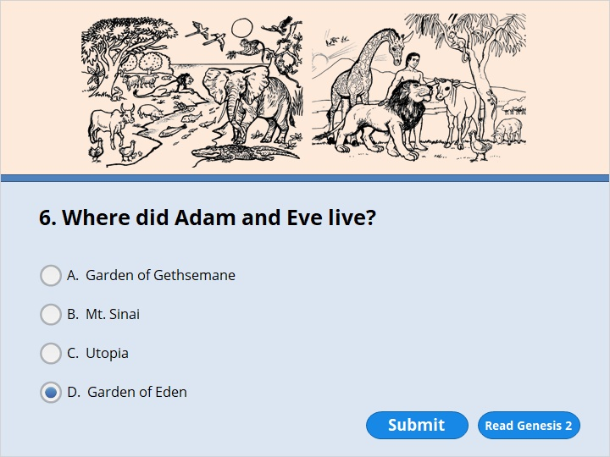
NEXT

Slide 19
NEXT

Slide 20
Genesis 2:15
The Lord God put the man in the Garden of Eden. He put him there to farm its land and take care of it.

Slide 21
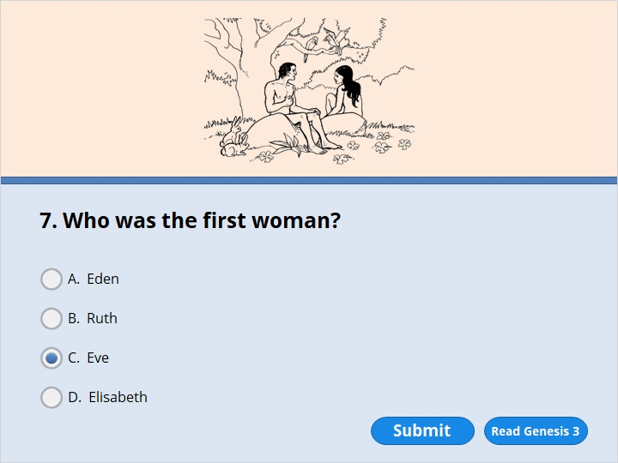
NEXT

Slide 22
NEXT

Slide 23
Genesis 3:20
Adam named his wife Eve. She would become the mother of every living person.

Slide 24
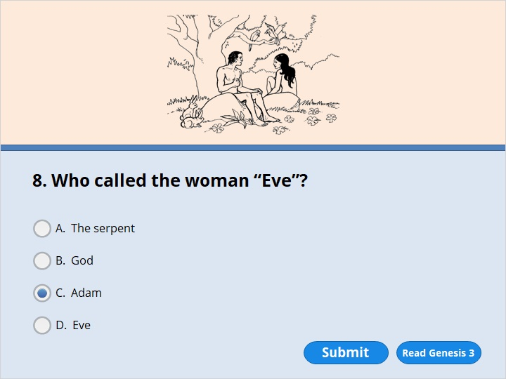
NEXT

Slide 25
NEXT

Slide 26
Genesis 3:20
Adam named his wife Eve. She would become the mother of every living person.

Slide 27
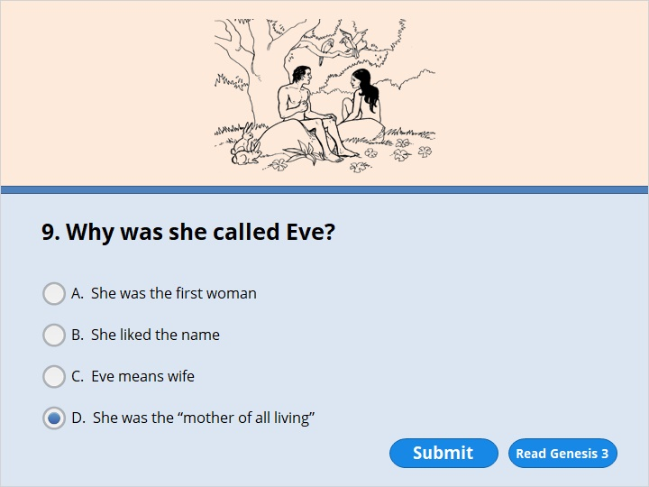
NEXT

Slide 28
NEXT

Slide 29
Genesis 3:20
Adam named his wife Eve. She would become the mother of every living person.

Slide 30
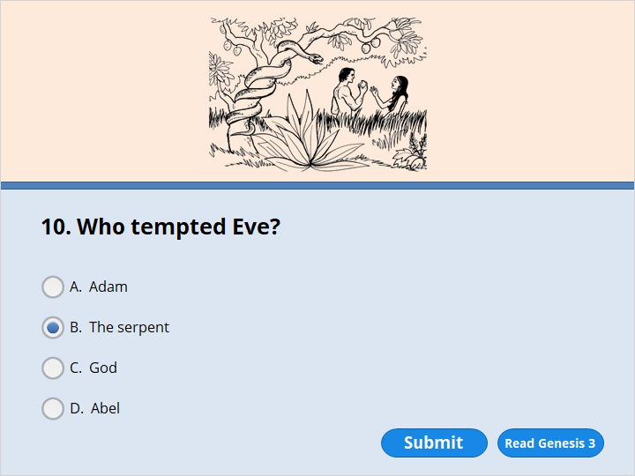
NEXT

Slide 31
NEXT

Slide 32
Genesis 3:4
“You will certainly not die,” the serpent said to the woman. 5 “God knows that when you eat fruit from that tree, you will know things you have never known before. Like God, you will be able to tell the difference between good and evil.”

Slide 33
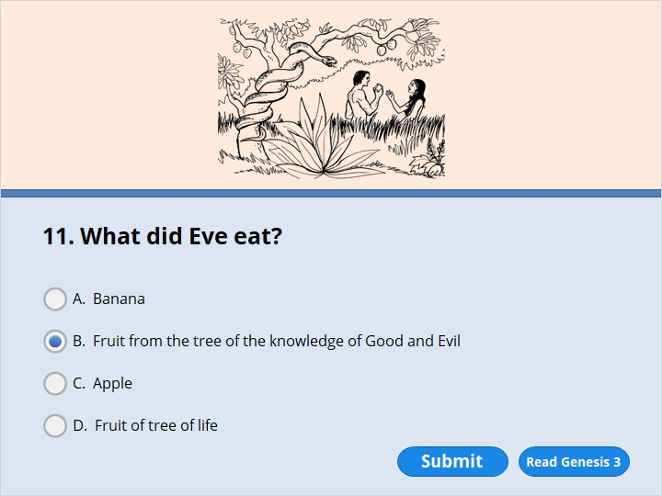
NEXT

Slide 34
NEXT

Slide 35
Genesis 3:4
“You will certainly not die,” the serpent said to the woman. 5 “God knows that when you eat fruit from that tree, you will know things you have never known before. Like God, you will be able to tell the difference between good and evil.”
6 The woman saw that the tree’s fruit was good to eat and pleasing to look at. She also saw that it would make a person wise. So she took some of the fruit and ate it.

Slide 36
NEXT

Slide 37
NEXT

Slide 38
Genesis 3:21
The Lord God made clothes out of animal skins for Adam and his wife to wear.

Slide 39
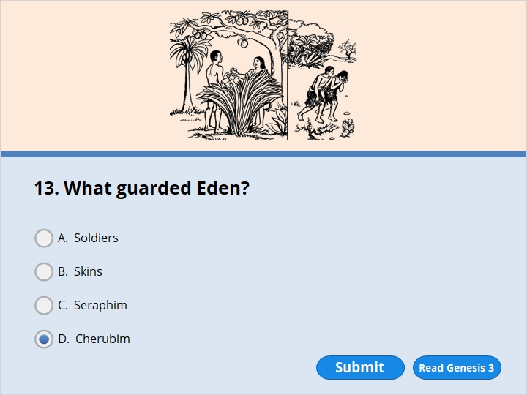
NEXT

Slide 40
NEXT

Slide 41
Genesis 3:24
The Lord God drove him out and then placed angels (cherubim) on the east side of the garden. He also placed there a flaming sword that flashed back and forth. The angels and the sword guarded the way to the tree of life.

Slide 42
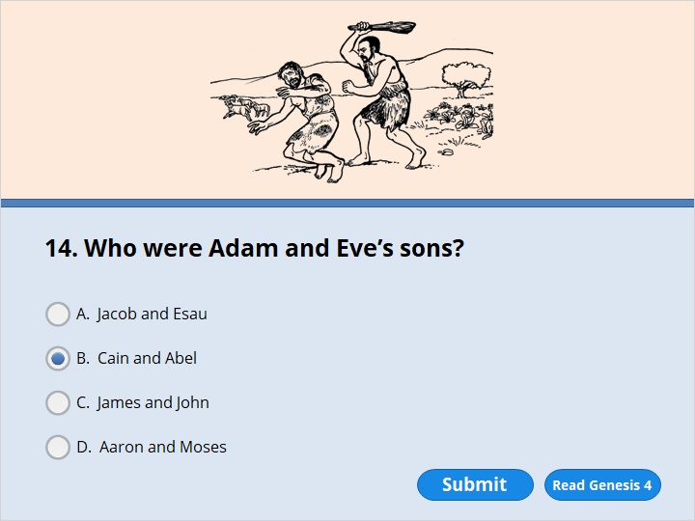
NEXT

Slide 43
NEXT

Slide 44
Genesis 4
Adam loved his wife Eve and slept with her. She became pregnant and gave birth to Cain. She said, “With the Lord’s help I have had a baby boy.” 2 Later she gave birth to his brother Abel.

Slide 45
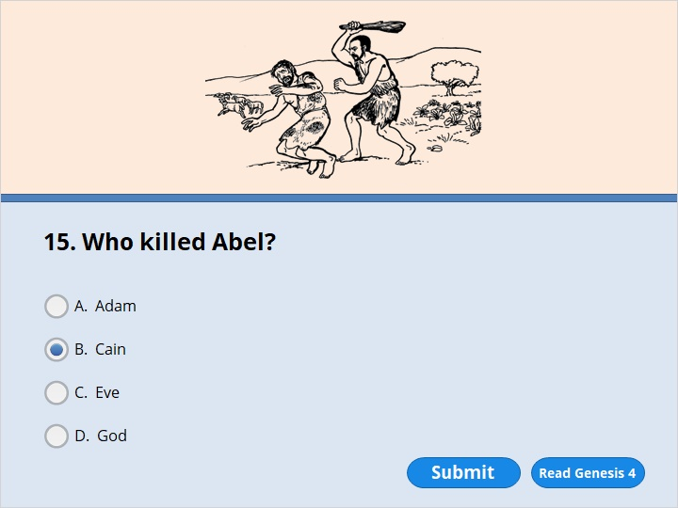
NEXT

Slide 46
NEXT

Slide 47
Genesis 4:8
Cain said to his brother Abel, “Let’s go out to the field.” So they went out. There Cain attacked his brother Abel and killed him.

Slide 48
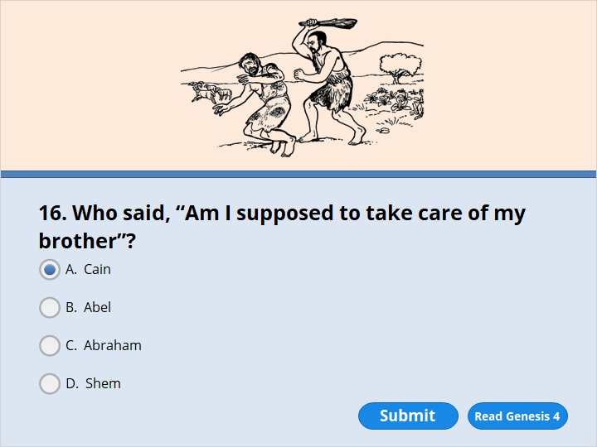
NEXT

Slide 49
NEXT

Slide 50
Genesis 4:9
Then the Lord said to Cain, “Where is your brother Abel?”
“I don’t know,” Cain replied. “Am I supposed to take care of my brother?”

Slide 51
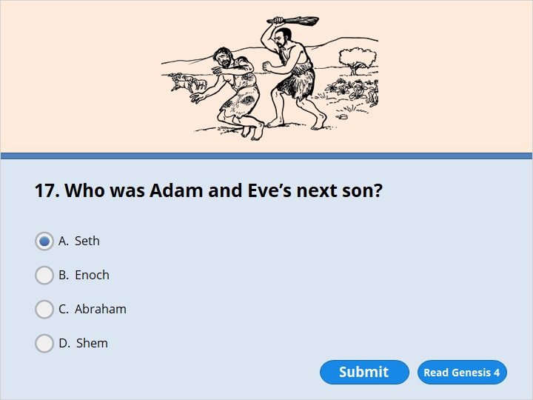
NEXT

Slide 52
NEXT

Slide 53
Genesis 4:25
Adam slept with his wife again. She gave birth to a son and named him Seth. She said, “God has given me another child. He will take the place of Abel, because Cain killed him.”

Slide 54
NEXT

Slide 55
NEXT

Slide 56
Genesis 5:21
Enoch lived 65 years. Then he became the father of Methuselah. 22 Enoch walked faithfully with God 300 years after Methuselah was born. He also had other sons and daughters. 23 Enoch lived a total of 365 years. 24 Enoch walked faithfully with God. And then he couldn’t be found, because God took him from this life.

Slide 57
NEXT

Slide 58
NEXT

Slide 59
Genesis 5:27
Methuselah lived a total of 969 years. And then he died.

Slide 60
NEXT

Slide 61
NEXT

Slide 62
Genesis 5:27
Methuselah lived a total of 969 years. And then he died.

Slide 63
NEXT

Slide 64
NEXT

Slide 65
Genesis 5:32
After Noah was 500 years old, he became the father of Shem, Ham and Japheth.

Slide 66
NEXT

Slide 67
NEXT

Slide 68
Genesis 6:13
So God said to Noah, “I am going to put an end to everyone. They have filled the earth with their harmful acts. I am certainly going to destroy them and the earth. 14 So make yourself an ark out of cypress wood. Make rooms in it. Cover it with tar inside and out. 15 Here is how I want you to build it.

Slide 69
NEXT

Slide 70
NEXT

Slide 71
Genesis 7:13
On that same day Noah entered the ark together with his sons Shem, Ham and Japheth. Noah’s wife and the wives of his three sons also entered it.

Slide 72
NEXT

Slide 73
NEXT

Slide 74
Genesis 7:17
For 40 days the flood kept coming on the earth. As the waters rose higher, they lifted the ark high above the earth.

Slide 75
NEXT

Slide 76
NEXT

Slide 77
Genesis 8:4
On the 17th day of the seventh month, the ark came to rest on the mountains of Ararat.

Slide 78
NEXT

Slide 79
NEXT

Slide 80
Genesis 8:6
After 40 days Noah opened a window he had made in the ark. 7 He sent out a raven. It kept flying back and forth until the water on the earth had dried up.

Slide 81
NEXT

Slide 82
NEXT

Slide 83
Genesis 8:8
Then Noah sent out a dove. He wanted to see if the water on the surface of the ground had gone down. 9 But the dove couldn’t find any place to rest. Water still covered the whole surface of the earth. So the dove returned to Noah in the ark. Noah reached out his hand and took the dove in. He brought it back to himself in the ark.

Slide 84
NEXT

Slide 85
NEXT

Slide 86
Genesis 8:6
After 40 days Noah opened a window he had made in the ark. 7 He sent out a raven. It kept flying back and forth until the water on the earth had dried up. 8 Then Noah sent out a dove. He wanted to see if the water on the surface of the ground had gone down. 9 But the dove couldn’t find any place to rest. Water still covered the whole surface of the earth. So the dove returned to Noah in the ark. Noah reached out his hand and took the dove in. He brought it back to himself in the ark. 10 He waited seven more days. Then he sent out the dove again from the ark. 11 In the evening the dove returned to him. There in its beak was a freshly picked olive leaf! So Noah knew that the water on the earth had gone down. 12 He waited seven more days. Then he sent out the dove again. But this time it didn’t return to him.

Slide 87
NEXT

Slide 88
NEXT

Slide 89
Genesis 9:15
Then I will remember my covenant between me and you and every kind of living creature. The waters will never again become a flood to destroy all life. 16 When the rainbow appears in the clouds, I will see it. I will remember that my covenant will last forever. It is a covenant between me and every kind of living creature on earth.”
17 So God said to Noah, “The rainbow is the sign of my covenant. I have made my covenant between me and all life on earth.”

Slide 90
NEXT

Slide 91
NEXT

Slide 92
Genesis 11:5
But the Lord came down to see the city and the tower the people were building. 6 He said, “All these people are united and speak the same language. That is why they can do all this. Now they will be able to do anything they plan. 7 Come on! Let us go down and mix up their language. Then they will not be able to understand one other.”
8 So the Lord scattered them from there over the whole earth. And they stopped building the city. 9 There the Lord mixed up the language of the whole world. That’s why the city was called Babel. From there the Lord scattered them over the whole earth.

Slide 93
NEXT

Slide 94
NEXT

Slide 95
Genesis 12:4
So Abram went, as the Lord had told him; and Lot went with him. Abram was seventy-five years old when he set out from Harran. 5 He took his wife Sarai, his nephew Lot, all the possessions they had accumulated and the people they had acquired in Harran, and they set out for the land of Canaan, and they arrived there.

Slide 96
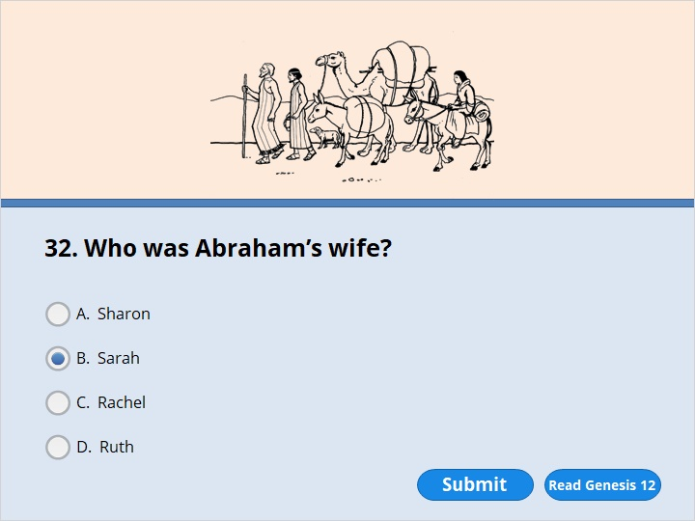
NEXT

Slide 97
NEXT

Slide 98
Genesis 12:4
So Abram went, just as the Lord had told him. Lot went with him. Abram was 75 years old when he left Harran. 5 He took his wife Sarai (Sarah) and his nephew Lot. They took all the people and possessions they had acquired in Harran. They started out for the land of Canaan. And they arrived there.

Slide 99
NEXT

Slide 100
NEXT

Slide 101
Genesis 13:8
So Abram said to Lot, “Let’s not argue with each other. The people taking care of your herds and those taking care of mine shouldn’t argue with one another either. After all, we’re part of the same family. 9 Isn’t the whole land in front of you? Let’s separate. If you go to the left, I’ll go to the right. If you go to the right, I’ll go to the left.”

Slide 102
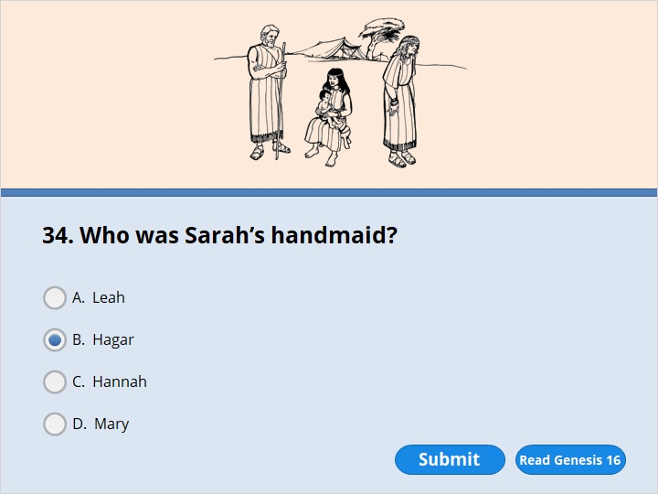
NEXT

Slide 103
NEXT

Slide 104
Genesis 16:1
Abram’s wife Sarai (Sarah) had never had any children by him. But she had a female slave from Egypt named Hagar.

Slide 105
NEXT

Slide 106
NEXT

Slide 107
Genesis 16:3
His wife Sarai gave him her slave Hagar to be his wife. That was after he had been living in Canaan for ten years. 4 Then he slept with Hagar, and she became pregnant.
When Hagar knew she was pregnant, she began to look down on the woman who owned her.
Genesis 16:11 The angel of the Lord also said to her,
“You are now pregnant
and will have a son.
You will name him Ishmael,
because the Lord has heard about your suffering.

Slide 108
NEXT

Slide 109
NEXT

Slide 110
Genesis 17:15
God also said to Abraham, “Do not continue to call your wife by the name Sarai. Her name will be Sarah. 16 I will give her my blessing. You can be sure that I will give you a son by her. I will bless her so that she will be the mother of nations. Kings of nations will come from her.”
17 Abraham fell with his face to the ground. He laughed and said to himself, “Can a 100-year-old man have a son? Can Sarah have a child at the age of 90?”

Slide 111
NEXT

Slide 112
NEXT

Slide 113
Genesis 19:15
The sun was coming up. So the angels tried to get Lot to leave. They said, “Hurry up! Take your wife and your two daughters who are here. Get out! If you don’t, you will be swept away when the city is destroyed.”
16 Lot didn’t move right away. So the men grabbed him by the hand. They also took hold of the hands of his wife and two daughters. They led all of them safely out of the city. The Lord had mercy on them.

Slide 114
NEXT

Slide 115
NEXT

Slide 116
Genesis 19:23
By the time Lot reached Zoar, the sun had risen over the land. 24 Then the Lord sent down burning sulfur. It came down like rain on Sodom and Gomorrah. It came from the Lord. It came out of the sky. 25 The Lord destroyed these cities and the whole valley. All the people who were living in the cities were wiped out. So were the plants in the land. 26 But Lot’s wife looked back. When she did, she became a pillar made out of salt.

Slide 117
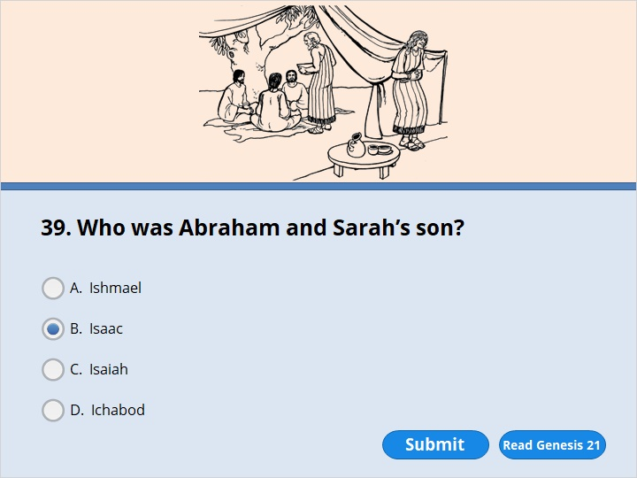
NEXT

Slide 118
NEXT

Slide 119
Genesis 21:1
The Lord was gracious to Sarah, just as he had said he would be. The Lord did for Sarah what he had promised to do. 2 Sarah became pregnant. She had a son by Abraham when he was old. The child was born at the exact time God had promised. 3 Abraham gave the name Isaac to the son Sarah had by him.

Slide 120
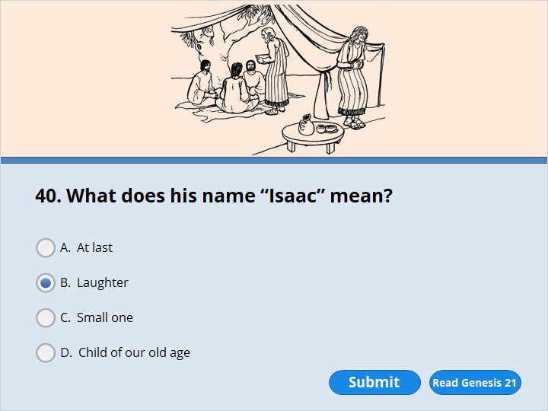
NEXT

Slide 121
NEXT

Slide 122
Genesis 21:1
The Lord was gracious to Sarah, just as he had said he would be. The Lord did for Sarah what he had promised to do. 2 Sarah became pregnant. She had a son by Abraham when he was old. The child was born at the exact time God had promised. 3 Abraham gave the name Isaac to the son Sarah had by him. 4 When his son Isaac was eight days old, Abraham circumcised him. He did it exactly as God had commanded him. 5 Abraham was 100 years old when his son Isaac was born to him.
6 Sarah said, “God has given laughter to me. Everyone who hears about this will laugh with me.” 7 She also said, “Who would have said to Abraham that Sarah would breast-feed children? But I’ve had a son by him when he is old.”

Slide 123
NEXT

Slide 124
NEXT

Slide 125
Genesis 21:1
The Lord was gracious to Sarah, just as he had said he would be. The Lord did for Sarah what he had promised to do. 2 Sarah became pregnant. She had a son by Abraham when he was old. The child was born at the exact time God had promised. 3 Abraham gave the name Isaac to the son Sarah had by him. 4 When his son Isaac was eight days old, Abraham circumcised him. He did it exactly as God had commanded him. 5 Abraham was 100 years old when his son Isaac was born to him.
6 Sarah said, “God has given laughter to me. Everyone who hears about this will laugh with me.” 7 She also said, “Who would have said to Abraham that Sarah would breast-feed children? But I’ve had a son by him when he is old.”

Slide 126
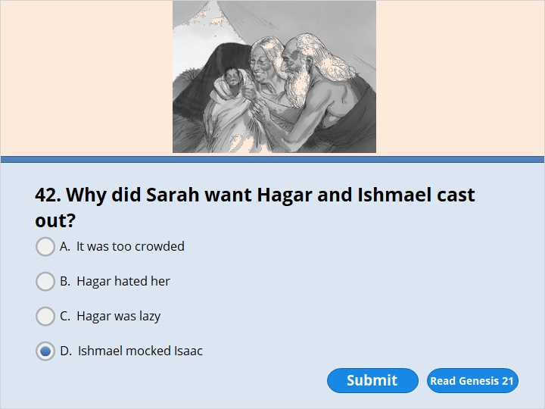
NEXT

Slide 127
NEXT

Slide 128
Genesis 21:9
But Sarah saw Ishmael making fun of Isaac. Ishmael was the son Hagar had by Abraham. Hagar was Sarah’s Egyptian slave. 10 Sarah said to Abraham, “Get rid of that slave woman! Get rid of her son! That woman’s son will never have a share of the family’s property. All of it belongs to my son Isaac.”

Slide 129
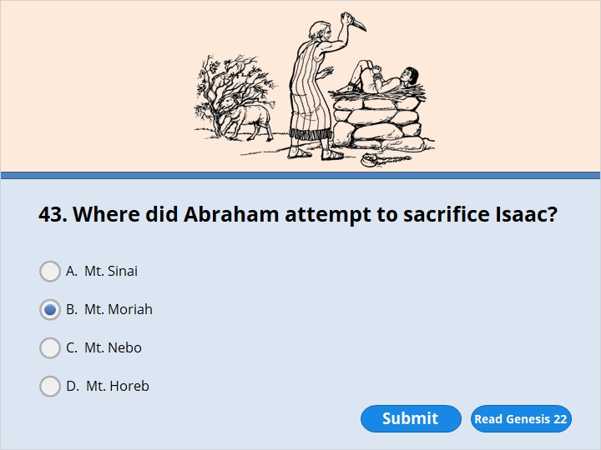
NEXT

Slide 130
NEXT

Slide 131
Genesis 22:2
Then God said, “Take your son, your only son. He is the one you love. Take Isaac. Go to the place called Moriah. Give your son to me there as a burnt offering. Sacrifice him on the mountain I will show you.”

Slide 132
NEXT

Slide 133
NEXT

Slide 134
Genesis 22:10
Then he reached out his hand. He picked up the knife to kill his son. 11 But the angel of the Lord called out to him from heaven. He said, “Abraham! Abraham!”
“Here I am,” Abraham replied.
12 “Do not lay a hand on the boy,” he said. “Do not harm him. Now I know that you would do anything for God. You have not held back from me your son, your only son.”

Slide 135
NEXT

Slide 136
NEXT

Slide 137
Genesis 22:13
Abraham looked around. There in a bush he saw a ram caught by its horns. He went over and took the ram. He sacrificed it as a burnt offering instead of his son. 14 So Abraham named that place The Lord Will Provide. To this day people say, “It will be provided on the mountain of the Lord.”

Slide 138
NEXT

Slide 139
NEXT

Slide 140
Genesis 23:1
Sarah lived to be 127 years old. 2 She died at Kiriath Arba. Kiriath Arba is also called Hebron. It’s in the land of Canaan. Sarah’s death made Abraham very sad. He went to the place where her body was lying. There he wept over her.

Slide 141
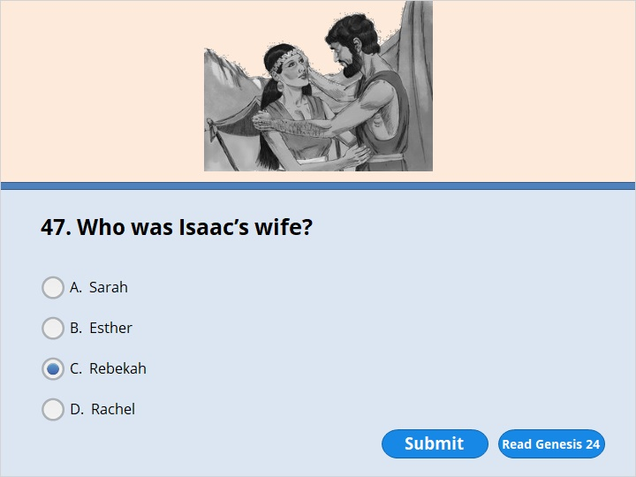
NEXT

Slide 142
NEXT

Slide 143
Genesis 24:50
Laban and Bethuel answered, “The Lord has done all of this. We can’t say anything to you one way or the other. 51 Here is Rebekah. Take her and go. Let her become the wife of your master’s son, just as the Lord has said.”

Slide 144
NEXT

Slide 145
NEXT

Slide 146
Genesis 25:7
Abraham lived a total of 175 years. 8 He took his last breath and died when he was very old. He had lived a very long time. Then he joined the members of his family who had already died.

Slide 147
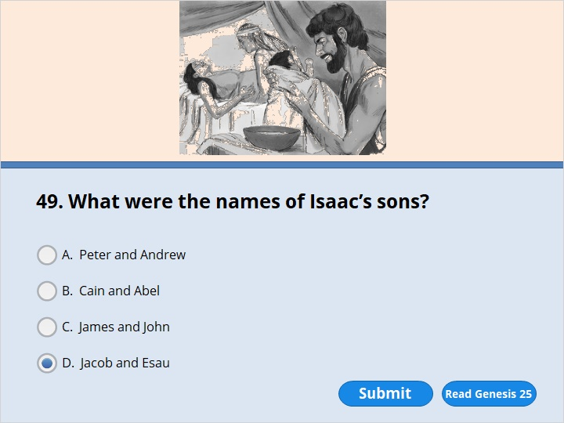
NEXT

Slide 148
NEXT

Slide 149
Genesis 25:24
The time came for Rebekah to have her babies. There were twin boys in her body. 25 The first one to come out was red. His whole body was covered with hair. So they named him Esau. 26 Then his brother came out. His hand was holding onto Esau’s heel. So he was named Jacob. Isaac was 60 years old when Rebekah had them.

Slide 150
NEXT

Slide 151
NEXT

Slide 152
Genesis 25:27
The boys grew up. Esau became a skillful hunter. He liked the open country. But Jacob was content to stay at home among the tents. 28 Isaac liked the meat of wild animals. So Esau was his favorite son. But Rebekah’s favorite was Jacob.

Slide 153
NEXT

Slide 154
NEXT

Slide 155
Genesis 25:27
The boys grew up. Esau became a skillful hunter. He liked the open country. But Jacob was content to stay at home among the tents. 28 Isaac liked the meat of wild animals. So Esau was his favorite son. But Rebekah’s favorite was Jacob.

Slide 156
NEXT

Slide 157
NEXT

Slide 158
Genesis 27:19
Jacob said to his father, “I’m your oldest son Esau. I’ve done as you told me. Please sit up. Eat some of my wild meat. Then give me your blessing.”

Slide 159
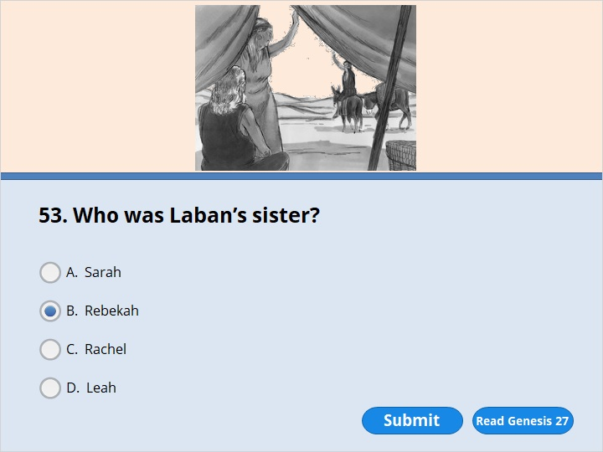
NEXT

Slide 160
NEXT

Slide 161
Genesis 27:42
Rebekah was told what her older son Esau had said. So she sent for her younger son Jacob. She said to him, “Your brother Esau is planning to get back at you by killing you. 43 Now then, my son, do what I say. Run away at once to my brother Laban in Harran. 44 Stay with him until your brother’s anger calms down. 45 When he forgets what you did to him, I’ll let you know. Then you can come back from there. Why should I lose both of you in one day?”

Slide 162
NEXT

Slide 163
NEXT

Slide 164
Genesis 28:10
Jacob left Beersheba and started out for Harran. 11 He reached a certain place and stopped for the night. The sun had already set. He took one of the stones there and placed it under his head. Then he lay down to sleep.

Slide 165
NEXT

Slide 166
NEXT

Slide 167
Genesis 28:12
In a dream he saw a stairway standing on the earth. Its top reached to heaven. The angels of God were going up and coming down on it. 13 The Lord stood beside the stairway. He said, “I am the Lord. I am the God of your grandfather Abraham and the God of Isaac. I will give you and your children after you the land you are lying on. 14 They will be like the dust of the earth that can’t be counted. They will spread out to the west and to the east. They will spread out to the north and to the south. All nations on earth will be blessed because of you and your children after you. 15 I am with you. I will watch over you everywhere you go. And I will bring you back to this land. I will not leave you until I have done what I have promised you.”

Slide 168
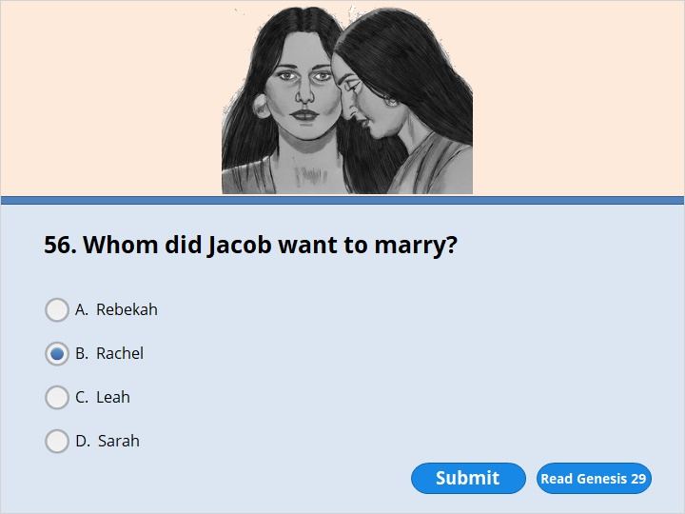
NEXT

Slide 169
NEXT

Slide 170
Genesis 29:16
Laban had two daughters. The name of the older one was Leah. And the name of the younger one was Rachel. 17 Leah was plain, but Rachel was beautiful. She had a nice figure. 18 Jacob was in love with Rachel. He said to Laban, “I’ll work for you for seven years so I can marry your younger daughter Rachel.”

Slide 171
NEXT

Slide 172
NEXT

Slide 173
Genesis 29:19
Laban said, “It’s better for me to give her to you than to some other man. Stay here with me.” 20 So Jacob worked for seven years so he could marry Rachel. But they seemed like only a few days to him because he loved her so much.

Slide 174
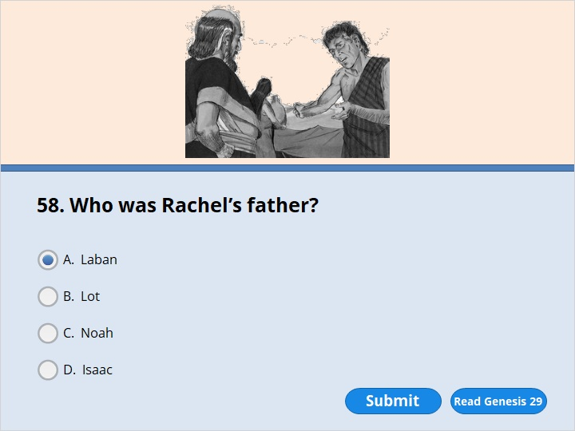
NEXT

Slide 175
NEXT

Slide 176
Genesis 29:16
Laban had two daughters. The name of the older one was Leah. And the name of the younger one was Rachel. 17 Leah was plain, but Rachel was beautiful. She had a nice figure. 18 Jacob was in love with Rachel. He said to Laban, “I’ll work for you for seven years so I can marry your younger daughter Rachel.”

Slide 177
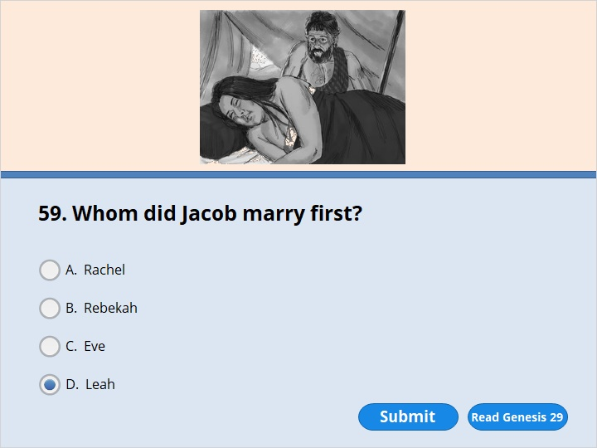
NEXT

Slide 178
NEXT

Slide 179
Genesis 29:22
So Laban brought all the people of the place together and had a feast prepared. 23 But when evening came, he gave his daughter Leah to Jacob. And Jacob slept with her. 24 Laban gave his female servant Zilpah to his daughter as her servant.
25 When Jacob woke up the next morning, there was Leah next to him! So he said to Laban, “What have you done to me? I worked for you so I could marry Rachel, didn’t I? Why did you trick me?”
26 Laban replied, “It isn’t our practice here to give the younger daughter to be married before the older one. 27 Complete this daughter’s wedding week. Then we’ll give you the younger one also. But you will have to work for another seven years.”

Slide 180
NEXT

Slide 181
NEXT

Slide 182
Genesis 29:26
Laban replied, “It isn’t our practice here to give the younger daughter to be married before the older one. 27 Complete this daughter’s wedding week. Then we’ll give you the younger one also. But you will have to work for another seven years.”
28 So Jacob completed the week with Leah. Then Laban gave him his daughter Rachel to be his wife. 29 Laban gave his female servant Bilhah to his daughter Rachel as her servant. 30 Jacob slept with Rachel also. He loved Rachel more than he loved Leah. And he worked for Laban for another seven years.

Slide 183
NEXT

Slide 184
NEXT

Slide 185
Genesis 32:28
Then the man said, “Your name will not be Jacob anymore. Instead, it will be Israel. You have wrestled with God and with people. And you have won.”

Slide 186
NEXT

Slide 187
NEXT

Slide 188
Genesis 32:28
Then the man said, “Your name will not be Jacob anymore. Instead, it will be Israel. You have wrestled with God and with people. And you have won.”

Slide 189
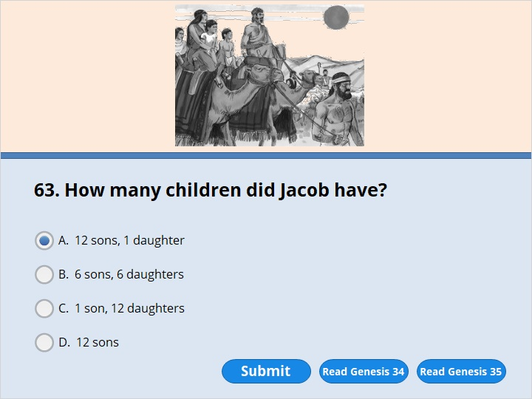
NEXT

Slide 190
NEXT

Slide 191
Genesis 34:1
Dinah was the daughter Leah had by Jacob. Dinah went out to visit the women of the land.
Genesis 35:21
Israel moved on again. He set up his tent beyond Migdal Eder. 22 While Israel was living in that area, Reuben went in and slept with Bilhah. She was the concubine of Reuben’s father. And Israel heard about it.
Here are the 12 sons Jacob had.
23 Leah was the mother of Reuben, Jacob’s oldest son. Her other sons were Simeon, Levi, Judah, Issachar and Zebulun.
24 The sons of Rachel were Joseph and Benjamin.
25 The sons of Rachel’s female servant Bilhah were Dan and Naphtali.
26 The sons of Leah’s female servant Zilpah were Gad and Asher.
These were Jacob’s sons. They were born in Paddan Aram.

Slide 192
NEXT

Slide 193
NEXT

Slide 194
Genesis 35:8
Rebekah’s attendant (nurse) Deborah died. They buried her body under the oak tree outside Bethel. So it was called Allon Bakuth.

Slide 195
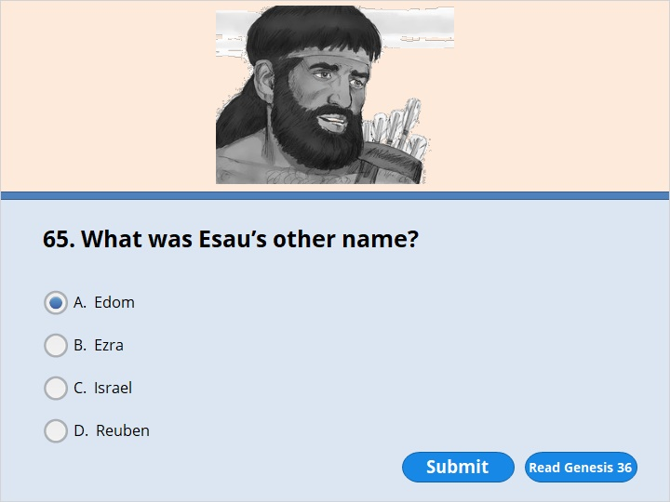
NEXT

Slide 196
NEXT

Slide 197
Genesis 36:1
Here is the story of the family line of Esau. Esau was also called Edom.

Slide 198
NEXT

Slide 199
NEXT

Slide 200
Genesis 37:2
Here is the story of the family line of Jacob.
Joseph was a young man. He was 17 years old. He was taking care of the flocks with some of his brothers. They were the sons of Bilhah and the sons of Zilpah, the wives of his father Jacob. Joseph brought their father a bad report about his brothers.
3 Israel loved Joseph more than any of his other sons. That’s because Joseph had been born to him when he was old. Israel made him a beautiful robe. 4 Joseph’s brothers saw that their father loved him more than any of them. So they hated Joseph. They couldn’t even speak one kind word to him.

Slide 201
NEXT

Slide 202
NEXT

Slide 203
Genesis 37:2
Here is the story of the family line of Jacob.
Joseph was a young man. He was 17 years old. He was taking care of the flocks with some of his brothers. They were the sons of Bilhah and the sons of Zilpah, the wives of his father Jacob. Joseph brought their father a bad report about his brothers.
3 Israel loved Joseph more than any of his other sons. That’s because Joseph had been born to him when he was old. Israel made him a beautiful robe. 4 Joseph’s brothers saw that their father loved him more than any of them. So they hated Joseph. They couldn’t even speak one kind word to him.

Slide 204
NEXT

Slide 205
NEXT

Slide 206
Genesis 37:21
Reuben heard them talking. He tried to save Joseph from them. “Let’s not take his life,” he said. 22 “Don’t spill any of his blood. Throw him into this empty well here in the desert. But don’t harm him yourselves.” Reuben said that to save Joseph from them. He was hoping he could take him back to his father.

Slide 207
NEXT

Slide 208
NEXT

Slide 209
Genesis 37:25
Then they sat down to eat their meal. As they did, they saw some Ishmaelite traders coming from Gilead. Their camels were loaded with spices, lotion and myrrh. They were on their way to take them down to Egypt.
26 Judah said to his brothers, “What will we gain if we kill our brother and try to cover up what we’ve done?
27 Come. Let’s sell him to these traders. Let’s not harm him ourselves. After all, he’s our brother. He’s our own flesh and blood.” Judah’s brothers agreed with him.
28 The traders from Midian came by. Joseph’s brothers pulled him up out of the well. They sold him to the Ishmaelite traders for eight ounces of silver. Then the traders took him to Egypt.

Slide 210
NEXT

Slide 211
NEXT

Slide 212
Genesis 37:25
Then they sat down to eat their meal. As they did, they saw some Ishmaelite traders coming from Gilead. Their camels were loaded with spices, lotion and myrrh. They were on their way to take them down to Egypt.
26 Judah said to his brothers, “What will we gain if we kill our brother and try to cover up what we’ve done?
27 Come. Let’s sell him to these traders. Let’s not harm him ourselves. After all, he’s our brother. He’s our own flesh and blood.” Judah’s brothers agreed with him.
28 The traders from Midian came by. Joseph’s brothers pulled him up out of the well. They sold him to the Ishmaelite traders for eight ounces of silver. Then the traders took him to Egypt.

Slide 213
NEXT

Slide 214
NEXT

Slide 215
Genesis 37:31
Then they got Joseph’s beautiful robe. They killed a goat and dipped the robe in the blood. 32 They took the robe back to their father. They said, “We found this. Take a look at it. See if it’s your son’s robe.”

Slide 218
Genesis 37:31
Then they got Joseph’s beautiful robe. They killed a goat and dipped the robe in the blood. 32 They took the robe back to their father. They said, “We found this. Take a look at it. See if it’s your son’s robe.”

Slide 219
NEXT

Slide 220
NEXT

Slide 221
Genesis 37:36
But the traders from Midian sold Joseph to Potiphar in Egypt. Potiphar was one of Pharaoh’s officials. He was the captain of the palace guard.

Slide 222
NEXT

Slide 223
NEXT

Slide 224
Genesis 39:11
One day Joseph went into the house to take care of his duties. None of the family servants was inside. 12 Potiphar’s wife grabbed him by his coat. “Come to bed with me!” she said. But he left his coat in her hand. And he ran out of the house.
13 She saw that he had left his coat in her hand and had run out of the house. 14 So she called her servants. “Look,” she said to them, “this Hebrew slave has been brought here to make fun of us! He came in here to force me to have sex with him. But I screamed for help. 15 He heard my scream. So he left his coat beside me and ran out of the house.”
16 She kept Joseph’s coat with her until Potiphar came home. 17 Then she told him her story. She said, “That Hebrew slave you brought us came to me to rape me. 18 But I screamed for help. So he left his coat beside me and ran out of the house.”
19 Potiphar’s wife told him, “That’s how your slave treated me.” When Joseph’s master heard her story, he became very angry. 20 So he put Joseph in prison. It was the place where the king’s prisoners were kept.

Slide 225
NEXT

Slide 226
NEXT

Slide 227
Genesis 40:5
Then each of the two men had a dream. The men were the Egyptian king’s baker and wine taster. They were being held in prison. Both of them had dreams the same night. Each of their dreams had its own meaning.
6 Joseph came to them the next morning. He saw that they were sad. 7 They were Pharaoh’s officials, and they were in prison with Joseph in his master’s house. So he asked them, “Why do you look so sad today?”
8 “We both had dreams,” they answered. “But no one can tell us what they mean.”
Then Joseph said to them, “Only God knows what dreams mean. Tell me your dreams.”
9 So the chief wine taster told Joseph his dream. He said to him, “In my dream I saw a vine in front of me. 10 There were three branches on the vine. As soon as it budded, it flowered. And bunches of ripe grapes grew on it. 11 Pharaoh’s cup was in my hand. I took the grapes. I squeezed them into Pharaoh’s cup. Then I put the cup in his hand.”

Slide 228
12 “Here’s what your dream means,” Joseph said to him. “The three branches are three days. 13 In three days Pharaoh will let you out of prison. He’ll give your job back to you. And you will put Pharaoh’s cup in his hand. That’s what you used to do when you were his wine taster. 14 But when everything is going well with you, remember me. Do me a favor. Speak to Pharaoh about me. Get me out of this prison. 15 I was taken away from the land of the Hebrews by force. Even here I haven’t done anything to be put in prison for.”
16 The chief baker saw that Joseph had given a positive meaning to the wine taster’s dream. So he said to Joseph, “I had a dream too. There were three baskets of bread on my head. 17 All kinds of baked goods for Pharaoh were in the top basket. But the birds were eating them out of the basket on my head.”
18 “Here’s what your dream means,” Joseph said. “The three baskets are three days. 19 In three days Pharaoh will cut your head off. Then he will stick a pole through your body and set the pole up. The birds will eat your flesh.”

Slide 229
NEXT

Slide 230
NEXT

Slide 231
Genesis 40:20
The third day was Pharaoh’s birthday. He had a feast prepared for all his officials. He brought the chief wine taster and the chief baker out of prison. He did it in front of his officials. 21 He gave the chief wine taster’s job back to him. Once again the wine taster put the cup into Pharaoh’s hand. 22 But Pharaoh had a pole stuck through the chief baker’s body. Then he had the pole set up. Everything happened just as Joseph had told them when he explained their dreams.

Slide 232
NEXT

Slide 233
NEXT

Slide 234
Genesis 41:1
When two full years had passed, Pharaoh had a dream. In his dream, he was standing by the Nile River. 2 Seven cows came up out of the river. They looked healthy and fat. They were eating some of the tall grass growing along the river. 3 After them, seven other cows came up out of the Nile. They looked ugly and skinny. They were standing beside the other cows on the riverbank. 4 The ugly, skinny cows ate up the seven cows that looked healthy and fat. Then Pharaoh woke up.
5 He fell asleep again and had a second dream. In that dream, seven heads of grain were growing on one stem. They were healthy and good. 6 After them, seven other heads of grain came up. They were thin and dried up by the east wind. 7 The thin heads of grain swallowed up the seven healthy, full heads. Then Pharaoh woke up. It had been a dream.

Slide 235
NEXT

Slide 236
NEXT

Slide 237
Genesis 41:9
Then the chief wine taster spoke up. He said to Pharaoh, “Now I remember that I’ve done something wrong. 10 Pharaoh was once angry with his servants. He put me and the chief baker in prison. We were in the house of the captain of the palace guard. 11 Each of us had a dream the same night. Each dream had its own meaning. 12 A young Hebrew servant was there with us. He was a servant of the captain of the guard. We told him our dreams. And he explained them to us. He told each of us the meaning of our dreams. 13 Things turned out exactly as he said they would. I was given back my job. The other man had a pole stuck through his body.”

Slide 238
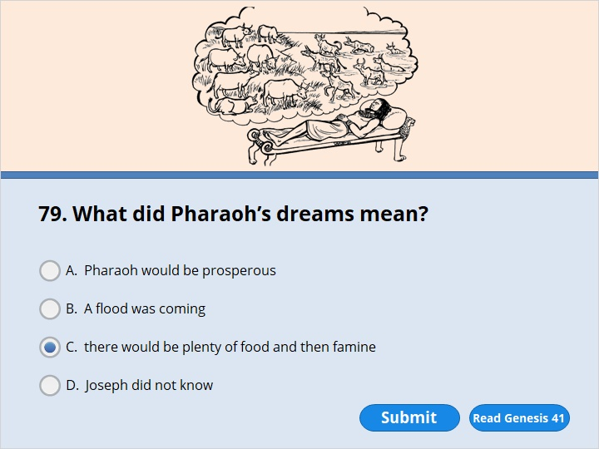
NEXT

Slide 239
NEXT

Slide 240
Genesis 41:25
Then Joseph said to Pharaoh, “Both of Pharaoh’s dreams have the same meaning. God has shown Pharaoh what he is about to do. 26 The seven good cows are seven years. And the seven good heads of grain are seven years. Both dreams mean the same thing. 27 The seven thin, ugly cows that came up later are seven years. So are the seven worthless heads of grain dried up by the east wind. They are seven years when there won’t be enough food.
28 “It’s just as I said to Pharaoh. God has shown Pharaoh what he’s about to do. 29 Seven years with plenty of food are coming to the whole land of Egypt. 30 But seven years when there won’t be enough food will follow them. Then everyone will forget about all the food Egypt had. Terrible hunger will destroy the land. 31 There won’t be anything left to remind people of the years when there was plenty of food in the land. That’s how bad the hunger that follows will be. 32 God gave the dream to Pharaoh in two forms. That’s because the matter has been firmly decided by God. And it’s because God will do it soon.

Slide 241
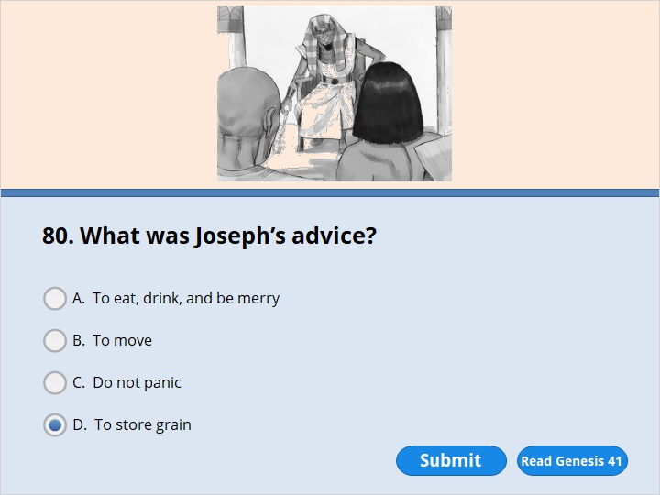
NEXT

Slide 242
NEXT

Slide 243
Genesis 41:33
“So Pharaoh should look for a wise and understanding man. He should put him in charge of the land of Egypt. 34 Pharaoh should appoint officials to be in charge of the land. They should take a fifth of the harvest in Egypt during the seven years when there’s plenty of food. 35 They should collect all the extra food of the good years that are coming. Pharaoh should give them authority to store up the grain. They should keep it in the cities for food. 36 The grain should be stored up for the country to use later. It will be needed during the seven years when there isn’t enough food in Egypt. Then the country won’t be destroyed just because it doesn’t have enough food.”

Slide 244
NEXT

Slide 245
NEXT

Slide 246
Genesis 41:33
“So Pharaoh should look for a wise and understanding man. He should put him in charge of the land of Egypt. 34 Pharaoh should appoint officials to be in charge of the land. They should take a fifth of the harvest in Egypt during the seven years when there’s plenty of food. 35 They should collect all the extra food of the good years that are coming. Pharaoh should give them authority to store up the grain. They should keep it in the cities for food. 36 The grain should be stored up for the country to use later. It will be needed during the seven years when there isn’t enough food in Egypt. Then the country won’t be destroyed just because it doesn’t have enough food.”
37 The plan seemed good to Pharaoh and all his officials. 38 So Pharaoh said to them, “The spirit of God is in this man. We can’t find anyone else like him, can we?”

Slide 247
39 Then Pharaoh said to Joseph, “God has made all this known to you. No one is as wise and understanding as you are. 40 You will be in charge of my palace. All my people must obey your orders. I will be greater than you only because I’m the one who sits on the throne.”
Joseph Is Put in Charge of Egypt
41 So Pharaoh said to Joseph, “I’m putting you in charge of the whole land of Egypt.” 42 Then Pharaoh took from his finger the ring he used to give his official stamp. He put it on Joseph’s finger. He dressed him in robes made out of fine linen. He put a gold chain around Joseph’s neck. 43 He also had him ride in a chariot. Joseph was now next in command after Pharaoh. People went in front of Joseph and shouted, “Get down on your knees!” By doing all these things, Pharaoh put Joseph in charge of the whole land of Egypt.

Slide 248
NEXT

Slide 249
NEXT

Slide 250
Genesis 41:46
Joseph was 30 years old when he began serving Pharaoh, the king of Egypt. He left Pharaoh’s palace and traveled all over Egypt. 47 During the seven years there was plenty of food. The land produced more than the people needed. 48 Joseph collected all the extra food produced in those seven years in Egypt. He stored it in the cities. In each city he stored up the food grown in the fields around it. 49 Joseph stored up huge amounts of grain. There was as much of it as sand by the sea. There was so much grain it couldn’t be measured. So Joseph stopped keeping records of it.

Slide 251
NEXT

Slide 252
NEXT

Slide 253
Genesis 41:53
The seven years when there was plenty of food in Egypt came to an end. 54 Then the seven years when there wasn’t enough food began. It happened just as Joseph had said it would. There wasn’t enough food in any of the other lands. But in the whole land of Egypt there was food. 55 When all the people of Egypt began to get hungry, they cried out to Pharaoh for food. He told all the Egyptians, “Go to Joseph. Do what he tells you.”

Slide 254
NEXT

Slide 255
NEXT

Slide 256
Genesis 41:53
The seven years when there was plenty of food in Egypt came to an end. 54 Then the seven years when there wasn’t enough food began. It happened just as Joseph had said it would. There wasn’t enough food in any of the other lands. But in the whole land of Egypt there was food. 55 When all the people of Egypt began to get hungry, they cried out to Pharaoh for food. He told all the Egyptians, “Go to Joseph. Do what he tells you.”

Slide 257
NEXT

Slide 258
NEXT

Slide 259
Genesis 41:50
Before the years when there wasn’t enough food, two sons were born to Joseph. He had them by Asenath, the daughter of Potiphera. Potiphera was the priest of On. 51 Joseph named his first son Manasseh. That’s because he said, “God has made me forget all my trouble and my father’s whole family.” 52 He named the second son Ephraim. That’s because he said, “God has given me children in the land where I’ve suffered so much.”

Slide 260
NEXT

Slide 261
NEXT

Slide 262
Genesis 42:24
Joseph turned away from his brothers and began to weep. Then he came back and spoke to them again. He had Simeon taken and tied up right there in front of them.

Slide 263
NEXT

Slide 264
NEXT

Slide 265
Genesis 42:3
So ten of Joseph’s brothers went down to Egypt to buy grain there. 4 But Jacob didn’t send Joseph’s brother Benjamin with them. He was afraid Benjamin might be harmed. 5 Israel’s sons were among the people who went to buy grain. There wasn’t enough food in the land of Canaan.

Slide 266
Genesis 42:14
Joseph said to them, “I still say you are spies! 15 So I’m going to test you. And here’s the test. You can be sure that you won’t leave this place unless your youngest brother comes here. You can be just as sure of this as you are sure that Pharaoh lives. I give you my word that you won’t leave here unless your brother comes. 16 Send one of you back to get your brother. The rest of you will be kept in prison. I’ll test your words. Then we’ll find out whether you are telling the truth. You can be sure that Pharaoh lives. And you can be just as sure that if you aren’t telling the truth, we’ll know that you are spies!” 17 So Joseph kept all of them under guard for three days.

Slide 267
NEXT

Slide 268
NEXT

Slide 269
Genesis 43:1
There still wasn’t enough food anywhere in the land. 2 After a while Jacob’s family had eaten all the grain the brothers had brought from Egypt. So their father said to them, “Go back. Buy us a little more food.”

Slide 270
NEXT

Slide 271
NEXT

Slide 272
Genesis 43:11
Then their father Israel spoke to them. He said, “If that’s the way it has to be, then do what I tell you. Put some of the best things from our land in your bags. Take them down to the man as a gift. Take some lotion and a little honey. Take some spices and myrrh. Take some pistachio nuts and almonds. 12 Take twice the amount of money with you. You have to give back the money that was put in your sacks. Maybe it was a mistake. 13 Also take your brother. Go back to the man at once. 14 May the Mighty God cause him to show you mercy. May the man let your other brother and Benjamin come back with you. And if I lose my sons, I lose them.”

Slide 273
NEXT

Slide 274
NEXT

Slide 275
Genesis 44:44
Joseph told the manager of his house what to do. “Fill the men’s sacks with as much food as they can carry,” he said. “Put each man’s money in his sack. 2 Then put my silver cup in the youngest one’s sack. Put it there along with the money he paid for his grain.” So the manager did what Joseph told him to do.

Slide 276
NEXT

Slide 277
NEXT

Slide 278
Genesis 45:1
Joseph couldn’t control himself anymore in front of all his attendants. He cried out, “Have everyone leave me!” So there wasn’t anyone with Joseph when he told his brothers who he was. 2 He wept so loudly that the Egyptians heard him. Everyone in Pharaoh’s house heard about it.
3 Joseph said to his brothers, “I am Joseph! Is my father still alive?” But his brothers weren’t able to answer him. They were too afraid of him.

Slide 279
NEXT

Slide 280
NEXT

Slide 281
Genesis 46:34
You should answer, ‘We’ve taken care of livestock from the time we were boys. We’ve done just as our fathers did.’ It’s the practice of the people of Egypt not to mix with shepherds. So Pharaoh will let you settle in the area of Goshen.”

Slide 282
NEXT

Slide 283
NEXT

Slide 284
Genesis 47:27
The people of Israel lived in Egypt in the area of Goshen. They received property there. They had children and so became many.

Slide 285
NEXT

Slide 286
NEXT

Slide 287
Genesis 47:28
Jacob lived 17 years in Egypt. He lived a total of 147 years. 29 The time came near for Israel to die. So he sent for his son Joseph. He said to him, “If you are pleased with me, put your hand under my thigh. Promise me that you will be kind and faithful to me. Don’t bury me in Egypt. 30 When I join the members of my family who have already died, carry me out of Egypt. Bury me where they are buried.”

Slide 288
NEXT

Slide 289
NEXT

Slide 290
Genesis 48:12
Then Joseph lifted his sons off Israel’s knees. Joseph bowed down with his face to the ground. 13 He placed Ephraim on his right, toward Israel’s left hand. He placed Manasseh on his left, toward Israel’s right hand. Then he brought them close to Israel. 14 But Israel reached out his right hand and put it on Ephraim’s head. He did it even though Ephraim was the younger son. He crossed his arms and put his left hand on Manasseh’s head. He did it even though Manasseh was the older son.

Slide 291
15 Then Israel gave Joseph his blessing. He said,
“May God bless these boys.
He is the God of my grandfather Abraham and my father Isaac.
They walked faithfully with him.
He is the God who has been my shepherd
all my life right up to this day.
16 He is the Angel who has saved me from all harm.
May he bless these boys.
May they be called by my name.
May they also be called by the names of my grandfather Abraham and my father Isaac.
And may the number of them greatly increase
on the earth.”

Slide 292
NEXT

Slide 293
NEXT

Slide 294
Genesis 50:22
Joseph stayed in Egypt, along with all his father’s family. He lived 110 years. 23 He lived long enough to see Ephraim’s children and grandchildren. When the children of Makir were born, they were placed on Joseph’s knees and counted as his own children. Makir was the son of Manasseh.

Slide 295
NEXT

Slide 296
NEXT

Slide 297
Genesis 50:24
Joseph said to his brothers, “I’m about to die. But God will surely come to help you. He’ll take you up out of this land. He’ll bring you to the land he promised to give to Abraham, Isaac and Jacob.” 25 Joseph made the Israelites promise him. He said, “God will surely come to help you. Then you must carry my bones up from this place.”

Slide 299
Our goal is not only for you to be able to study God’s Word, but also give you a way to teach and share with other people.
We pray God will bless your time in His Word!
WWW.Mark732.org
For more information and for further training: Contact
Rev. Dr. John Reinke
At RevReinke@gmail.com
or 608-436-9600 (voice/text)
Material Copyright ©Mark732
Bible Verses are from the New International Readers Version - NIrV
Pictures: Copyright © Language Recordings Inc (Australia). Used by permission
Material Copyright ©Mark732

